Slide 1
Measures of Central Tendency and Spread
SSI II
Jan 17, 2019

Slide 2
Previously…
Variables
Measurement
Graphs
Visual Representations

Slide 3
Essential Questions
Why do we use descriptive statistics?
When do we use each type of descriptive statistic?

Slide 4
Statistic
A number that summarizes a characteristic of the data
The range of scores on the exam, the average score on the exam, etc.
Especially:
Central tendency – what is the middle or center?
Spread – how spread out, dispersed, or variable are the data?

Slide 5
Mode
The category that occurs most frequently
Mode is used most frequently for categorical and ordinal variables, but may also be used for continuous variables

Slide 6
What is the mode?
Values | Frequency | Percentage
Newspapers | 446 | 24.5%
Internet | 243 | 13.4%
TV | 916 | 50.4%
Radio | 131 | 7.2%
Family, Friends | 71 | 3.9%
TOTAL | 1817 | 100%
Notes:
Source of News (2005 General Social Survey)

Slide 7
What is the mode?
Value | Frequency | Percentage
Extremely liberal | 70 | 4.3%
Liberal | 230 | 14.1%
Slightly liberal | 188 | 11.6%
Moderate; middle of the road | 514 | 31.6%
Slightly conservative | 238 | 14.6%
Conservative | 311 | 19.1%
Extremely conservative | 75 | 4.6%
Total | 1626 | 4.6%
Notes:
Liberal-conservative self-placement (2008 ANES)

Slide 8
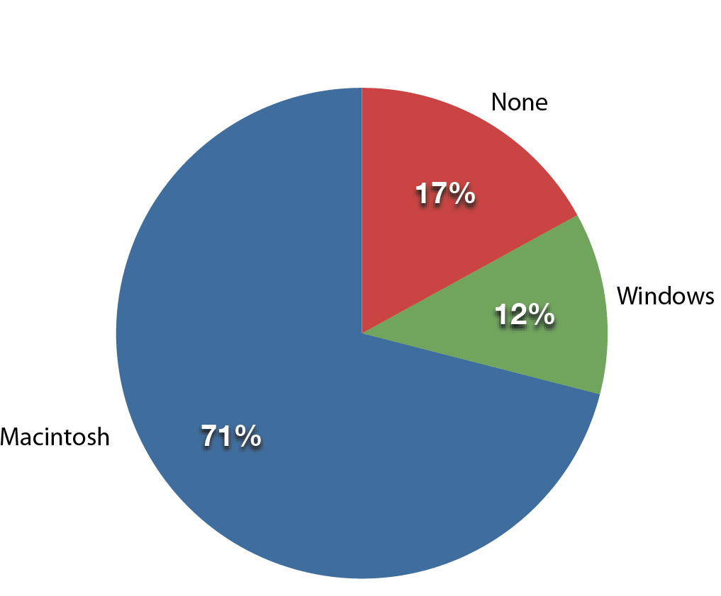
What is the mode?
Notes:
Source: Lane, Ch 2

Slide 9
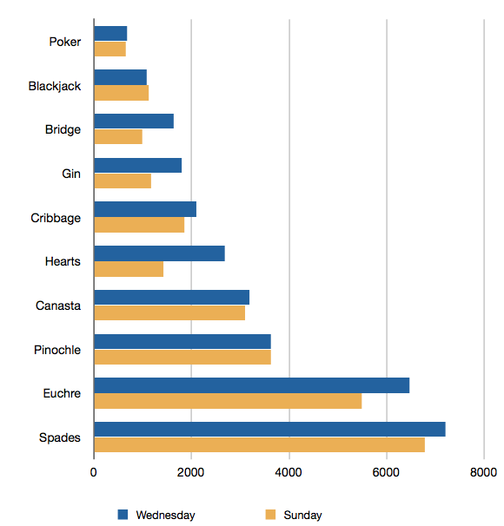
What is the mode?
Notes:
Source: Lane, Ch 2

Slide 10
Median
A measure of central tendency
If we sort by our variable, what is value of the middle observation?
The median splits the data in half
It is the 50th percentile
If you have an even number, you average the middle two values

Slide 11
Median
Country | Political Rights Score
Cape Verde | 1
France | 1
Kiribati | 1
Liechtenstein | 1
Marshall Islands | 1
Norway | 1
Portugal | 1
Switzerland | 1
San Tome & Principe | 2
Botswana | 3
East Timor | 3
Guatemala | 3
Turkey | 3
Mozambique | 4
Cote d’Ivoire | 5
Algeria | 6
Iran | 6
Bahrain | 7
Somalia | 7
The median is 3

Slide 12
Median
The median is the value that minimizes the sum of absolute deviations.
Values | Absolute differences from 10
2 3 4 9 16 | 8 7 6 1 6
Sum | 28
Values | Absolute differences from 4
2 3 4 9 16 | 2 1 0 5 12
Sum | 20
Notes:
The median is the value that minimizes the sum of absolute deviations. Here the absolute differences from the arbitrarily-chosen number 10 are shown. The total is 28. The sum of the absolute deviations from the median of 4 is only 20. Of course, the value that minimizes the sum of absolute deviations is also the value that minimizes the average absolute deviation.

Slide 13
Mean (Average)
Another measure of central tendency
Average value of the distribution
This is more sensitive to extreme values and outliers than the median

Slide 14
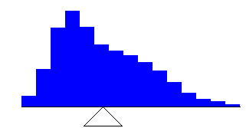
Balance Point
The mean is the point at which a distribution would balance.
Notes:
The mean is the point on which a distribution would balance. In the figure, the fulcrum (the top of the triangle) is the mean of the distribution.

Slide 15


Computing the Mean
Add up all of the values
Divide by the number of observations (N)

Slide 16
Mean
Country | Political Rights Score
Algeria | 6
Bahrain | 7
Botswana | 3
Cape Verde | 1
Cote d’Ivoire | 5
East Timor | 3
France | 1
Guatemala | 3
Iran | 6
Kiribati | 1
Liechtenstein | 1
Marshall Islands | 1
Mozambique | 4
Norway | 1
Portugal | 1
San Tome & Principe | 2
Somalia | 7
Switzerland | 1
Turkey | 3
Sum of all scores: 66
N: 19
66/19=3.47
Mean=3.47

Slide 17
Mean
The mean is the value that minimizes the sum of the squared deviations.
Values | Squared differences from 5
2 3 4 9 16 | 9 4 1 16 121
Sum | 151
Values | Squared differences from 6.8
2 3 4 9 16 | 23.04 14.44 7.84 4.84 84.64
Sum | 134.8
Notes:
The mean is the value that minimizes the sum of the squared differences. Here you can see that the sum of the squared differences from 5 is 151. For example, the difference between the first value of 2 and 5 is three. Square three and you get 9 which is shown in the second column. The sum of squared differences from the mean of 6.8 is only 134.8.

Slide 18

Median and Mean
The numbers 2, 3, 4, 9, and 16 have a median of 4 and a mean of 6.8.
Notes:
To see this in action, let’s apply these principles to a set of five numbers (2, 3, 4, 9, and 16) with their median of 4 and their mean of 6.8. You can see that the distribution indeed balances at the mean of 6.8 and not the median of 4.

Slide 19
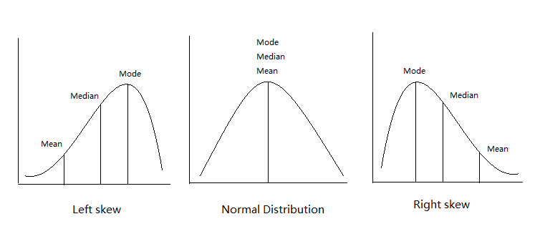
Mean, Median, Mode

Slide 20
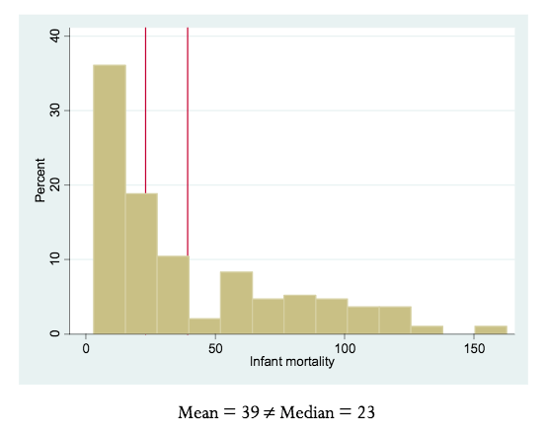
Mean vs Median

Slide 21
Mean - $72,641

Slide 22
What relationship for the mean, median and mode?

Slide 23
What relationship for the mean, median and mode?

Slide 24
What relationship for the mean, median and mode?

Slide 25
What relationship for the mean, median and mode?

Slide 26
What relationship for the mean, median and mode?

Slide 27
Median and Mean
When a distribution is symmetric, then the mean, and the median are the same.
The mean, median, and mode are identical in the bell-shaped normal distribution.
Notes:
There are two important final points to note when thinking about means and medians.
When a distribution is symmetric, then the mean, and the median are the same.
Moreover, the mean, median, and the mode are identical in a bell-shaped normal distribution.

Slide 28
Summary of Central Tendency Statistics
Describe the “middle” or “central” values of a variable
Mode: most frequent value of a variable
Median: 50th percentile of a continuous variable
Mean: average of a continuous variable

Slide 29
Range
A measure of spread (continuous variables)
What is the difference between the highest and lowest value?
What is the range of the Freedom House scores?

Slide 30
Range
Country | Political Rights Score
Cape Verde | 1
France | 1
Kiribati | 1
Liechtenstein | 1
Marshall Islands | 1
Norway | 1
Portugal | 1
Switzerland | 1
San Tome & Principe | 2
Botswana | 3
East Timor | 3
Guatemala | 3
Turkey | 3
Mozambique | 4
Cote d’Ivoire | 5
Algeria | 6
Iran | 6
Bahrain | 7
Somalia | 7
The minimum is 1
The maximum is 7
Range= max-min
7-1=6

Slide 31
Inter-quartile Range
A measure of spread (continuous variables)
Difference between the 75th percentile and the 25th percentile (range of the middle 50% of values)

Slide 32
Inter-quartile Range
Country | Political Rights Score
Cape Verde | 1
France | 1
Kiribati | 1
Liechtenstein | 1
Marshall Islands | 1
Norway | 1
Portugal | 1
Switzerland | 1
San Tome & Principe | 2
Botswana | 3
East Timor | 3
Guatemala | 3
Turkey | 3
Mozambique | 4
Cote d’Ivoire | 5
Algeria | 6
Iran | 6
Bahrain | 7
Somalia | 7
IQR=75th percentile – 25th percentile
5-1=4

Slide 33

Variance
A measure of spread that uses all of the data (for continuous variables)
It is the sum of the squared deviations, divided by n-1

Slide 34

Standard Deviation
The square root of the variance
Used more often than variance
The average difference between values of Y and the mean of Y
Notes:
Look at Excel example

Slide 35
Standard Deviation(s)
Sometimes you will see this formula with N as the denominator, rather than N-1
N-1 is the formula for the sample, N is the formula for the population
R will compute the sample standard deviation
It is also what we use for significance tests, later, since we are almost always using samples

Slide 36
Root Mean Square and SD
The size of a set of numbers

Slide 37
Summary of Dispersion Statistics
Describe how spread out the values of a variable are
Inter-quartile range: how far is the 75th percentile value from the 25th percentile value
Variance: no quick English version…
Standard deviation: Average difference between values of Y and the mean of Y

Slide 38
Essential Questions
Why do we use descriptive statistics?
When do we use each type of descriptive statistic?

Slide 39
Next Time…
The importance of the normal distribution
What standard deviations tell us
Probability

Slide 40
R Workshop
Do today’s R_Jan17_DescriptiveStats.rmd file
Complete the previous in-class files
Write up a script to clean the data for both the BES 2005 and College Scorecard
You should be able to copy most of this from in-class assignments and the exercise
Write it so that you can copy and paste into the top of future assignments without having to re-do it every time
This should include opening the data, replacing missing data, making things numeric, creating new variables, etc.
Keeping these updated as you go will make things easier
Begin working on Assignment 1 (due Wednesday)
Feel free to ask each other for help and help others!

