Slide 1
Probability and Introduction to Statistical Inference
SSI II
Jan 22

Slide 2
Previously…
The normal curve (briefly)
Variations from the normal curve
Standard deviation and mean
Samples
Samples and populations
Random samples

Slide 3
Essential Questions
Why is the normal curve important?
Why is the law of averages important?

Slide 4
The Normal Curve

Slide 6
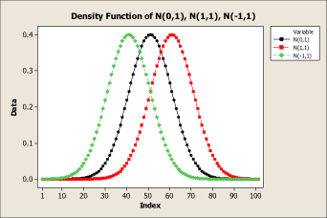
Changing the Mean

Slide 7
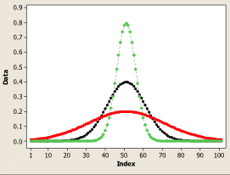
Changing the Standard Deviation

Slide 8
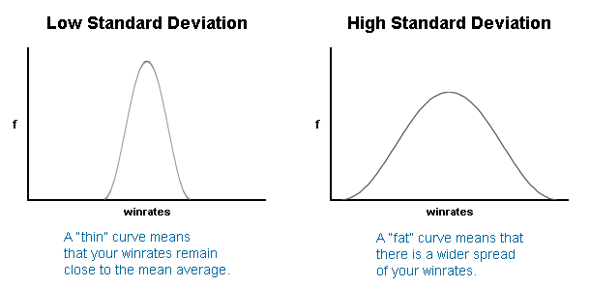
Low vs. High Standard Deviation

Slide 9
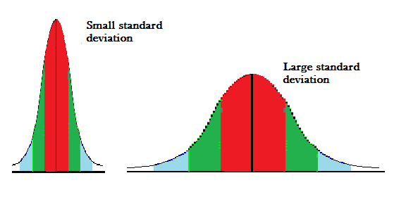
Getting the picture?

Slide 10
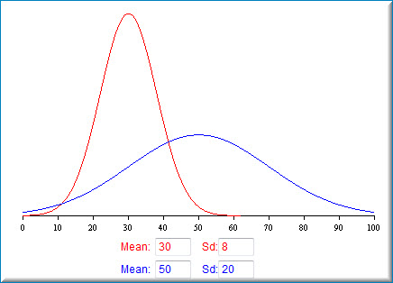

Slide 11
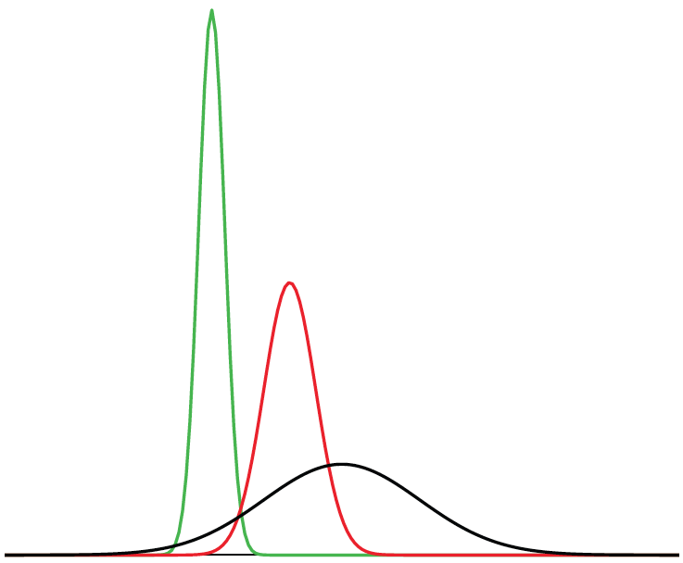
Naming the Normal Distribution(s)
=
=
Gaussian Curve
Normal Curve = Bell Curve = Gaussian Curve
Notes:
The normal distribution is also called the “Gaussian curve” after the mathematician Karl-Friedrich Gauss.

Slide 12
Features of Normal Distributions
Normal distributions are symmetric around their mean.
The mean, median, and mode of a normal distribution are equal.
The area under the normal curve is equal to 1.0 or 100%
Notes:
Listed here are are three of the six features of normal distributions. Normal distributions are symmetric around their mean. The mean, median, and mode of a normal distribution are equal. The area under the normal curve is equal to 1.0.

Slide 13
Features of Normal Distributions
Normal distributions are denser in the center and less dense in the tails.
Normal distributions are defined by two parameters, the mean (μ) and the standard deviation(σ).
68% of the area of a normal distribution is within one standard deviation of the mean.
Notes:
Normal distributions are denser in the center and less dense in the tails. Normal distributions are defined by two parameters, the mean and the standard deviation. 68% of the area of a normal distribution is within one standard deviation of the mean.

Slide 14
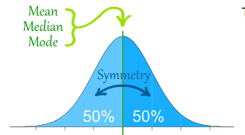

Slide 15
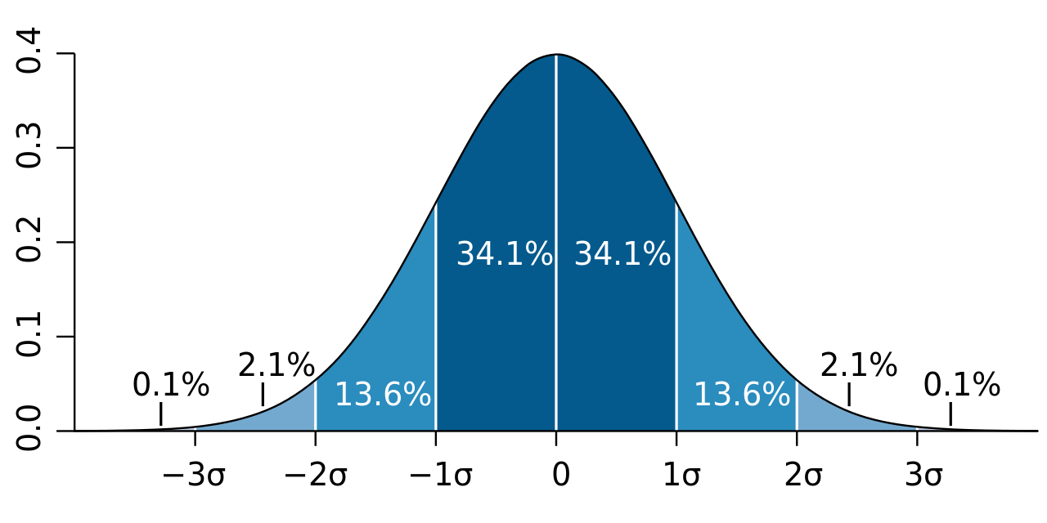
The Normal Curve and Standard Deviation

Slide 16
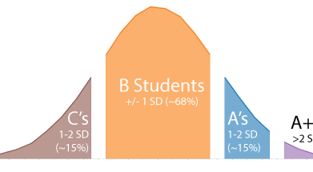
Grade Distributions

Slide 17
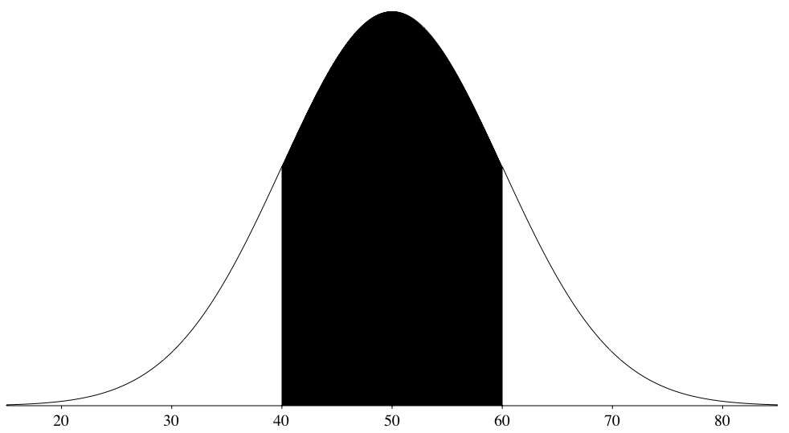
Areas Under Normal Distributions
The normal distribution shown here has a mean of 50 and a standard deviation of 10.
Notes:
This figure shows a normal distribution with a mean of 50 and a standard deviation of 10. The shaded area is the area from one standard deviation below the mean (50-10 = 40) to one standard deviation above the mean (50 + 10 = 60).

Slide 18
One Standard Deviation from the Mean
The shaded area between 40 and 60 contains 68% of the distribution
Notes:
The shaded area between 40 and 60 contains 68% of the distribution. The area within one standard deviation of the mean is 0.68.

Slide 19
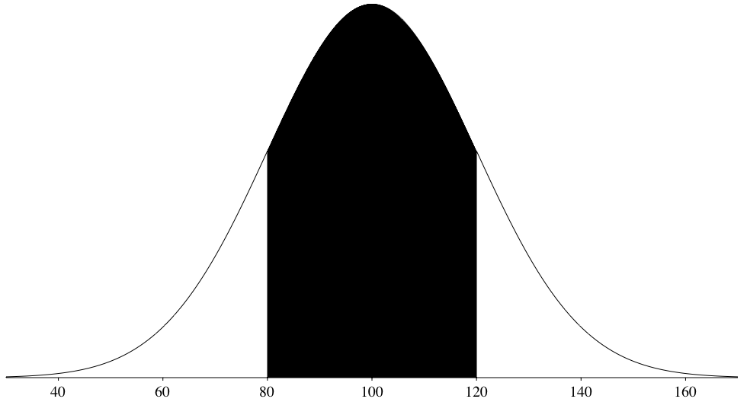
Normal Distribution with a Mean of 100 an SD of 20
Notes:
Here you see a normal distribution with a mean of 100 and a standard deviation of 20.

Slide 20
One Standard Deviation from the Mean
68% of the area
Notes:
Again 68% of the distribution is within one standard deviation of the mean.

Slide 21
One Standard Deviation from the Mean
68% of the area of any normal distribution is within one standard deviation of the mean.
Notes:
The two normal distributions you just saw are specific examples of the general rule that 68% of the area of any normal distribution is within one standard deviation of the mean.

Slide 22
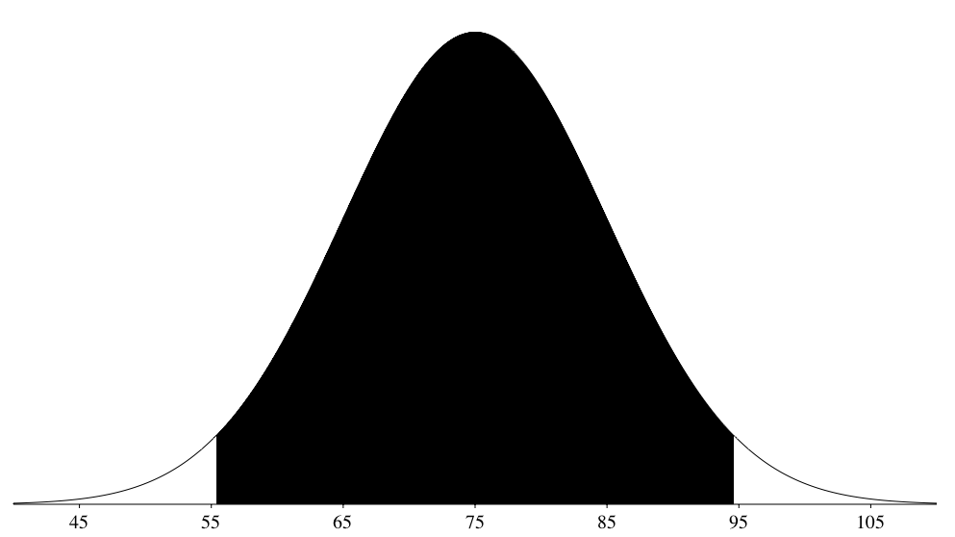
1.96 Standard Deviations from the Mean
Notes:
For all normal distributions, 95% of the area is within 1.96 standard deviations of the mean

Slide 23
Two Standard Deviations from the Mean
For normal distributions 95% of the area is within 1.96 standard deviations of the mean
An approximation of 2 standard deviations can be used
Notes:
For all normal distributions, 95% of the area is within 1.96 standard deviations of the mean. For quick approximations, it is sometimes useful to round off and use 2 rather than 1.96.

Slide 24
Three Standard Deviations from the Mean
For normal distributions 99.7% of the area is within 3 standard deviations of the mean

Slide 25
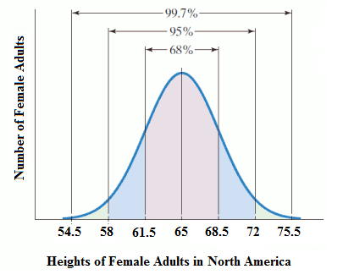
Example: Female Height
What percent are:
Between 61.5 and 68.5 inches
Between 65 and 72 inches
Between 54.5 and 58 inches
Above 72 inches
Notes:
95/2=47.5
Source: Ingrid Stewart

Slide 26
Almost Normally Distributed

Slide 27
ACT Scores
Mean = 25.52
Standard Deviation = 3.44
About 68% of the data should be in what range?
About 95% of the data should be in what range?

Slide 28
ACT Scores
About 68%
Mean-1 SD to Mean+1 SD
25.52-3.44 to 25.52+3.44
22.08 to 28.96
About 95%
Mean-2 SD to Mean+2 SD
25.52-2(3.44) to 25.52+2(3.44)
25.52-6.88 to 25.52+6.88
18.64 to 32.4

Slide 29
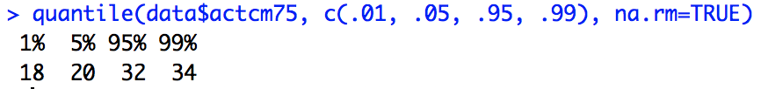
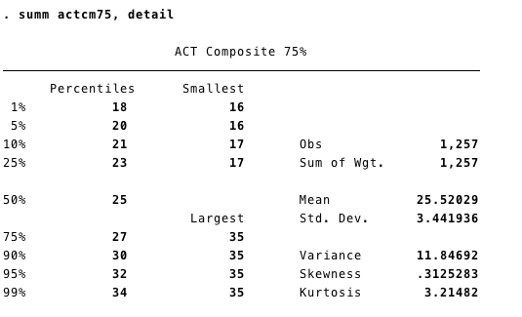
ACT Scores – It’s close
Notes:
We estimated that 95% of the data should be between 18.64 and 32.4

Slide 30
Standard Normal Distribution
Normal distributions do not necessarily have the same means and standard deviations
Notes:
As discussed in the introductory section, normal distributions do not necessarily have the same means and standard deviations.

Slide 31
Standard Normal Distribution
A normal distribution with a mean of 0 and a standard deviation of 1 is called a standard normal distribution
Notes:
A normal distribution with a mean of 0 and a standard deviation of 1 is called a standard normal distribution.

Slide 32
Standard Normal Distribution
Areas of the normal distribution are often represented by tables of the standard normal distribution.
Z | Area below Z
-2.50 | 0.0062
-2.49 | 0.0064
-2.48 | 0.0066
-2.47 | 0.0068
-2.46 | 0.0069
-2.45 | 0.0071
-2.44 | 0.0073
-2.43 | 0.0075
-2.42 | 0.0078
-2.41 | 0.0080
-2.40 | 0.0082
-2.39 | 0.0084
-2.38 | 0.0087
-2.37 | 0.0089
-2.36 | 0.0091
-2.35 | 0.0094
-2.34 | 0.0096
-2.33 | 0.0099
-2.32 | 0.0102
Notes:
Areas of the normal distribution are often represented by tables of the standard normal distribution. A portion of a table of the standard normal distribution is shown here.

Slide 33
Standard Normal Distribution
Z | Area below Z
-2.50 | 0.0062
-2.49 | 0.0064
-2.48 | 0.0066
-2.47 | 0.0068
-2.46 | 0.0069
-2.45 | 0.0071
-2.44 | 0.0073
-2.43 | 0.0075
-2.42 | 0.0078
-2.41 | 0.0080
-2.40 | 0.0082
-2.39 | 0.0084
-2.38 | 0.0087
-2.37 | 0.0089
-2.36 | 0.0091
-2.35 | 0.0094
-2.34 | 0.0096
-2.33 | 0.0099
-2.32 | 0.0102
The column “Z” contains values of the standard normal distribution
The second column contains the area below Z
Notes:
The first column titled “Z” contains values of the standard normal distribution; the second column contains the area below Z.

Slide 34
Standard Normal Distribution
The Z column is equal to the number of standard deviations below (or above) the mean
A Z of -2.5 represents a value 2.5 standard deviations below the mean
Z | Area below Z
-2.50 | 0.0062
-2.49 | 0.0064
-2.48 | 0.0066
-2.47 | 0.0068
-2.46 | 0.0069
-2.45 | 0.0071
-2.44 | 0.0073
-2.43 | 0.0075
-2.42 | 0.0078
-2.41 | 0.0080
-2.40 | 0.0082
-2.39 | 0.0084
-2.38 | 0.0087
-2.37 | 0.0089
-2.36 | 0.0091
-2.35 | 0.0094
-2.34 | 0.0096
-2.33 | 0.0099
-2.32 | 0.0102
Notes:
Since the distribution has a mean of 0 and a standard deviation of 1 the Z column is equal to the number of standard deviations below (or above) the mean. For example, a Z of -2.5 represents a value 2.5 standard deviations below the mean. The area below Z is 0.0062. This means that 0.0062 of the distribution is below -2.5.

Slide 35
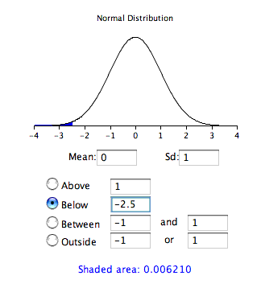
Standard Normal Distribution
The same information can be obtained using a calculator
It can be used to compute the area below a value of -2.5
Notes:
The same information can be obtained using the included normal calculator. The figure shows how it can be used to compute the area below a value of -2.5 on the standard normal distribution. Note the mean is set to 0 and the standard deviation is set to 1. Although the use of tables is being supplanted by the use of computer programs, it is still important to know what a table of the standard normal distribution is, and how to use one.

Slide 36
Transforming to a Standard Normal Distribution
A value from any normal distribution can be transformed into its corresponding value on a standard normal distribution using this formula:
Z = (X-μ)/σ
Notes:
A value from any normal distribution can be transformed into its corresponding value on a standard normal distribution using this formula.

Slide 37
Transforming to a Standard Normal Distribution
Z = (X-μ)/σ
Z is the value on the standard normal distribution
X is the value on the original distribution
μ is the mean of the original distribution
σ is the standard deviation of the original distribution
Notes:
In this formula, Z is the value on the standard normal distribution, X is the value on the original distribution, μυ is the mean of the original distribution and sigma is the standard deviation of the original distribution.

Slide 38
An Example
What portion of a normal distribution with a mean of 50 and a standard deviation of 10 is below 26?
Z = (X-μ)/σ = (26 – 50)/10 = -2.4
Notes:
As a simple application, what portion of a normal distribution with a mean of 50 and a standard deviation of 10 is below 26? First we transform the score of 26 to a score on the standard normal distribution (a Z score). The result is -2.4.

Slide 39
An Example
Z | Area below Z
-2.50 | 0.0062
-2.49 | 0.0064
-2.48 | 0.0066
-2.47 | 0.0068
-2.46 | 0.0069
-2.45 | 0.0071
-2.44 | 0.0073
-2.43 | 0.0075
-2.42 | 0.0078
-2.41 | 0.0080
-2.40 | 0.0082
-2.39 | 0.0084
-2.38 | 0.0087
-2.37 | 0.0089
-2.36 | 0.0091
-2.35 | 0.0094
-2.34 | 0.0096
-2.33 | 0.0099
-2.32 | 0.0102
From the table we can see that 0.0082 of the distribution is below -2.4.
Notes:
From the table, we can see that 0.0082 of the distribution is below -2.4.

Slide 40
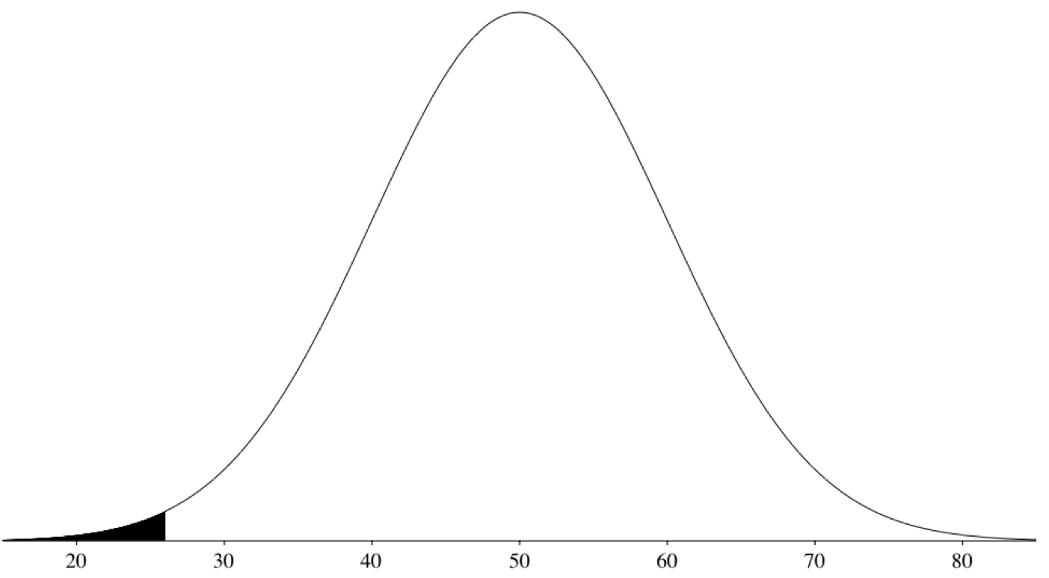
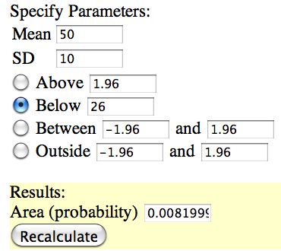
Standard Normal Distribution
Notes:
There is no need to transform to Z if you use the calculator as shown here.

Slide 41
Standard Normal Distribution
If all values transformed to Z scores, then the distribution will have a mean of 0 and a standard distribution
This process is called standardizing the distribution
Notes:
If all the values in a distribution are transformed to Z scores, then the distribution will have a mean of 0 and a standard distribution. This process of transforming the distribution to one with a mean of 0 and a standard deviation of 1 is called standardizing the distribution.

Slide 42
Example: Female Height
What are the z scores for women who are:
60 inches
65 inches
73 inches
Remember:
Z = (X-μ)/σ
Notes:
5/3.5=1.43
8/3.5=2.29
Source: Ingrid Stewart

Slide 43
Probability

Slide 44

The Basics
What is the probability of a coin flip landing on heads? ½
What is the probability of rolling a 6 on a normal die?
What is the probability of rolling a 1 or a 6 on a normal die?
If you have two dice, what numbers have the highest probability? The lowest?

Slide 45
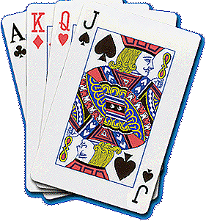
Cards
The same formula also applies to other games of chance.
P(draw an ace) = 4/52 = 1/13
P(draw a club) = 13/52 = 1/4

Slide 46
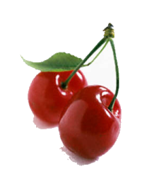
Bag of Cherries
Say you have a bag of 20 cherries:
14 are sweet and 6 are sour
So, if you pick a cherry at random,
P(sweet) = 14/20 = 7/10.

Slide 47
Outcomes must be equally likely
If the sweet cherries are smaller than the sour cherries:
You would be more likely to grab the larger sour cherries.
Then the outcomes are not equally likely, and P(sour) > 3/10.

Slide 48
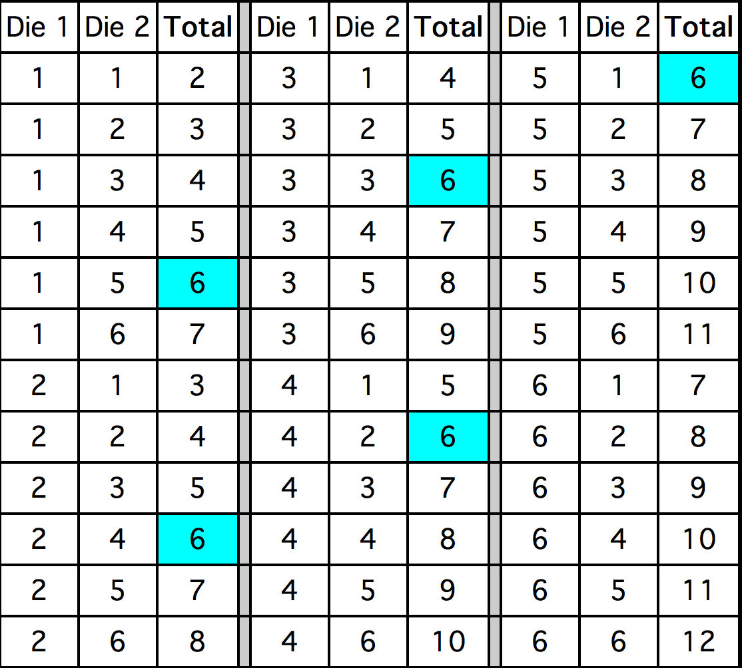
Two Dice – Sum of Six

Slide 49
Complementary Events
The probability that event A occurs
is written as P(A)
The probability that event A does not occur is then 1-P(A)
So, P(two dice don’t sum to 6)
= 1 - (5/36) = 31/36

Slide 50
Independent Events
Events A and B are independent if the probability of event B happening is unaffected by whether event A happens.
Event A = {a fair coin comes up heads on the first toss} and
Event B = {a fair coin comes up heads on the second toss}
Are independent events

Slide 51
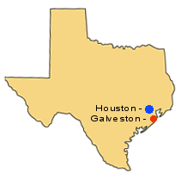
Non-Independent Events
Event A = {It will rain tomorrow in Houston}
Event B = {It will rain tomorrow in Galveston}
Since Houston and Galveston are less than 50 miles apart, Events A and B are dependent
When it rains in Houston, it will most
likely rain in Galveston too.

Slide 52
Probability of A and B
If events A and B are independent:
P(A and B) = P(A) x P(B)
Thus, if you flip a coin twice:
P(heads on flip 1 and heads on flip 2)
= (1/2) x (1/2) = 1/4

Slide 53
Coin and Die
Event A = {a fair coin comes up Heads}
Event B = {a fair die comes up Six}
Since Events A and B are independent, in an experiment where you flip a coin and then roll a die:
P(Heads and 6) = 1/2 x 1/6 = 1/12

Slide 54
Cards
Draw a card from a deck of 52. Put it back. Then draw another.
P(First card is a Heart and Second card is Black) = 1/4 x 1/2 = 1/8

Slide 55
Probability of A or B
If events A and B are independent, then
P(A or B) = P(A)+P(B) – P(A and B)
Note that “A or B” includes:
1) Event A occurs but Event B does not
2) Event A does not occur but Event B does
3) Both Events A and B occur

Slide 56
A or B - Coins
P(Head in 1st or 2nd Flip)
= P(Head in 1st)+P(Head in 2nd)-P(Head in Both)
= 1/2 + 1/2 - 1/4
= 3/4

Slide 57
A or B – Coin and Die
Event A = {a fair coin comes up Heads}
Event B = {a fair die comes up Six}
Since A and B are independent, we get
P(6 or head) = P(6)+P(Head)-P(6 and Head)
= 1/6 + 1/2 - (1/6)(1/2)
= 7/12

Slide 58
By Negation
Alternatively, note that
P(6 or Head)
= 1-P(not a 6 and not a Head)
= 1- P(not a 6) x P(not a Head)
= 1- (1-1/6)(1-1/2)
= 1- (5/6)(1/2)
= 7/12

Slide 59
P(at least one 6 in 3 tries)
P(6 on 1st or 6 on 2nd or 6 on 3rd)
= 1- P(not 6 on 1st and 2nd and 3rd throws)
= 1- (5/6)(5/6)(5/6)
= 1- 125/216
= 91/216

Slide 60
P(draw two aces from a deck of 52)
By what we have done before:
P(Two Aces)
= P(Ace on 1st Draw) x P(Ace on 2nd Draw)
= 1/13 x 1/13
= 1/169
Is this right?

Slide 61
No.
The events are not independent:
If the first card drawn is an ace, the probability of getting an ace on the second draw is smaller:
There are only 3 aces left to find in the remaining 51 cards.

Slide 62
Conditional Probability
Once the first card is drawn as an Ace, we are interested in the conditional probability that the second card is an ace:
P(Ace on 2nd draw | Ace on 1st draw)
This value is 3/51 since there are 3 aces left in the remaining deck of 51

Slide 63
General Formula
So, if Events A and B are not independent, we can write:
P(A and B) = P(A) x P(B|A)
So P(draw 2 Aces)
= (4/52)(3/51)
= 12/2652 = 1/221.

Slide 64
P(Ace of Diamonds and a black card)
Draw two cards from the deck. What is the probability of getting the Ace of Diamonds and a Black Card?
Remember, you can get the Ace of Diamonds in either the first draw or the second.

Slide 65
Two Cases
Case A: the first card is the Ace of Diamonds.
P(Case A)
= P(A of D) x P(Black|A of D)
= 1/52 x 26/51 = 1/102
Case B: the second card is the Ace of Diamonds.
P(Case B)
= P(Black) x P(A of D|Black)
= 26/52 x 1/51 = 1/102

Slide 66
Result
Thus, P(Ace of Diamonds and Black)
= P(Case A or Case B)
= P(Case A) + P(Case B) – P(Case A and Case B)
= 1/102 + 1/102 - 0
= 1/51

Slide 67
Conditional Probability and Bayes’ Theorem
You may have covered this in the fall

Slide 68
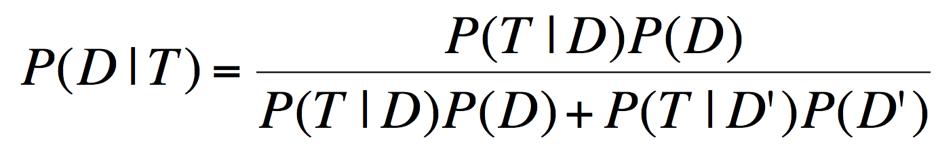
Bayes’ Theorem
D: the event that you have disease X
T: the event that you test positive for disease X
P(T|D) = prior probability
P(D|T) = posterior probability

Slide 69
Disease X
You’ve tested positive for Disease X.
The test is known to be 95% accurate.
So, you’d think P(you have Disease X) would be 0.95.
Right?

Slide 70
Misses and False Positives
Misses: You have Disease X, but test negative
False Positives: You don’t have Disease X, but test positive.
Suppose there is a miss rate of 0.01 and a false positive rate of 0.09.
So, you’d think :
P(have Disease X | test positive) = 0.91
Right?

Slide 71
Base Rates
Hit rate = 0.99
False positive rate = 0.09
Base rate = 0.02
Of 1,000,000 people:
0.02 x 1,000,000 = 20,000 have disease
0.99 x 20,000 =19,800 are hits
980,000 do not have disease
0.09 x 980,000 = 88,200 are false positives
88,200 incorrectly diagnosed with the disease

Slide 72
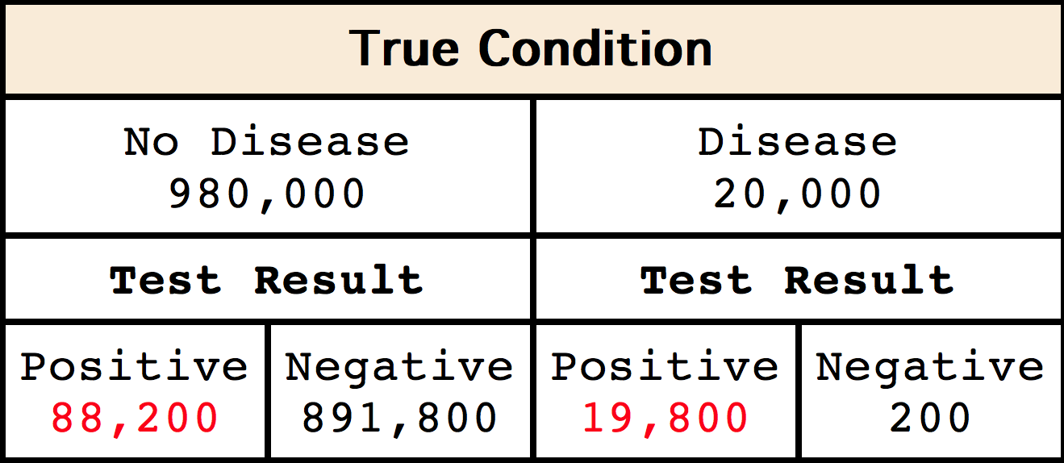
Summary
Probability you have the disease given that you test positive is only 19,800/(19,800 + 88,200) = 0.1833!

Slide 73
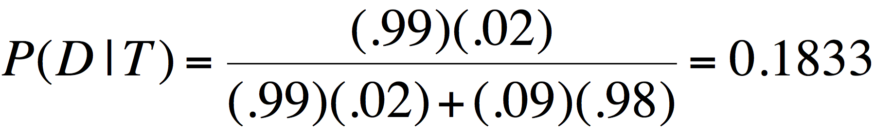
Bayes’ Theorem
P(T|D) = | 0.99
P(T|D’) = | 0.09
P(D) = | 0.02
P(D’) = | 0.98

Slide 74
Combinations and Permutations

Slide 75
Permutations and Combinations
counting number of possible orders
counting using the multiplication rule
counting number of permutations
counting the number of combinations

Slide 76
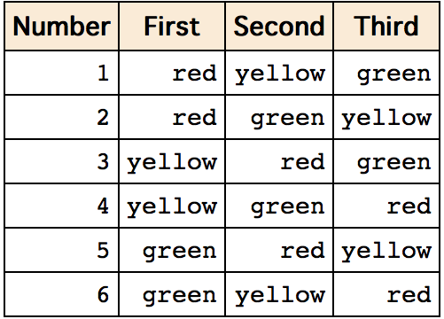
Counting Possible Orders

Slide 77
Factorials
Number of orders = n!
3! = 3 x 2 x 1 = 6
5! = 5 x 4 x 3 x 2 x 1 = 120

Slide 78
Multiplication Rule
3 soups
6 entrées
4 desserts
Total = 3 x 6 x 4 = 72

Slide 79
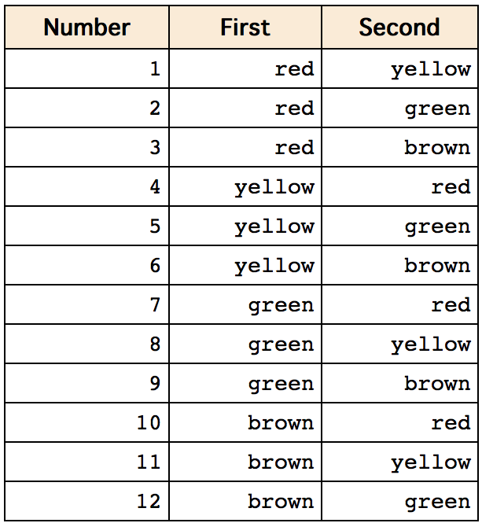
Permutations
Choose 2 pieces from a set of 4 in an order

Slide 80
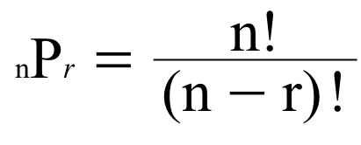
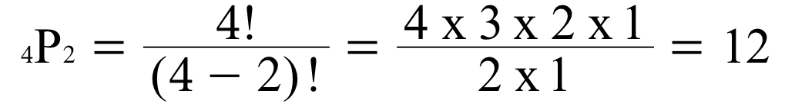
Permutations

Slide 81
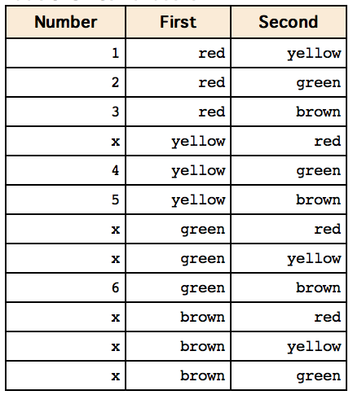
Combinations
Choose 2 pieces from a set of 4 in any order

Slide 82
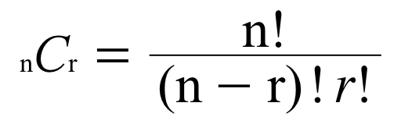
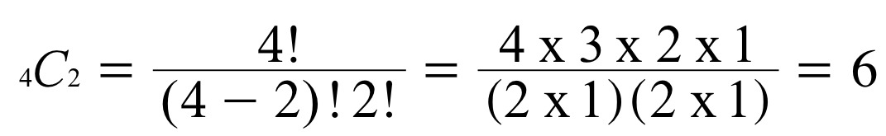
Combinations

Slide 83
Probability Dad Joke
A combination lock should really be called a permutation lock – the order matters!

Slide 84
The Law of Averages
AKA The Law of Large Numbers

Slide 85
The Probability Stays the Same
Kerrich (as imagined in Statistics by Friedman, Pisani, and Purves): “With a fair coin, the chance for heads stays at 50%, no matter what happens. Whether there are two heads in a row or twenty, the chance of getting a head the next time is still 50%”

Slide 86
The Law of Averages
Kerrich (as imagined in FPP): “With a large number of tosses, the size of the difference between the number of heads and the expected number is likely to be quite large in absolute terms. But compared to the number of tosses, the difference is likely to be quite small. That’s the law of averages.”

Slide 87
Chance Error
Actual number – expected number
Number of heads – half the number of tosses

Slide 88
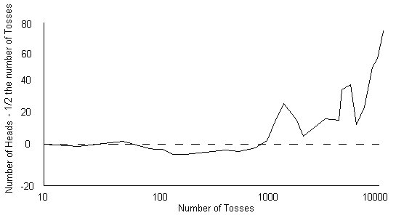
Chance Error

Slide 89
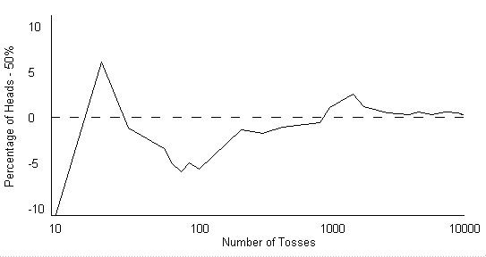
Chance Error as % of Tosses

Slide 90

Law of Averages

Slide 91
Flipping a Coin
How many heads would you expect after 10 flips? What percentage?
After 50?
What is the actual number of heads after 10 flips? After 50?
What is the actual percentage of heads after 10 flips? After 50?
Notes:
28; 56%

Slide 92
Flipping a Coin
Someone tells you that you will win a prize if:
You toss a coin and get between 40% and 60% heads
You toss a coin and get exactly 50% heads
For each, would you rather toss a coin 10 times, 100 times, or does it not matter?

Slide 93
Gambler’s Fallacy
If you have gotten five tails in a row, does that make the odds of a heads more likely on the next flip?
NO!

Slide 94
Making a Box Model
What numbers go into the box?
How many of each kind?
How many draws?
What would a box model for the coin flips look like?

Slide 95

Roulette

Slide 96
Roulette
You bet $1 on red
What does the box model look like?
What if you bet $1 on black?
On odd?
On 1-18?
On a split between 11 and 12 (covers both numbers, pays 17 to 1)
On the four adjoining numbers 23, 24, 26, 27 (covers four numbers, pays 8 to 1)
Notes:
38 total spaces

Slide 97
Essential Questions
Why is the normal curve important?
Why is the law of averages important?

Slide 98
Next Time…
Combining the normal curve and the law of averages

