Slide 1
Statistical Inference
SSI II
Jan 24, 2019

Slide 2
Previously…
The Law of Averages
The Normal Curve

Slide 3
Essential Questions
Why are the expected value and standard error important?
How does the normal curve relate to probability?
Why are random samples important?

Slide 4
Last Time…
Chance error = observed value – expected value
Observed value = expected value ± chance error

Slide 5
Standard Error
Observed value = expected value ± chance error
We estimate the error with the standard error

Slide 6
Expected Value of the Sum
Expected Value = Number of draws * Average of box

Slide 7
Standard Error
The expected size of the error
The amount by which we expect our observed values to vary around the expected value

Slide 8
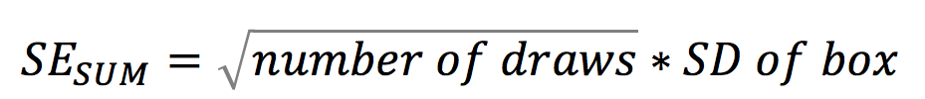
Standard Error of the Sum
AKA the Square Root Law

Slide 9
Example 1
One hundred draws are made at random with replacement from the box
1
2
3
4
5
6
7

Slide 10
Example 1 – Expected Value
Expected value = Number of draws * Average of box
100 * (1+2+3+4+5+6+7)/7
100 * 28/7
100* 4
400

Slide 11
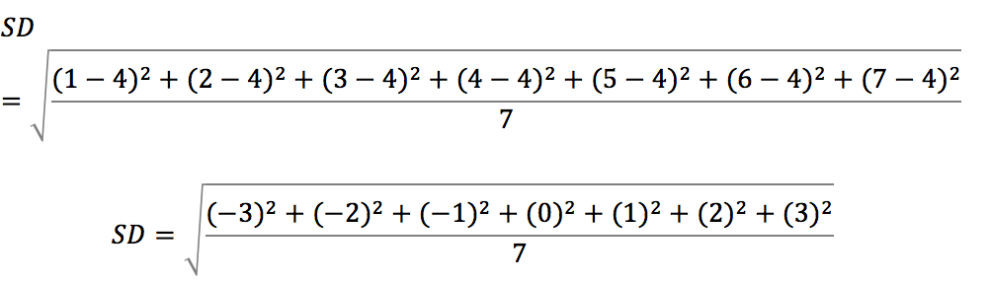
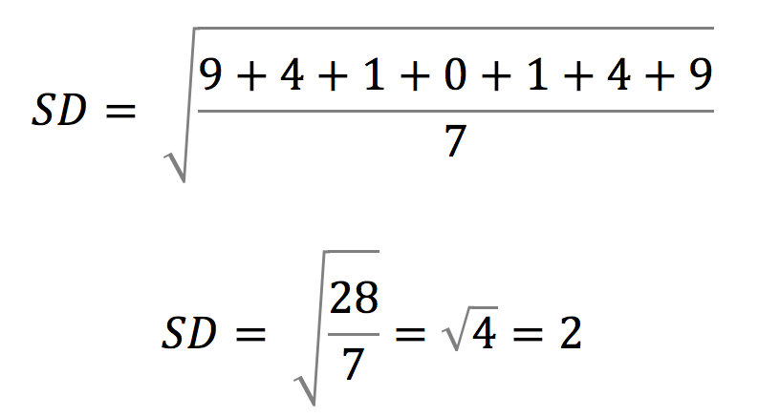
Example 1 – Standard Deviation

Slide 12
Example 1 – Standard Error
SE_{SUM} = √100 * 2
= 10 * 2
= 20

Slide 13
Example 1
The sum of the draws will be around 400, give or take 20 or so

Slide 14
Example 2
Frank makes fifty draws at random with replacement from the following box. The sum of his draws turns out to be 157. What is the:
Expected value for the sum?
Observed value for the sum?
Chance error?
Standard error?
1
2
3
4
5

Slide 15
Standard Errors
In general, observations are rarely more than 2 or 3 SEs away from the expected value

Slide 16
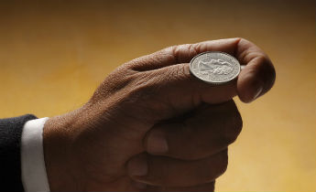
Example 3 – Coin Toss
Toss a coin 100 times.
What is the chance of getting between 40 and 60 heads?

Slide 17
Box
0
1

Slide 18
Example 3 - Average
(0+1)/2
½ = .5

Slide 19
Example 3 – Expected Value
Expected Value = draws * average
= 100 * .5
=50

Slide 20
SD Shortcut
If your “box” has only two numbers
SD=
(big # - small #) * √ (frac. w/ big # * frac. w/ small #)
This is technically the population SD, not the sample SD
In class, we will sometimes fudge this

Slide 21
Example 3 – Standard Deviation
The easier way
SD = (1 – 0) * √ (1/2) * (1/2)
SD= 1 * √(1/4)
SD = ½

Slide 22
Example 3 – Standard Error
SE_{SUM} = √100 * ½
= 10 * ½
= 5

Slide 23
Example 3
The number of heads will be around 50, give or take 5 or so
Now what is the chance of getting between 40 and 60?

Slide 24
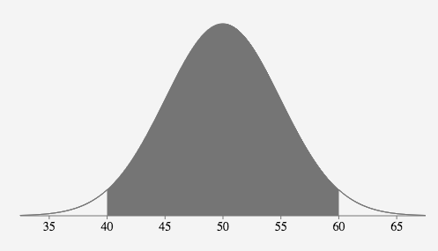
Example 3 – Using the Normal Curve

Slide 25
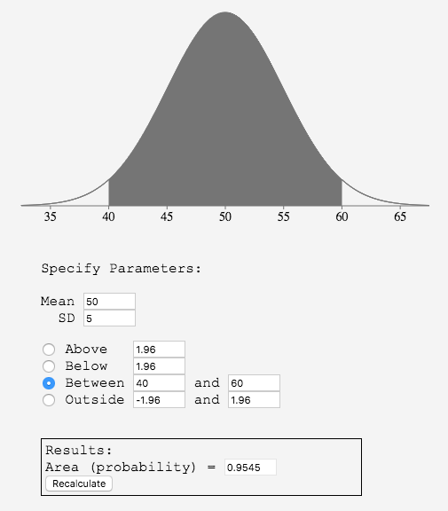
Example 3 – Using the Normal Curve

Slide 26
Example 3 - Extension
We would expect that 99.7% of the time, the sum of the draws will be between what two numbers?

Slide 27
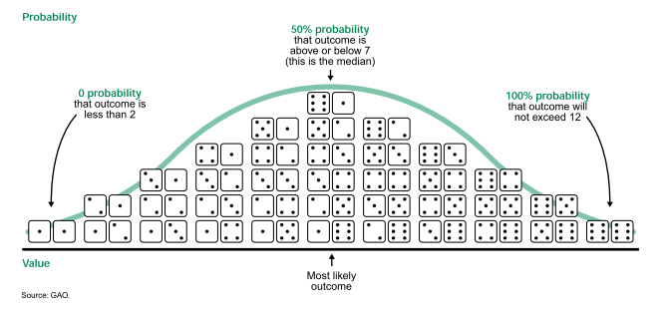
Probability
Notes:
Source: http://www.johngoodpasture.com/2010/05/all-things-bell-shaped.html

Slide 28
Settlers of Catan
Notes:
Image source: catan.com

Slide 29
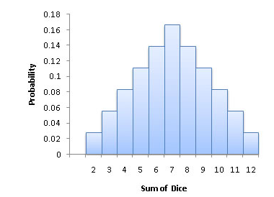
Probability Histogram
Notes:
Source: https://faculty.elgin.edu/dkernler/statistics/ch06/6-1.html

Slide 30
Probability Histogram
Y-axis is probability or chance, not data

Slide 31
Central Limit Theorem, re: Sums
If events are random and independent, the probability histogram for the sum will follow the normal curve
This holds even if the underlying process/contents of the box are not normally distributed
The probability distribution has
A mean equal to the original mean * N
A standard deviation equal to the original SD * sqrt(N)

Slide 32
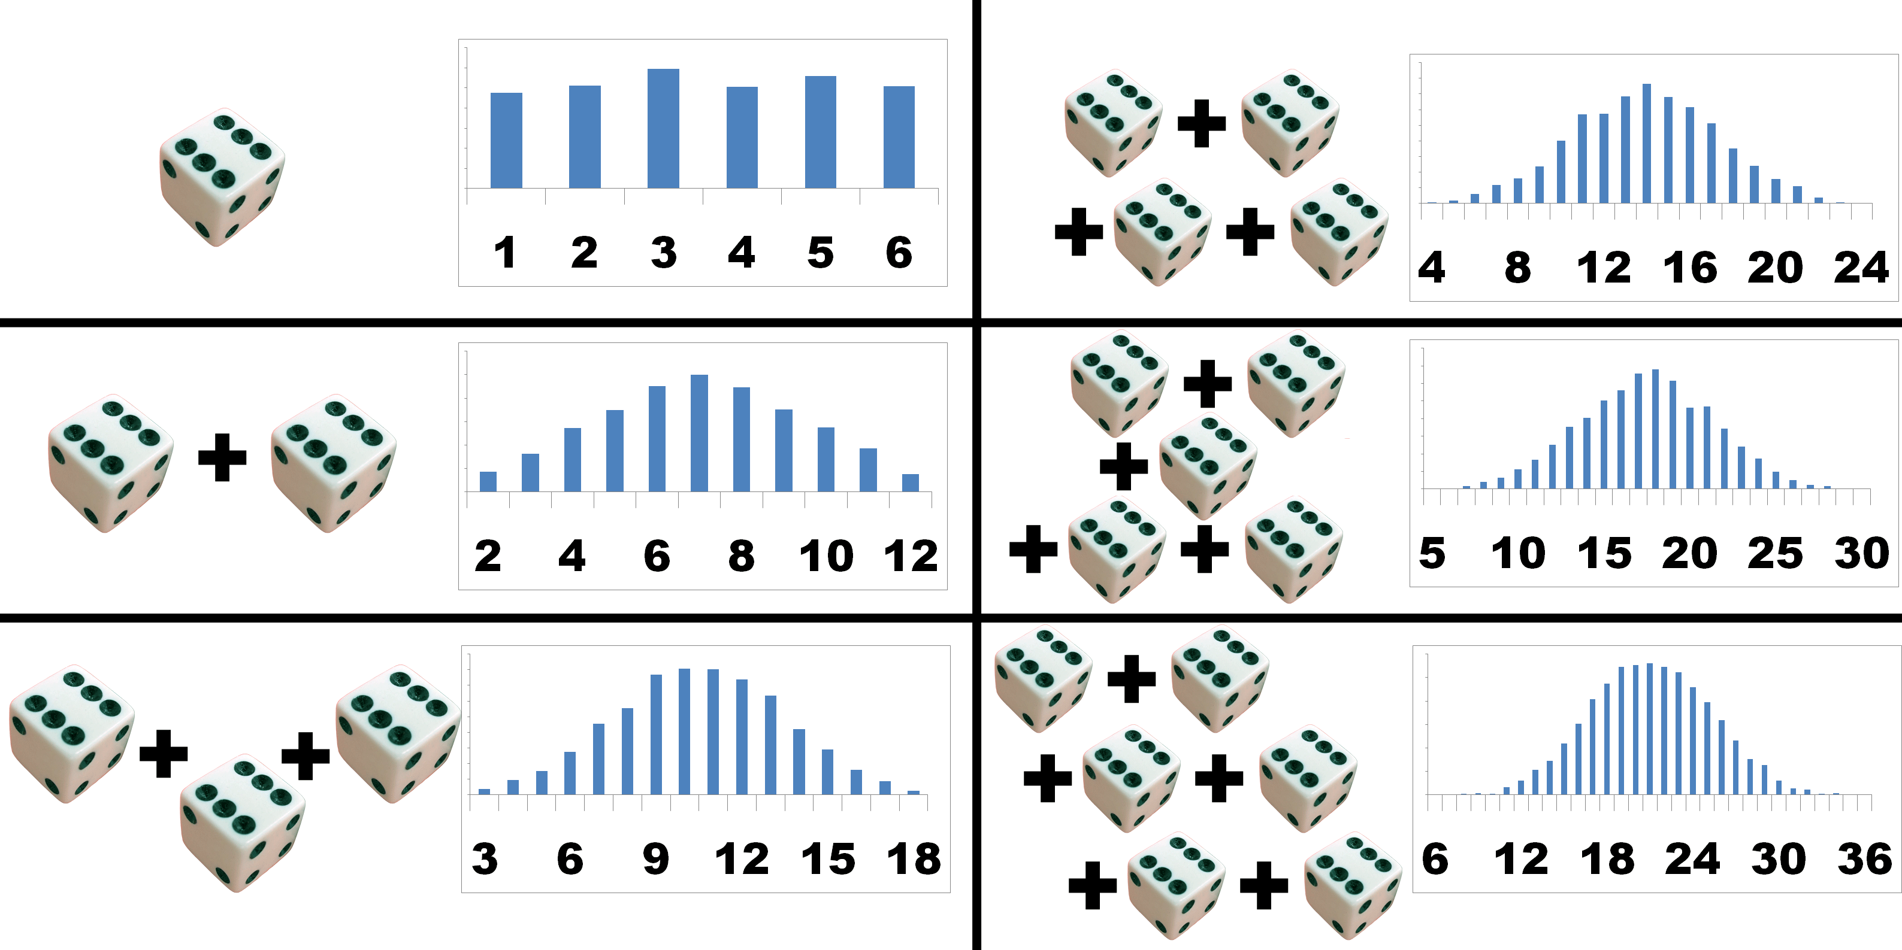
Notes:
Probability distribution’s mean = original mean *N: 3.5*2=7, 3.5*3=10.5, 3.5*4=14, 3.5*5=17.5, 3.5*6=21

Slide 33
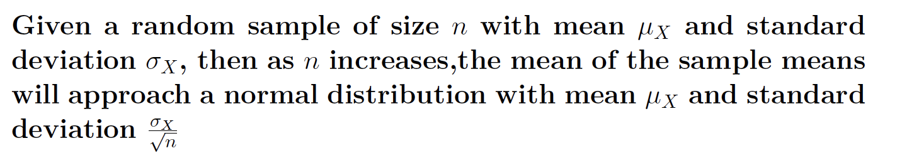
Central Limit Theorem, re: mean and SD
Next time, we will see:
This is generally more applicable in statistics than the sum

Slide 34
Sampling and Statistical Inference

Slide 35
Statistical Inference
These ideas hold as we try to begin statistical inference
The process of inferring information about the population from the sample

Slide 36
Polls and Approval Ratings
There are over 250 million adults in the US
In the most recent Quinnipiac poll, 41% of those sampled approve of the way Trump is doing his job
The margin of error is plus or minus 3.3%
It is a random sample of 1,209 people
How confident can we be from the sample that the true level of approval is within the range of 37.7%-44.3%?

Slide 37
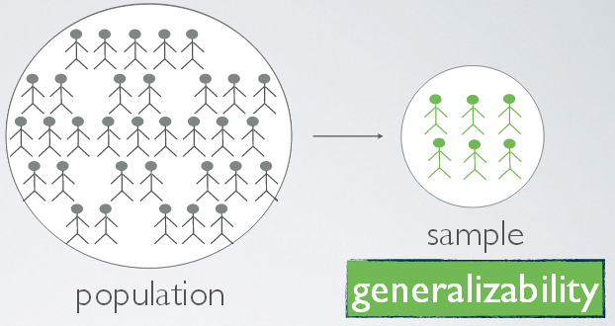
Goal of Statistical Inference
We want to calculate descriptive statistics for a large population (all relevant units)
But we only have a relatively small random sample (a subset of the population)

Slide 38
Statistical Inference
Statistical inference involves drawing conclusions about unknown population characteristics from the characteristics of a known sample
How can we estimate the mean and frequency in a population from sample data?
How close will a statistic computed from the sample be to the true (but unknown) population value?
How much randomness or uncertainty is there in our estimate?

Slide 39
Randomness and Probability
A process is random if we cannot predict in advance what its outcome will be
Random means unpredictable, NOT unsystematic
Random processes often have long-term patterns
We can think of the probability of an outcome that results from a random process is the proportion of times that it would occur if a process were infinitely repeated

Slide 40
Random Sampling
A simple random sample is one in which each individual observation (unit) has an equal probability of being selected
More generally, a random sample is one where every possible sample has an equal probability of being selected
Example: Suppose we draw a random sample of 3 unique letters. ABC is just as likely as XYZ, IOU, PHD, RAT, CAT, MAT, SAT, ETC…

Slide 41
Sample and Population Statistics
If our data consists of a random sample from a larger population, we can compute sample statistics (descriptive statistics for the sample)
We can also distinguish sample statistics from population statistics
Does a sample statistic provide the best estimate (best guess) about population statistics?

Slide 42
What if it is a non-random sample?
What would happen if we had a non-random coin?
This introduces selection bias

Slide 43
Literary Digest Example
1936 election
Literary Digest prediction: Roosevelt 43%
Election result: 62%
Based on 2.4 million responses, the largest ever
What might have gone wrong?

Slide 44
Selection Bias
Literary digest procedure
Mailed questionnaires to 10 million people
Addresses came from telephone books and club membership lists
Who was likely to be missing from their address list?

Slide 45
Selection Bias
Bias against poorer individuals
Only ¼ of households had a telephone
Poorer individuals are also less likely to be in clubs
Voting in the 1936 election was highly predicted by income

Slide 46
Non-Response Bias
Individuals also had to choose whether or not to mail back the questionnaire
Who would be more likely to mail it back?
1/3 of Chicago residents received the questionnaire
20% responded
Over 50% of respondents favored Landon
Chicago voted 2:1 for Roosevelt

Slide 47

Third Debate 2016

Slide 48
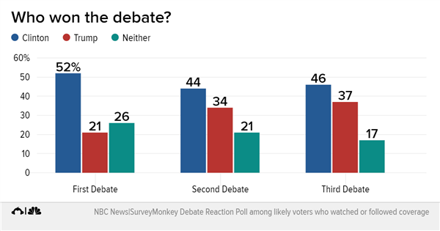
Third Debate 2016

Slide 49
Self-Selection Bias
The ones Trump tweeted were simply available online
Anyone could choose to go participate
His supporters were more likely to do so
Especially on some sites

Slide 50
Essential Questions
Why are the expected value and standard error important?
How does the normal curve relate to probability?
Why are random samples important?

Slide 51
Next Time
Standard Error of the Mean
Sampling Distributions
Central Limit Theorem, continued

