Slide 1
Aimbot Report for Csgo
Presented by: Kevin Yao
-Proj2 for AI-fundamentals-2024-Spring
1

Slide 2
Report Outline
1. Mission profile
-Background introduce about aimbot
2. Pre proj research & Proj procedure
-Consider which model to use and what data set to choose and why
-How to conduct the proj
3. Problems during proj & my solution
-Some problems I meet during proj & how I solve them
4. Further Q&A
-More questions are welcomed
2

Slide 3
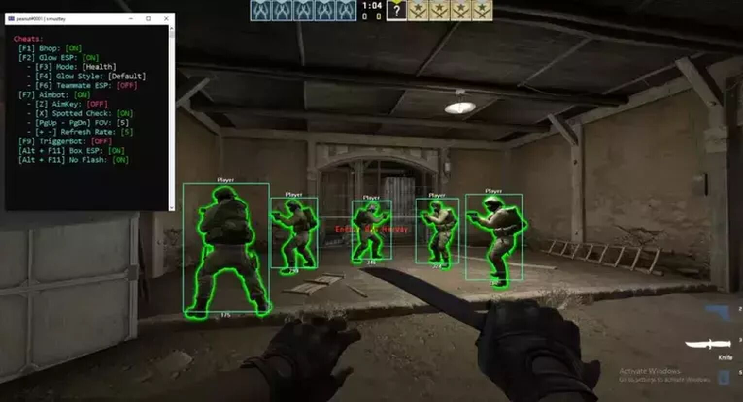
Let’s begin: Mission profile
What is aimbot:
-Object Detection
-AI model usage in Cs2
3

Slide 4

AimBoT Preliminary Questions: Research
Which model to choose? And why?
-YOLOv8
-Leveraging YOLOv8 Features to Build an Aimbot System
-Dataset Compatibility
YOLOv8
Real-time Performance
High Accuracy
Lightweight
Multi-scale Detection
Easy Integration and Use
Community Support
……
4
Notes:
Goal- Precise mathematical description

Slide 5
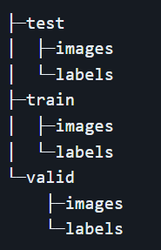


AimBoT Preliminary Questions: Research
How is the dataset obtained?
- https://universe.roboflow.com/
- Open source dataset
What is the format of the dataset?
-train, test, valid
-each image has a corresponding label file
5
Notes:
Goal- Precise mathematical description

Slide 6
Proj Procedure
How this proj is conduct ?
Overall Project Understanding
Parameter Understanding and Training Set Preparation
Start Training Based on the Code
Implement Real-Time Screenshot and Refactor Model Loading Code
Integrate Code and Achieve Initial Recognition Results
Mouse Monitoring and Control
5
Notes:
Goal- Precise mathematical description

Slide 7
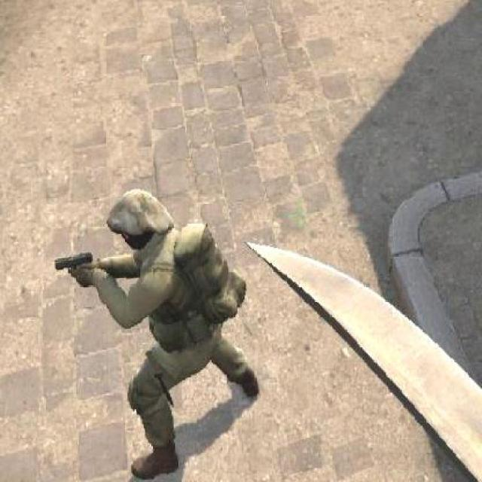
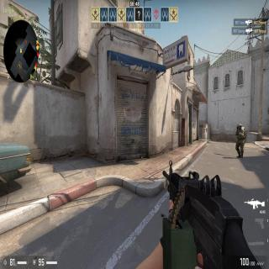
Problems during proj & my solution
Dirty Data(Noisy Data)
-missing info
6
Notes:
Goal- Precise mathematical description

Slide 8
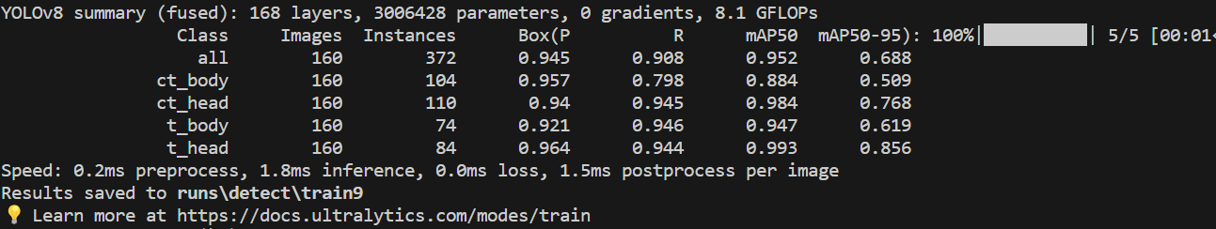
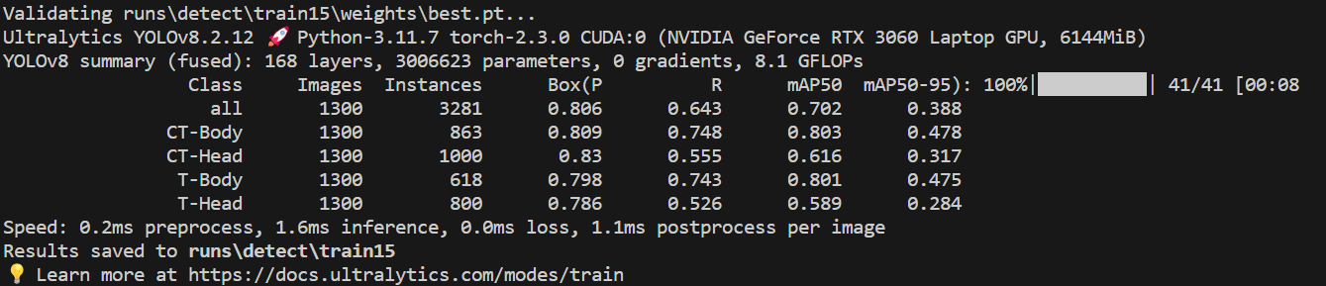
Problems during proj & my solution
2. model overfitting
-train to much
7
Notes:
Goal- Precise mathematical description

Slide 9

Q&A
8

