Slide 1
Genetic Programming

Slide 2
Last Week: Genetic Algorithms
Population based solution
Used concepts from natural selection to evolve individuals
Used properties of DNA to exchange and change information between individuals
Individuals represented as lists
[Gene₀, Gene₁, Gene₂, …, Gene_{N-1}]

Slide 3
This Week: Genetic Programming
Instead of taking an individual and having a function evaluator to obtain objective scores…
[0, 1, 0, 1, 0, 1] 3
The individual is the function itself
[0, 1, 2, 3, 4, 5] [0, 1, 4, 9, 16, 25]
Individual
Objective Score
Evaluator
Input Data
Output Data
Individual
Evaluator
What’s the function?
Y = X²

Slide 4
Tree Representation
We can represent a program as a tree structure
Nodes are called primitives and represent functions
Leaves are called terminals and represent parameters
The input can be thought of as a particular type of terminal.
The output is produced at the root of the tree.
Primitive
Primitive
Terminal
Primitive
X
Terminal
Terminal
Terminal
Primitive
Primitive
Terminal
Primitive
Terminal
Terminal
Terminal
Terminal
Output: f(X)

Slide 5
Tree Representation: Example
What’s the function?
+
*
1
3
4
f(X) = 3*4 + 1
Note: it’s a constant

Slide 6
How is the Tree Stored?
The tree is converted to a lisp preordered parse tree.
Operator followed by inputs
The tree for f(X) = 3*4 + 1 can be written as:
[+, *, 3, 4, 1]
This comes from using the root first and then expanding:
[+, input1, input2]
[+, *, input3, input4, 1]
[+, *, 3, 4, 1]
+
*
1
3
4

Slide 7
Tree Representation: Example 2
What’s the function?
What’s the parse tree?
-
2
+
0
1
f(X) = 2 – (0+1)
Note: it’s a constant
[-, 2, +, 0, 1]

Slide 8
Crossover in GP
Crossover in tree-based GP is simply exchanging subtrees
Start by randomly picking a point in each tree
These points and everything below create subtrees
+
*
1
3
4
-
2
+
0
1
*
3
4
0

Slide 9
Crossover in GP Continued
The subtrees are exchanged to produce children
What are these new trees?
+
*
1
3
4
-
2
+
0
1
*
3
4
0
+
1
-
2
+
1
f(X) = 0 + 1
[+, 0, 1]
f(X) = 2 – [(3*4) + 1]
[-, 2, +, *, 3, 4, 1]

Slide 10
Mutation in GP
Mutation can involve…
Inserting a node or subtree
Deleting a node or subtree
Changing a node

Slide 11
Example: Symbolic Regression
Using simple primitives, use genetic programming to evolve a solution to y=sin(x)
Primitives include:
+, *, -, /
Terminals include integers and…?
X
How did Calc I solve this?
Taylor series!

Slide 12
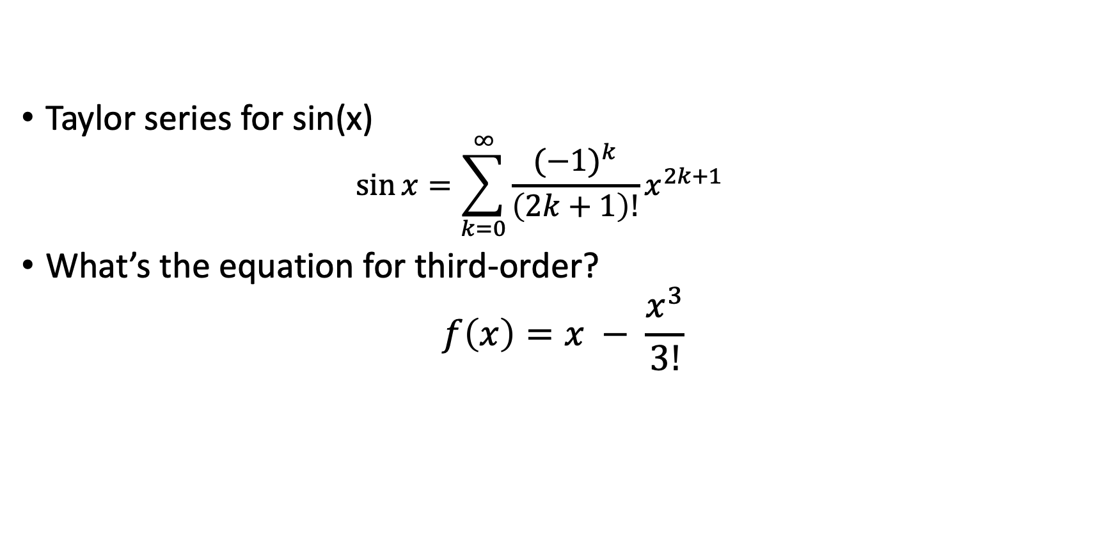
Example: Symbolic Regression
Taylor series for sin(x)
$$\sin{x}=\sum_{k=0}^{∞}{\frac{{(−1)}^{k}}{\left(2k+1\right)!}}x^{2k+1}$$
What’s the equation for third-order?
$$f\left(x\right)=x − \frac{x^{3}}{3!}$$

Slide 13
Third Order Expression
[-, input1, input2]
[-, x, /, input3, input4]
[-, x, /, *, input5, input6, *, input7, input8]
[-, x, /, *, x, *, input9, input10, *, 3, 2]
[-, x, /, *, x, *, x, x, *, 3 , 2]
-
x
*
x
*
x
/
*
3
2
x

Slide 14
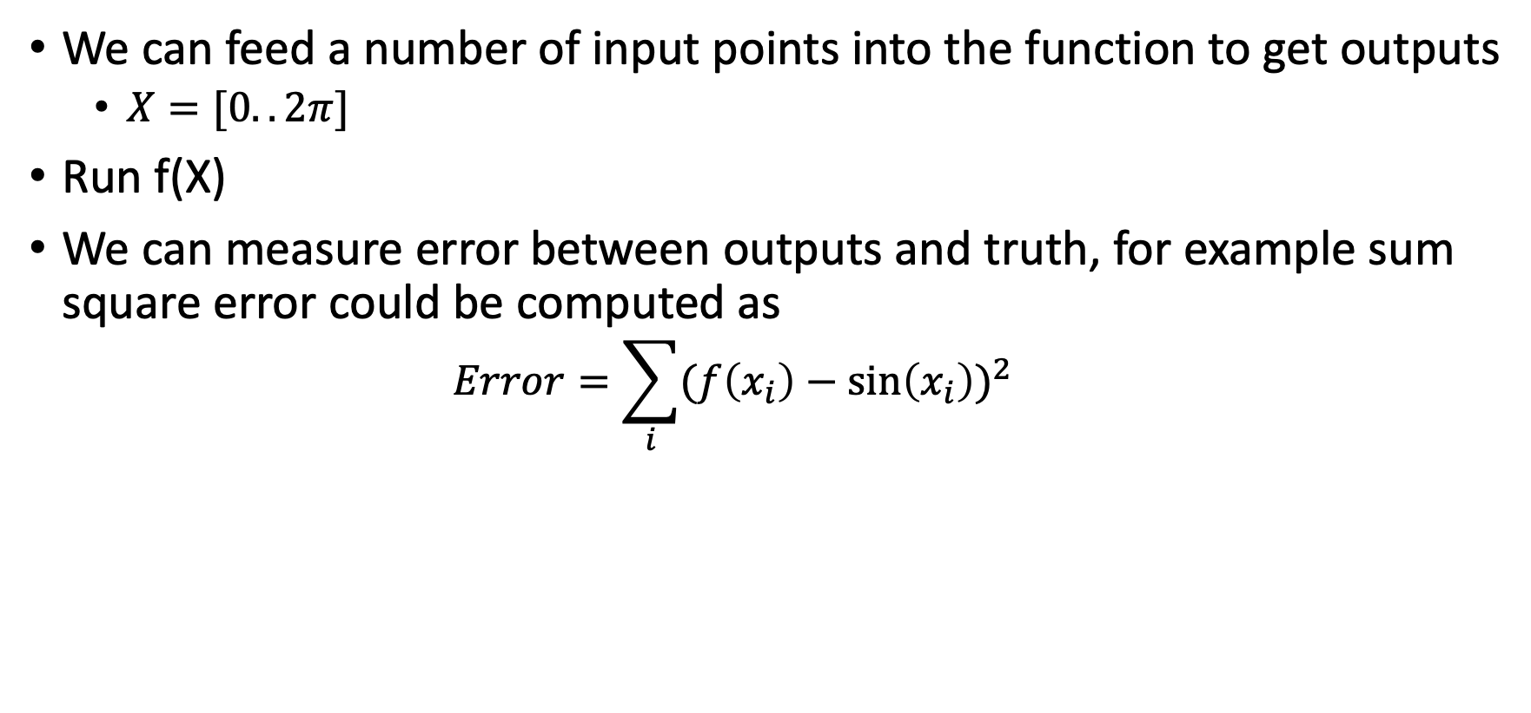
Evaluating a tree
We can feed a number of input points into the function to get outputs
$X=[0..2π]$
Run f(X)
We can measure error between outputs and truth, for example sum square error could be computed as
$$Error=\sum_{i}{{(f\left(x_{i}\right)−\sin\left(x_{i}\right))}^{2}}$$

Slide 15
What Primitives Could Make This Evolution Easier?
Power()
Factorial()
Sin()
Cos()
Tan()
This is the idea behind EMADE! But more on that later!

