Slide 1
Introduction to EMADE

Slide 2
What is EMADE?
EMADE is the Evolutionary Multi-objective Algorithm Design Engine.
It combines a multi-objective evolutionary search with high-level primitives to automate the process of designing machine learning algorithms.

Slide 3
This week you will…
Follow the install instructions:
emade/README.md at master · emade/emade (gatech.edu)
Configured a mysql 5.x server on your machine (some people have an easier time with MariaDB).
Downloaded and installed git-lfs.
Cloned the emade repository.
Run the setup module to install the package.
I have copied a conda environment file into this reference repo if you would like to try that: conda env create –f emade.yml
python setup.py install

Slide 4
Today we will cover…
What is required to run EMADE?
What are all the pieces of EMADE?
Where can you monitor results?

Slide 5
Running EMADE
To start a run of EMADE you will navigate to the top level directory and run
python src/GPFramework/launchGTMOEP.py templates/input_titanic.xml
Module to start a run of EMADE, takes in an input file to configure a run
Input file describing to EMADE how to run the titanic problem you investigated in the last two assignments

Slide 6
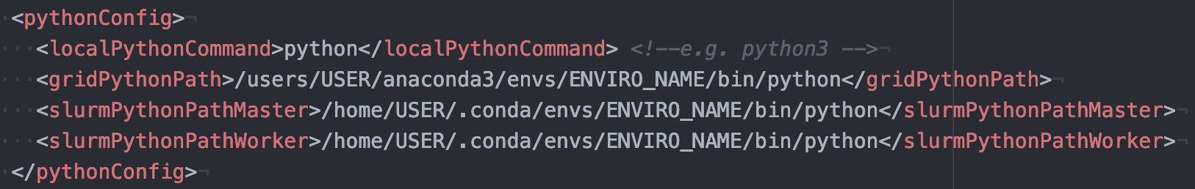
What is in the Input File?
The input file is an xml document that configures all the moving parts in EMADE, we will step through it now.
The first block is for configuring Python:
EMADE automatically detects cluster management software for gridengine and SLURM. For our purposes, you only need to worry about the local python command. This should be the command to run python where all of EMADE python dependencies are installed.
If you have your virtual environment activated, or if they are installed at the base installation, this can just be python.

Slide 7
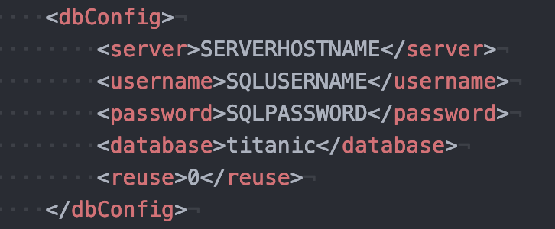
Input File: Database Configuration
The next block is for configuring a MySQL connection:
If you are running locally, server can be localhost or 127.0.0.1
Username and password are for MySQL, the user should have full permissions on the database specified.
You will have to make the server, user, and database outside of EMADE, through MySQL.

Slide 8
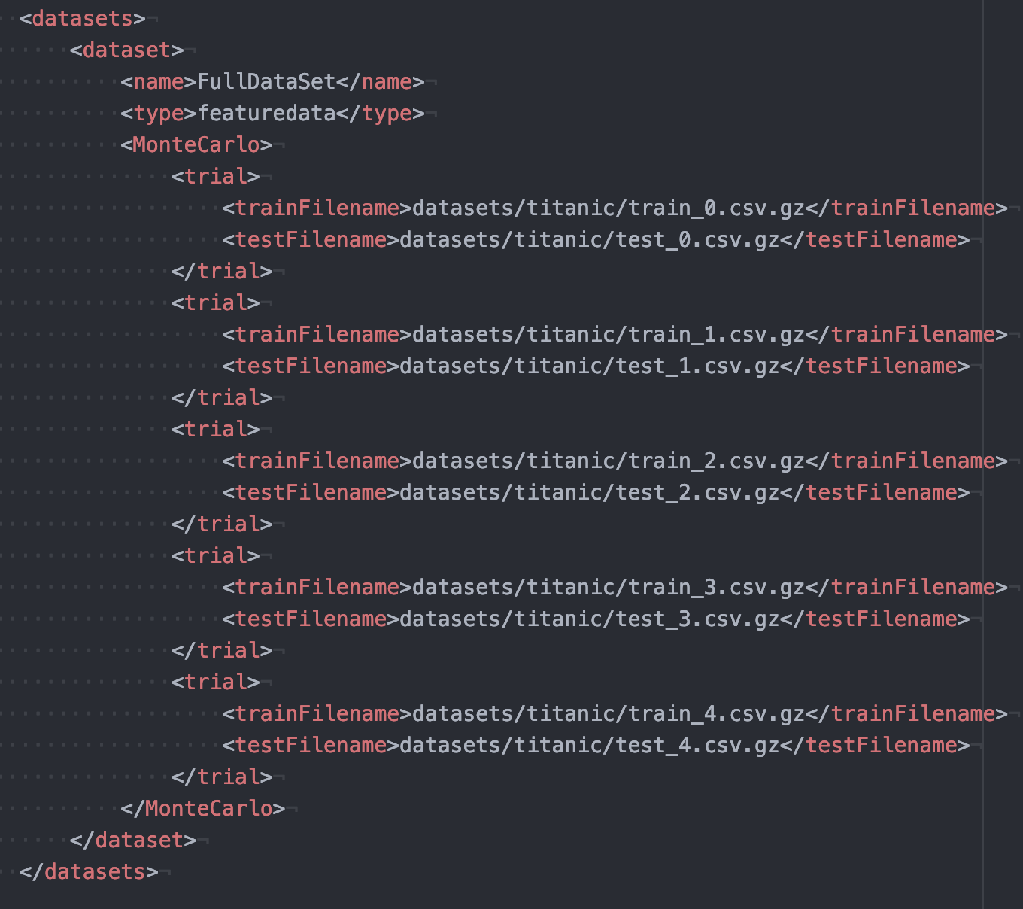
Input File: Datasets
EMADE can run across multiple datasets, the titanic example uses only one.
The data is preprocessed into gzipped csv files. (Example on next slide).
It is cross folded 5 times, this will create 5 Monte Carlo trials that algorithms can be scored with.
Each train and test file create a DataPair object in EMADE. More on this later.

Slide 9
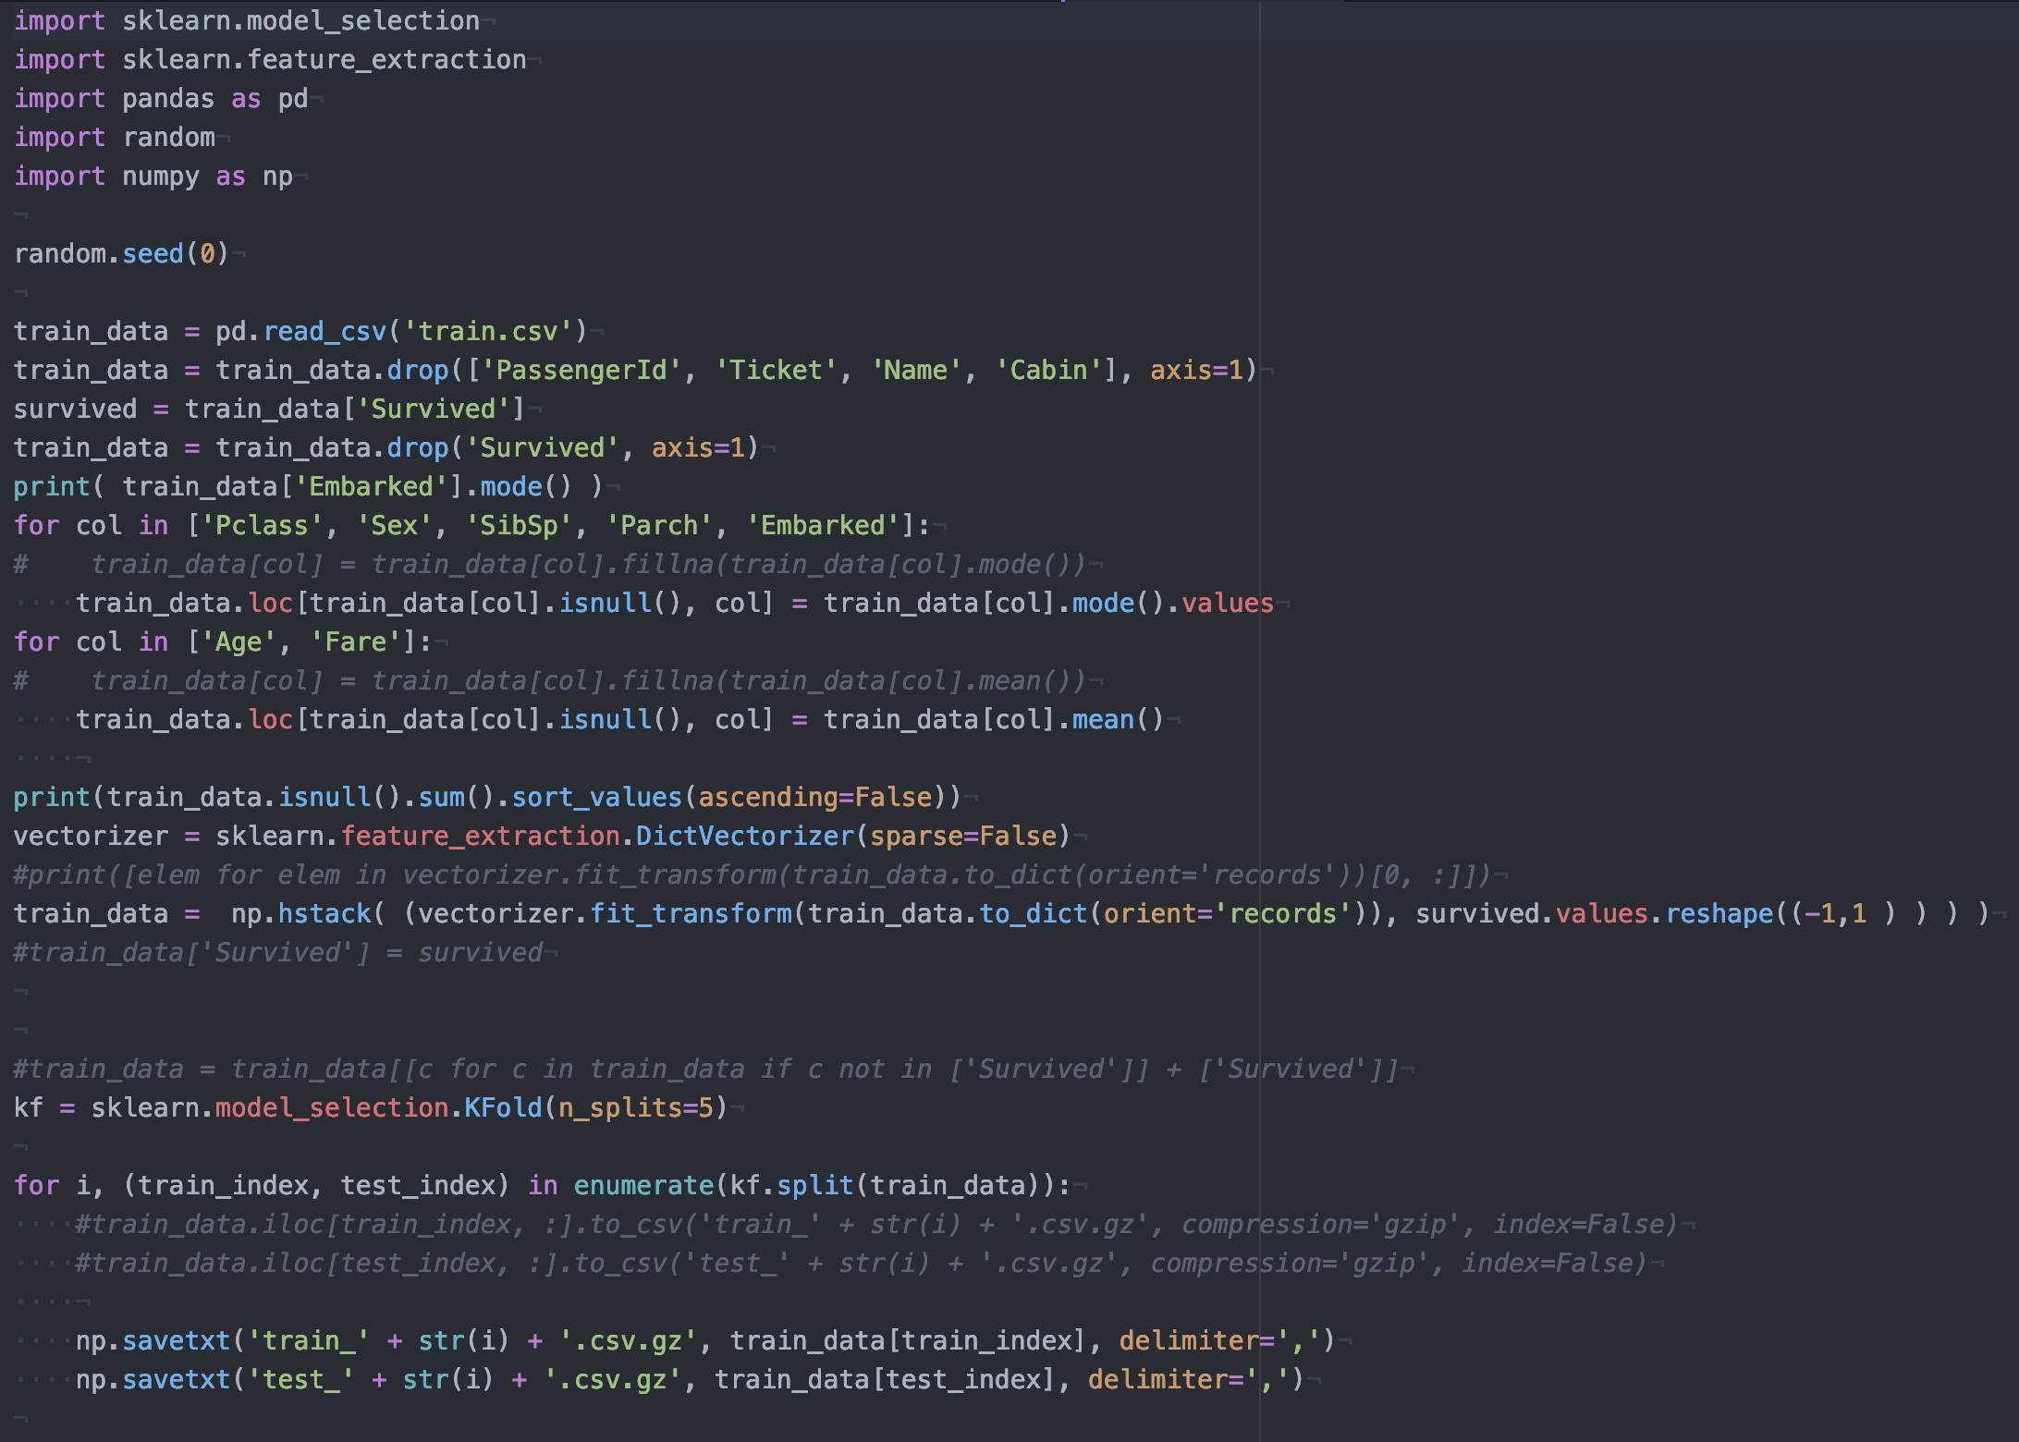
What Does One of These Files Look Like?
These files are prepared with the titanic_data_splitter.py in datasets/titanic/
You can decompress them or use an editor such as gvim to view them while zipped.
Each row corresponds to an instance (person), each column is a feature, the final column is the truth data.
EMADE reserves the last column for fitting models (train data) and scoring (test data).

Slide 10
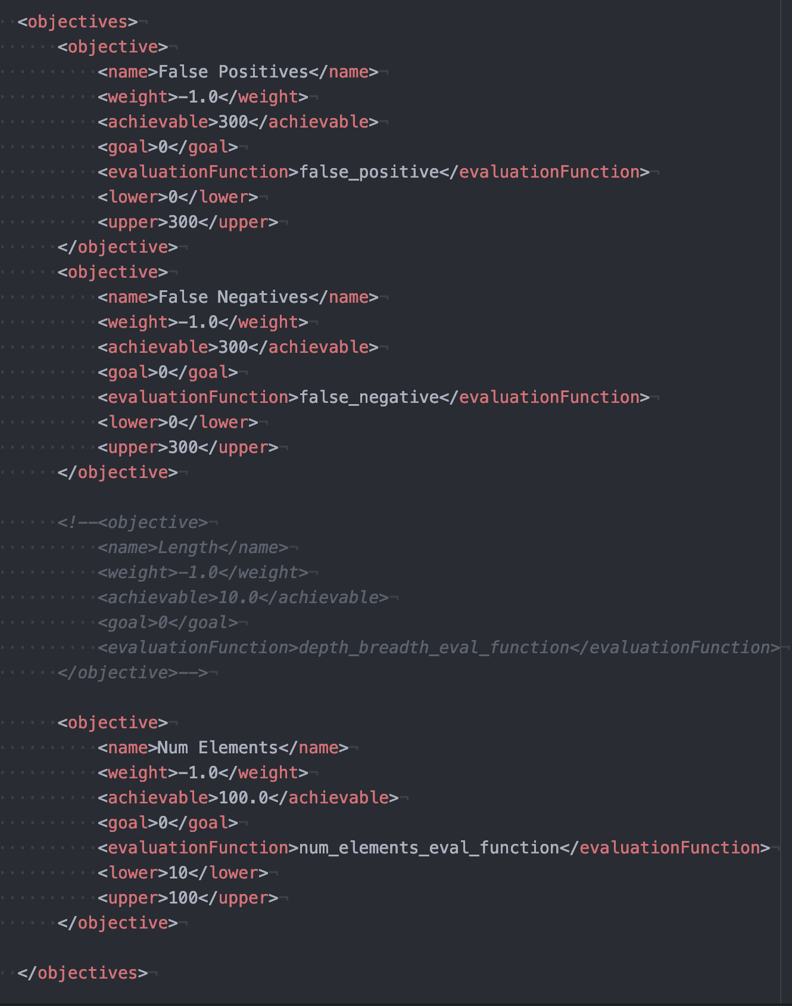
Input File: Objectives
Objectives are described next.
The names will be used as columns in the database.
Weight specifies if it should be minimized (-1.0) or maximized (1.0)
The <evaluationFunction> specifies the name of a method in src/GPFramework/evalFunctions.py
Achievable and goal are used for steering the optimization, lower and upper are used for bounding.

Slide 11
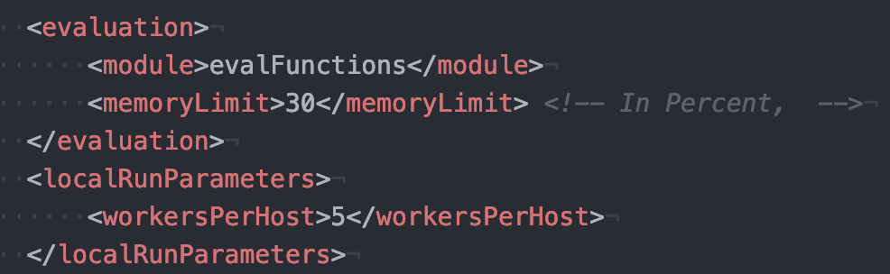
Input File: Some More Parameters
Evaluation specifies where evaluation functions specified in the objectives section live, and how much memory each worker is allowed to use before marking an individual as “fatal”
<workersPerHost> specifies how many evaluations to run in parallel.
EMADE is resource intensive, keep this number low on a laptop! (2-3).

Slide 12
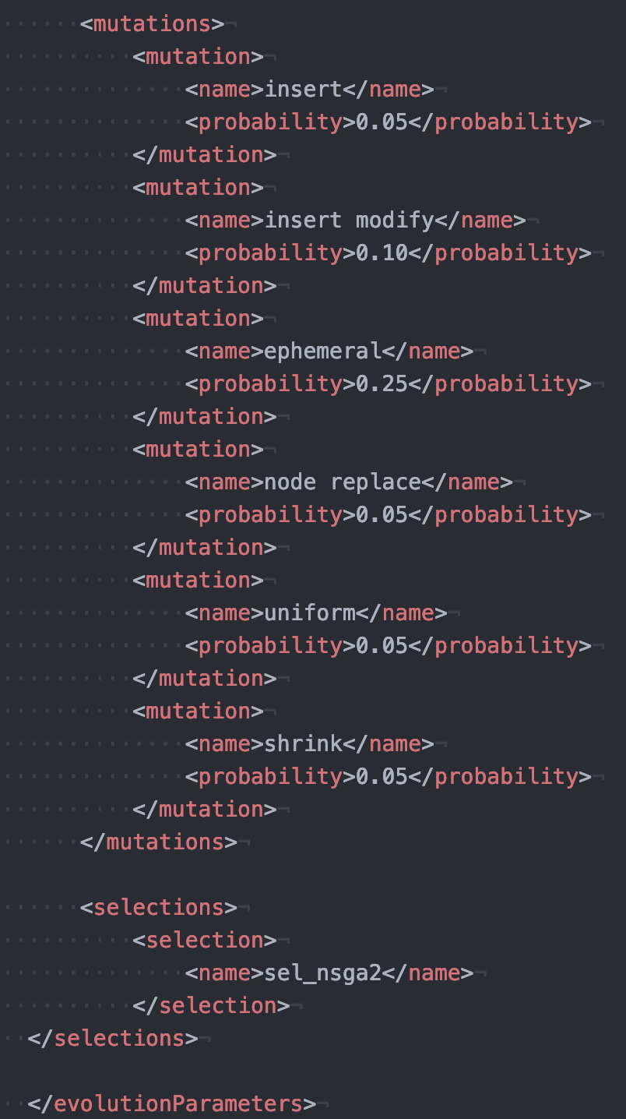
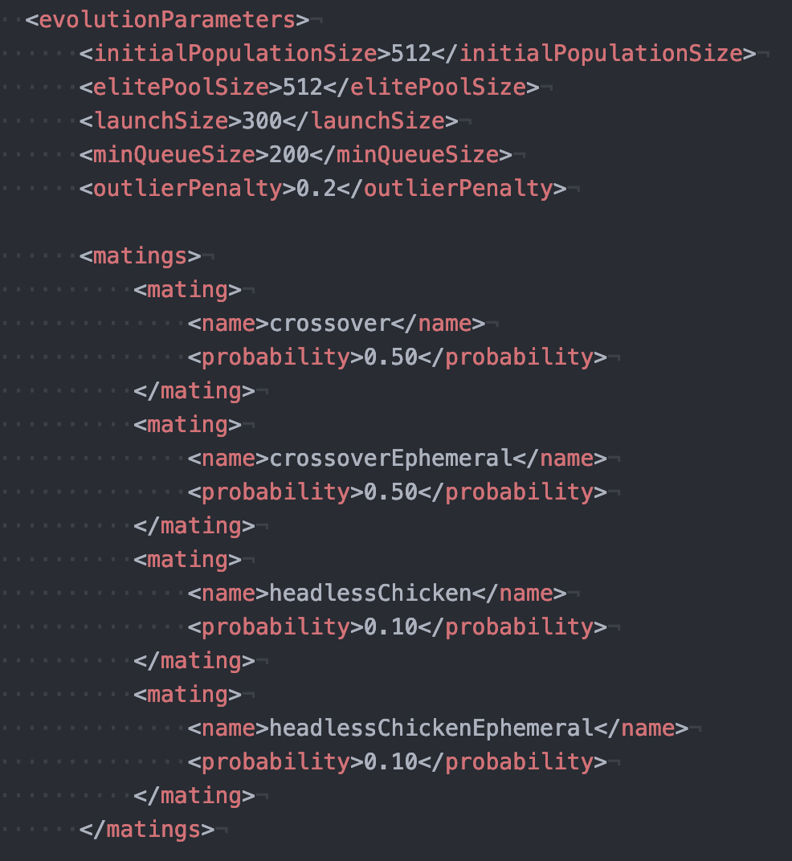
Input File: Evolution Parameters
All of these control the various ”magic constants” or hyperparameters that affect the evolutionary process

Slide 13
Connecting a Worker Process to a Peer
You can use the –w flag along with your peer’s server info in the dbconfig in order to allow your computer to act as a worker process for your peer’s master process.
python src/GPFramework/launchGTMOEP.py templates/input_titanic.xml -w
Make sure that your dbconfig in the input file specifies their IP address and not localhost.

Slide 14
Understanding EMADE output
The best place to look at the outputs of EMADE are in the MySQL databases.
You can connect to a mysql server from the command line:
Mysql –h hostname –u username –p
You will be prompted for a password
Once in you can select a database:
Use database_name;
Now you are in the database, some helpful queries
Select * from individuals;
Select * from individuals where `FullDataSet False Negatives` is not null;
Select * from individuals join paretofront on individuals.hash=paretofront.hash where paretofront.generation=(select max(generation) from paretofront);
Give EMADE some time and you will see individuals complete

Slide 15
EMADE Structure
src/GPFramework is the main body of code
gtMOEP.py is the main EMADE engine, most of the evolutionary loop is in here, including the evaluation method
gp_framework_helper.py is where the primitive set is built for EMADE, this function points to where the primitives live, such as:
methods.py
signal_methods.py
spatial_methods.py
Etc…
data.py provisions the DataPair object that is passed from primitive to primitive.
datasets/ is where some test datasets live.
templates/ is where the input files live.
Next week we will talk more about the primitives and datapair objects.

Slide 16
Your Assignment
Run EMADE as a group. 1 person should have the sql server set up and act as the master process, the rest should connect their workers.
Run for a substantial number of generations (as you did last assignment).
Teach yourselves some SQL: Play with the database to see what information you can mine.
Make a plot of your non-dominated frontier at the end of the run, compare with ML and MOGP assignments.
Make any other plots and figures to show your analysis of EMADE running on the Titanic problem, see if you can find some successful trees!
This assignment will have a presentation on Monday the 25st, DO NOT WAIT UNTIL THE LAST MINUTE TO GET EMADE WORKING!

Slide 17
Get Started!

