Slide 1
CS162
Operating Systems and
Systems Programming
Lecture 23
Remote Procedure Call
November 27, 2013
Anthony D. Joseph and John Canny
http://inst.eecs.berkeley.edu/~cs162

Slide 2
Goals for Today
Remote Procedure Call
Examples using RPC
  Distributed File Systems
  World-Wide Web
Note: Some slides and/or pictures in the following are
adapted from slides ©2005 Silberschatz, Galvin, and Gagne,
notes by Joseph and Kubiatowicz.

Slide 3
Distributed Systems – Message Passing
Distributed systems use a variety of messaging frameworks to communicate:
  e.g. the protocols for TCP: connecting, flow control, loss…
  2PC for transaction processing
  HTTP GET and POST
  UDP messages for MS SQL Server (last time)
Disadvantages of message passing:
  Complex, stateful protocols, versions, feature creep
  Need error recovery, data protection, etc.
  Ad-hoc checks for message integrity
  Resources consumed on server between messages (DoS risk)
  Need to program for different OSes, target languages,…
Want a higher-level abstraction that addresses these issues, but whose effects are application-specific

Slide 4
Remote Procedure Call
Another option: Remote Procedure Call (RPC)
  Looks like a local procedure call on client:
  file.read(1024);
  Translated automatically into a procedure call on remote machine (server)
Implementation:
  Uses request/response message passing “under the covers”
  Deals with many of the generic challenges of protocols that use message passing – may even be “transactional” - but usually not.
  Allows the programmer to focus on the message effects: as though the procedure were executed on the server.

Slide 5
RPC Details
Client and server use “stubs” to glue pieces together
  Client stub is responsible for “marshalling” arguments and “unmarshalling” the return values
  Server-side stub is responsible for “unmarshalling” arguments and “marshalling” the return values
Marshalling involves (depending on system) converting values to a canonical form, serializing objects, copying arguments passed by reference, etc.
  Needs to account for cross-language and cross-platform issues
Technique: compiler generated stubs
  Input: interface definition language (IDL)
    Contains, among other things, types of arguments/return
  Output: stub code in the appropriate source language

Slide 6

RPC Information Flow
bundle
args
Client
(caller)
call
Client
Stub
send
Packet
Handler
return
receive
unbundle
ret vals
Machine A
Network
Network
Machine B
bundle
ret vals
Server
(callee)
return
Server
Stub
send
Packet
Handler
call
receive
unbundle
args

Slide 7
RPC Binding
How does client know which machine to send RPC?
  Need to translate name of remote service into network endpoint (e.g., host:port)
  Binding: the process of converting a user-visible name into a network endpoint
    This is another word for “naming” at network level
    Static: fixed at compile time
    Dynamic: performed at runtime
Dynamic Binding
  Most RPC systems use dynamic binding via name service
  Why dynamic binding?
    Access control: check who is permitted to access service
    Fail-over: If server fails, use a different one
Object registry (if used)
  Contains remote object names and client stub code
  Allows dynamic loading of remote object stub

Slide 8
Cross-Domain Communication/Location Transparency
How do address spaces communicate with one another?
  Shared Memory with Semaphores, monitors, etc…
  File System
  Pipes (1-way communication)
  “Remote” procedure call (2-way communication)
RPC’s can be used to communicate between address spaces on different machines or the same machine
  Services can be run wherever it’s most appropriate
  Access to local and remote services looks the same
Examples of modern RPC systems:
  ONC/RPC (originally SUN RPC) in Linux, Windows,…
  DCE/RPC (Distributed Computing Environment/RPC)
  MSRPC: Microsoft version of DCE/RPC
  RMI (Java Remote Method Invocation)

Slide 9
Microkernel Operating Systems
Example: split kernel into application-level servers using RPC
  File system looks remote, even though on same machine
App
App
App
App
File
sys
windows
file system
Windowing
address
spaces
RPC
VM
Networking
Threads
threads
Monolithic Structure
Microkernel Structure

Slide 10
Microkernel Operating Systems
Why split the OS into separate domains?
  Fault isolation: bugs are more isolated (build a firewall)
  Enforces modularity: allows incremental upgrades of pieces of software (client or server)
  Location transparent: service can be local or remote
    For example in the X windowing system: Each X client can be on a separate machine from X server; Neither has to run on the machine with the frame buffer
App
App
App
App
File
sys
windows
file system
Windowing
address
spaces
RPC
VM
Networking
Threads
threads
Monolithic Structure
Microkernel Structure

Slide 11
Problems with RPC
Handling failures
  Different failure modes in distributed system than on a single machine
  Without RPC a failure within a procedure call usually meant whole application would crash/die
  With RPC a failure within a procedure call means remote machine crashed, but local one could continue working
  Answer? Distributed transactions can help
Performance
  Cost of Procedure call « same-machine RPC « network RPC
  Means programmers must be aware they are using RPC (so much for transparency!)
    Caching can help, but may make failure handling even more complex

Slide 12



Distributed File Systems
Read File
Network
Data
Client
Server
Distributed File System:
  Transparent access to files stored on a remote disk
  Transparent concurrency: All clients have the same view of the state of the file system.
  Failure transparency The client and client programs should operate correctly after a server failure.
  Replication transparency To support scalability, we may wish to replicate files across multiple servers. Clients should be unaware of this.
  Migration transparency Files should be able to move around without the client's knowledge.

Slide 13
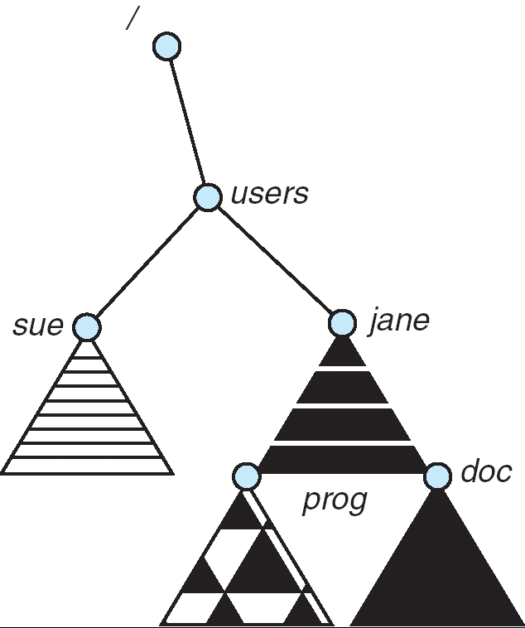
Distributed File Systems
Naming choices (always an issue):
  Hostname:localname: Name files explicitly
    No location or migration transparency
  Mounting of remote file systems
    System manager mounts remote file system
    by giving name and local mount point
    Transparent to user: all reads and writes
    look like local reads and writes to user
    e.g. /users/sue/foo→/sue/foo on server
  A single, global name space: every file
  in the world has unique name
    Location Transparency: servers
    can change and files can move
    without involving user
mount
adj:/jane
mount
coeus:/sue
mount
adj:/prog

Slide 14
Simple Distributed File System
Read (RPC)
Return (Data)
Client
Write (RPC)
Server
cache
ACK
Client
EVERY read and write gets forwarded to server
Advantage: Server provides completely consistent view of file system to multiple clients
Problems? Performance!
  Going over network is slower than going to local memory
  Server can be a bottleneck

Slide 15
Failures
Crash!
What if server crashes? Can client wait until server comes back up and continue as before?
  Any data in server memory but not on disk can be lost
  Shared state across RPC: What if server crashes after seek? Then, when client does “read”, it will fail
  Message retries: suppose server crashes after it does UNIX “rm foo”, but before acknowledgment?
    Message system will retry: send it again
    How does it know not to delete it again? (could solve with two-phase commit protocol, but NFS takes a more ad hoc approach)

Slide 16
Stateless Protocol
Crash!
Stateless protocol: A protocol in which all information required to process a request is passed with request
  Server keeps no state about client, except as hints to help improve performance (e.g. a cache)
  Thus, if server crashes and restarted, requests can continue where left off (in many cases)
What if client crashes?
  Might lose modified data in client cache
Examples:
  HTTP
  REST (Representational State Transfer)
Stateful
  SOAP (Simple Object Access Protocol) - usually over HTTP!

Slide 17
Network File System (NFS)
Three Layers for NFS system
  UNIX file-system interface: open, read, write, close calls + file descriptors
  VFS layer: distinguishes local from remote files
    Calls the NFS protocol procedures for remote requests
  NFS service layer: bottom layer of the architecture
    Implements the NFS protocol

Slide 18
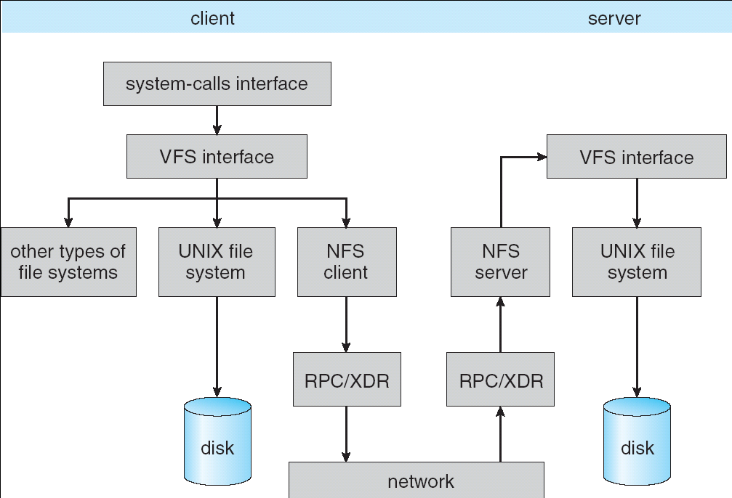
Schematic View of NFS Architecture

Slide 19
Network File System (NFS)
NFS Protocol: RPC for file operations on server
  Reading/searching a directory
  Manipulating links and directories
  Accessing file attributes/reading and writing files
Write-through caching: Modified data committed to server’s disk before results are returned to the client
  Lose some of the advantages of caching
  Time to perform write() can be long
  Need some mechanism for readers to eventually notice changes! (more on this later)

Slide 20
NFS Continued
NFS servers are stateless; each request provides all arguments require for execution
  E.g. reads include information for entire operation, such as ReadAt(inumber,position), not Read(openfile)
  No need to perform network open() or close() on file – each operation stands on its own
Idempotent: Performing requests multiple times has same effect as performing it exactly once
  Example: Server crashes between disk I/O and message send, client resend read, server does operation again
  Example: Read and write file blocks: just re-read or re-write file block – no side effects
  Example: What about “remove”? NFS does operation twice and second time returns an advisory error

Slide 21
NFS Continued
Failure Model: Transparent to client system
  Is this a good idea? What if you are in the middle of reading a file and server crashes?
  Options (NFS Provides both):
    Hang until server comes back up (next week?)
    Return an error. (Of course, most applications don’t know they are talking over network)

Slide 22
NFS Cache consistency
NFS protocol: weak consistency
  Client polls server periodically to check for changes
    Polls server if data hasn’t been checked in last 3-30 seconds (exact timeout it tunable parameter).
    Thus, when file is changed on one client, server is notified, but other clients use old version of file until timeout.
  What if multiple clients write to same file?
    In NFS, can get either version (or parts of both)
    Completely arbitrary!
cache
F1 still ok?
F1:V2
F1:V1
No: (F1:V2)
Client
Write (RPC)
Server
cache
ACK
F1:V2
cache
F1:V2
Client

Slide 23
NFS Pros and Cons
NFS Pros:
  Simple, Highly portable
NFS Cons:
  Sometimes inconsistent!
  Doesn’t scale to large # clients
    Must keep checking to see if caches out of date
    Server becomes bottleneck due to polling traffic

Slide 24
Andrew File System
Andrew File System (AFS, late 80’s) → DCE DFS (commercial product)
Callbacks: Server records who has copy of file
  On changes, server immediately tells all with old copy
  No polling bandwidth (continuous checking) needed
Write through on close
  Changes not propagated to server until close()
  Session semantics: updates visible to other clients only after the file is closed
    As a result, do not get partial writes: all or nothing!
    Although, for processes on local machine, updates visible immediately to other programs who have file open
In AFS, everyone who has file open sees old version
  Don’t get newer versions until reopen file

Slide 25
Andrew File System (con’t)
Data cached on local disk of client as well as memory
  On open with a cache miss (file not on local disk):
    Get file from server, set up callback with server
  On write followed by close:
    Send copy to server; tells all clients with copies to fetch new version from server on next open (using callbacks)
What if server crashes? Lose all callback state!
  Reconstruct callback information from client: go ask everyone “who has which files cached?”

Slide 26
Andrew File System (con’t)
AFS Pro: Relative to NFS, less server load:
  Disk as cache ⇒ more files can be cached locally
  Callbacks ⇒ server not involved if file is read-only
For both AFS and NFS: central server is bottleneck!
  Performance: all writes→server, cache misses→server
  Availability: Server is single point of failure
  Cost: server machine’s high cost relative to workstation

Slide 27
Administrivia
MIDTERM II 5:30-7pm in 145 Dwinelle (A-L) and 2060 Valley LSB (M-Z)
  Review: 306 Soda 7-9pm, Sunday Dec 1
  Covers Lectures #14-24, projects, and readings
  One sheet of notes, both sides
Project 4 Initial Design Due Monday

Slide 28
5min Break

Slide 29
Quiz 23.1: RPC and NFS
Q1: True _ False _ RPC requires special networking support and functionality
Q2: True _ False _ The client and server for RPC must use the same hardware architecture (e.g., little endian)
Q3: True _ False _ Local procedure call << same-machine RPC << remote machine RPC
Q4: True _ False _ NFS provides weak client-server data consistency

Slide 30
Quiz 23.1: RPC and NFS
Q1: True _ False _ RPC requires special networking support and functionality
Q2: True _ False _ The client and server for RPC must use the same hardware architecture (e.g., little endian)
Q3: True _ False _ Local procedure call << same-machine RPC << remote machine RPC
Q4: True _ False _ NFS provides weak client-server data consistency
X
X
X
X

Slide 31
Distributed Object-Oriented Systems
Distributed systems, like any complex software benefit from careful software architecture, especially object-oriented programming.
Major efforts were devoted to OOP distributed systems architectures:
CORBA (Common Object Request Broker Architecture)
DCOM (Distributed Component Object Model) from MS, which drew heavily from the open system DCE/DFS
These systems use remote methods, and add object proxying and even garbage collection.

Slide 32
Internet-Scale Distributed Computing
CORBA and DCOM were robust, powerful RPC-based distributed object systems. They were supposed to become the substrate for internet-scale distributed computing.
What happened? (they didn’t)
From last time:
  Morris worm
  Code Red
  Slammer ………………….
  which led to…
Ubiquitous firewalls, packet filters etc., across the internet.
HTTP (port 80) was the only reliable route to a remote host

Slide 33
Internet-Scale Distributed Computing
One approach is to tunnel other types of payload (other than HTTP) through port 80, and demultiplex at the server.
Usually, but not always, this works.
Instead many systems have used HTTP directly as a high-level transport for RPC. A cluster of technologies have developed around data messaging, RPC and distributed objects over HTTP:
  SOAP/WSDL
  REST
  and enabled by XML and JSON (JavaScript Object Notation)

Slide 34
WWW- SOAP RPC
SOAP covers the following four main areas:
A message format for one-way communication describing how a message can be packed into an XML document.
A description of how a SOAP message should be transported using HTTP (for Web-based interaction) or SMTP (for e-mail-based interaction).
A set of rules that must be followed when processing a SOAP message and a simple classification of the entities involved in processing a SOAP message.
A set of conventions on how to turn an RPC call into a SOAP message and back.

Slide 35
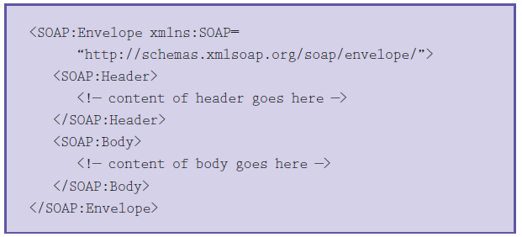
Soap Message
Typically an XML element containing header and body elements

Slide 36
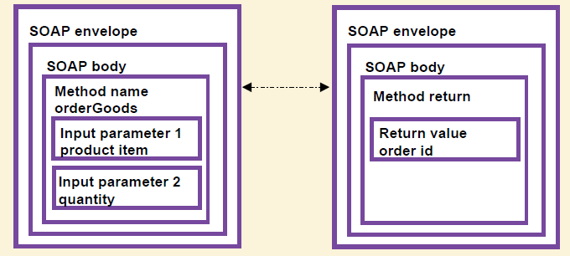
SOAP RPC
SOAP RPC messages typically encode arguments that are presented to the calling program as parameters and return values:

Slide 37

Soap RPC

Slide 38
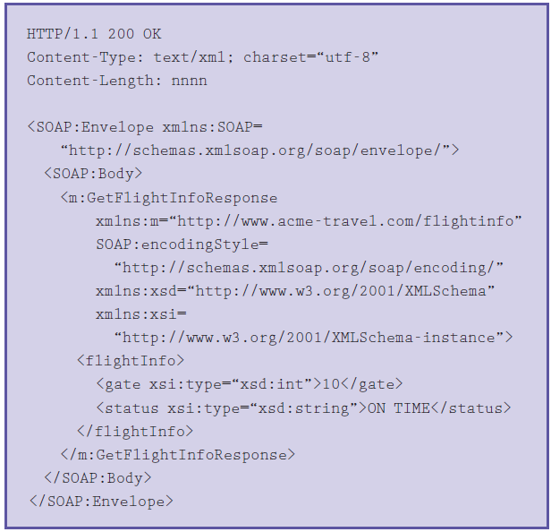
Soap Response

Slide 39
WSDL
Is “Web Services Description Language” an XML format for specifying metadata about a SOAP protocol.
WSDL is used to describe precisely
what a service does, i.e., the operations the service provides,
where it resides, i.e., details of the protocol specific address, e.g., a URL, and
how to invoke it, i.e., details of the data formats and protocols

Slide 40
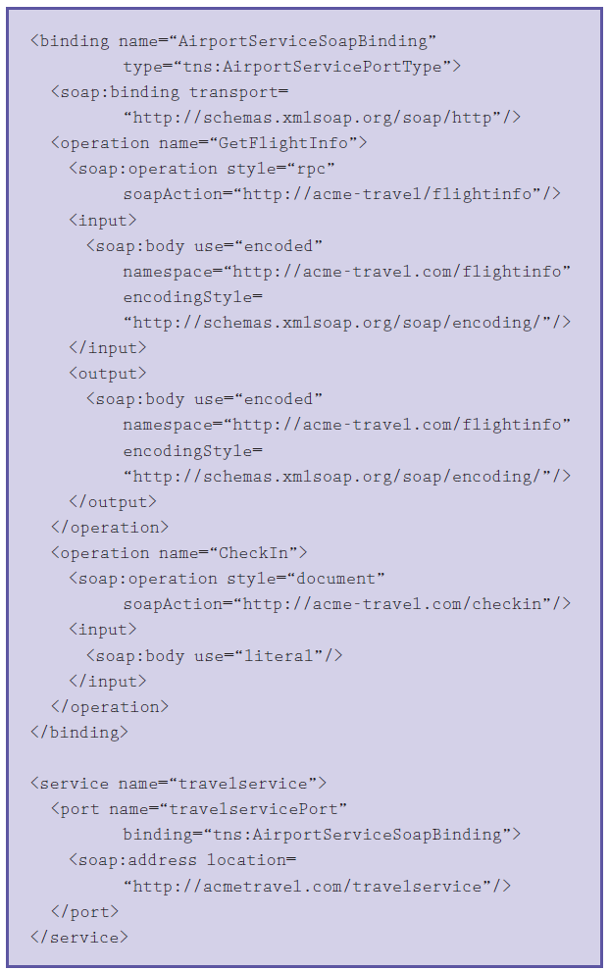
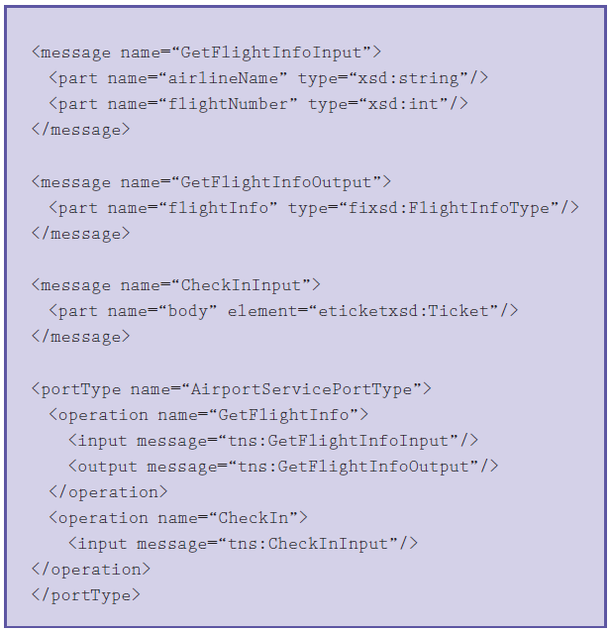
WSDL
Service Implementation section →
Service Interface section ↓

Slide 41
REST – “post RPC”
REpresentation State Transfer
Stateless Client/Server Protocol: Principles
Each message in the protocol contains all the information needed by the receiver to understand and/or process it. This constraint attempts to “keep things simple” and avoid needless complexity
Set of Uniquely Addressable Resources
  “Everything is a Resource” in a RESTful system
  Requires universal syntax for resource identification (e.g. URI)

Slide 42
REST
Set of Well-Defined Operations that can be applied to all resources
  In context of HTTP, the primary methods are
  POST, GET, PUT, DELETE
  these are similar (but not exactly) to the database notion of
  CRUD (Create, Read, Update, Delete)
The use of Hypermedia both for Application Information and State Transitions
  Resources are typically stored in a structured data format that supports hypermedia links, such as XHTML or XML

Slide 43
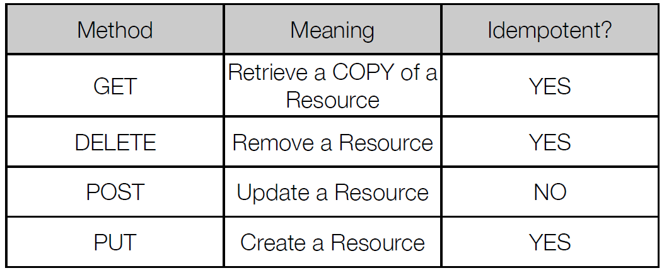
REST
Idempotency: repeated application of the operation does not change the state of the target

Slide 44
REST example
<user>
<name>Jane</name>
<gender>female</gender>
<location href="http://www.example.org/us/ny/new_york">
New York City, NY, USA</location>
</user>
This documentation is a representation used for the User resource
It might live at http://www.example.org/users/jane/
If a user needs information about Jane, they GET this resource
If they need to modify it, they GET it, modify it, and PUT it back
The href to the Location resource allows savvy clients to gain access to its information with another simple GET request
Implication: Clients cannot be “thin”; need to understand resource formats

Slide 45
REST vs. RPC
In RPC systems, the design emphasis is on verbs
What operations can I invoke on a system?
getUser(), addUser(), removeUser(), updateUser(), getLocation(), updateLocation(), listUsers(), listLocations(), etc.
In REST systems, the design emphasis is on nouns
User, Location
In REST, you would define XML representations for these resources and then apply the standard methods to them

Slide 46
Conclusion
Remote Procedure Call (RPC): Call procedure on remote machine
  Provides same interface as procedure
  Automatic packing and unpacking of arguments without user programming (in stub)
Distributed File System:
  Transparent access to files stored on a remote disk
    NFS uses caching for performance
SOAP and WSDL:
  An RPC protocol and an RPC description format
REST:
  Simplicity of RPC without any state and without “verbs”
Notes:
Finished at 5:15 for HKN

