Slide 1

Building a Better DNS
“He who controls the past commands the future.
He who commands the future conquers the past.”
- Orwell, “1984”
Prepared by: Ross Wm. Rader (ross@tucows.com)

Slide 2

Overview
How did we get here?
  The roots of DNS
Where is here?
  ICANN Structure, Industry Structure and where we all fit in…
What next?
  Concrete areas where we can make a difference

Slide 3
Goals
Take a look at the history that got us here.
Answer some questions…for example:
  Why is ICANN important to everyone that uses the Internet?
  What role does the U.S. government play behind the scenes?
  Where ICANN is going with new gTLDs?
Why is *your* involvement crucial?
  …and that means your customers as well!

Slide 4
The Ancient History
DNS has long been governed by technicians and politicians.
It is difficult to look back through the digital record and decipher the actual events.
  Mailing list archives incomplete
  Web pages move or no longer exist
  People leave the business and retire to tropical islands without telephones

Slide 5
The Ancient History
ARPAnet NIC created in 1967 by Doug Engelbart
  DNS did not exist
    The network was small
    Users knew how to get around
    It was however that a directory service would be important at some point
  Host mnemonics (RFC 226) “invented” by Karp in 1971
    The first real roots of “DNS”

Slide 6
The Ancient Hoststory
Karp created “HOSTS.TXT” as a first step
  Centrally administered
  Manual
  Not scalable
    Collisions
    Mistakes

Slide 7
The Ancient History
RFC 799 penned in 1981 by Dr. David Mills
  First explicit statement of “DNS”
  Goal: “…The emerging intercommunity mail forwarding of the time was highly fragmented and ad hoc. Everyone knew that the mail world would eventually be fragmented according to conventional organizational principles. My Interest [in creating Internet Name Domains] were more focused on the mechanics of doing this and on mail forwarding principles for the Internet. Not the least of my concerns were the mechanisms for handing mail between forwarders and handling errors as they might develop…” (Interview w/ Mills)
  Challenge: “It will not be practicable for every internet host to include all Internet hosts in its name-address tables.” (RFC 799)
  Solution: RFC 819

Slide 8
Ancient History
RFC 819
  Penned in 1982 by Jon Postel (ISI) and Zaw-Sing Su (SRI)
  Provided a general outline of the DNS structure
  Illustrated easier cross-network access
  Provided a solid foundation for Mockapetris RFC 882 and 883
    882/883 later obsoleted by the canonical 1034/1035
      Outlined a completely new way of managing host lookups
      Introduced “delegation” and “authority”.

Slide 9
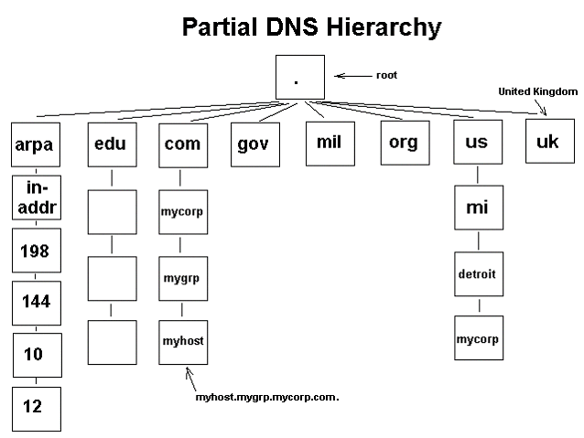
Sidetrip: Delegation/Authority
D/A is the basis upon which all power and conflict in the DNS is derived

Slide 10
Ancient History
881/882 outlined the basic precepts
920 outlined the plan of work (Postel/Reynolds)
  Included the initial TLDs that should be created;
    .com, .net, .org, .edu, .gov, .mil and .arpa
      Also outlined the concept of a TLD for multi/meta organizations. Later assumed under .int
    outlined the plan for including country-related TLDs
      To use the two letter codes found in ISO-3166-1, Alpha 2

Slide 11
The Ancient History
The Postel/Mockapetris drafts made the DCA realize that a centralized management authority was necessary to oversee and coordinate the functions of the DNS.
  Cooperation with ARPAnet, MILnet and the DDN was of paramount importance.
  SRI chosen to manage “DDN-NIC”
    Precursor to InterNIC.

Slide 12
The Ancient History
1985 – the DNS finally works
  Four years have elapsed since Mills penned RFC 799 and 17 since the ARPAnet NIC was launched.
  “symbolics.com” or “think.com” were each the first domain name registered
    Depending on whom you talk to ;)
The Modern Age of DNS begins

Slide 13
The Ancient History
1986 – NSFnet created to separate traffic out from the DDN
  Merit awarded operations contract in 1987
1990 – ARPAnet retired, over 100,000 hosts on the network
  ARPAnet demonstrated that a globally distributed, fault-toleran, standards-based network was practical.

Slide 14
The Modern Age
DISA rebids DDN-NIC in 1991
  Contracted awarded to GSI in May.
  GSI outsourced to NSI, a small consulting firm in Virginia.
By 1992, NSI had outmaneuvered GSI and became the prime contractor to manage network services for NSFnet and NREN.

Slide 15
The Modern Age
NSF Cooperative Agreement # NCR-9218742
  “The non-military internet registration services to be provided under this agreement will initially include, but not be limited to, the following: Domain name registration, Domain name server registration, Network number assignment, Autonomous system number assignment”
The central nervous system of the Internet was now in the hands of the private sector.

Slide 16
The Modern Age
1994 – the Internet begins to get big
1995 – NSI strikes a deal with the NSF to charge $50 per year for a domain name registration in a bid to recoup operational costs.
  The NSF was eventually forced to drop 30% of the fee as it was found to be an illegal tax.
  Thousands of dollars were collected from non-US citizens and were not refunded when the “tax” was dropped.

Slide 17
The Modern Age
The “tax” set the Internet ablaze and sparked the beginning of the “DNS Wars”.
  Lines were drawn around the thorny issue of who *really* controlled the namespace –
    NSI?
    USG?
    The Internet?
  NSI singled out as a monopoly interest

Slide 18
The DNS Wars
Postel attempted to focus the debate by issuing his “iTLD” drafts in 1996.
  Based on prior work by Landweber and revised by Bush, Denninger and Carpenter.
  Defined the political structure of today’s DNS
  Sparked a continuing, unresolved debate about “DNS Governance”.

Slide 19
Side Trip: Draft Postel
Open competition for Registration Services
  Mute the NSI monopoly
Provide IANA with a financial and legal umbrella necessary to survive and coordinate.
Accepted by ISOC in July, 1996.

Slide 20
The DNS Wars
ISOC endorsement of Draft-Postel led the the founding of IAHC in October of 1996
  MISSION: “…undertake defining, investigating and resolving issues resulting from current international debate over a proposal to establish global registries and additional international [TLDs]…”
  Initial board included representatives from:
    ITU, WIPO, INTA, ISOC and IANA
  Created the concept of “registrar” and kicked-ff the new TLD debate.

Slide 21
The DNS Wars
IAHC issued its report concerning DNS governance in February, 1997
  Essentially Draft-Postel wrapped in compromise to satisfy the various interests at the table.
  Described in detail a new not-for-profit registrar consortium to run the registry operations
    CORE
  Became self-enacted through the gTLD-MoU

Slide 22
The DNS Wars
gTLD-MoU
  Some viewed it as simply a more complex version of Draft-Postel
  Others viewed it as the first step towards a New World Internet Government
  Largely pushed by insiders as a “done deal”
Dissident voices grew
  eDNS (Denninger, Kashpureff)
  The first “real” demonstration of “alt.roots”

Slide 23
The DNS Wars
eDNS imploded and Denninger largely dropped out of the picture
Two events conspired against the process however
  Kashpureff redirected traffic from one of the root servers (cache poisoning)
  Network Solutions corrupted the zone file
The DNS was indeed front page news and everyone now knew that the Internet was not indestructible
  …and was largely under the control of NSI

Slide 24
The DNS Wars
The Clinton Administration started to get involved;
  Magaziner drafted the White & Green Papers
NSI spun-off address assignments
  ARIN was created
The IAHC generally imploded with the creation of the IFWP process
  Backed by NSI

Slide 25
The DNS Wars
Postel again figured centrally and drafted the architecture of a new organization that would fulfill the requirements of the White Paper in mid-1998
  Advocated the creation of NewCo which eventually became ICANN
  Endorsed by the then CEO of NSI, Gabe Battista.
Postel passed away on October 16, 1998 but not before he set the cornerstone for the new IANA – ICANN.
  ICANN was confirmed by the DOC in late 1998 and finally recognized by NSI/SAIC in late 1999.

Slide 26
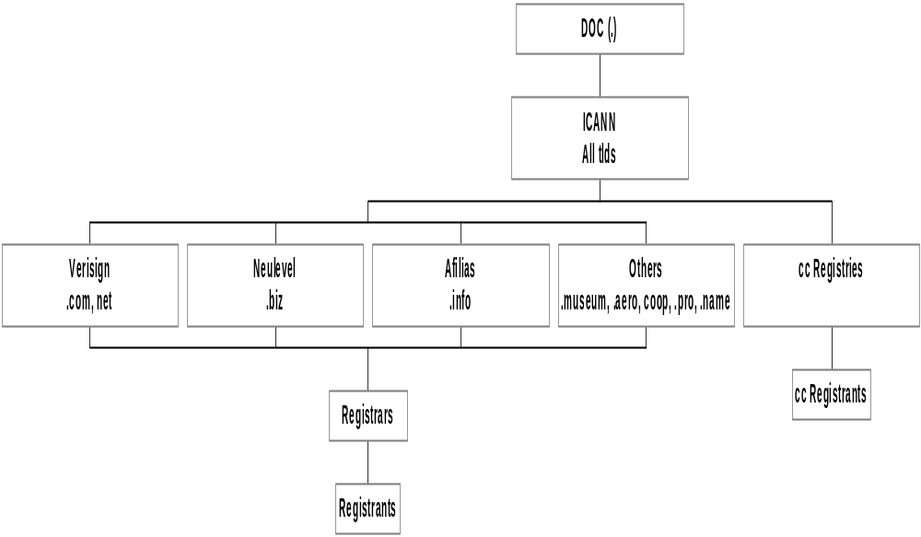
State of the Names

Slide 27
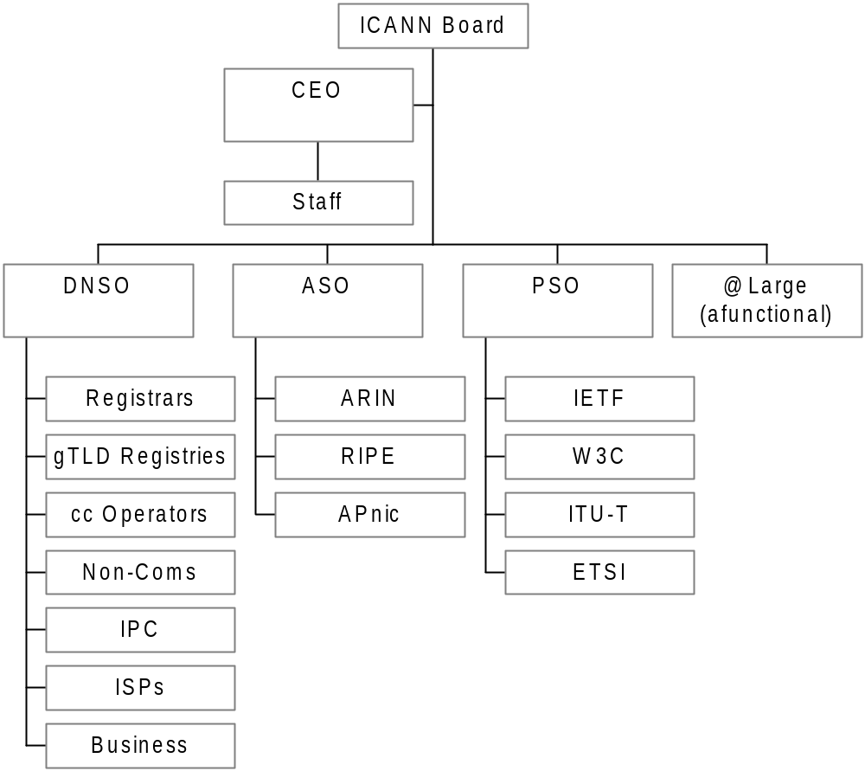
ICANN Structure

Slide 28
Where do *I* fit in?
Current ISP/C Membership
  ABRANET AFA ANIEL British Telecom Cabase Cabinet Oy CAIP CAFEnet Chunghwa Telecom CIX Concentric Network CSL Deutsche Telekom eCOMLAC ETNO ETSI EuroISPA Eurotel Excite@Home France Telecom Global Crossing IAWH InfraServ Gendorf Interland ISPC Knipp Gmbh KPNQwest Finland Oy Mindspring NTT Professional Internet Telia World.net Korea Telecom SDNP Verio Freebuyers Net Genuity
38 Telco’s, BigCo’s and the odd association.
The interests of the average xSP are not well represented within ICANN.

Slide 29


Why should I fit in?
The policies that ICANN creates and administers have a direct and measurable impact on your business
  Transferring registrations
  Trademark disputes
  Costs
  Privacy
  …ad nauseum…
  ICANN is undergoing structural reform as we speak, there are very few times where you will be able to make as much of a difference as you can now.
        “Heathrow Declaration”

Slide 30
Q&A
Presentation, references and resources can be found at:
http://www.byte.org/ispbe2002
Thanks!
Ross Wm. Rader
ross@tucows.com

