Slide 1
Review & Outlook
Client template | Season review and preparation for the next campaign_x000B_
[Client] | [Meeting date]

Slide 2

SEASON REVIEW
Tangible results, a shared plan for what comes next
3

Slide 3
The season in numbers: establishing a common baseline
QUANTITATIVE REVIEW
Metric (all SMS combined) | Year N-2 result | Year N-1 result | Year N result | Change vs. N-1
Syngenta sales to distributor | [Revenue €] | [Revenue €] | [Revenue €] | [%]
Syngenta market share at distributor | [%] | [%] | [%] | [%]
Syngenta market share by hectares at farmer sales | [%] | [%] | [%] | [%]
4

Slide 4
Product review
REVENUE CHANGE BY PRODUCT
Product | Quantity ordered N-1 (specify unit) | Quantity ordered N (specify unit) | Change vs. N-1 | Revenue N-1 | CA N | Change vs. N-1
PRODUIT A | [ L ] | [ L ] | [ % ] | [ € ] | [ € ] | [ % ]
PRODUIT B | [ L ] | [ L ] | [ % ] | [ € ] | [ € ] | [ % ]
PRODUIT C | [ L ] | [ L ] | [ % ] | [ € ] | [ € ] | [ % ]
PRODUIT D | [ L ] | [ L ] | [ % ] | [ € ] | [ € ] | [ % ]
PRODUIT E | [ L ] | [ L ] | [ % ] | [ € ] | [ € ] | [ % ]
PRODUIT F | [ L ] | [ L ] | [ % ] | [ € ] | [ € ] | [ % ]
PRODUIT G | [ L ] | [ L ] | [ % ] | [ € ] | [ € ] | [ % ]
PRODUIT H | [ L ] | [ L ] | [ % ] | [ € ] | [ € ] | [ % ]
PRODUIT I | [ L ] | [ L ] | [ % ] | [ € ] | [ € ] | [ % ]
4

Slide 5
Review by market segment
CHANGE IN SYNGENTA SALES (amounts in €)
Market segments | Sales N-2 | Sales N | Sales N | Change vs. N-1
Cereal fungicides | [€] | [€] | [€] | [%]
Cereal herbicides | [€] | [€] | [€] | [%]
In-crop insecticides | [€] | [€] | [€] | [%]
Biostimulants | [€] | [€] | [€] | [%]
Corn herbicides | [€] | [€] | [€] | [%]
Oilseed rape fungicides | [€] | [€] | [€] | [%]
TOTAL | [€] | [€] | [€] | [%]
4

Slide 6
Review by market segment
CHANGE IN SYNGENTA MARKET SHARE BY HECTARES AT FARMER SALES
Market segments | Market share by hectares N-2 | Market share by hectares N-1 | Market share by hectares N | Change vs. N-1
Cereal fungicides | [%] | [%] | [%] | [%]
Cereal herbicides | [%] | [%] | [%] | [%]
In-crop insecticides | [%] | [%] | [%] | [%]
Biostimulants | [%] | [%] | [%] | [%]
Corn herbicides | [%] | [%] | [%] | [%]
Oilseed rape fungicides | [%] | [%] | [%] | [%]
TOTAL | [%] | [%] | [%] | [%]
4

Slide 7
Example: cereal herbicides
Review by market segment
CHANGE IN ORDER QUANTITIES
CEREAL HERBICIDES | Quantity ordered N-2 | Quantity ordered N-1 | Quantity ordered N | Change vs. N-2 | Change vs. N-1
Product A
Product B
Product C
Product D
Product E
Product F
Product G
4
Notes:
Exemple des Herbicides céréales

Slide 8
Link results to priority crops and opportunities
QUALITATIVE REVIEW
Crop / area | Opportunity / offer | Result & variance | Validated takeaway
[Crop / area] | [Product / offer] | [result vs. target] | [gain, loss or obstacle]
[Crop / area] | [Product / offer] | [result vs. target] | [team / customer feedback]
[Crop / area] | [Product / offer] | [result vs. target] | [competitive / market context]
[Crop / area] | [Product / offer] | [result vs. target] | [action to repeat / adjust]
5

Slide 9
OUTLOOK
Projections for the next campaign
3
Classification: INTERNAL USE ONLY

Slide 10
Your priorities set the direction for the next campaign
YOUR PRIORITIES
Crops & areas
Priority customers
Value proposition
Teams & service
Choose the crops and territories where farmer needs and potential are clearest.
Define the customer segments to support based on the distributor’s growth and value objectives.
Build clear proposals with comparable, validated economic elements.
Identify field teams’ needs for commercial and technical support, and product availability.
6

Slide 11
Prepare next campaign opportunities by crop
OUTLOOK
Crop / opportunity | Opportunity to explore | Item to validate together | Next step
Cereals — fungicides | [local need / opportunity] | Technical relevance, approved uses and current timing | [trial / targeting / date]
Corn — herbicides | [pre-emergence / post-emergence] | Local issue, positioning and available offer | [field plan / date]
Relevant crops — soil protection | [protection need to be confirmed] | Conditions of use, availability and field feasibility | [technical review / stock]
Other priority crop | [to be completed with the customer] | Potential, farmer need and approved solution | [owner / date]
7

Slide 12
Prepare for the next campaign with four priorities
OUTLOOK
Crop priorities
Portfolio
Launches & projects
Support
Select the crops, territories and opportunities where the distributor sees a concrete customer need.
Confirm which offers to maintain, develop or test; verify approved uses and up-to-date product information.
Prioritize new products and co-developed projects based on timing, expected value and execution capacity.
Plan commercial support, technical expertise, stewardship and check-ins ahead of key decision periods.
7

Slide 13
Decisions and next steps
CONCLUSION & ACTIONS
Agreed action | Owner | Deadline / measure
Validate season figures and key learnings | [Syngenta + distributor] | [date / validated data]
Finalize priority crops, opportunities and offers | [owner] | [date / approved list]
Finalize stock plan and field activation | [owner] | [date / shared plan]
Launch joint campaign tracking | [named leads] | [date / frequency / metric]
9

Slide 15
Appendix

Slide 16
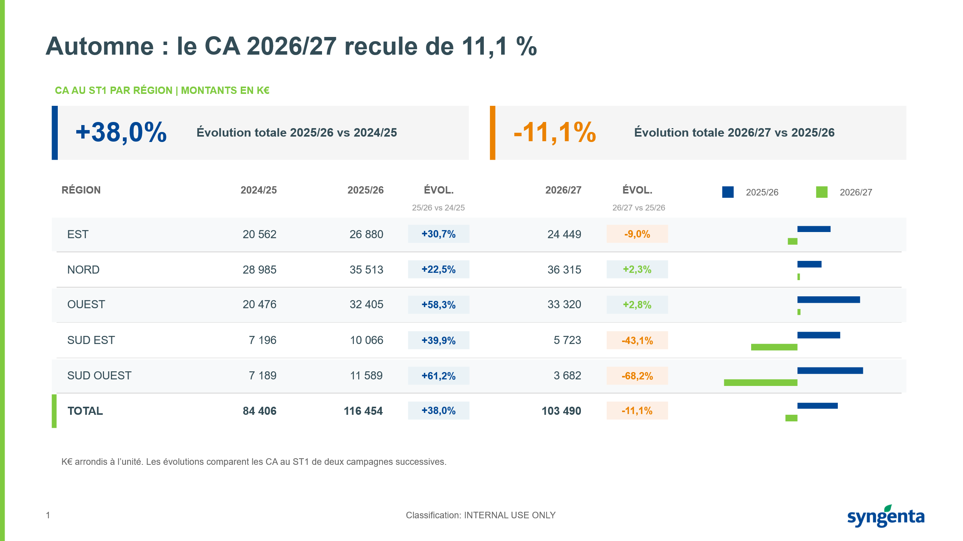
Reference – Visual format for tables & KPIs

