Slide 1
Communities in graphs

Slide 2
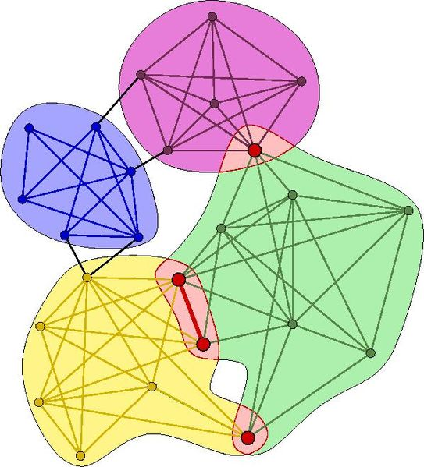
Communities in graphs are groups of nodes such that the nodes within a group are much more connected to each other than the rest of the network.

Slide 3
