Slide 1
Dimensionality Reduction Framework for detection of multiscale Community Structure

Slide 2
Problem Statement
Many Complex networks in the real world like biological , social , information networks can be modeled as graphs or networks.
These complex networks are found to naturally divide into communities.
Previous methods show division of a network into single scale communities i.e. only two communities , whereas multiple communities are often found to provide more information.

Slide 3
Problem Statement (continued)
We consider the detection of multiscale community structure by introducing a novel framework based on dimensionality reduction.
Under this framework, we show that community detection can be viewed as Principal Component Analysis, a major dimensionality reduction method, on the high dimensional description of networks.

Slide 4
System Design
Dataset
Laplacian
Modularity
Laplacian Matrix
Modularity Matrix
svd
svd
Eigen values and Eigenvectors of the matrix
Eigen values and Eigenvectors of the matrix
Single_scale
Multi_scale
Single scale Detection
Multi scale detection

Slide 5
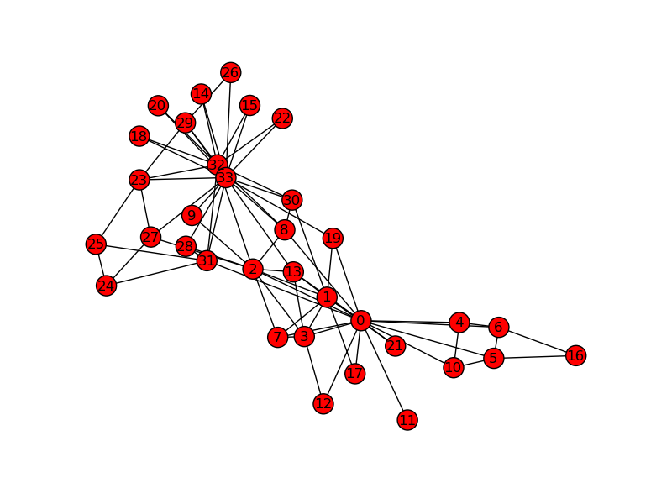
Input

Slide 6
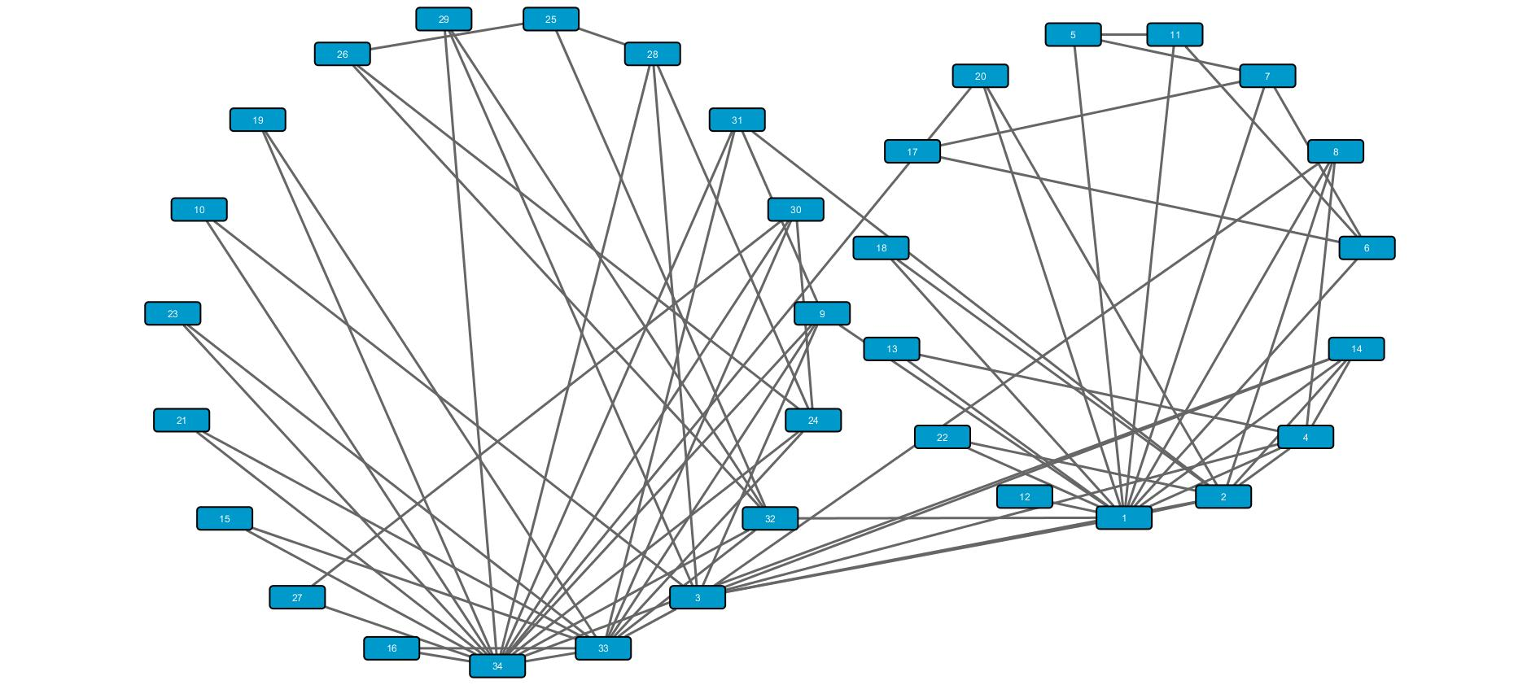
Result

Slide 7
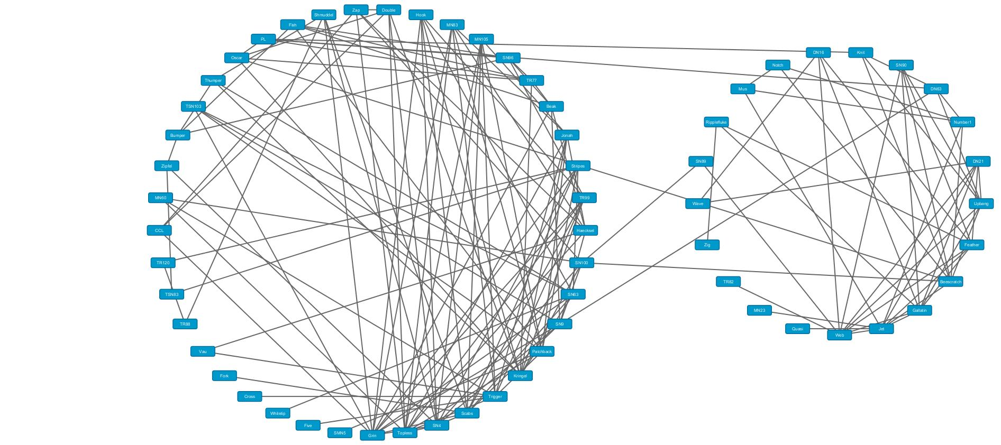

Slide 8
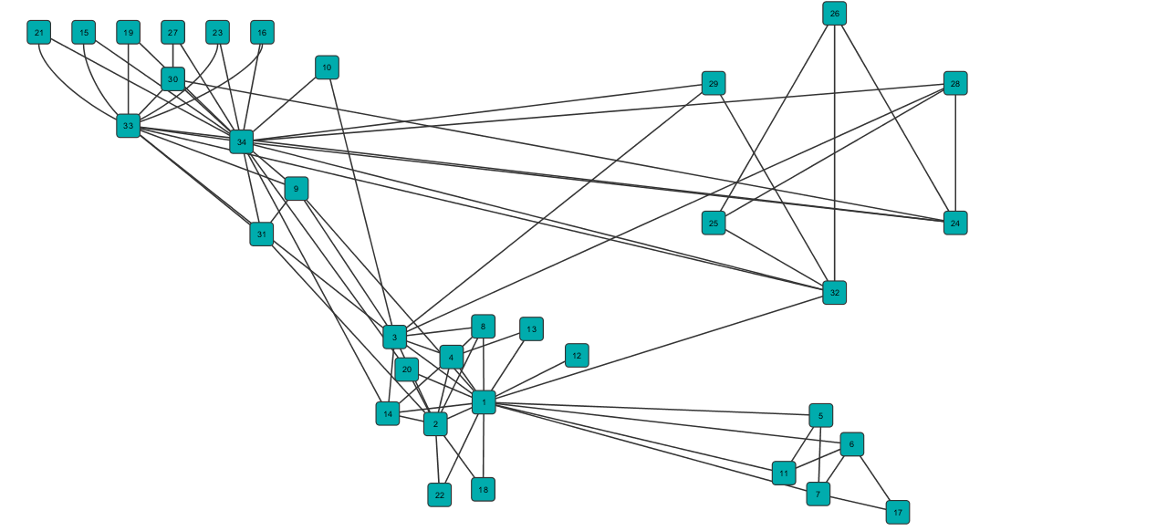

Slide 9
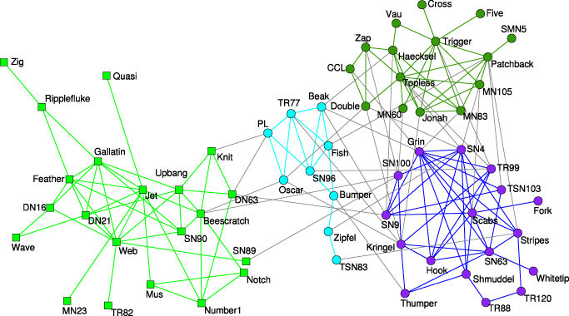

Slide 10
Conclusion
In this project, we observed the problem of detecting multiscale community structure in networks under a new framework of dimensionality reduction. This framework views community detection as a process of transforming a high-dimensional representation of a network, where each node is one dimension, to a low- dimensional representation, where each dimension corresponds to a community. The main contributions of this project are as follows:

Slide 11
1) We developed a dimensionality reduction frame- work for the detection of multiscale community structure of networks. This framework provides a uniﬁed explanation to the role of the Laplacian matrix for graph partitioning and the modularity matrix for community detection.

Slide 12
2) Based on the new framework, we revealed that existing methods based on Laplacian and modularity matrices cannot eﬀectively detect multiscale communities. We proposed to use the eigengaps of the covariance matrices to identify diﬀerent topological scales. We then proposed a new method for detecting multiscale communities which uses signiﬁcant eigenvectors to project network nodes into low-dimensional vectors and clusters those vectors into multiscale communities.

