Slide 1
UE23CS320A – Project Phase 2 Review
A Deep Learning and Generative AI-Driven Diet Recommendation System for Personalized Chronic Disease Management
Phase 2 review deck aligned to the ISA structure, updated with current preprocessing, model benchmarking, and terminal validation.
Project ID: 17
Guide: Dr. Saritha
Team: Vatsal Jain | Vivek Tutika | Pranav Shetty | Sourabh S Hegde
Updated review deck prepared from the current repository state on April 19, 2026.

Slide 2
Problem Statement
02 / 17
Problem Statement
The core challenge remains adaptive and medically safe nutrition guidance for chronic disease patients.
Clinical Gaps
System Gaps
Our Phase 2 Focus
• Existing diet tools are still mostly generic and one-size-fits-all.
• Patients need disease-aware recommendations for CKD, diabetes, and hypertension.
• Trust falls when the system cannot explain risk or adapt to real intake patterns.
• No dynamic feedback loop means meal deviations are rarely recalibrated safely.
• Risk prediction fails if preprocessing collapses important clinical features.
• A robust backend needs both predictive accuracy and clear deployment logic.
• Stabilize preprocessing first.
• Train viable disease-risk models next.
• Use those outputs as the entry point for meal calibration in the next phase.
This slide keeps the same ISA heading but updates the project status to the current backend milestone.

Slide 3
Abstract and Scope
03 / 17
Abstract and Scope
Phase 2 narrows the implementation to a working risk-model backbone before meal synthesis.
Current Scope
What Is In Progress
• Build reliable disease-risk prediction for CKD, hypertension, and diabetes.
• Serve predictions through the backend and terminal interfaces.
• Keep the architecture modular so nutrition generation can sit on top of validated risk outputs.
• Meal recommendation logic already exists as a rule-based backend layer.
• Risk thresholds and top disease factors are now regenerated from full-feature models.
• The next implementation step is raw patient input mapping into these disease-specific feature spaces.
Scope remains focused on T2DM, CKD, and Hypertension, with future meal calibration planned immediately after model stabilization.

Slide 4
Suggestions from Phase 1
04 / 17
Suggestions from Phase 1
The review suggestions were used as direct decision criteria for the current data pipeline.
Panel Suggestion
What We Changed
Outcome
• Do not depend on synthetic datasets.
• Avoid overloading the system with too many disconnected AI ideas.
• Choose the most efficient model stack instead of the most complex one.
• Audited the large amalgamated tables instead of assuming they were useful.
• Removed the sparse BRFSS-heavy serving path after verifying key columns collapsed to constants.
• Shifted to full-feature disease-specific datasets for training and serving.
• Project models are now all Random Forest classifiers.
• Each model aligns to a dataset with real usable features.
• Terminal prediction and backend validation are now consistent with the trained artifacts.
Phase 2 execution follows the panel advice more closely than the earlier broad pipeline.

Slide 5
Requirement Specification
05 / 17
Requirement Specification
The current backend milestone already covers the core disease-risk and reporting layer.
Functional Requirements
Non-Functional Requirements
• Disease-wise risk prediction through trained models.
• Threshold-aware risk reporting with top factors.
• Meal-plan recommendation endpoint and meal deviation logging.
• Terminal and API access for live demos and panel verification.
• Modular preprocessing and retraining workflow.
• Explainable factor reporting for clinical interpretation.
• Low-friction terminal demo path for review screenshots.
• Separation between stable risk modeling and future nutrition calibration work.
Backend endpoints currently available: /predict-risk, /recommend-plan, /log-meal, /risk-report.

Slide 6
Confirmed Datasets
06 / 17
Confirmed Datasets
The overall system uses an amalgamation of nutrition, survey, and disease-specific data sources.
Nutrition Knowledge Base
Disease and Public Health Sources
Source Site Names
• IFCT 2017 from ICMR-NIN.
• Indian Food Recipes Dataset from Mendeley Data.
• Open Food Facts India for packaged-food coverage.
• These support nutrient lookup and future meal calibration.
• UCI Machine Learning Repository for CKD.
• Kaggle disease datasets for Hypertension and Diabetes.
• CDC BRFSS annual public files.
• CDC NHANES 2017-2018 merged clinical records.
• UCI Machine Learning Repository
• Kaggle
• Framingham Heart Study
• Pima Indians Diabetes Dataset
• CDC BRFSS Annual Data
• CDC NHANES 2017-2018
• ICMR-NIN IFCT 2017
• Mendeley Data
• Open Food Facts India
Amalgamated sources were audited separately from the final serving datasets to avoid low-quality feature collapse.

Slide 7
Temporary Datasets
07 / 17
Temporary Datasets
Active disease-risk training now uses full-feature clinical datasets instead of sparse merged survey tables.
CKD dataset
Hypertension dataset
Rows: 400
Target: class
Source site(s): UCI Machine Learning Repository
Rows: 4240
Target: prevalentHyp
Source site(s): Kaggle (Framingham Heart Study dataset)
Columns:
age, bp, sg, al, su, rbc, pc, pcc, ba, bgr, bu, sc, sod, pot, hemo, pcv, wbcc, rbcc, htn, dm, cad, appet, pe, ane, class
Columns:
male, age, education, currentSmoker, cigsPerDay, BPMeds, prevalentStroke, diabetes, totChol, sysBP, diaBP, BMI, heartRate, glucose, TenYearCHD, prevalentHyp
Serving feature lists exactly match these column sets after preprocessing and retraining.

Slide 8
Temporary Datasets
08 / 17
Temporary Datasets
Diabetes remains active for serving; BRFSS and NHANES remain useful as audit/reference sources.
Diabetes dataset
Amalgamated Public Sources
Rows: 768
Target: Outcome
Source site(s): Kaggle (Pima Indians Diabetes dataset)
• CDC BRFSS 2016-2024 and CDC NHANES 2017-2018 were ingested and audited locally.
• They are still useful as reference sources for feature enrichment and future scaling.
• However, their current merged disease tables were not retained for serving because several lab and BP columns became all-missing or constant.
• The active model pipeline therefore uses the disease-specific datasets shown on Slides 7 and 8.
Columns:
Pregnancies, Glucose, BloodPressure, SkinThickness, Insulin, BMI, DiabetesPedigreeFunction, Age, Outcome
Audit report generated at reports/current/data_audit_summary.json.

Slide 9
Temporary Datasets
09 / 17
Temporary Datasets
Benchmarking now shows the selected project models clearly against the baseline family.
Commands for screenshot: training + benchmark
Set-Location "d:/sem 6/capstone/Sem_6_Capstone"
& ".\.venv\Scripts\python.exe" scripts\preprocess_all_datasets.py --source legacy
& ".\.venv\Scripts\python.exe" scripts\train_models.py --data-source preprocessed
& ".\.venv\Scripts\python.exe" scripts\build_risk_profiles.py
& ".\.venv\Scripts\python.exe" scripts\benchmark_baseline_models.py
Commands for screenshot: terminal prediction
& ".\.venv\Scripts\python.exe" scripts\predict_from_terminal.py --disease ckd --show-template
& ".\.venv\Scripts\python.exe" scripts\predict_from_terminal.py --input demo_inputs\terminal_samples\ckd_sample_1.json
& ".\.venv\Scripts\python.exe" scripts\predict_from_terminal.py --input demo_inputs\terminal_samples\hypertension_sample_1.json
& ".\.venv\Scripts\python.exe" scripts\predict_from_terminal.py --input demo_inputs\terminal_samples\diabetes_sample_1.json
& ".\.venv\Scripts\python.exe" scripts\backend_smoke_test.py
Project model used in all three diseases: RandomForestClassifier.

Slide 10
Design Approach
10 / 17
Design Approach
The implementation keeps the original hybrid design, but Phase 2 is centered on a stronger risk-model core.
Approach Followed
Why This Approach
Phase 2 Benefit
• Layered modular architecture from client to backend to safety and reporting.
• Disease-wise preprocessing and model training instead of a single blended risk table.
• Rule-based meal logic remains downstream of validated risk inference.
• Pure generative output without reliable risk estimation is unsafe.
• Pure rules without predictive risk cannot personalize intensity or alerting.
• A stable model layer gives us the right handoff point into meal calibration.
• Cleaner artifacts.
• Repeatable retraining.
• Terminal and backend demos now match the same model definitions.
Current deployment path: preprocess -> train -> build thresholds -> backend/terminal inference.

Slide 11
Design Constraints, Assumptions & Dependencies
11 / 17
Design Constraints, Assumptions & Dependencies
The current backend is bounded by data realism, explainability, and safe handoff into nutrition logic.
Constraints
Assumptions
Dependencies
• Only clinically usable features should reach serving artifacts.
• Terminal demos must use the same artifact features as the backend.
• We avoid claiming meal calibration quality before risk prediction is stable.
• Disease datasets are small but feature-rich enough for Phase 2 benchmarking.
• Random Forest is currently the most reliable serving choice on these processed splits.
• Raw patient-friendly input mapping will be added in the next implementation step.
• Python + scikit-learn preprocessing/training stack.
• FastAPI backend and persisted model artifacts.
• Unified food knowledge base for the next meal-calibration milestone.
Backend smoke test passed after retraining and threshold regeneration.

Slide 12
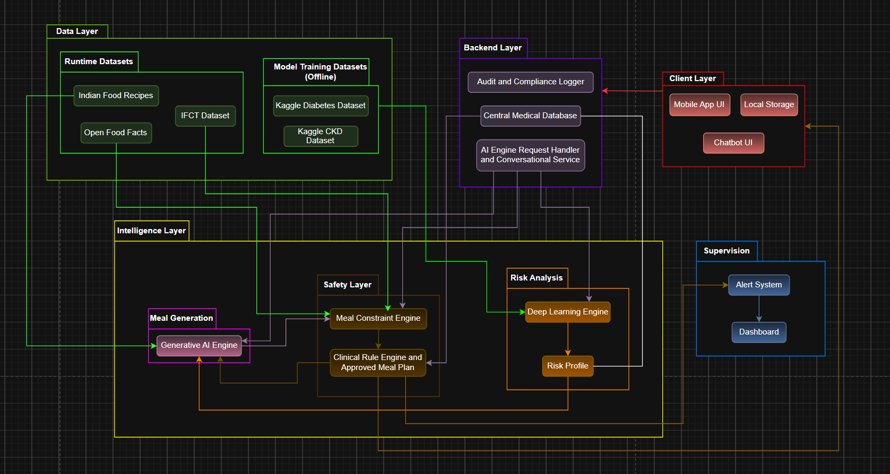
Architecture Diagram
12 / 17
Architecture Diagram
The architecture remains the same; the completed portion is now the risk-model and backend-serving path.
Implemented now: preprocessing, training, thresholds, backend inference, risk report, and terminal prediction.

Slide 13
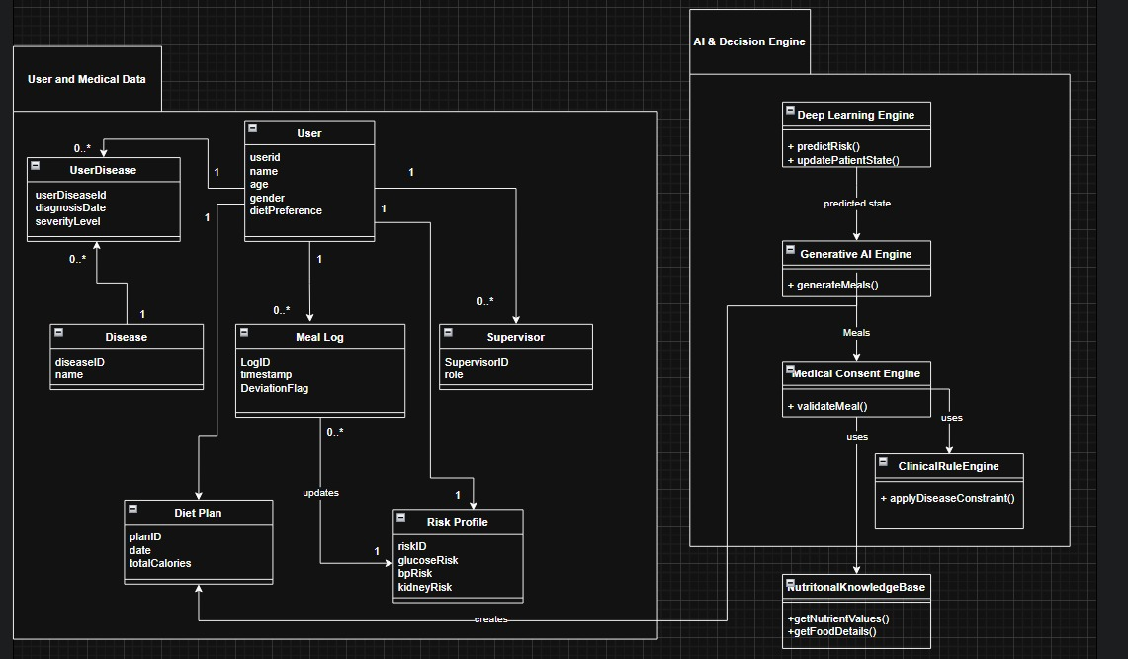
Master Class Diagram
13 / 17
Master Class Diagram
The review deck keeps the original system-structure slides so the panel can compare design intent to implementation progress.
Class diagram asset reused from the original review materials.

Slide 14
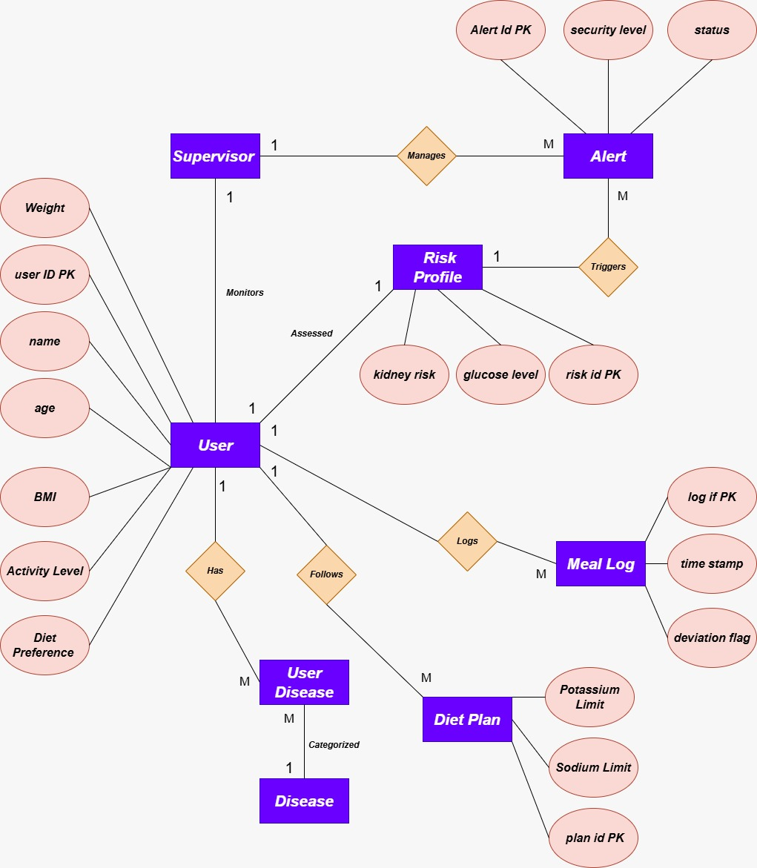
ER Diagram
14 / 17
ER Diagram
This still reflects the data-oriented view of the application and supervision flow.
ER diagram asset reused from the original review materials.

Slide 15
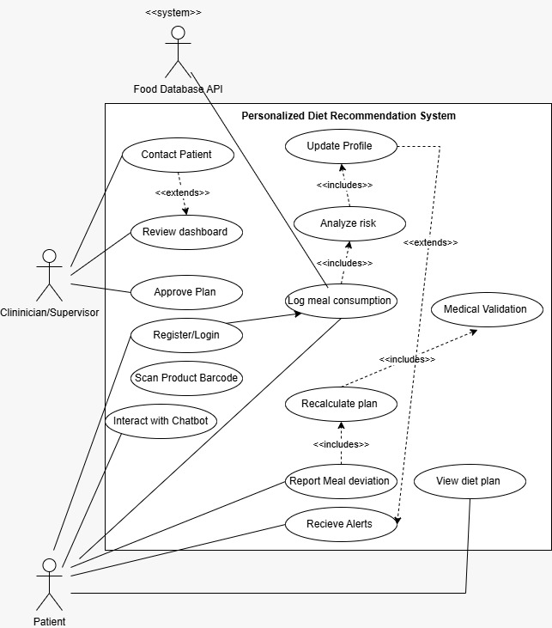
Use-Case Diagram
15 / 17
Use-Case Diagram
This remains relevant for the eventual app flow once risk prediction feeds meal calibration.
Use-case diagram asset reused from the original review materials.

Slide 16
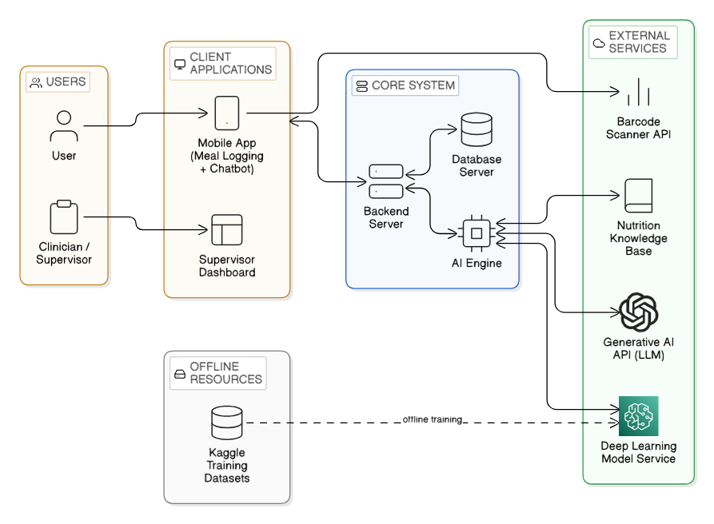
External Interface Diagram
16 / 17
External Interface Diagram
Terminal prediction and backend endpoints are the current externally demonstrable interfaces.
For the live demo, terminal and backend prediction paths are now aligned with the same artifacts.

Slide 17
Thank You
Serving models
CKD RF 150
HTN RF 150
DIAB RF 150
Smoke test: PASS
Current status:
• preprocessing fixed
• project models retrained
• baseline comparison complete
• terminal prediction working
Next step after this review: raw input mapping and nutrition/diet calibration.
Deck prepared from ISA_Review1 structure and the current repository outputs.

