Slide 1
UE23CS320A - Project Phase 2 Review
A Deep Learning and Generative AI-Driven Diet Recommendation System for Personalized Chronic Disease Management
Updated review deck using the same ISA-1 headings with refreshed dataset counts, source sites, benchmark comparison, full-train model status, and terminal demo steps.
Project ID: 17
Guide: Dr. Saritha
Team: Vatsal Jain | Vivek Tutika | Pranav Shetty | Sourabh S Hegde
Prepared from the repository state on April 19, 2026.

Slide 2
Problem Statement
02 / 17
Problem Statement
The project still targets safe, adaptive nutrition support, but Phase 2 focuses on making the disease-risk layer reliable first.
Clinical problem
Implementation problem
Phase 2 answer
- Generic diet tools ignore disease-specific risk and patient state.
- Unsafe recommendations can happen if prediction and nutrition layers drift apart.
- The system must explain risk before it can justify meal correction.
- Merged survey datasets can look large but still lose critical lab and blood-pressure columns.
- Terminal and backend demos break if model artifacts are too heavy or feature schemas are inconsistent.
- The review deck therefore needs current numbers, not earlier placeholders.
- Retrain project-final disease models on the large prepared splits.
- Keep benchmark comparison visible against baseline models.
- Make terminal prediction reproducible from the actual deployed artifacts.
Current implementation priority: stable disease prediction first, diet calibration next.

Slide 3
Abstract and Scope
03 / 17
Abstract and Scope
The scope is now a working disease-risk backbone that cleanly feeds the next meal recommendation step.
In scope now
Next scope after this review
- CKD, hypertension, and diabetes risk modeling.
- Preprocessing, training, benchmarking, threshold building, and terminal/API inference.
- Dataset audit notes, source tracking, and screenshot-ready demo commands.
- Raw patient-friendly input mapping into each disease feature space.
- Direct coupling of risk levels into the diet recommendation engine.
- End-to-end meal recalibration once the raw-input layer is finalized.
This keeps the original project vision but narrows the live demo to what is fully implemented now.

Slide 4
Suggestions from Phase 1
04 / 17
Suggestions from Phase 1
The Phase 1 review directly influenced the current implementation decisions.
Panel suggestions
What changed
Result
- Do not depend only on synthetic or weak placeholder data.
- Avoid spreading effort across too many disconnected ideas.
- Prioritize the most practical models and flows for the review demo.
- The project retained large amalgamated disease tables but audited them instead of trusting them blindly.
- The final artifacts were retrained with lighter, deployable models.
- The terminal demo inputs were updated to match the active feature schemas.
- Project-final models now load and predict in terminal.
- Training uses full 400k+ prepared splits per disease.
- The review deck can now cite exact row counts, columns, and source sites.
The present repo state reflects those review-driven corrections.

Slide 5
Requirement Specification
05 / 17
Requirement Specification
The current milestone satisfies the core risk-layer requirements needed for the next implementation step.
Functional requirements covered
Non-functional requirements covered
- Disease-wise preprocessing and train/test generation.
- Model artifact creation for CKD, hypertension, and diabetes.
- Terminal prediction from JSON input and template generation.
- Baseline comparison and threshold/factor reports.
- Repeatable commands for review screenshots.
- Smaller artifacts that can actually load for demo use.
- Clear source-site traceability for the amalgamated data.
- Explicit separation between current backend work and next-step diet calibration.
Current review assets now live under outputs/isa-review2 and reports/current.

Slide 6
Confirmed Datasets
06 / 17
Confirmed Datasets
The project is an amalgamation of disease, public-health, and nutrition sources.
Disease and public-health sources
Nutrition sources
What is confirmed here
- UCI Machine Learning Repository
- Framingham Heart Study
- Pima Indians Diabetes Dataset
- CDC BRFSS Annual Data
- CDC NHANES 2017-2018
- ICMR-NIN IFCT 2017
- Mendeley Data
- Open Food Facts India
- Kaggle support files where relevant
- Site names for the full data amalgamation are explicitly listed.
- Dataset row counts and column names are now documented per active serving dataset.
- Large train splits exceed 400k rows for every disease model.
Source sites used across the project: UCI Machine Learning Repository | Framingham Heart Study | Pima Indians Diabetes Dataset | CDC BRFSS Annual Data | CDC NHANES 2017-2018 | ICMR-NIN IFCT 2017 | Mendeley Data | Open Food Facts India | Kaggle.

Slide 7
Temporary Datasets
07 / 17
Temporary Datasets
Dataset detail for CKD and Hypertension.
CKD large serving dataset
Hypertension large serving dataset
File: medical datasets/large/ckd_large.csv
Rows: 455,590 | Columns: 10
Training rows used for final model: 690,956
Target: ckd_label
Final model: DecisionTreeClassifier
File: medical datasets/large/hypertension_large_500k.csv
Rows: 500,000 | Columns: 13
Training rows used for final model: 785,242
Target: prevalentHyp
Final model: LogisticRegression
Columns:
age, male, BMI, sysBP, diaBP, glucose, diabetes, prevalentHyp, source, ckd_label
Columns:
male, age, education, currentSmoker, cigsPerDay, prevalentStroke, BMI, sysBP, diaBP, glucose, diabetes, source, prevalentHyp
Sites used in amalgamation:
CDC BRFSS Annual Data
CDC NHANES 2017-2018
UCI Machine Learning Repository
Sites used in amalgamation:
CDC BRFSS Annual Data
Framingham Heart Study
These cards include rows, columns, training rows used, model used, column names, and source-site names.

Slide 8
Temporary Datasets
08 / 17
Temporary Datasets
Dataset detail for Diabetes plus the current 400k+ training proof.
Diabetes large serving dataset
Training proof and caveat
File: medical datasets/large/diabetes_large_500k.csv
Rows: 500,000 | Columns: 10
Training rows used for final model: 754,970
Target: diabetes
Final model: GaussianNB
- CKD train split used for the final model: 690,956 rows.
- Hypertension train split used for the final model: 785,242 rows.
- Diabetes train split used for the final model: 754,970 rows.
- Baseline benchmarking remains capped at 120,000 rows per disease for runtime control.
- That cap only applies to the comparison study, not to the saved project-final artifacts.
Columns:
age, male, BMI, sysBP, diaBP, glucose, prevalentHyp, currentSmoker, source, diabetes
Sites used in amalgamation:
CDC BRFSS Annual Data
Pima Indians Diabetes Dataset
Kaggle
This slide answers the panel request to show that the deployed models were trained on at least 400k values per disease.

Slide 9
Temporary Datasets
09 / 17
Temporary Datasets
Model comparison graph and the exact terminal commands needed for screenshots.
Commands for training + comparison screenshot
Set-Location "D:\sem 6\capstone\Sem_6_Capstone"
& ".\.venv\Scripts\python.exe" scripts\train_models.py --data-source preprocessed
& ".\.venv\Scripts\python.exe" scripts\build_risk_profiles.py
& ".\.venv\Scripts\python.exe" scripts\benchmark_baseline_models.py
Commands for terminal prediction screenshot
& ".\.venv\Scripts\python.exe" scripts\predict_from_terminal.py --disease ckd --show-template
& ".\.venv\Scripts\python.exe" scripts\predict_from_terminal.py --input demo_inputs\terminal_samples\ckd_sample_1.json
& ".\.venv\Scripts\python.exe" scripts\predict_from_terminal.py --input demo_inputs\terminal_samples\hypertension_sample_1.json
& ".\.venv\Scripts\python.exe" scripts\predict_from_terminal.py --input demo_inputs\terminal_samples\diabetes_sample_1.json
Chart note: project metrics come from full-train artifacts; best baseline metrics come from the capped benchmark report.

Slide 10
Design Approach
10 / 17
Design Approach
The implementation keeps the original layered design but tightens the modeling core.
Approach followed
Why this approach
Current outcome
- Use prepared disease-specific large tables for training.
- Store final artifacts separately from baseline comparison outputs.
- Keep the meal recommendation layer downstream of verified risk inference.
- The review demo needs a working prediction path before a richer meal-calibration path.
- A lighter model family makes deployment and terminal inference feasible.
- The same headings can be preserved while the content becomes implementation-driven.
- CKD final model: DecisionTreeClassifier
- Hypertension final model: LogisticRegression
- Diabetes final model: GaussianNB
The model family is intentionally lighter than the earlier Random Forest artifacts to keep inference practical.

Slide 11
Design Constraints, Assumptions & Dependencies
11 / 17
Design Constraints, Assumptions & Dependencies
Current constraints are mostly about data realism, deployability, and review-time clarity.
Constraints
Assumptions
Dependencies
- The deck must reflect the exact repo outputs as of April 19, 2026.
- Terminal samples must match the deployed feature schema.
- Large-data training is required, but baseline comparison must still finish in reasonable time.
- The prepared large splits remain the active training source for this review snapshot.
- Baseline comparisons are acceptable on a capped training subset as long as that is stated clearly.
- The next coding step will continue from the saved artifacts already produced here.
- Python + scikit-learn + imbalanced-learn
- Saved artifacts under artifacts/
- Benchmark and threshold reports under reports/current/
- Legacy diagram images for design-alignment slides
This makes the implementation state transparent without changing the original review structure.

Slide 12
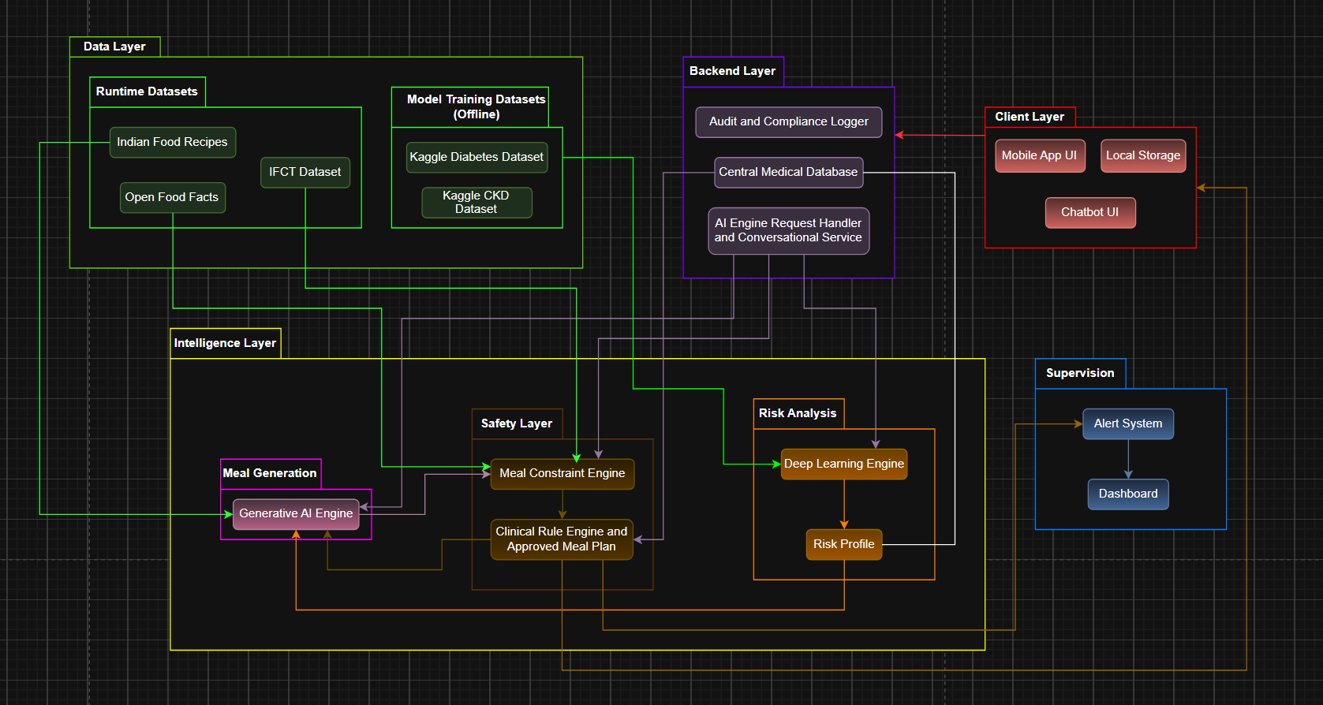
Architecture Diagram
12 / 17
Architecture Diagram
The architecture slide is preserved so the panel can compare design intent with the now-working model/report path.
Implemented now: preprocessing, final-model training, threshold report generation, terminal inference, and benchmark reporting.

Slide 13
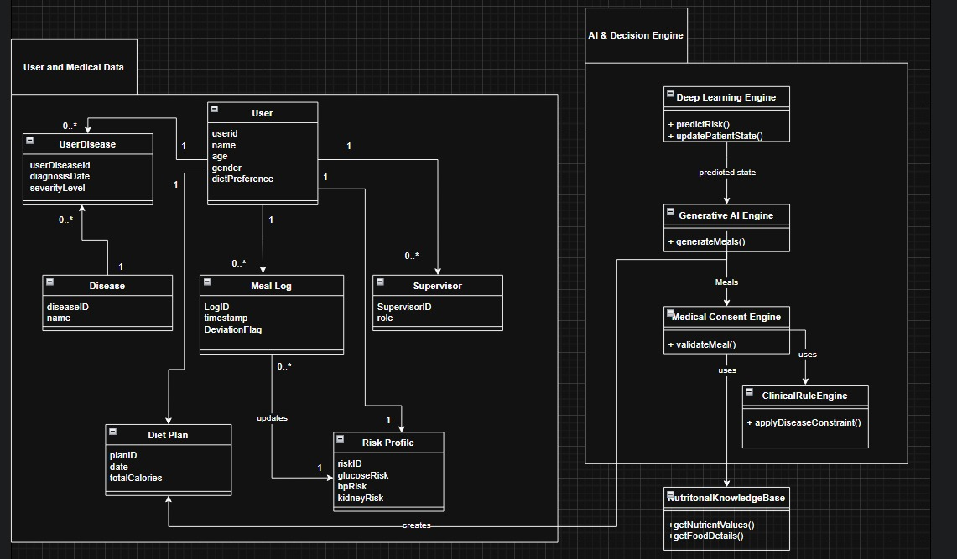
Master Class Diagram
13 / 17
Master Class Diagram
The original class-level view is retained for design continuity.
Diagram asset reused from the ISA-1 review material.

Slide 14
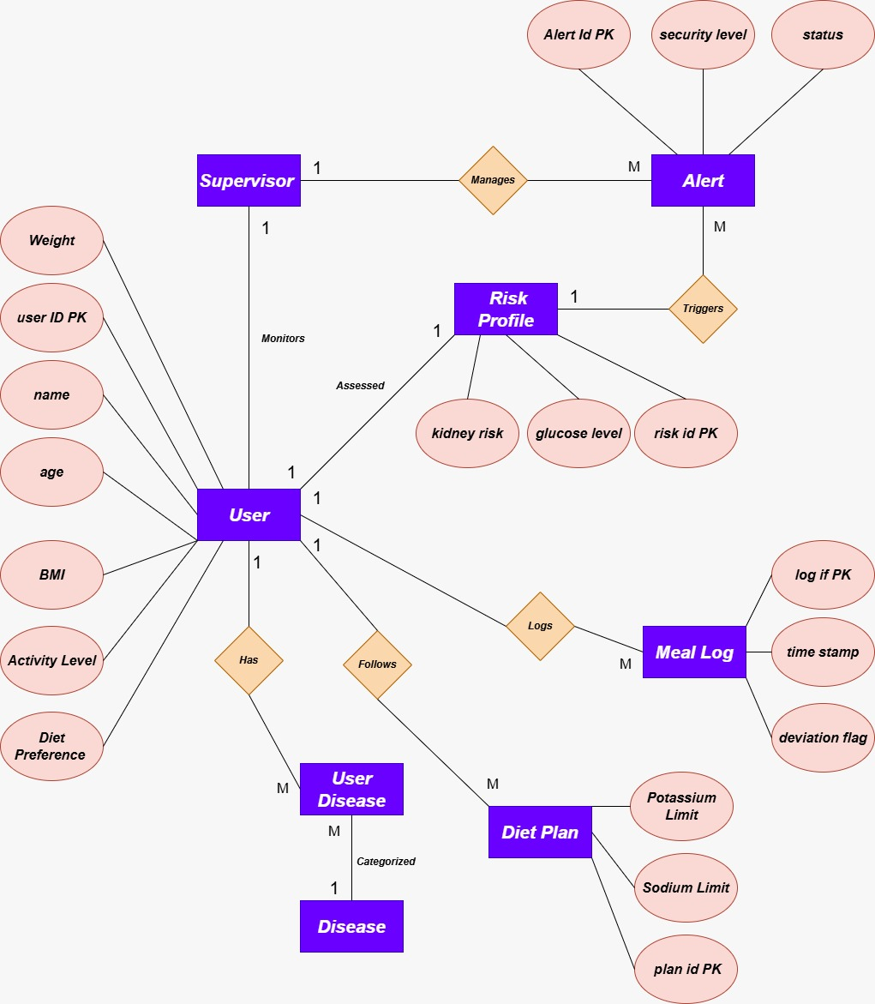
ER Diagram
14 / 17
ER Diagram
This remains useful for explaining how user, disease, meal, and report data fit together.
Diagram asset reused from the ISA-1 review material.

Slide 15
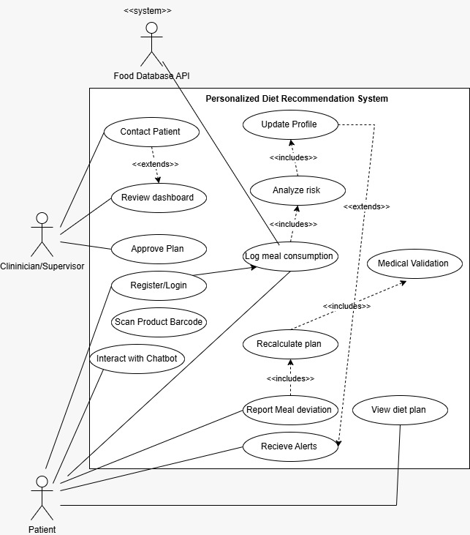
Use-Case Diagram
15 / 17
Use-Case Diagram
The use-case view still reflects the intended journey once risk prediction connects into meal calibration.
Diagram asset reused from the ISA-1 review material.

Slide 16
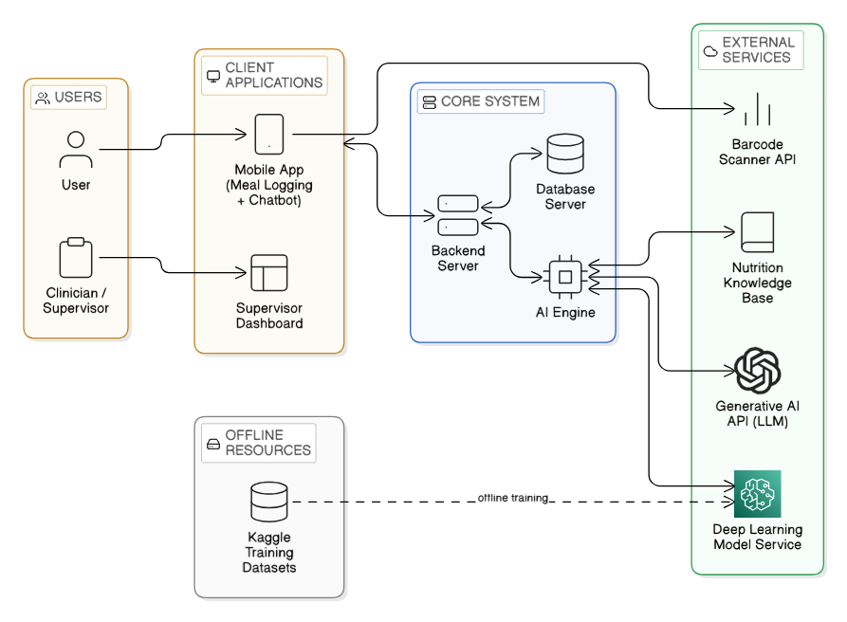
External Interface Diagram
16 / 17
External Interface Diagram
For this review, the clearest external interface is the working terminal and backend prediction path.
Terminal prediction now runs using the current lightweight deployed artifacts and schema-correct demo payloads.

Slide 17
Thank You
Final models
CKD: DecisionTree
HTN: LogisticRegression
DIAB: GaussianNB
Full-train rows
690,956 | 785,242 | 754,970
Current status:
- project-final models retrained
- terminal prediction working
- screenshot commands documented
- comparison graph added
- dataset rows, columns, and source sites documented
Next step: continue the implementation with raw-input mapping and then reconnect risk into diet calibration.
Deck follows the exact ISA-1 heading sequence extracted from the legacy review PDF.

