Slide 1

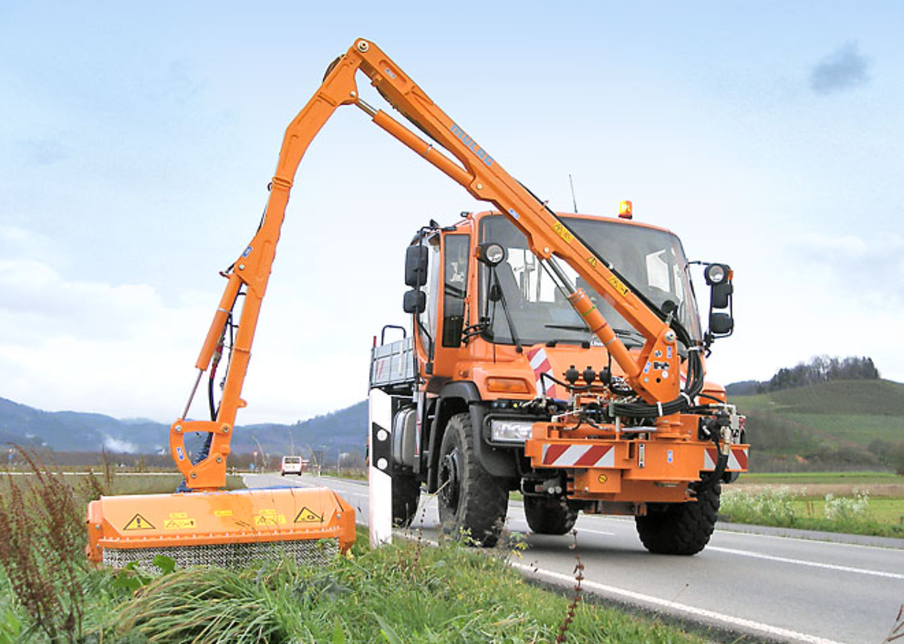
Mechanical-Hydraulic Modeling of an Embankment Mower in Simscape
Kevin Kudakwashe Murera
Robotics Research Lab
Department of Computer Science
University of Kaiserslautern-Landau, Germany

Slide 2
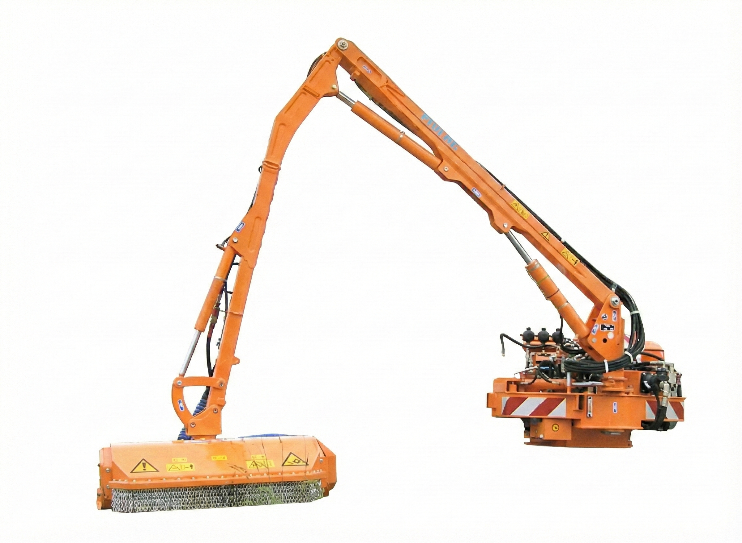
Outline
Introduction and Motivation
Theoratical Background
Mechanical Subsystem
Hydraulic Subsystem
Intergrated System
Control Design
Simulation and Results Analysis
Conclusion and Future Work
Validation Strategy

Slide 3
Introduction and Motivation
The Mulag FME 500 is a heavy hydraulic manipulator that works in
stochastic environments.
The Problem
Accurate simulation is difficult because of bidirectional coupling between the domains e.g. hydraulic forces drive the mechanics and mechanical loads alter fluid properties.
Standard kinematics fail to capture „stiff“ oscillatory behaviors.
The Goal
Develop a high fidelity physically consistent Digital Twin in Simscape that captures these nonlinearities to support future safety verification and control development.

Slide 4
Theoratical Background
Hydraulic Nonlinearities
The system is governed by nonlinearities such as bulk modulus and stribeck friction.
Modeling Philosophy
The approach is physical modeling. Simscape is used to solve the rigid multibody mechanics and hydraulic networks simultaneously ensuring energy conservation across dormains.

Slide 5
Simscape versus Robot Engines
Feature | Simscape | Robot Engines
1. Coupling Strategy | Unified and bidirectional | Decoupled and assumes ideal actuation
2. Actuator Fidelity | High (physical) | Low (kinematic)
3. Solver Type | Implicit (stiff) | Explicit (fast)
4. Component Detail | Physical networks | Abstract constraints

Slide 6

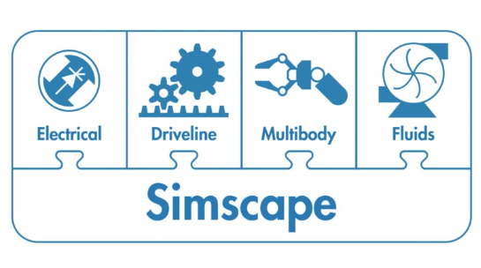
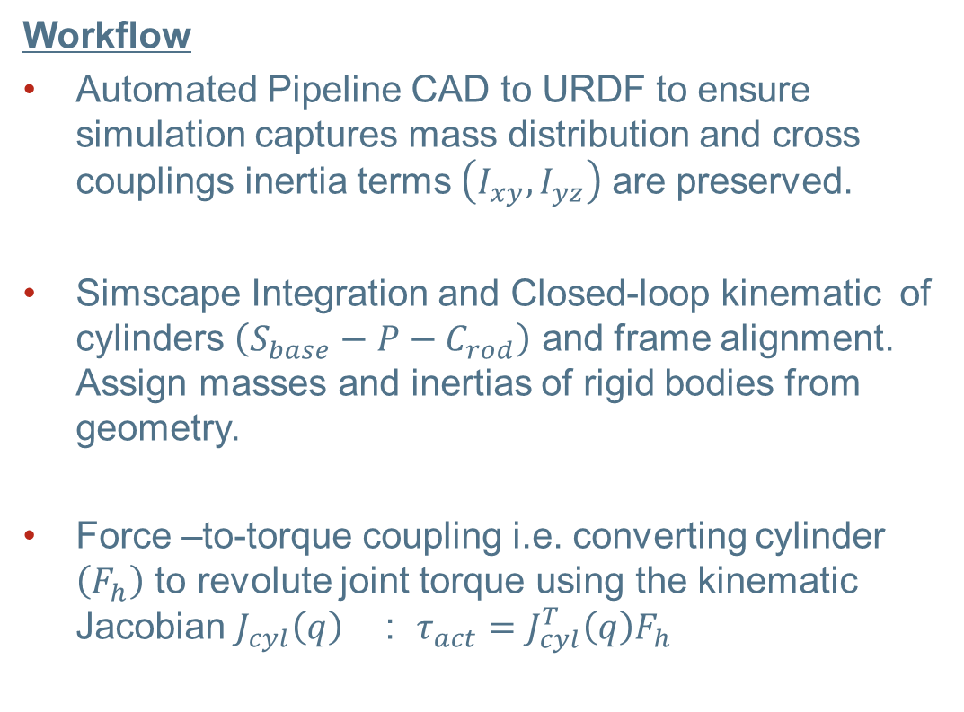
Mechanical Subsystem (1)
Workflow
Automated Pipeline CAD to URDF to ensure simulation captures mass distribution and cross couplings inertia terms $\left(I_{xy},I_{yz}\right)$ are preserved.
Simscape Integration and Closed-loop kinematic of cylinders $\left(S_{base}−P−C_{rod}\right)$ and frame alignment. Assign masses and inertias of rigid bodies from geometry.
Force –to-torque coupling i.e. converting cylinder $\left(F_{h}\right)$ to revolute joint torque using the kinematic Jacobian $J_{cyl}\left(q\right)$ : $τ_{act}=J_{cyl}^{T}\left(q\right)F_{h}$

Slide 7
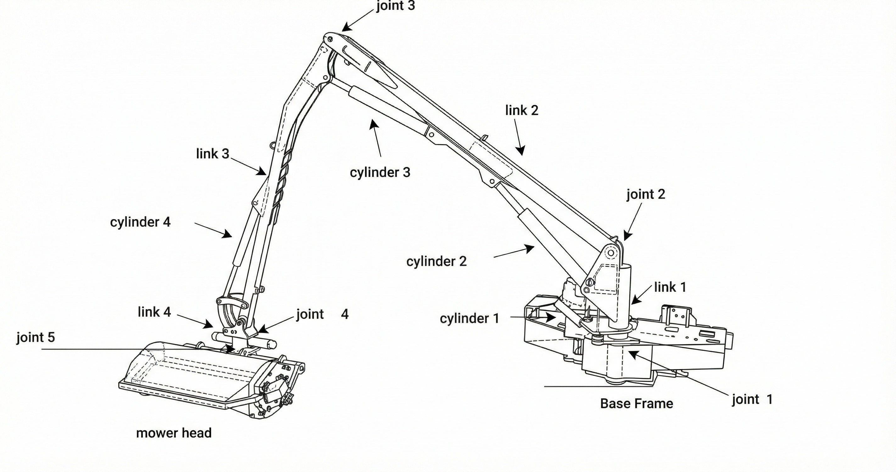
Mechanical Subsystem (2)
5-DOF Mulag FME 500

Slide 8
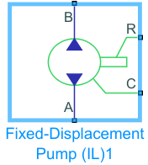
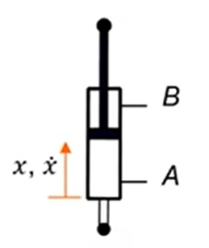
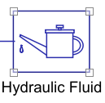
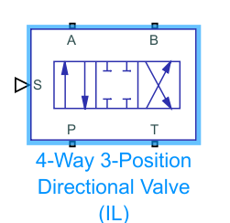
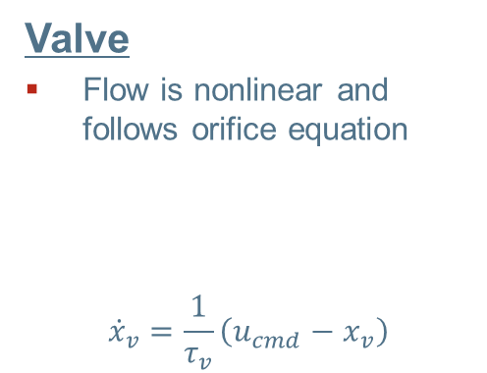
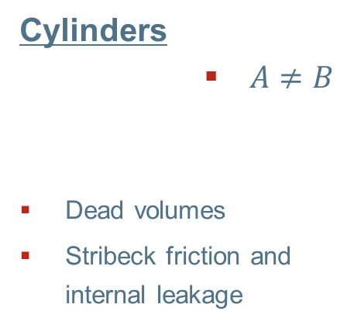
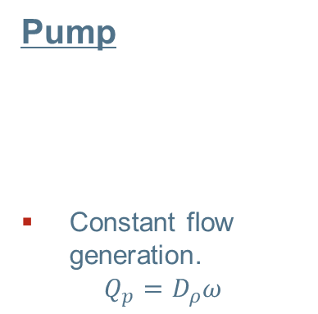
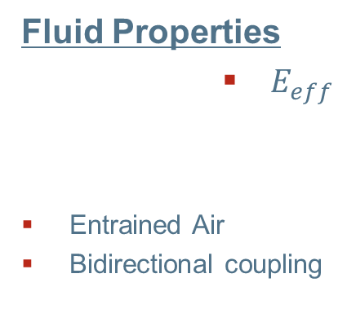
Hydraulic Subsystem (1)
Pump
Constant flow generation.
$$Q_{p}=D_{ρ}ω$$
Circuit Design
Fixed-displacement pump, gas-charged accumulator, 4/3 proportional directional control valves that drive the double-acting cylinders.
Dynamic response of the hydraulic cylinder is governed by the bulk modulus of working fluid.
Cylinders
$A≠B$
Dead volumes
Stribeck friction and internal leakage
Valve
Flow is nonlinear and follows orifice equation
$${\dot{x}}_{v}=\frac{1}{τ_{v}}\left(u_{cmd}−x_{v}\right)$$
Fluid Properties
$E_{eff}$
Entrained Air
Bidirectional coupling

Slide 9
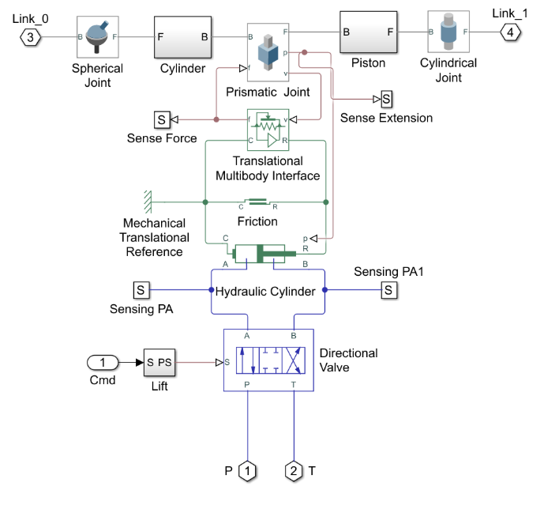
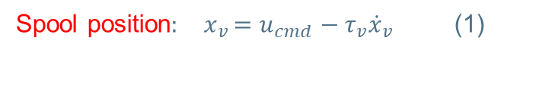
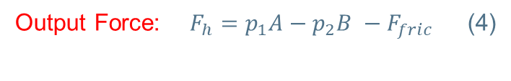
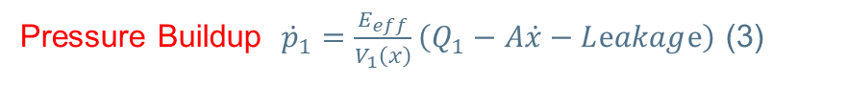
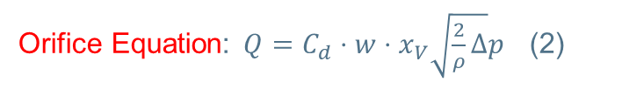
Hydraulic Subsystem (2)
Electro-hydraulic actuator subsystem
Output Force: $F_{h}=p_{1}A−p_{2}B −F_{fric}$ (4)
Pressure Buildup ${\dot{p}}_{1}=\frac{E_{eff}}{V_{1}\left(x\right)}\left(Q_{1}−A\dot{x}−Lⅇakagⅇ\right)$ (3)
Orifice Equation: $Q=C_{d}⋅w⋅x_{V}\sqrt{\frac{2}{ρ}Δ}p$ (2)
Spool position${: x}_{v}=u_{cmd}−τ_{v}{\dot{x}}_{v}$ (1)

Slide 10
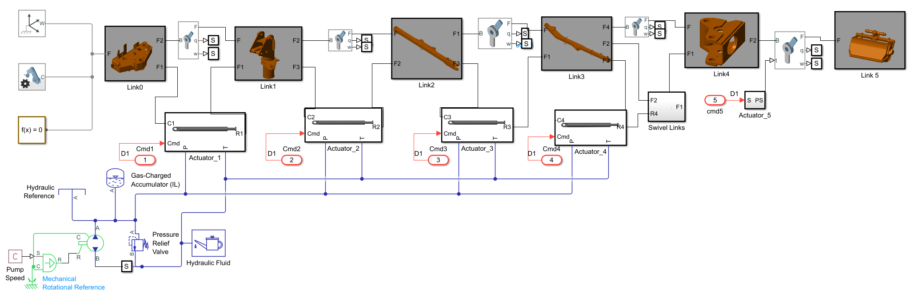
Integrated System
Flow rate 40 L/min rated 280 bar to 360 bar
The system is stiff due to the mix of fast pressure transients and slow boom motion.
Variable-step implicit solver is used to resolve
compliance without the global step sizeo [ode23t]

Slide 11
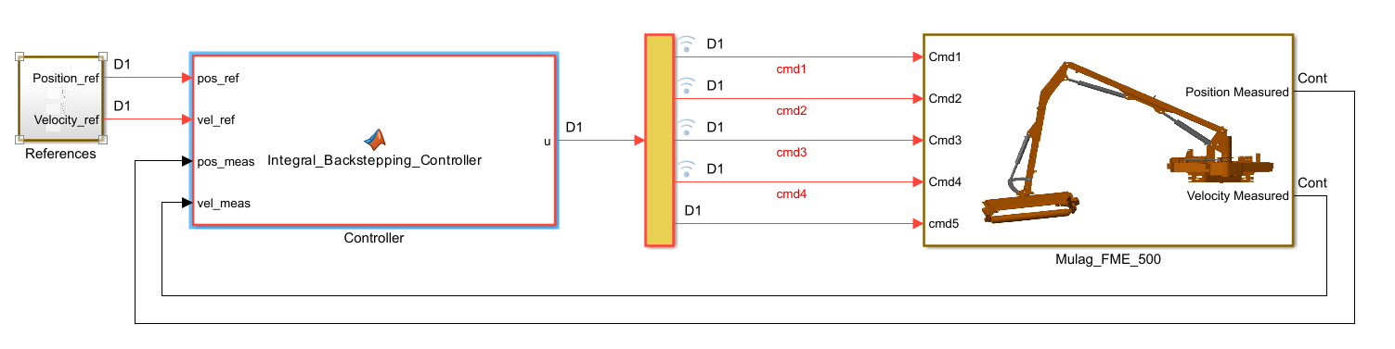
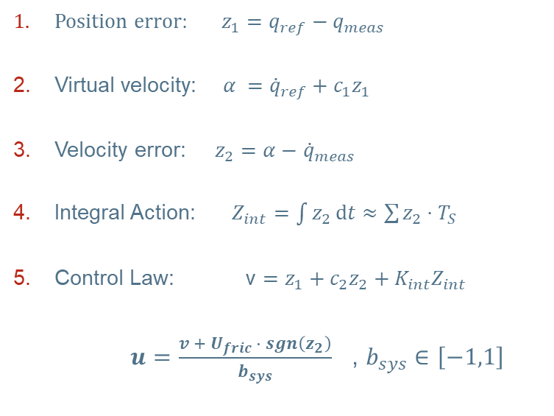
Control Design
Position error: $z_{1}=q_{ref}−q_{meas}$
Virtual velocity: $α ={\dot{q}}_{ref}+c_{1}z_{1}$
Velocity error: $z_{2}=α−$ ${\dot{q}}_{meas}$
Integral Action: $Z_{int}=\int{z_{2}ⅆt}≈\sum{z_{2}}⋅T_{S}$
Control Law: v $=z_{1}+c_{2}z_{2}+K_{int}Z_{int}$
$u=\frac{v +{ U}_{fric }⋅ sgn\left(z_{2}\right)}{b_{sys}}$ , $b_{sys}∈\left[−1,1\right]$
The controller serves as a validation instrument to validate the plant.
A decentralized Integral Backstepping Controller is used to stabilize error dynamics.

Slide 12
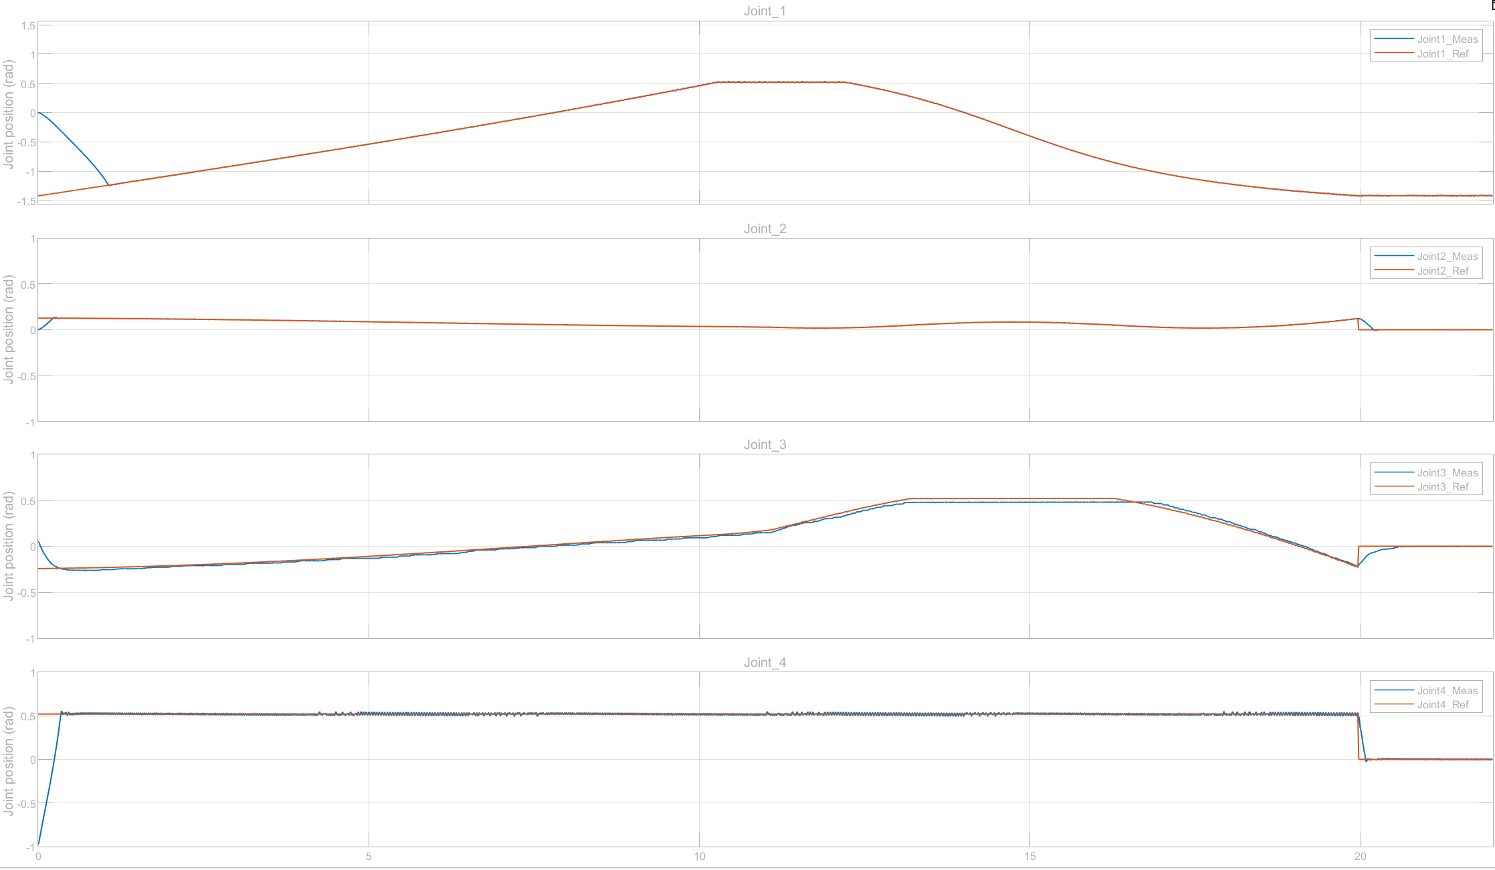
Control Design
Joint Space Control

Slide 13
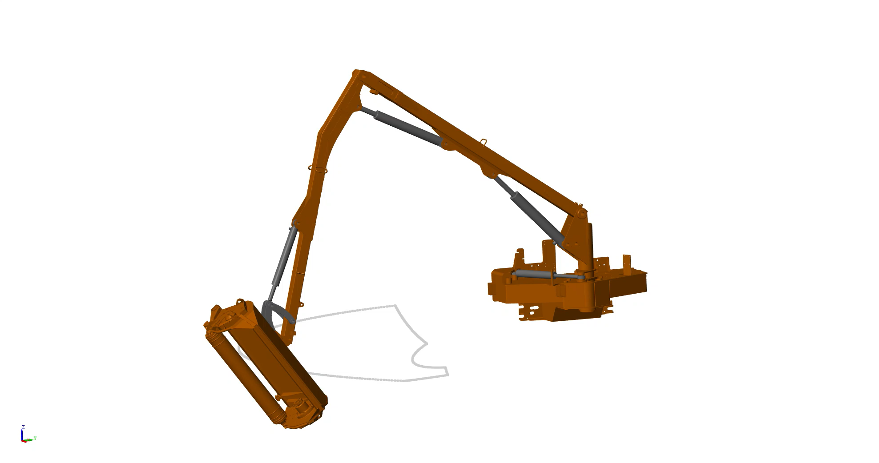
Simulation
With the control architecture in place, the mower head was commanded to follow a closed-loop reference path in the task space.

Slide 14
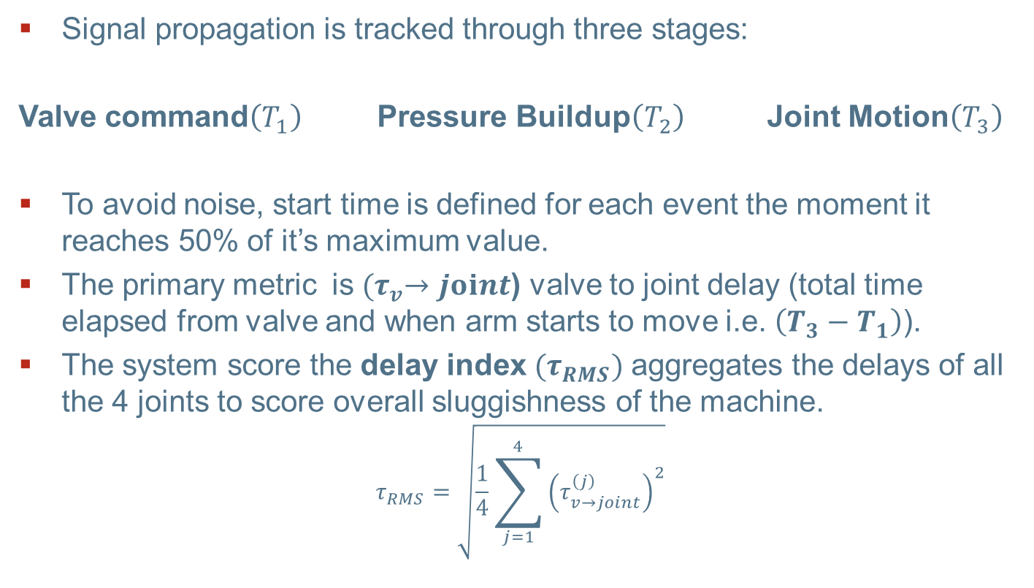
Validation Strategy (Hydraulic Actuation Delay)
Signal propagation is tracked through three stages:
Valve command$\left(T_{1}\right)$ Pressure Buildup$\left(T_{2}\right)$ Joint Motion$\left(T_{3}\right)$
To avoid noise, start time is defined for each event the moment it reaches 50% of it’s maximum value.
The primary metric is ${(τ}_{v}→joⅈnt$) valve to joint delay (total time elapsed from valve and when arm starts to move i.e. $\left(T_{3}−T_{1}\right)$).
The system score the delay index ${(τ}_{RMS})$aggregates the delays of all the 4 joints to score overall sluggishness of the machine.
$$τ_{RMS}=\sqrt{\frac{1}{4}\sum_{j=1}^{4}{{\left(τ_{v→joint}^{\left(j\right)}\right)}^{2}}}$$

Slide 15
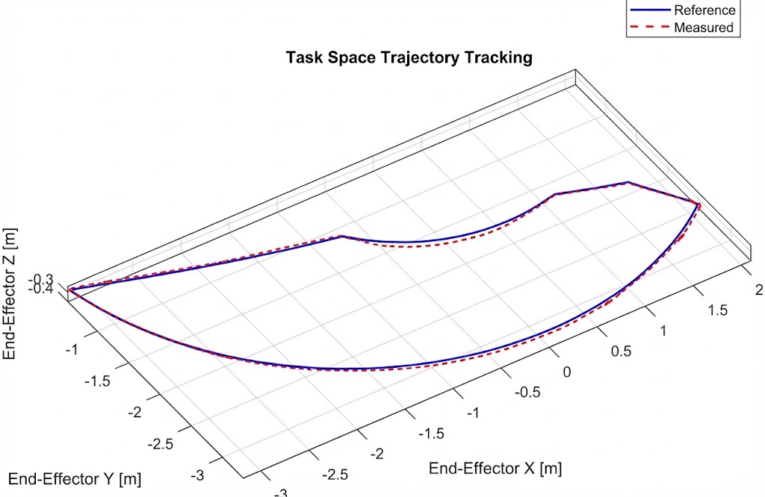
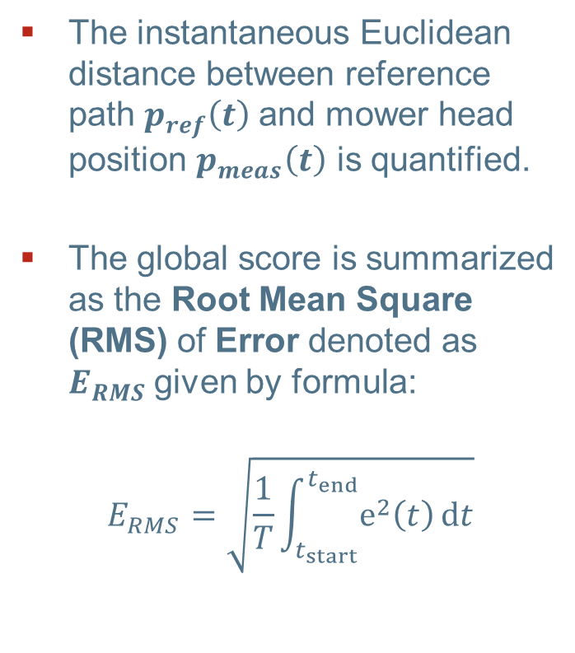
Validation Strategy (Task Space Tracking Error)
The instantaneous Euclidean distance between reference path $p_{ref}\left(t\right)$and mower head position $p_{meas}\left(t\right)$ is quantified.
The global score is summarized as the Root Mean Square (RMS) of Error denoted as $E_{RMS}$given by formula:
$$E_{RMS}=\sqrt{\frac{1}{T}\int_{t_{start}}^{t_{end}}{ⅇ^{2}\left(t\right)ⅆt}}$$

Slide 16
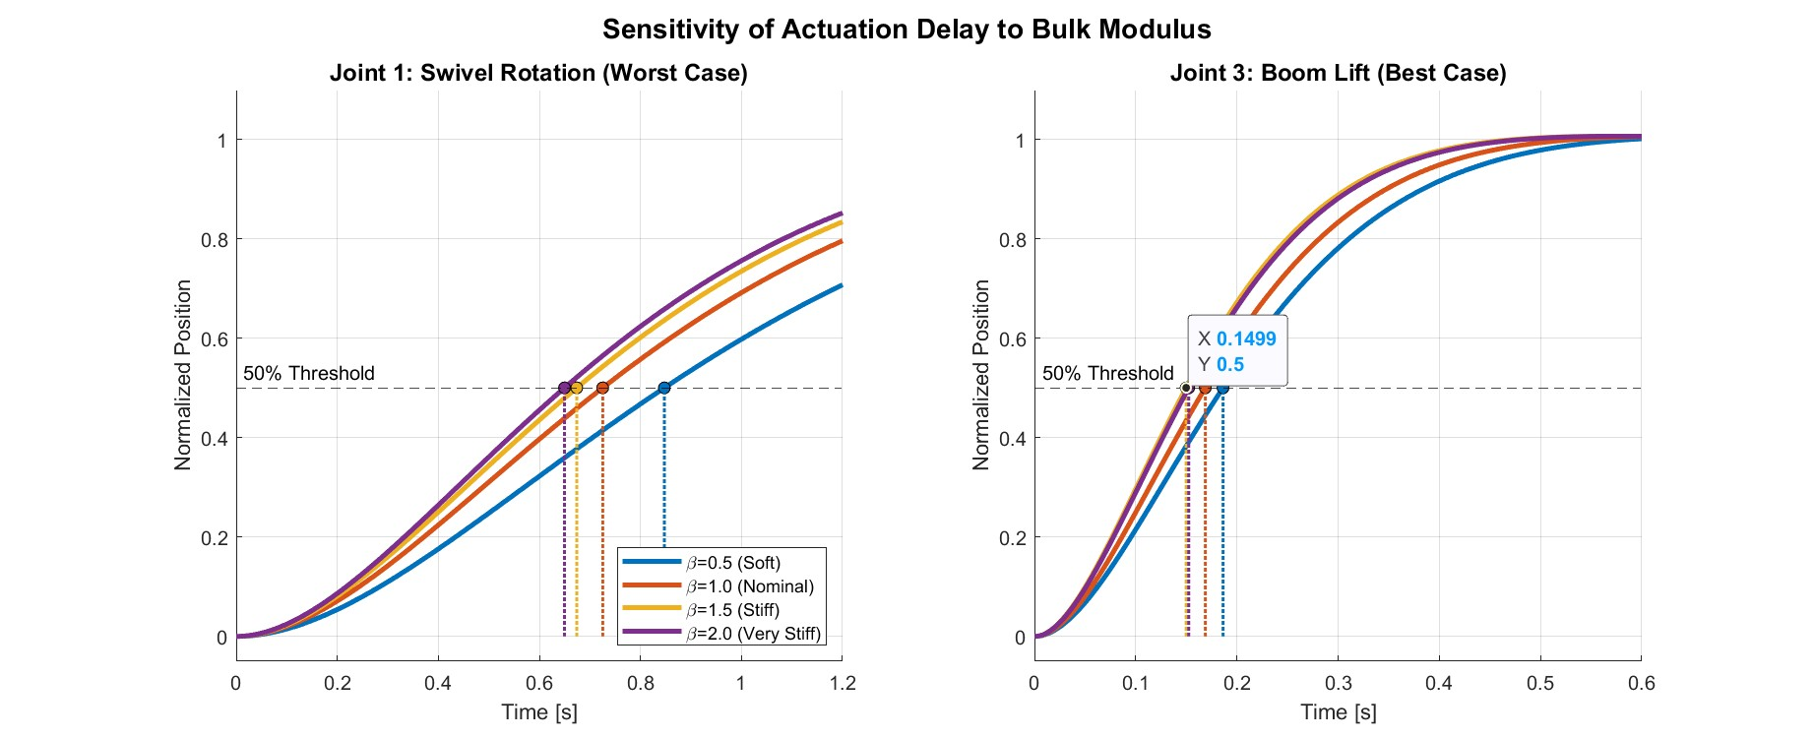
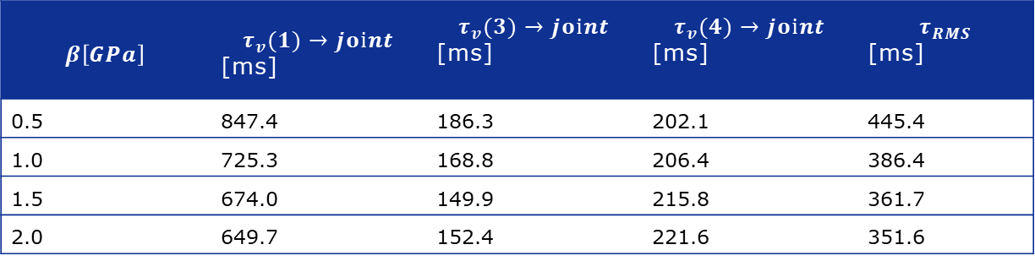
Results and Discussion
$$β\left[GPa\right]$$ | $$τ_{v}(1)→joⅈnt$$ [ms] | $$τ_{v}(3)→joⅈnt$$ [ms] | $$τ_{v}(4)→joⅈnt$$ [ms] | $$τ_{RMS}$$ [ms]
0.5 | 847.4 | 186.3 | 202.1 | 445.4
1.0 | 725.3 | 168.8 | 206.4 | 386.4
1.5 | 674.0 | 149.9 | 215.8 | 361.7
2.0 | 649.7 | 152.4 | 221.6 | 351.6
Valve-to-joint 50% delays and delay index for different bulk moduli

Slide 17
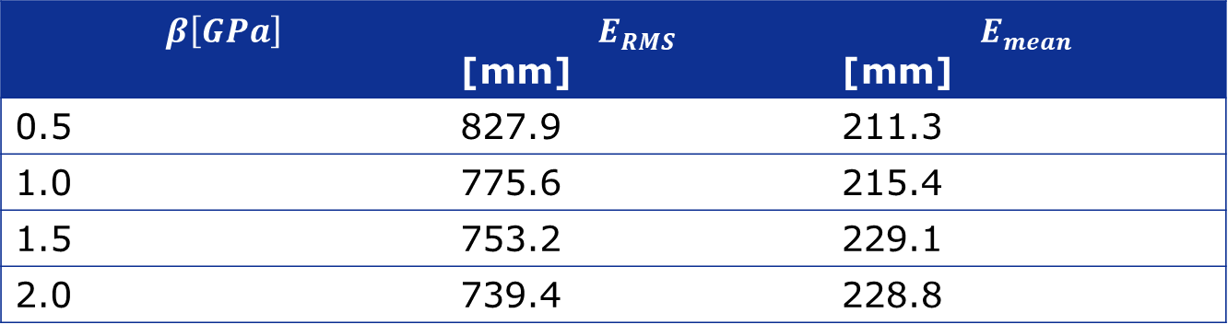
Results and Discussion
End effector Accuracy to Bulk Modulus
$$β\left[GPa\right]$$ | $$E_{RMS}$$ [mm] | $$E_{mean}$$ [mm]
0.5 | 827.9 | 211.3
1.0 | 775.6 | 215.4
1.5 | 753.2 | 229.1
2.0 | 739.4 | 228.8

Slide 18
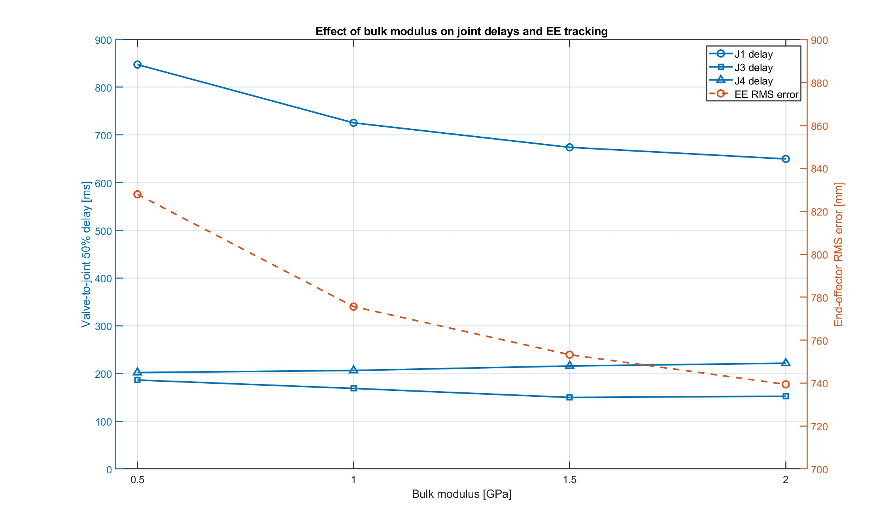
Results and Discussion

Slide 19
Conclusion & Future Work
A model that bridges the gap between rigid multibody mechanics and nonlinear hydraulic dynamics was successfully developed.
The simulaton captures the bidirectional coupling i.e. actuator forces drive the structure while structural loads induce transients.
The results from valiadtion confirm the model physical intergrity specifically the ability to replicate „stiff“ yet oscillatory nature of hydraulic machinery and sensitivity of delays to fluid compressibility.
This validated model will serve as a digital twin for developing data-driven control methods.
The goals are to learn the complex nonlinear hydraulic-mechanical coupling then develop advanced control architectures capable hydraulic delays compensation.

Slide 20
Questions

