Slide 1

Get your little ones around the camp fire!
Kevin and Ella Moens https://github.com/kevmoens/ThatConference2022

Slide 2
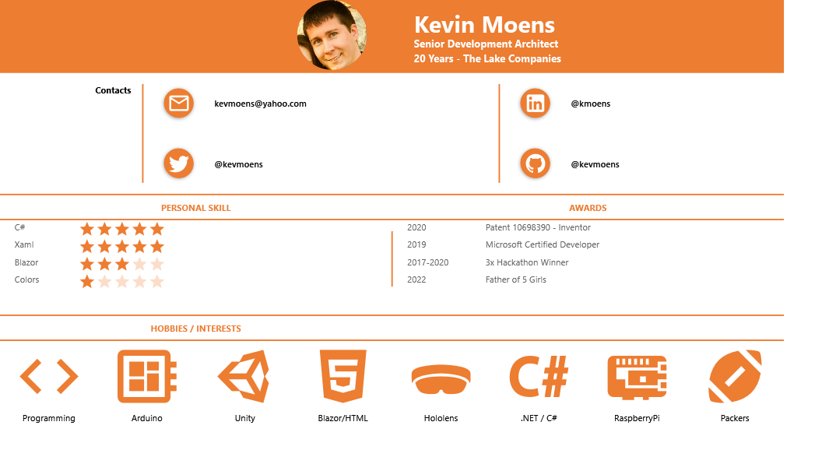

Slide 3
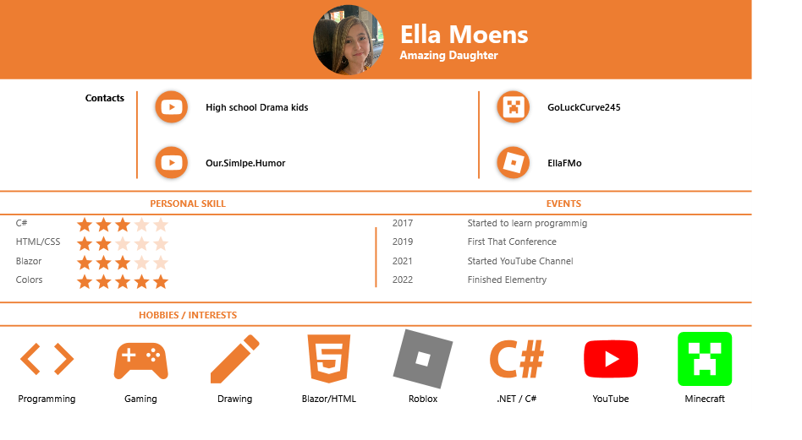

Slide 4
Sections
Goals of coding with kids
How we got started
Projects
Miscellaneous Activities
Key Points when programming with kids
Resources
Colors – by Ella
Flow Charts
Try it your self

Slide 5
Goals of coding with kids
Have fun with our children
Spend time together
Problem Solving / logic skills
Growth Mindset
Learn ways which they learn
Increase Creativity
Communication skills
Teach persistence / Perseverance

Slide 6
Story

Slide 7
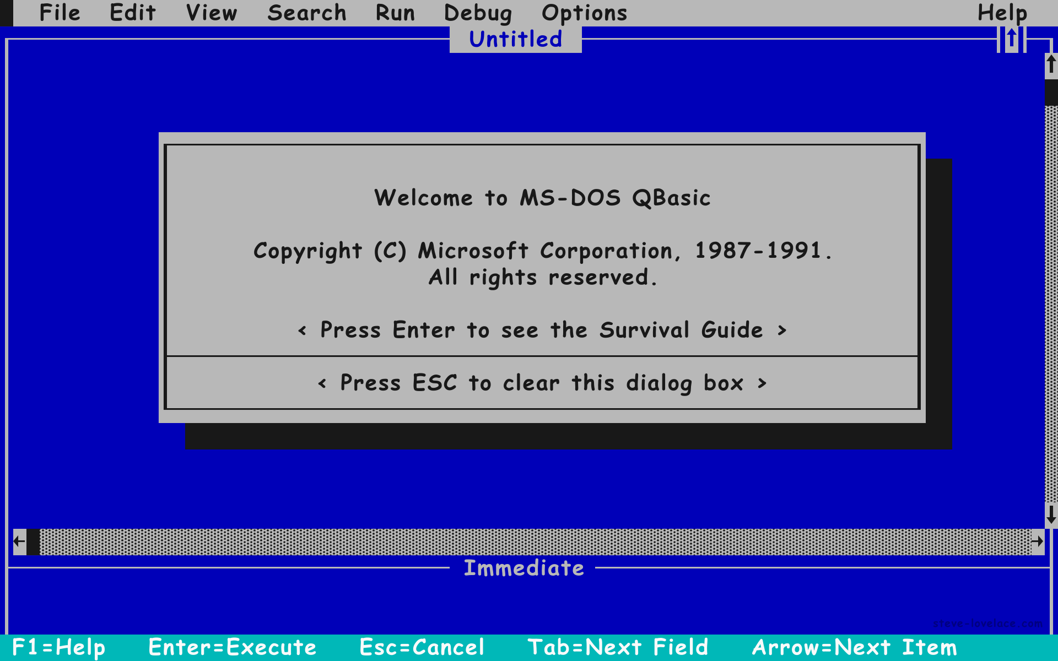
QBasic

Slide 8
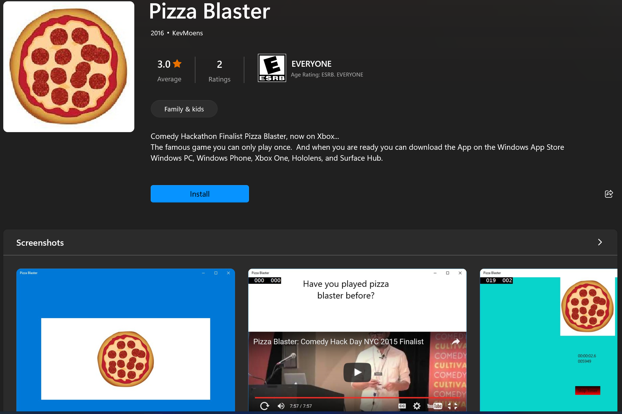
Pizza Blaster

Slide 9
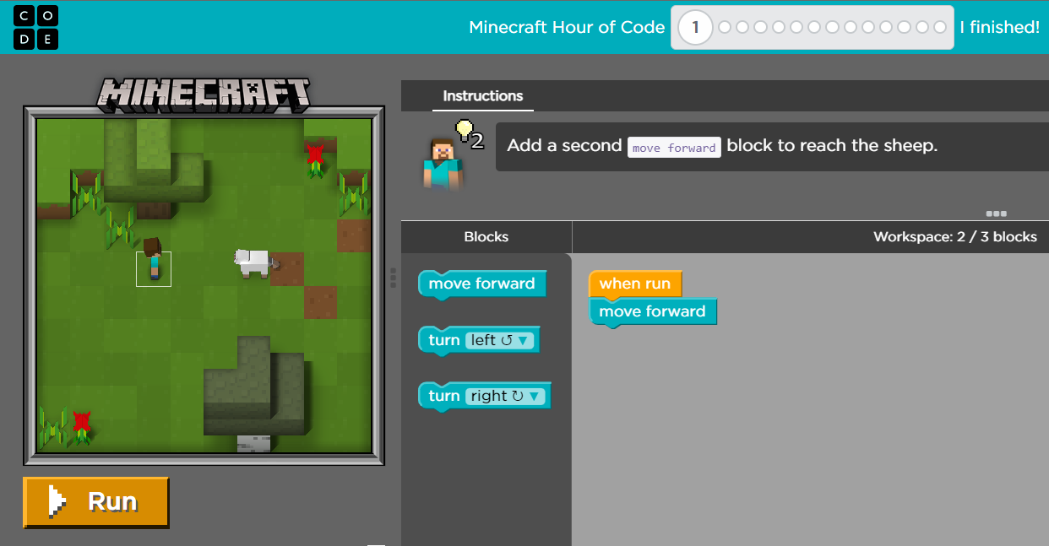
Details
Code.org
Minecraft

Slide 10
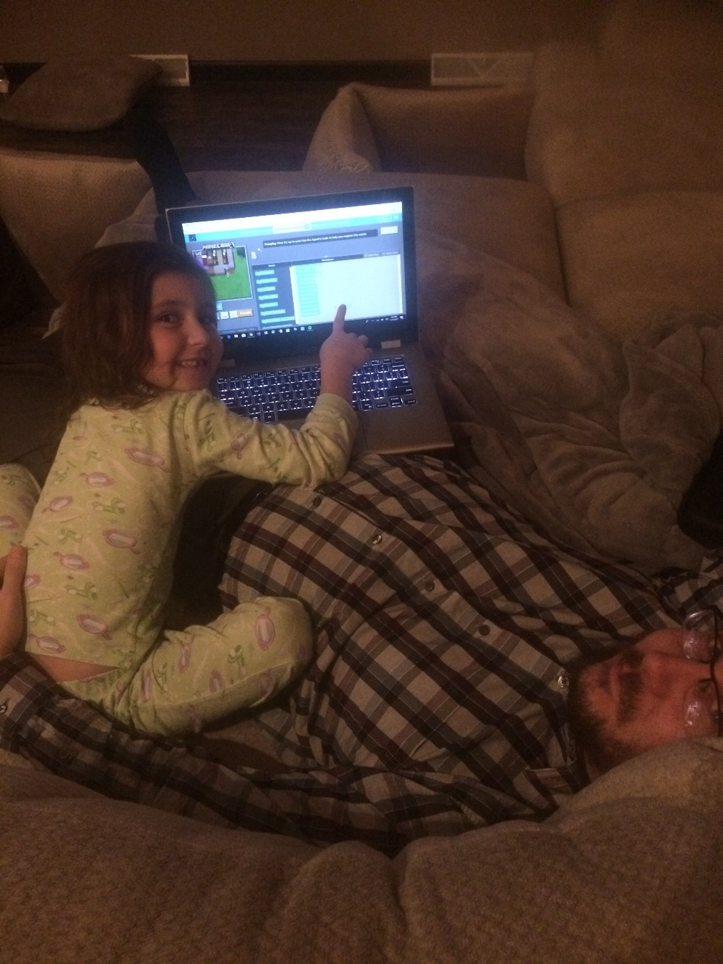
Gave the choice of reading or coding before bed

Slide 11
C# Console Apps
Guess a number
MadLibs
Rock Paper Scissors

Slide 12
Unity
YouTube/Brackeys
Cosmic Battle
https://kevmoens.s3.amazonaws.com/CosmicBattle/index.html
Lego – Unity Tutorial
https://kevmoens.s3.amazonaws.com/LegoSampleGame/index.html
Matt Ramage – Green Bay Packers Podcaster
Unity WebGL Player | MattRamage (kevmoens.s3.amazonaws.com)

Slide 13
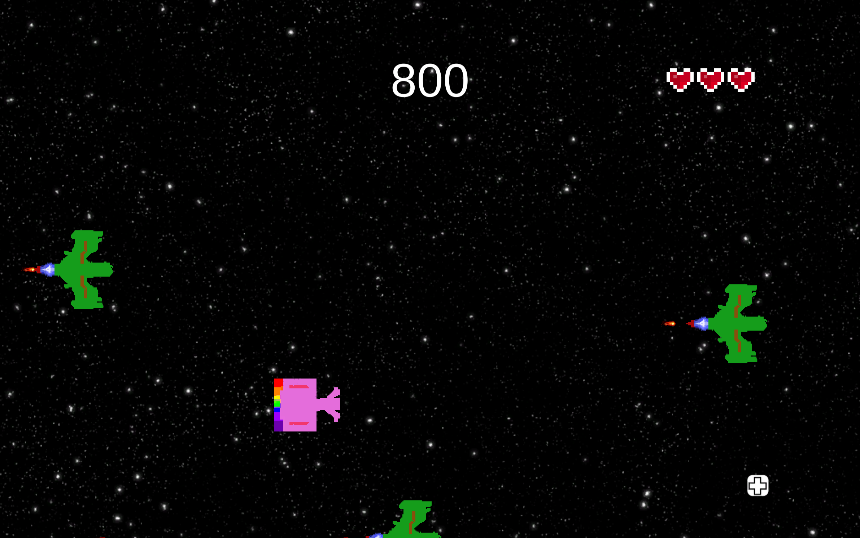
Unity

Slide 14
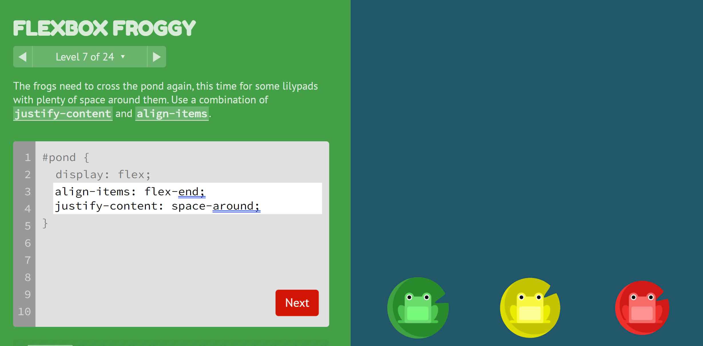
Flexbox Froggy

Slide 15
HTML Web Blazor
Free Code Camp
Flexbox Froggy
Grid Garden
Microsoft Learn
Tim Corey C# Challenge using GitHub OSS
Wuphf

Slide 16
Blazor
Projects
Madlibs
Hangman
Jacks are Junk
Math Bingo
Ella School
Binary Puzzle Solver
Ellabit https://kevmoens.github.io/Ellabit

Slide 17
How we started
Age 6 Scratch and Hour of Code
Age 7 Subscription Boxes KiwiCo/MakerBlock
Age 8/9 C# Console Apps
Age 9 Unity
Age 10+ HTML/Web/Blazor
End Goal C# Blazor Web API
10 years old is the optimal time to learn programming. Yet the earlier the better.

Slide 18
Miscellaneous Activities
Science Fair
Fidget Spinner, spin counter (Arduino)
360 Photobooth (Raspberry Pi)
Remote Control Car (Raspberry Pi + Xbox controller)
MakerBlock – NextMaker subscription kit
Kiwi Co – Tinker Crate subscription box
Crunch Labs – Subscription Box (Mark Rober)

Slide 19
Events
Hack4Kids
Milwaukee 4-30-2022
Chicago 9-17-2022
Hour of Code (Green Bay - NWTC)
Week of December 9th
That Conference (Wisconsin Dells)
AWS Summit
Chicago 8-25-2022
Hackathons (Chicago)

Slide 20
Key Points when programming with kids
Don’t start with basic computer concepts.
JUST JUMP IN!

Slide 21
Code with Kids
Kids want to see results quickly
Use games to make it fun
Repetition overtime will generate learning and understanding
Be PATIENT (small steps matter)
MAKE IT FUN

Slide 22
Code with Kids
Typing is a big hurdle.
Goal is to have a quick Dev Loop
Eventually kids will want more of a challenge
Example: When ready move from Blockly to a typed language.
Revisit old projects later and make changes with new concepts

Slide 23
Code with Kids
As a parent it takes a lot of planning or time to keep kids involved and interested
Find a coding club
CREATE A
POSITIVE EXPERIENCE

Slide 24
Resources
FlexboxFroggy.com
HourOfCode.com
Code.org
Scratch.com
Microsoft MakeCode
Minecraft – Education Edition
Microsoft Learn
FreeCodeCamp.org
CSSGridGarden.com
HackerRank.com
YouTube
Brackeys – Unity

Slide 25
Colors

Slide 26
Colors
LAVENDER(#daf)
PERIWINKLE(#bbf)
BABY BLUE(#cfcfff) YES THERE’S A DIFFERENCE!
SALMON(#f99)
BROWN(#840)
ORANGE(#F80)
MAGENTA-ROSE(#F0A)
BLUE VIOLET(#60F)
TAKE NOTES!
MAROON (#823)
HAY GOLD(#EBB000)
Ok well I know WAY more but we don’t have more than 10 hours sooo….

Slide 27
Colors
Red | #F00
Green | #0F0
Blue | #00F
Red+Green=Yellow | #FF0
Red+Blue=Magenta | #F0F
Green+Blue=Teal | #0FF
Red+Green+Blue=White | #FFF
None = Black | #000

Slide 28
Flowcharts
Visually represent a process or workflow in a step-by-step manner.
Each step is represented by blocks or ovals and connected by lines or arrows.
Can be used to brainstorm and design how you will create your code

Slide 29

Flowcharts
Start / Terminator
Use this shape for the beginning or ending step of your process

Slide 30

Flowcharts
Process
This shape stands for a step in your process

Slide 31

Flowcharts
Decision
It indicates a point where the outcome of a decision dictates the next step. There can be various outcomes, but usually there are just two - yes and no

Slide 32

Flowcharts
Input / Output
This shape shows that information is coming into the process from outside, or leaving the process

Slide 33
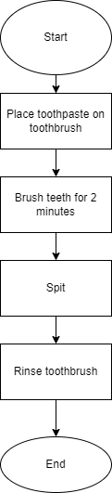
Flowcharts

Slide 34
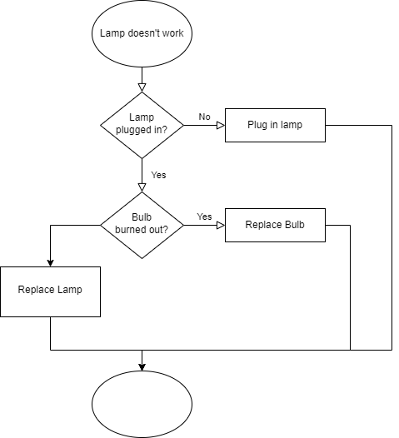
Flowcharts

Slide 35
Flowchart Ideas
Under 10
Pick a game to play
What should I eat?
What should I watch on TV?
Pick my pet
Ages 10+
Find largest value among 3 values
Should I bring an umbrella
Ages 13+
How to add multidigit numbers
How to prepare an egg

Slide 36
Thank You
All resources can be found at:
https://github.com/kevmoens/ThatConference2022

