Slide 1

Fun and Efficient Testing with Specflow
Kevin Moens https://github.com/kevmoens/ThatConference2023
Notes:
Before you start
Reset code
Test AhaSlides in PowerPoint
Start ZoomIt
Test screen text size in Visual Studio with helper
Open 2 Visual Studios – RequestTimeOff and blank
Open VS Code to fake sales pitch and tab for checklist of Demo

Slide 2
Specflow
Hello
@Kevmoens
15 projects in the queue and 12 pull requests coming in Q4 2023
Samantha Roberts
QA Manager
TechologyPro Inc and Corp Solutions LLC Ltd
GetSpecflow.com
Notes:
Read VS Code

Slide 3
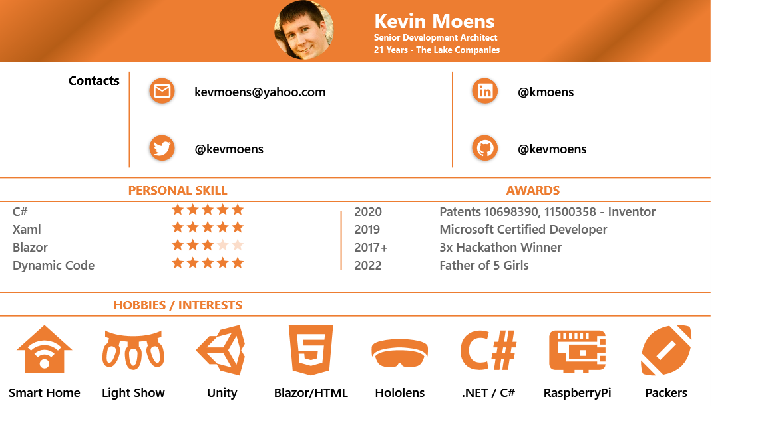
Notes:
I don’t have sales experience

Slide 4
Background
Continuously try to improve my skills
Follow Dave Farley / Nick Chapsas
Attended Nick Chapsas’ 2022 Workshop
NDC Minnesota
From Zero to Hero: Effective Testing
Started Specflow after Nick’s videos in 2021

Slide 5
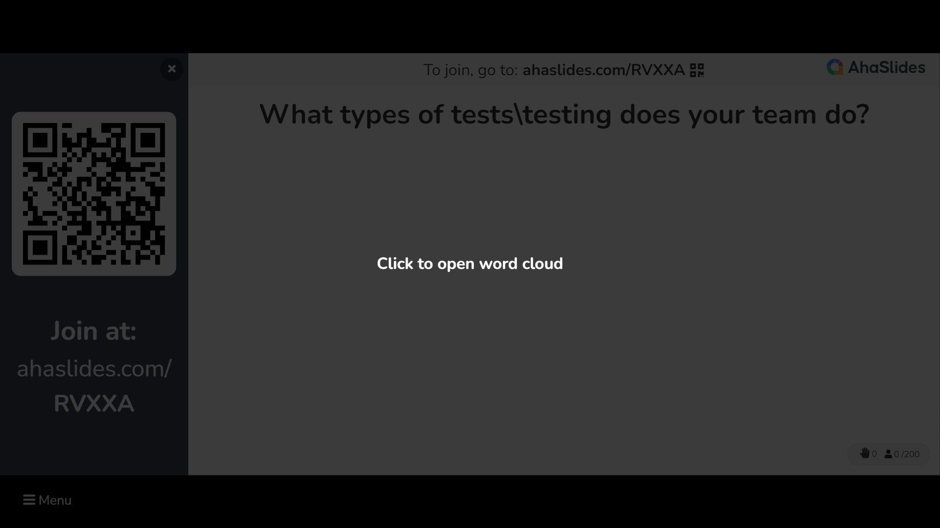

Slide 6
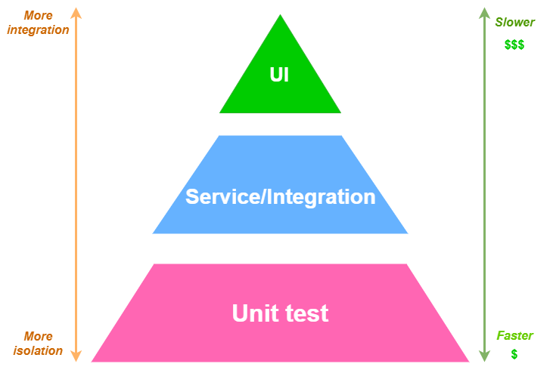
Types of Tests
Nick Chapsas – From Zero To Hero: Effective Testing

Slide 7
Goals
Ready
Introduce BDD
Set
Gherkin Syntax
Go
Demo Specflow

Slide 8
TDD
Build trust of the users
Reduce the numbers of bugs found by users
Finding errors sooner by development team
Done before writing end user software
TDD teams had 40% to 90% fewer defects
TDD teams spent 15% to 33% more time writing code
Problems
Focuses on tests and how to create tests
When focused on code coverage it slows the development processes down
https://cucumber.io/blog/bdd/how-to-measure-the-roi-of-bdd-and-tdd
Notes:
1000 at a boys wiped out by 1 oops
TDD many times leads to hyperfocus on the unit of code.
TDD -> Great coverage (side effect – not goal)
TDD is about drive development from tests (initiating force / driver)

Slide 9
BDD
Tries to do TDD, but better
Not TDD’s fault
Avoid misunderstandings of adopting TDD
Move focus to behaviors instead of tests
Avoid complex slow and tightly coupled tests
Start from end user perspective
Get business and technical teams on the same page
Notes:
BDD sounds like TDD
TDD many times leads to hyperfocus on the unit of code.
BDD tries to focus on Acceptance tests from an
TDD -> Great coverage (side effect – not goal)
TDD is about drive development from tests (initiating force / driver)
Obvious change the concept / words that make up how to do proper TDD (What do you test?)
It should be more about design and development than tests
We shouldn’t ask how to test the implementation DETAIL of the code.
BDD changes thought from:
Test Cases -> Specifications / Features
Tests -> Scenarios
Stop thinking how software works, think about what the users want to achieve

Slide 10
Gherkin
Way of writing test cases in natural language
(SHARED UNDERSTANDING)
Scenario – expected situation
Given, When, Then – acceptance criteria
Feature – unique attribute
Notes:
New Feature is edit request
We also need a Background
Scenario Outline – TimeOffValidator (updates)
Table – TimeOffDateRange.feature
The purpose of feature files is to create readable specifications that can be understood by the whole team, not to provide test coverage

Slide 11
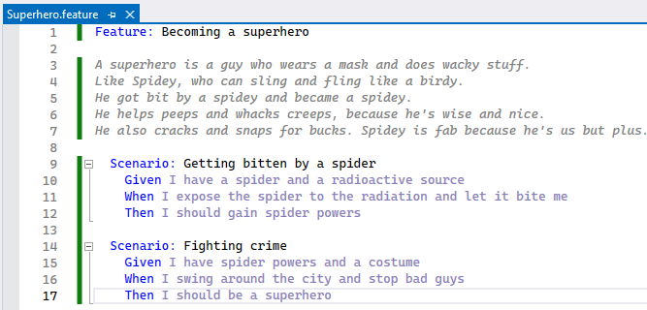
Gherkin
Notes:
Intellectual property
No technical details
- Isotope radioactive source
- Species

Slide 12
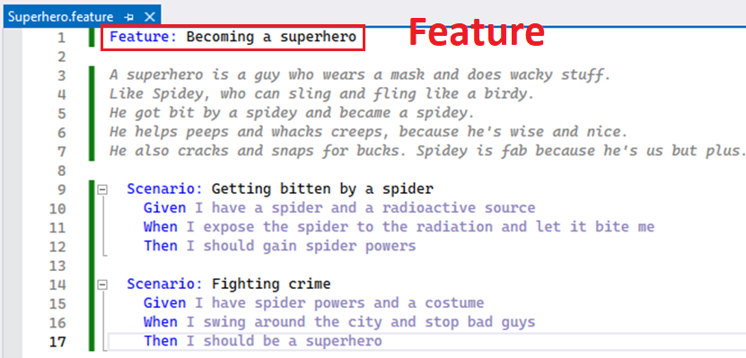

Gherkin

Slide 13
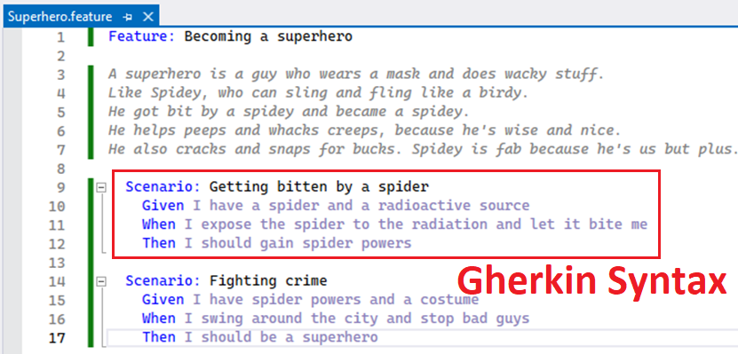
Gherkin

Slide 14
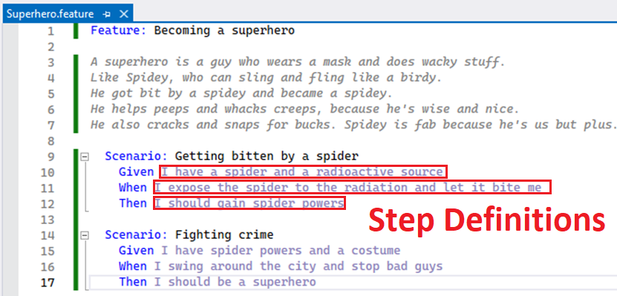
Gherkin

Slide 15
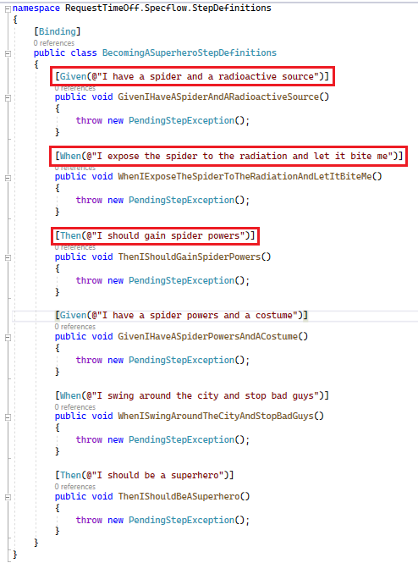

Slide 16
Demo
Notes:
Start with creating a new SuperHero.Feature and then generate the step definitions
Show persistence methods in the class
Arrange Act Assert
Show TimeOffValidator to show
- Same Given used on multiple scenarios
- Introduce parameters on the error strings
-Show Attribute using Regular Expressions
Show UserYearInfo to show
- numeric parameters
Show TimeOffDateRange to show
- Tables
- And
Mention the Specflow.Assist helper Nuget
Start creating Scenario Outline and explain it can tie into development process by using
Living Documentation

Slide 17
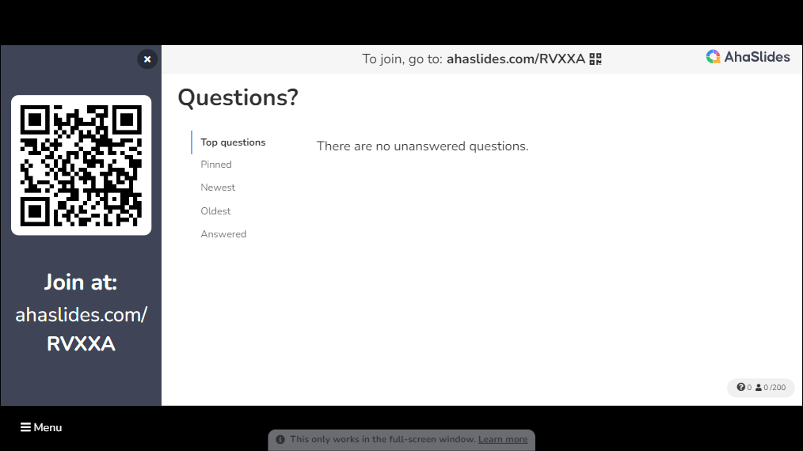

Slide 18


Slide 19


Slide 20
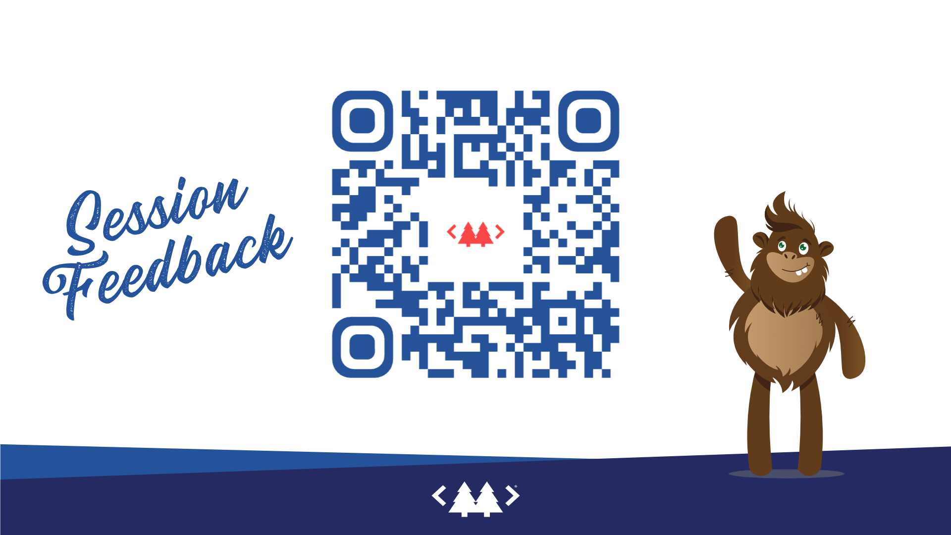
All resources can be found at:
https://github.com/kevmoens/ThatConference2023
https://github.com/kevmoens/RequestTimeOff
https://youtube.com/kevmoens/Specflow...TODO

