Slide 1

Fun and Efficient Testing with Specflow
Kevin Moens https://github.com/kevmoens/ThatConference2023

Slide 2
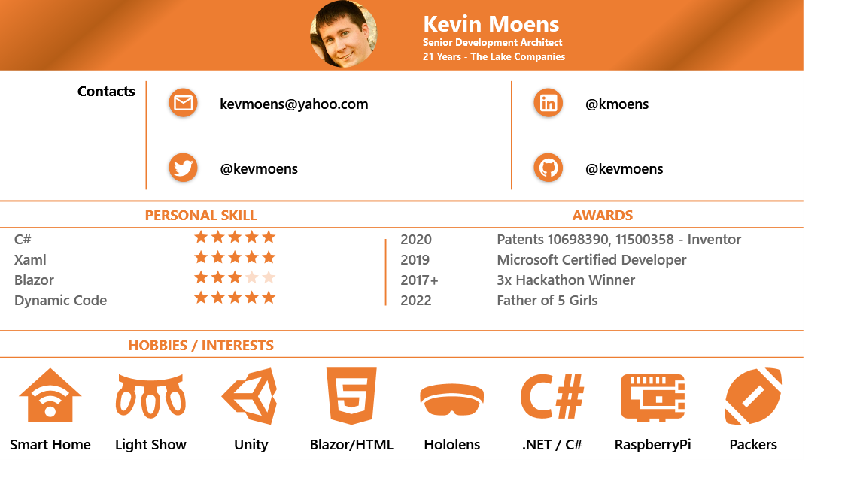
Notes:
Your color game is weak!
No Way!

Slide 3
Sections

Slide 4
Ready
Set
Go

Slide 5
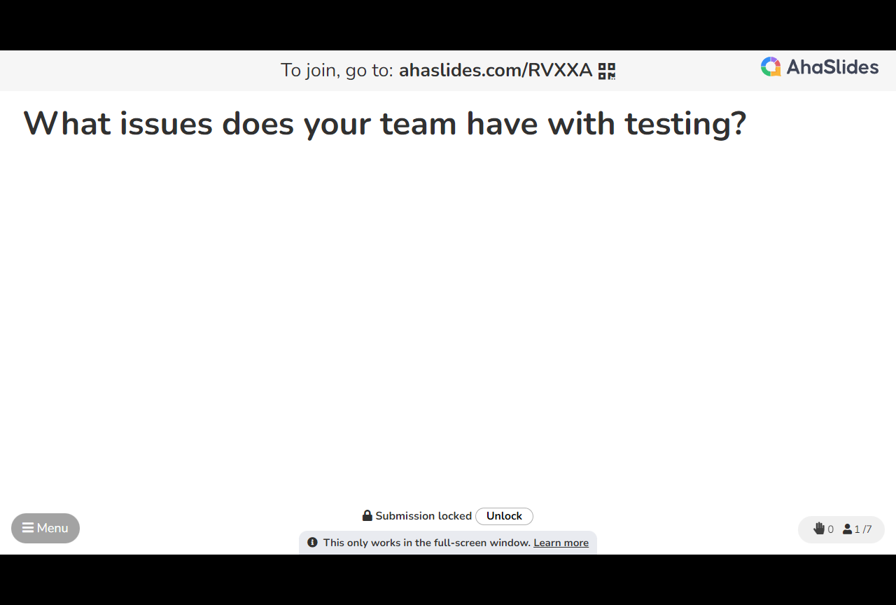
Sections

Slide 6
Notes:
END 2:37

Slide 7
Thank You
All resources can be found at:
https://github.com/kevmoens/ThatConference2023

