Slide 1
Where should you go when you’re hungry?
Restaurants in Toronto and Lexington, KY

Slide 2
Introduction
People who live near Lexington, Kentucky often note that it seems to have a large number of restaurants for its population.
Is this true?
How does it compare to a much larger city?
Toronto has 2.7 million people
Lexington has 324,000 people
How does the number of restaurants per capita compare?
What kind of restaurants are present in each city?
In short, is Lexington truly a 'restaurant town' or would a hungry person prefer a larger city like Toronto?

Slide 3
Who might be interested in this study?
Entrepreneurs can see whether Lexington is a good place to start restaurants.
Food tourists can understand if Lexington is worth a trip.
Residents and leaders of both cities can learn more about this aspect of their city's culture.
Are certain parts of Lexington particularly good for certain types of restaurants?
Are there areas of town which lack a particular genre of food?

Slide 4
Where did we get the data?
Population data is available on Wikipedia
Neighborhood data for Toronto came from a .csv file in this assignment package
Lexington neighborhood data came from several realty websites
The lists of restaurants by neighborhood was scraped from Foursquare.com

Slide 5
How was the project executed?
Once the libraries were loaded, the analysis for each city was nearly identical
I created dataframes containing zip codes, neighborhoods, geospatial coordinates, and restaurant data for each city
These data were processed through K-Means clusters to identify logical groupings
Finally, the reports for each city were compared

Slide 6
What different types of restaurants were found in Foursquare?
The following restaurant types were found in Toronto
…and in Lexington
Afghan Restaurant | American Restaurant | Asian Restaurant | BBQ Joint
Bed & Breakfast | Belgian Restaurant | Brazilian Restaurant | Breakfast Spot
Burger Joint | Café | Caribbean Restaurant | Chinese Restaurant
Colombian Restaurant | Comfort Food Restaurant | Diner | Doner Restaurant
Dumpling Restaurant | Eastern European Restaurant | Empanada Restaurant | Ethiopian Restaurant
Falafel Restaurant | Fast Food Restaurant | Filipino Restaurant | French Restaurant
Fried Chicken Joint | Gaming Cafe | Gastropub | German Restaurant
Gluten-free Restaurant | Greek Restaurant | Hotpot Restaurant | Indian Restaurant
Italian Restaurant | Japanese Restaurant | Korean Restaurant | Latin American Restaurant
Mediterranean Restaurant | Mexican Restaurant | Middle Eastern Restaurant | Modern European Restaurant
Molecular Gastronomy Restaurant | New American Restaurant | Pizza Place | Polish Restaurant
Portuguese Restaurant | Ramen Restaurant | Restaurant | Sandwich Place
Seafood Restaurant | Sushi Restaurant | Taiwanese Restaurant | Thai Restaurant
Theme Restaurant | Vegetarian / Vegan Restaurant | Vietnamese Restaurant | Wings Joint
American Restaurant
Asian Restaurant
Breakfast Spot
Café
Diner
French Restaurant
Gastropub
Hot Dog Joint
Latin American Restaurant
Molecular Gastronomy Restaurant
Pizza Place
Restaurant
Sandwich Place
Vegetarian / Vegan Restaurant

Slide 7
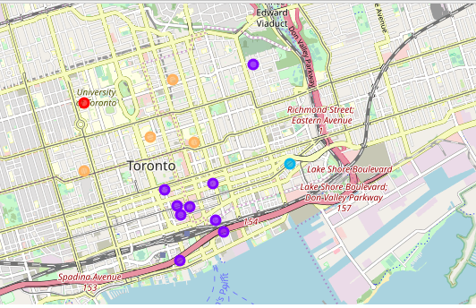
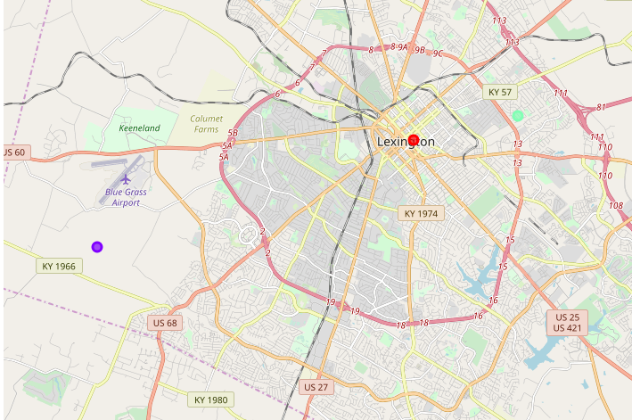
Comparing the clusters in Toronto and Lexington
Toronto’s clusters are generally defined by distance from the University of Toronto
Lexington has fewer clusters, so it is difficult to identify trends
NOTE: Foursquare was missing restaurant data for several Lexington neighborhoods

Slide 8
What types of restaurants are found in each cluster?
Neighbour-hood | 1st Most Common Venue | 2nd Most Common Venue | 3rd Most Common Venue | 4th Most Common Venue | 5th Most Common Venue | 6th Most Common Venue | 7th Most Common Venue | 8th Most Common Venue | 9th Most Common Venue | 10th Most Common Venue
Harbourfront,Regent Park | Restaurant | Café | Mexican Restaurant | Asian Restaurant | French Restaurant | Breakfast Spot | Wings Joint | Doner Restaurant | Fried Chicken Joint | Filipino Restaurant
Ryerson,Garden District | Middle Eastern Restaurant | Japanese Restaurant | Café | Restaurant | Diner | Italian Restaurant | Pizza Place | Ramen Restaurant | Fast Food Restaurant | Sandwich Place
St. James Town | Restaurant | Café | Italian Restaurant | Diner | Breakfast Spot | American Restaurant | Thai Restaurant | Gastropub | BBQ Joint | Seafood Restaurant
Berczy Park | Restaurant | Seafood Restaurant | Café | Japanese Restaurant | Eastern European Restaurant | Breakfast Spot | Greek Restaurant | French Restaurant | BBQ Joint | Thai Restaurant
Central Bay Street | Italian Restaurant | Japanese Restaurant | Sandwich Place | Burger Joint | Café | Middle Eastern Restaurant | Chinese Restaurant | Thai Restaurant | Seafood Restaurant | Sushi Restaurant
Toronto tends to have general restuarants, cafes, and Japanese restaurants.
Several ethnic restaurants appear in the top 10 in each cluster.
Neighbor-hood | 1st Most Common Venue | 2nd Most Common Venue | 3rd Most Common Venue | 4th Most Common Venue | 5th Most Common Venue | 6th Most Common Venue | 7th Most Common Venue | 8th Most Common Venue | 9th Most Common Venue | 10th Most Common Venue
Central Downtown | Vegetarian / Vegan Restaurant | Sandwich Place | Pizza Place | Molecular Gastronomy Restaurant | Latin American Restaurant | Hot Dog Joint | Gastropub | French Restaurant | Diner | Café
Eastland | Restaurant | Vegetarian / Vegan Restaurant | Sandwich Place | Pizza Place | Molecular Gastronomy Restaurant | Latin American Restaurant | Hot Dog Joint | Gastropub | French Restaurant | Diner
Southern Park | Diner | Vegetarian / Vegan Restaurant | Sandwich Place | Restaurant | Pizza Place | Molecular Gastronomy Restaurant | Latin American Restaurant | Hot Dog Joint | Gastropub | French Restaurant
Lexington has several vegetarian/vegan options and sandwich places
Only a few ethnic restaurants make the top 10

Slide 9
Conclusions
Does Lexington have more restaurants than would be expected from a city its size?
Toronto has 479 restaurants listed in Foursquare
Lexington has 49
Since Toronto is 9.1 times the size of Lexington, this is a comparable number per capita
However, Toronto has many more types of restaurants than Lexington
This is especially true for ethnic restaurants

Slide 10
Conclusions
If you’re a vegetarian, Lexington would be a good place to visit
Vegetarian restaurants were prominent in all clusters
Pizza places were found in the top 10 for all Lexington clusters, but it was only in 5th place in the Southern Park neighborhood
Perhaps this would be a good place to start a pizzeria!

Slide 11
Recommendations for future study
Lexington and Toronto are different in many ways
How does Lexington compare to cities which are more similar?
It would be interesting to study cities of similar sice
Is Lexington more in line with other cities in the US?
Is Lexington more similar to southern US cities?

