Slide 1
Active Polymer Brushes
K. Speyer, C. Pastorino and M. Müller

Slide 2
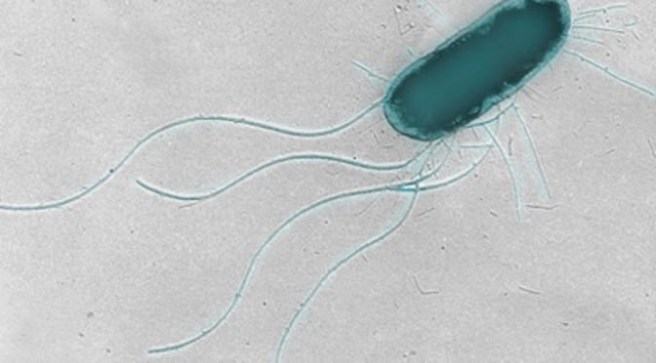
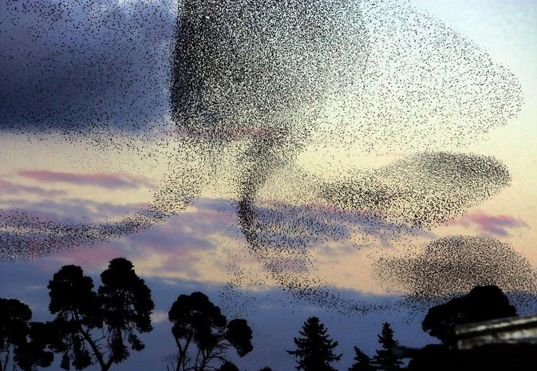
Introduction
Active Matter: Agents that consume energy in order to move or exert mechanical forces
Some cells use flagella (hairs) to propel themselves
A flock of starlings acting as a swarm
Active Polymer Brushes – Kevin Speyer

Slide 3
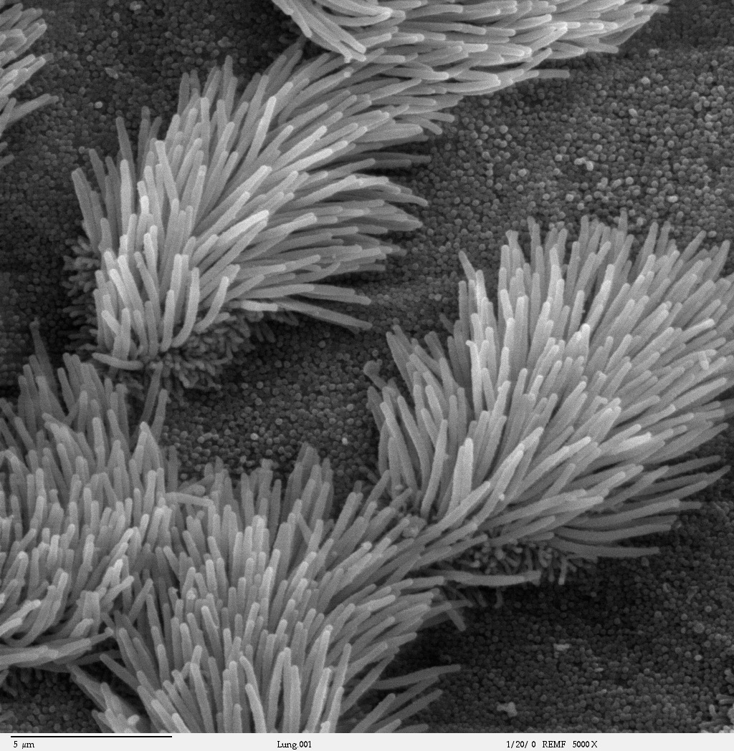
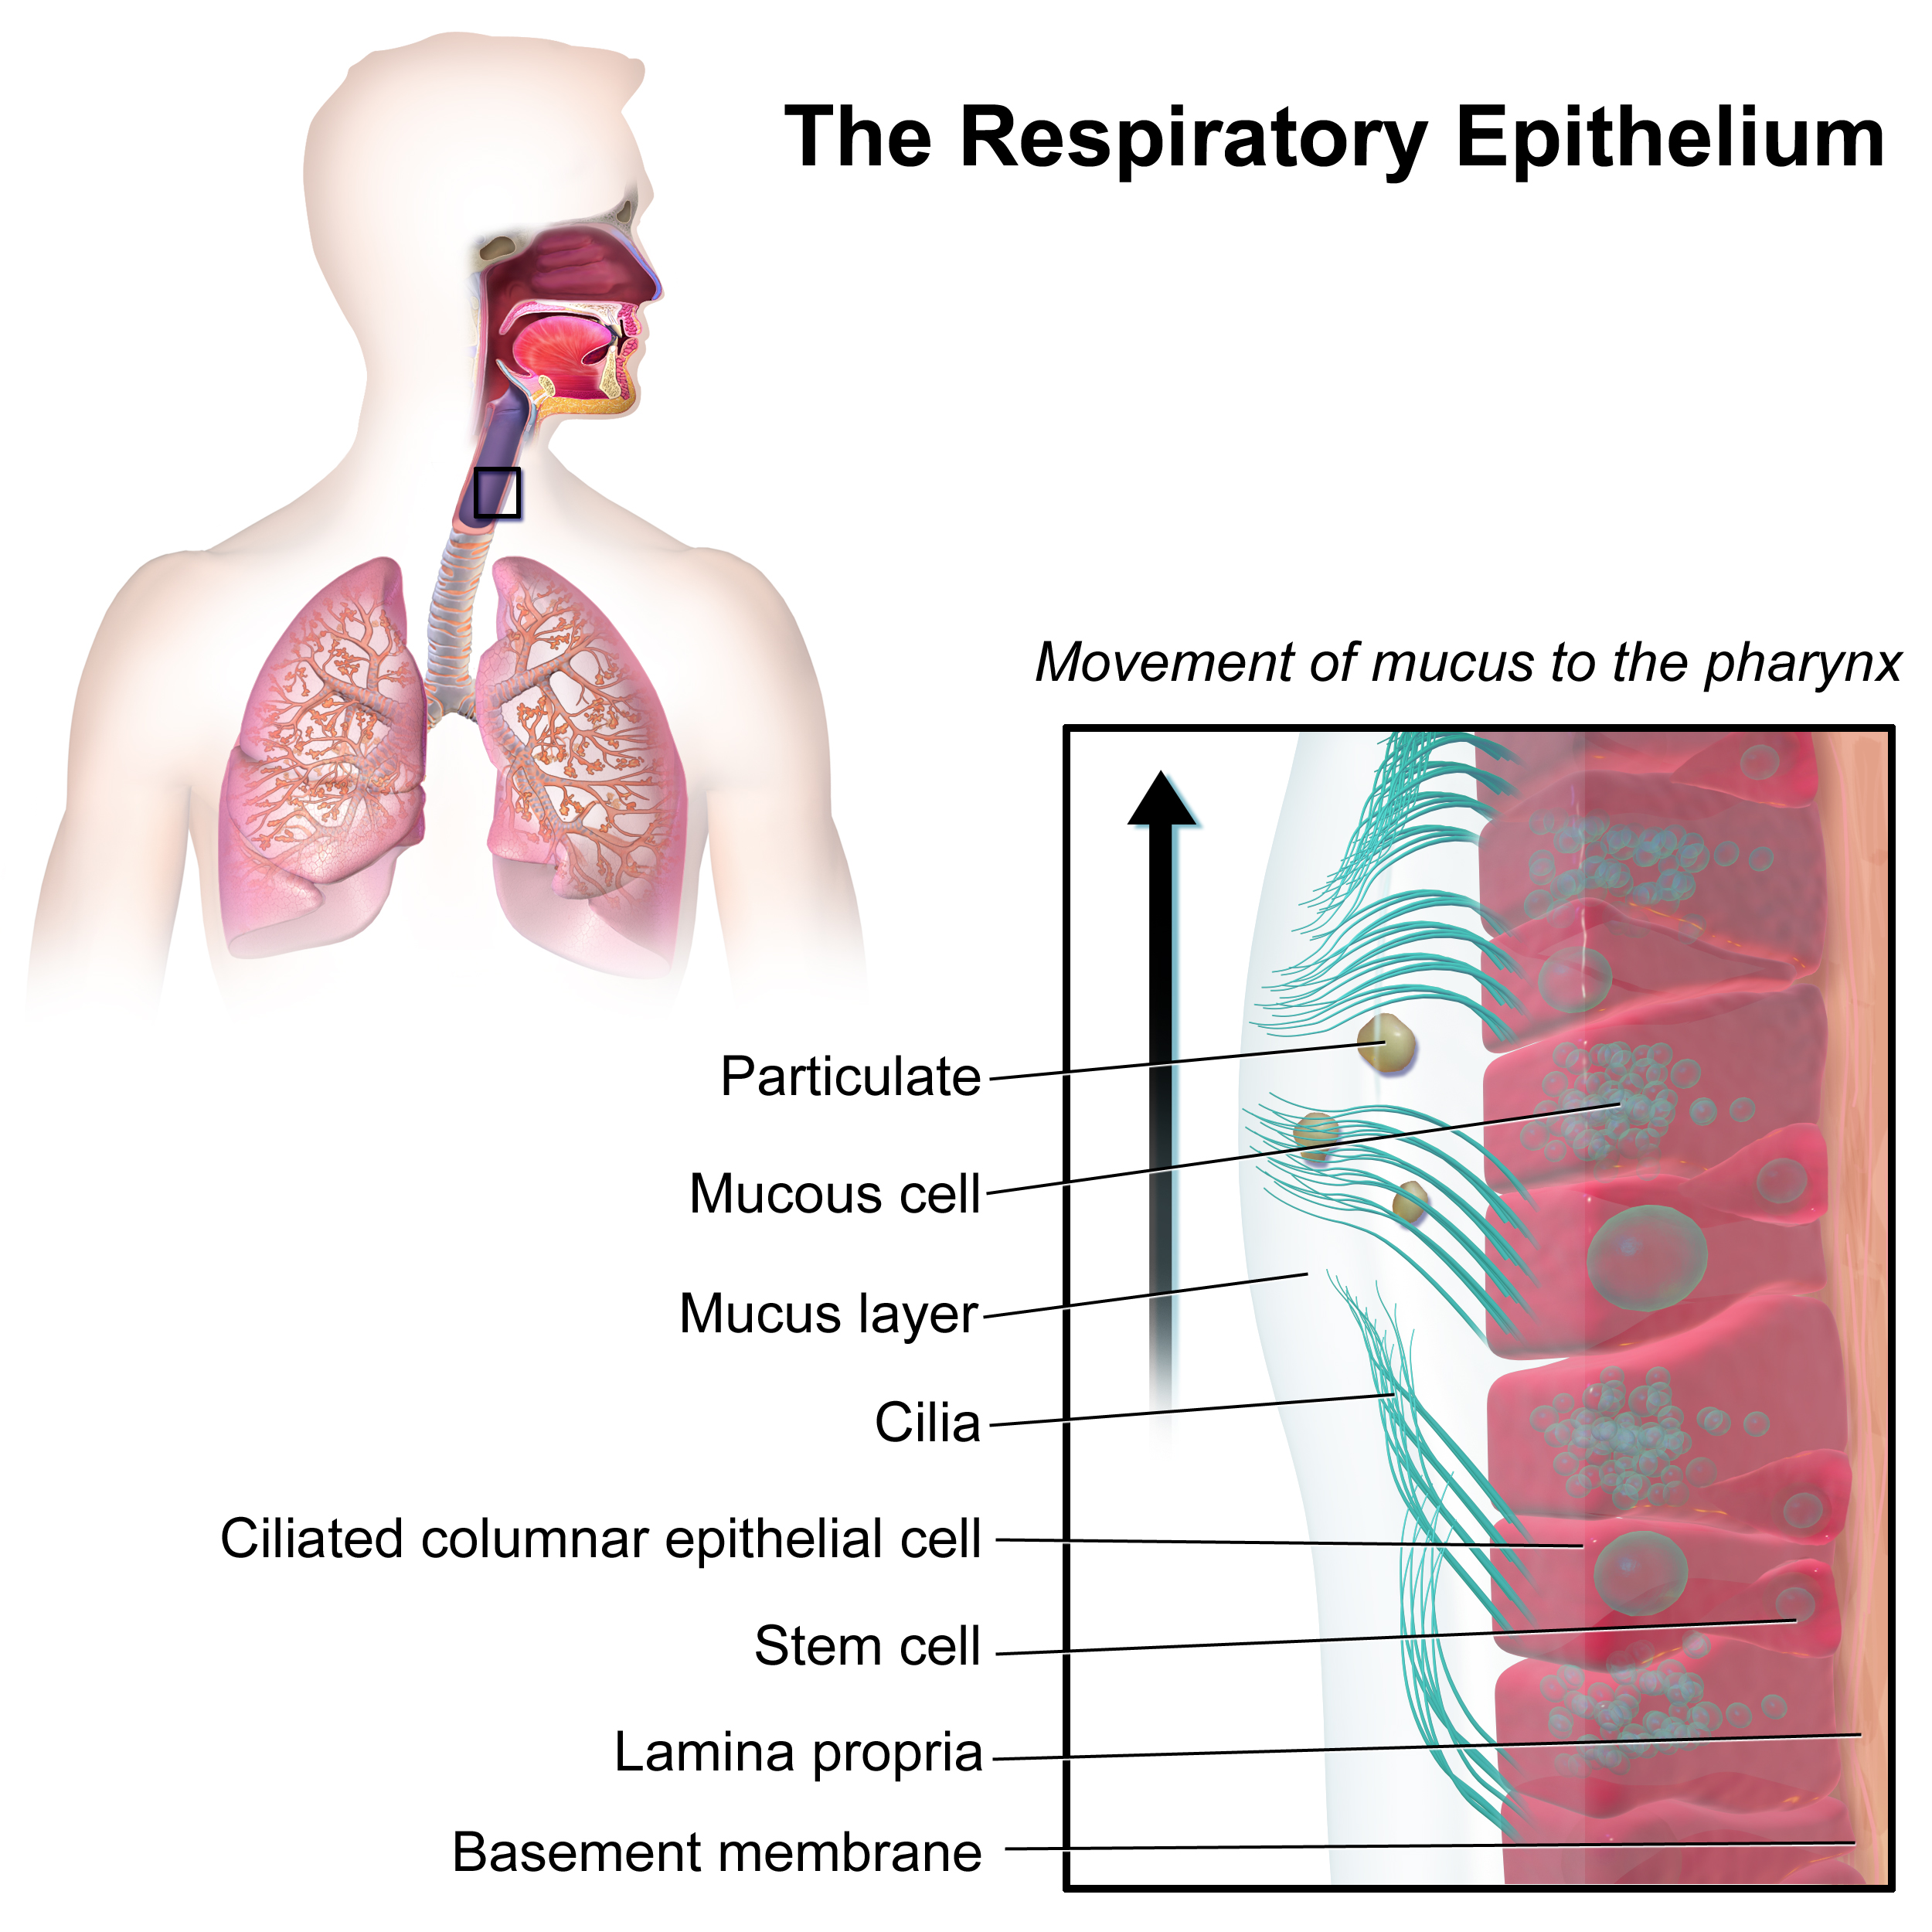
Introduction
Case of study: Cilia
Active Polymer Brushes – Kevin Speyer

Slide 4
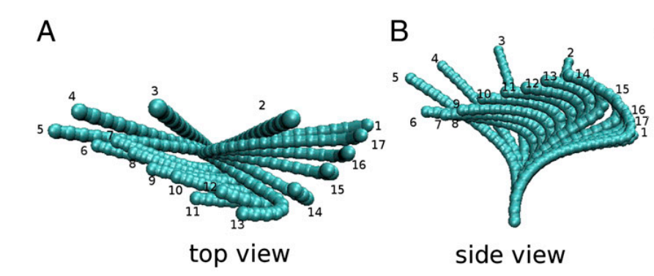
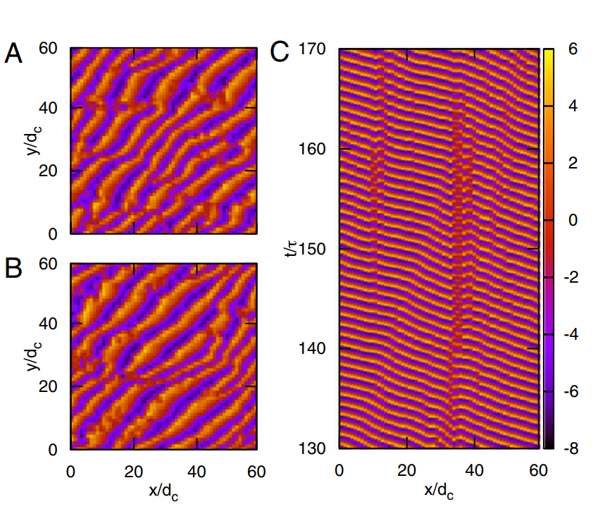
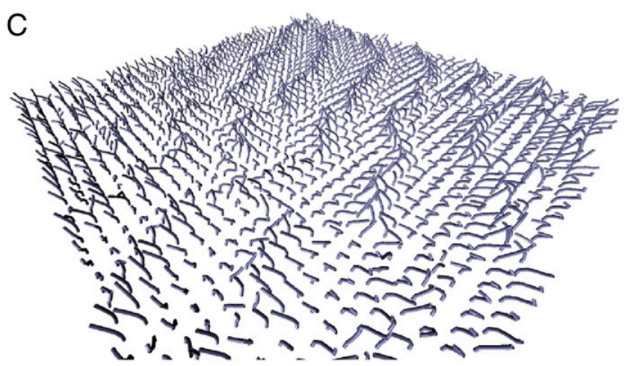
Literature Overview
Elgeti & Gomper; PNAS; 2013
Active Polymer Brushes – Kevin Speyer

Slide 5
Objectives and Workplan
Implement a simple activation model for coarse grain polymer brushes in explicit solvent, and observe hydrodynamic coupling between polymers.
Adapt a 3D activation model
Implement Multiple Time Scale MD (RESPA)
Rewrite cell linked list algorithm
Add Soft Potentials
OpenAcc speedup
Analyze data
Active Polymer Brushes – Kevin Speyer

Slide 6
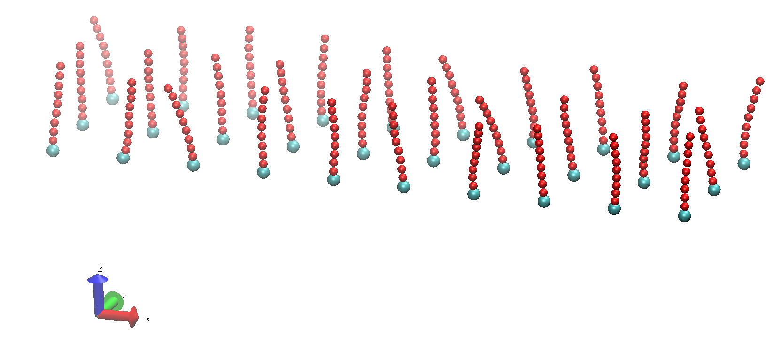
System Studied
Active grafted Polymers + Liquid (not shown)
Active Polymer Brushes – Kevin Speyer

Slide 7
Forces
Intramolecular forces:
- FENE (conectivity)
- Lennard-Jonnes (excluded voume)
- Bending (flexibility)
- Activation
Solvent forces:
- Soft Potential
Thermostat:
- DPD (correct hydrodynamic behaviour)
Wall – Particles Interaction:
- Integrated 9-3 Potential on Bottom Wall
- Specular Wall on Top

Slide 8
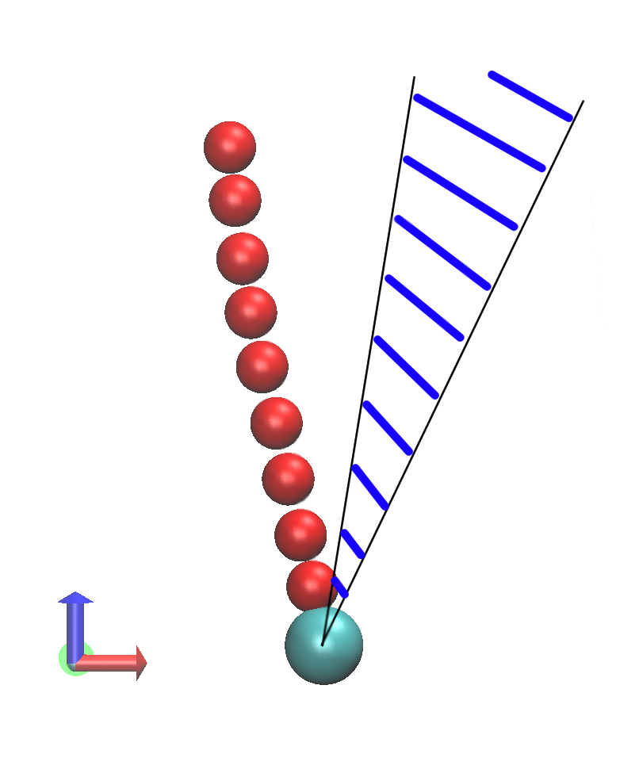
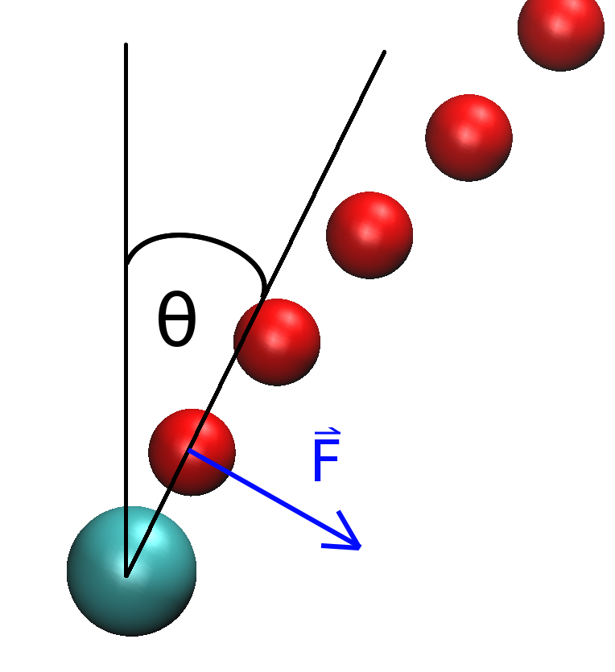
Activation Model
2D Model
Active Zone
Active Polymer Brushes – Kevin Speyer

Slide 9
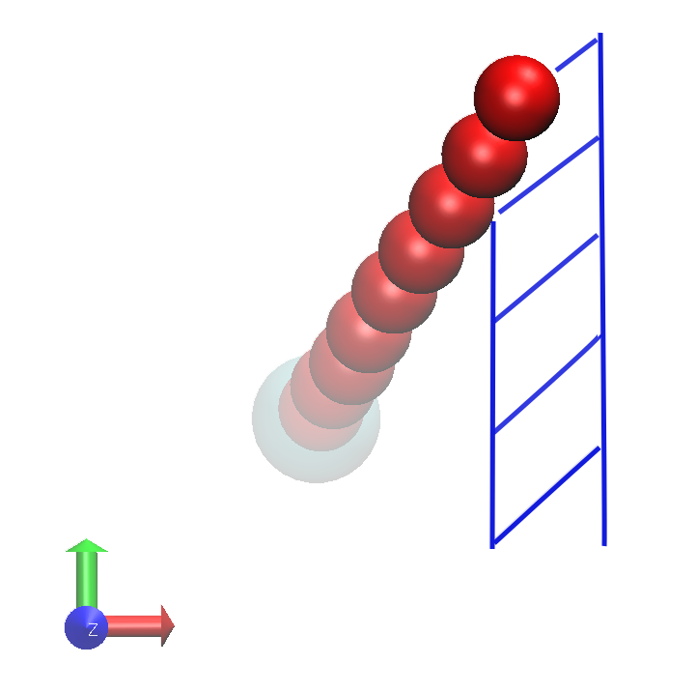
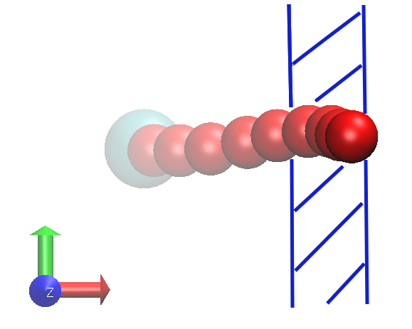
Activation Model
Straightforward 3D Model
Active Zone
Active Zone
At different oscillation angles, the time spent in the Active Zone differs → Oscillation frequency varies
Active Polymer Brushes – Kevin Speyer

Slide 10
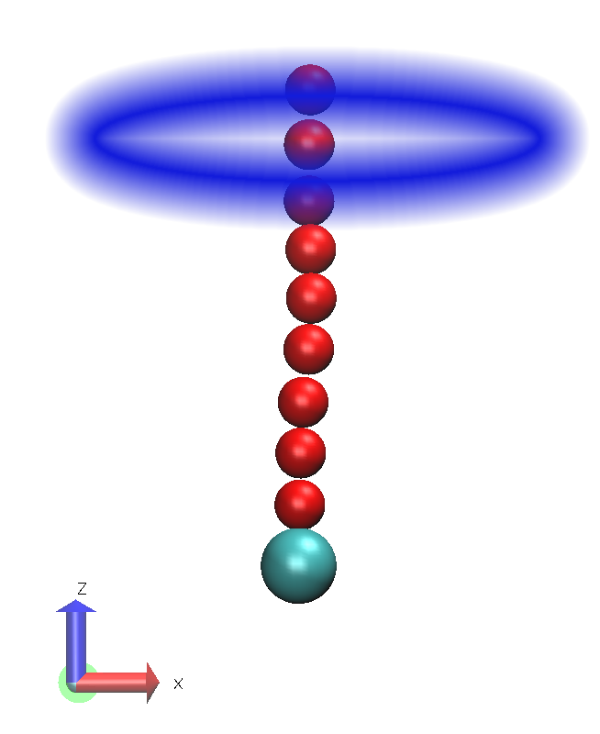
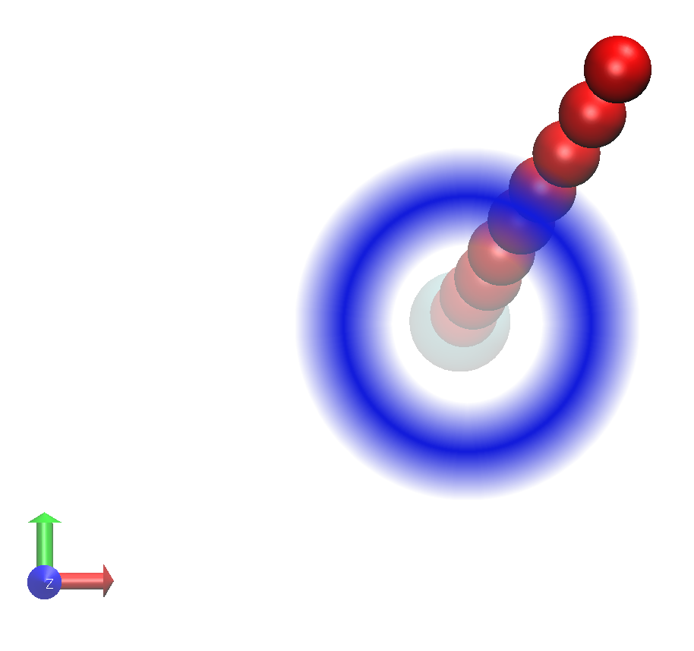
Activation Model
Symetric 3D Model
Active Zone
Active Zone
Active Polymer Brushes – Kevin Speyer

Slide 11
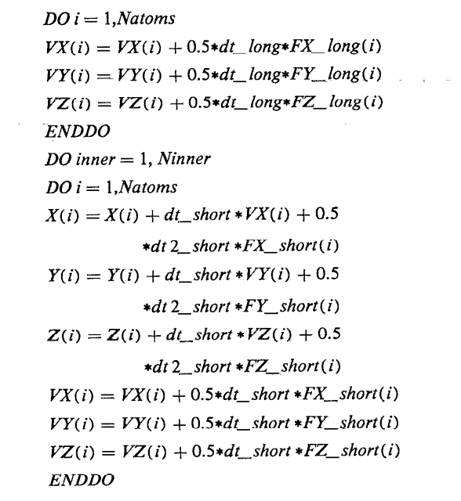
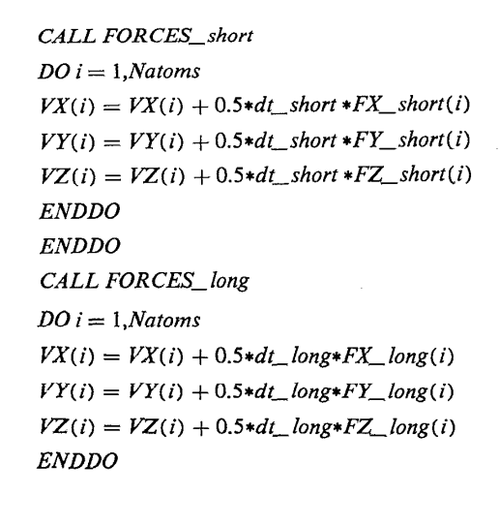
Multiple Time Scale MD
Tuckerman, Berne and Martyna; J. Chem. Phys; 1992
Active Polymer Brushes – Kevin Speyer

Slide 12
Multiple Time Scale MD
Speedup:
x6 with RESPA
x14 with RESPA + OpenMP
Tuckerman, Berne and Martyna; J. Chem. Phys; 1992
Active Polymer Brushes – Kevin Speyer

Slide 13
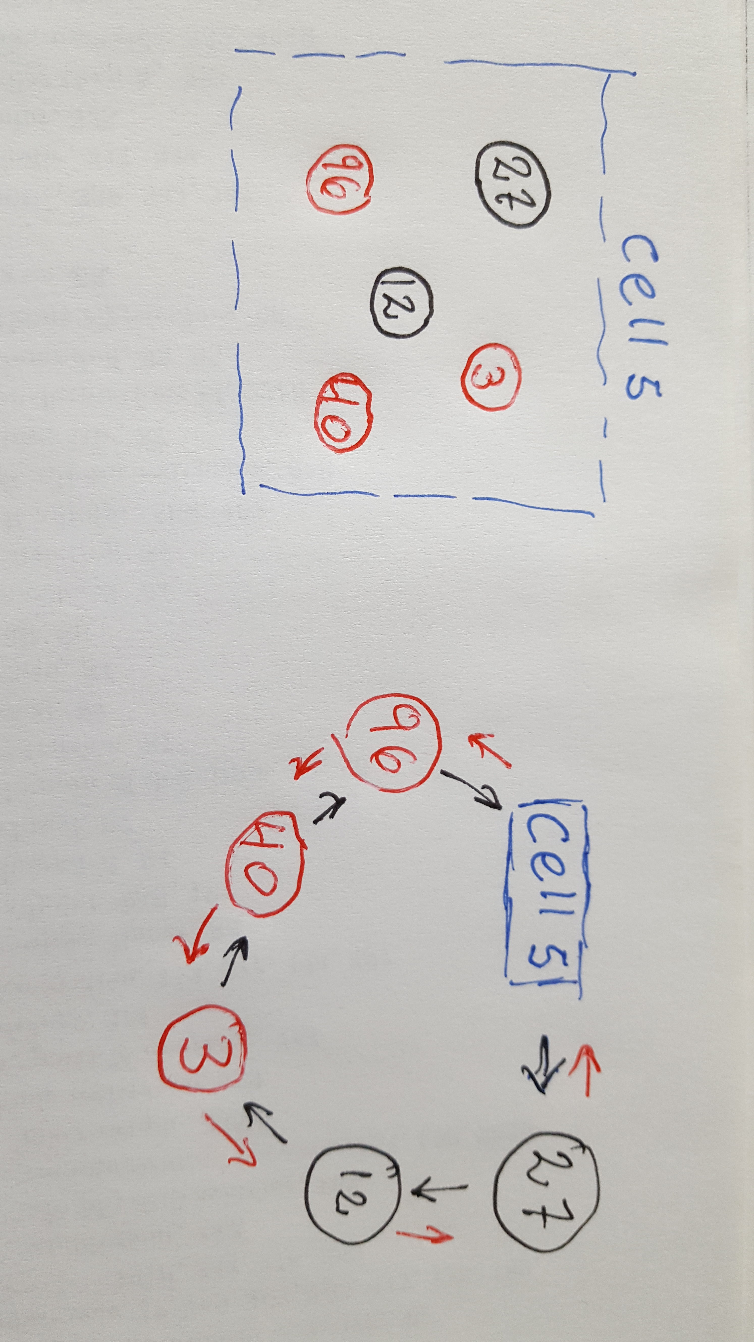
Ordered cell linked list
An ordered cell-linked list allows to loop over the liquid particles (or monomers) alone.
r_neigh(27) = 12
r_neigh(3) = 40
l_neigh(3) = 12
l_neigh(96) = 40
head(5) = 27
tail(5) = 96
Active Polymer Brushes – Kevin Speyer

Slide 14
GPU acceleration
OpenAcc parallelization was attempted, but unsuccessful due to time constrains.
Data transfer between host and device is time-wise expensive.
Routines called often should be parallelized.
Cell linked list algorithm is not trivial to parallelize.
Active Polymer Brushes – Kevin Speyer

Slide 15
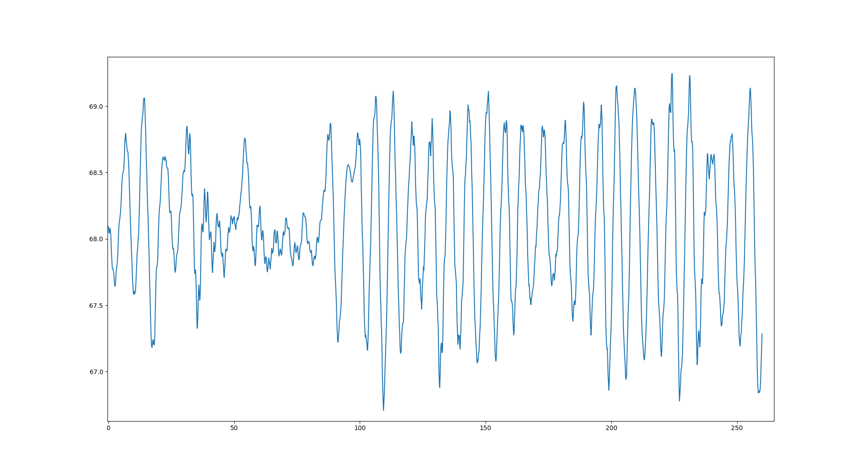
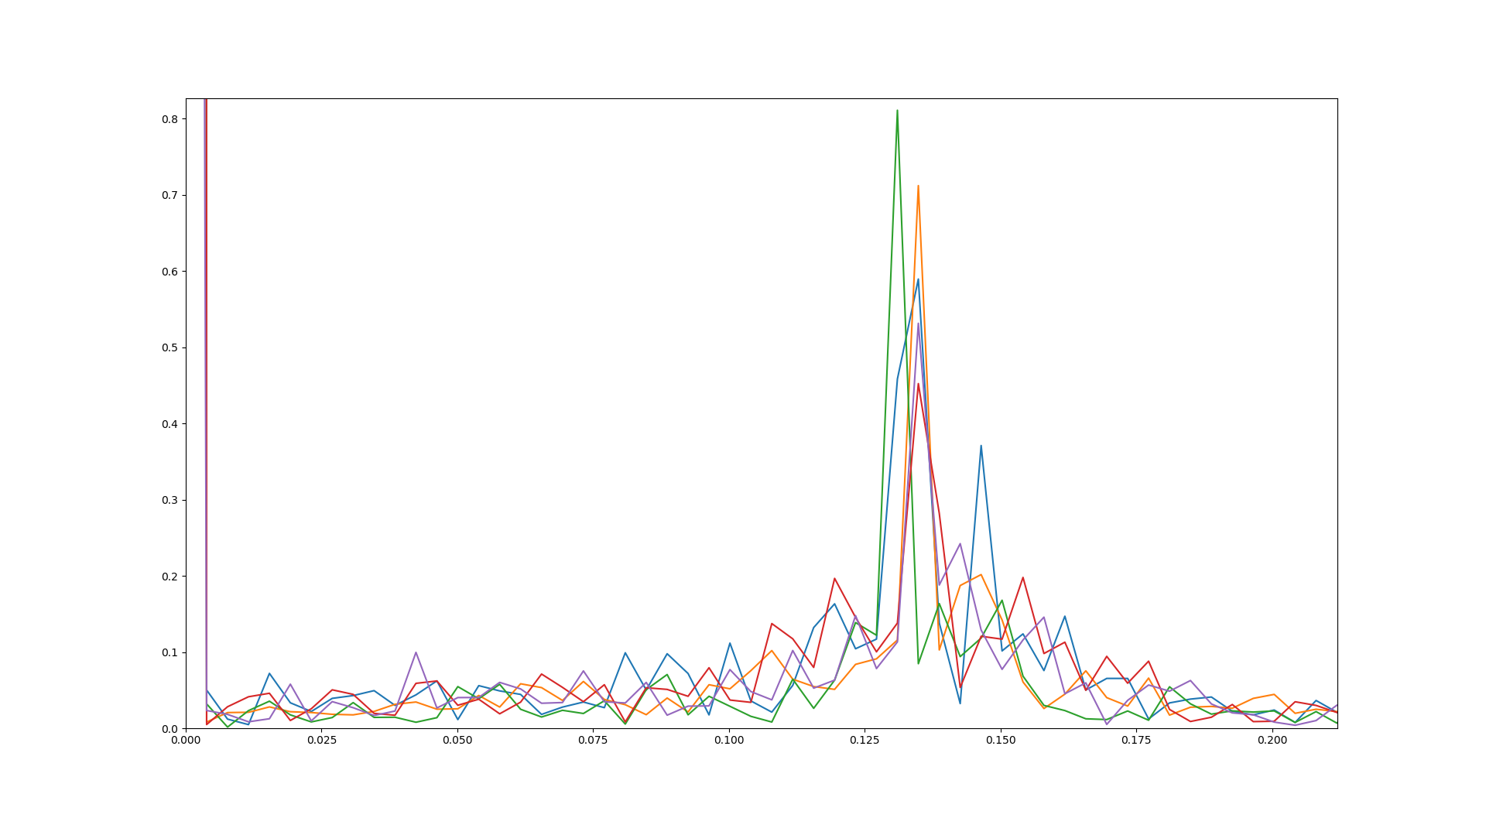
Results: Single Chain Dynamics
Position
T = 7.5
Time
Fourier Transform
Frequency
Active Polymer Brushes – Kevin Speyer

Slide 16
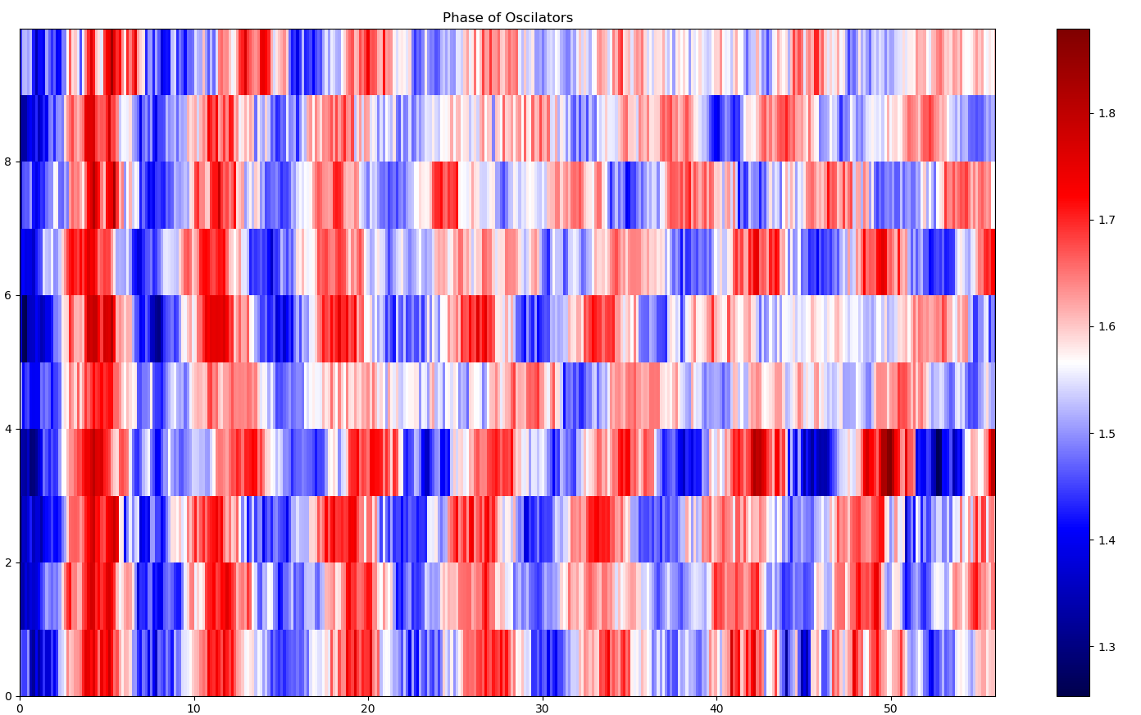
Results: Phase Field Dynamics
Phase
Parameters
asb = 0.4 kBT
ass = 0.04 kBT
γ = 0.03
Position
time
Active Polymer Brushes – Kevin Speyer

Slide 17
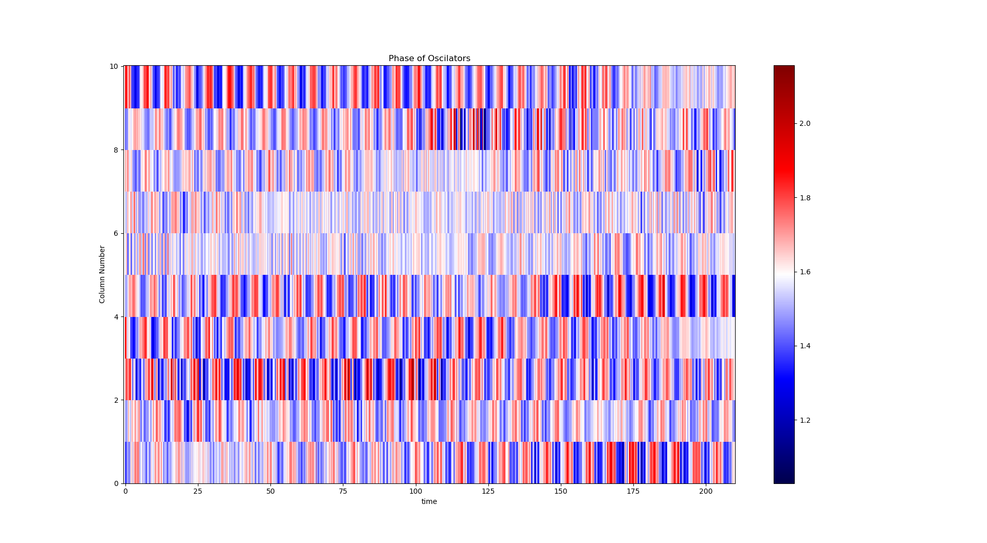
Results: Phase Field Dynamics
Phase
Parameters
asb = 1 kBT
ass = 0.04 kBT
γ = 0.005
Position
time
Active Polymer Brushes – Kevin Speyer

Slide 18
Why was there no synchronization?
1) Complex Interplay between parameters:
A low asb gives no coupling, while a high value hinders the self sustained oscillations
A low γ doesn’t thermalize the system, while a high value hinders the self sustained oscillations
Higher kact → more power pumped into the system → higher friction coefficient (& lower time step ) → loss of phase coherence
2) The activation model enhances the excitation of Internal modes which are unnecesary for the system description and require a higher friction coefficient and lower time step
Active Polymer Brushes – Kevin Speyer

Slide 19
End
Thank you for your hospitality!
Active Polymer Brushes – Kevin Speyer
Active Polymer Brushes – Kevin Speyer

Slide 20
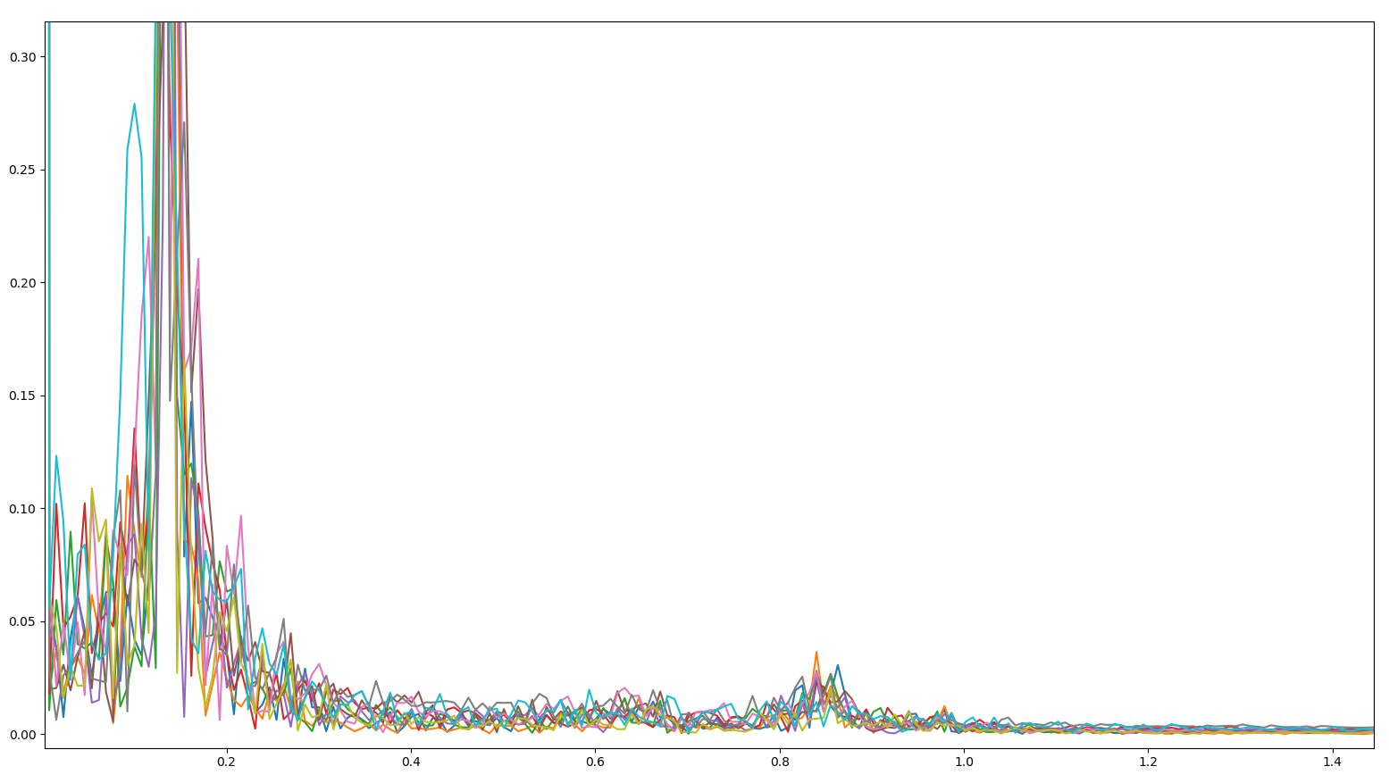
Higher Modes FFT
Fourier Transform
Frequency
Active Polymer Brushes – Kevin Speyer
Active Polymer Brushes – Kevin Speyer

Slide 21
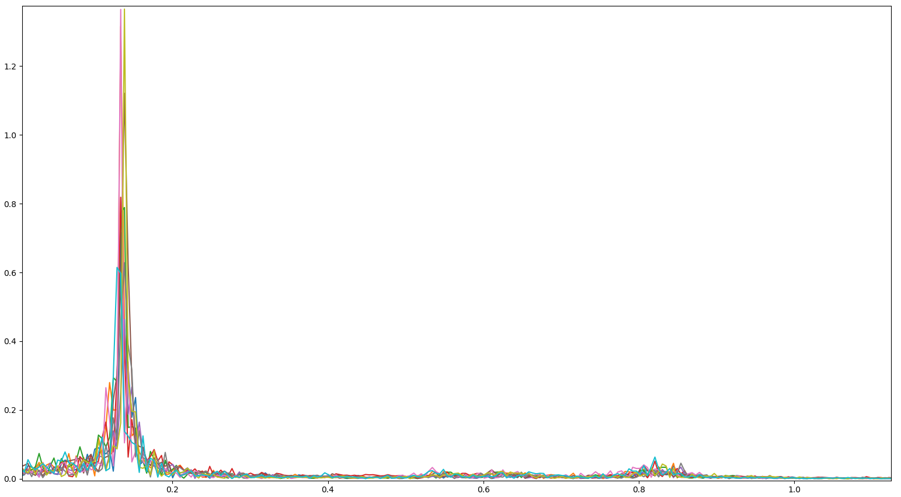
Higher Modes FFT
Fourier Transform
Frequency

Slide 22
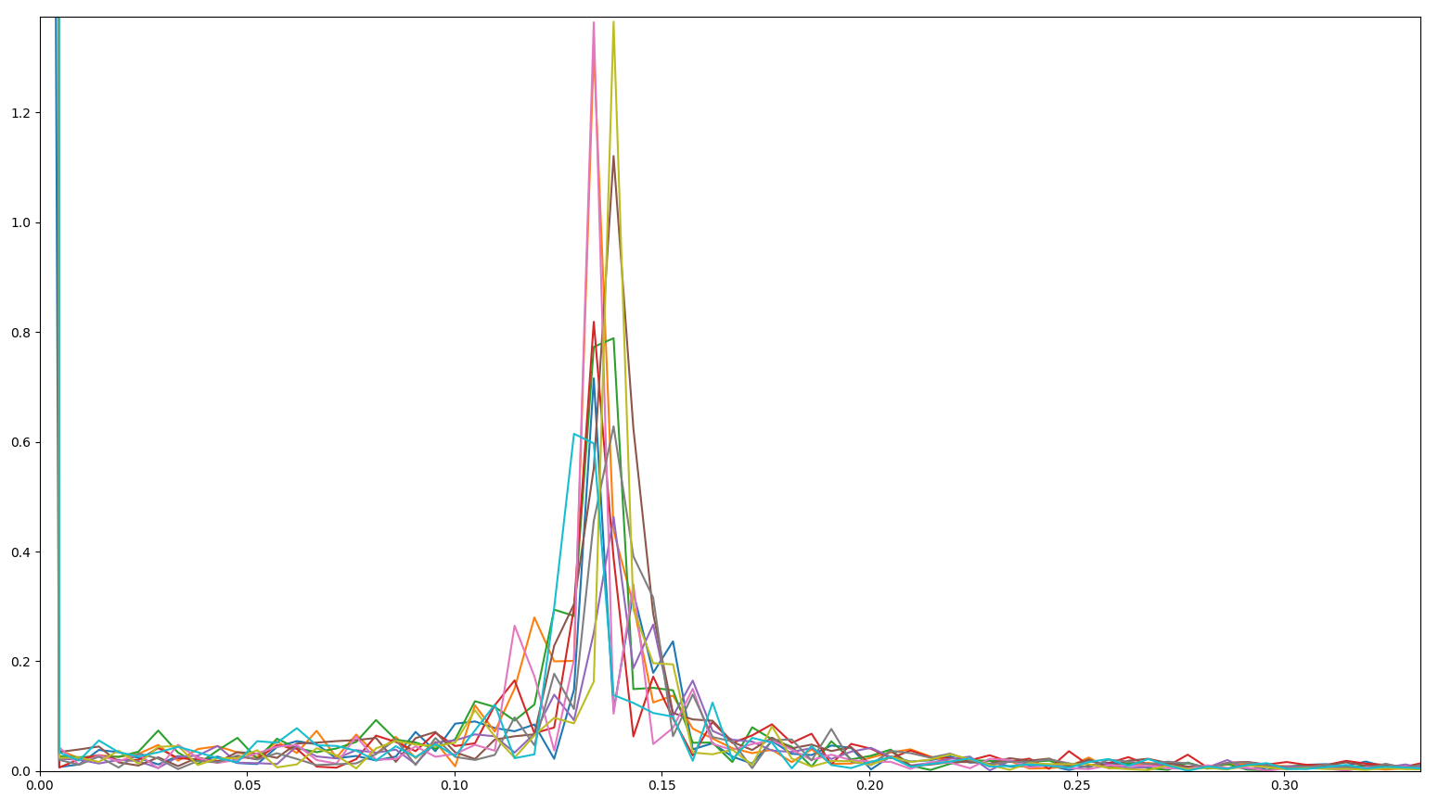
FFT
Fourier Transform
Frequency

Slide 23
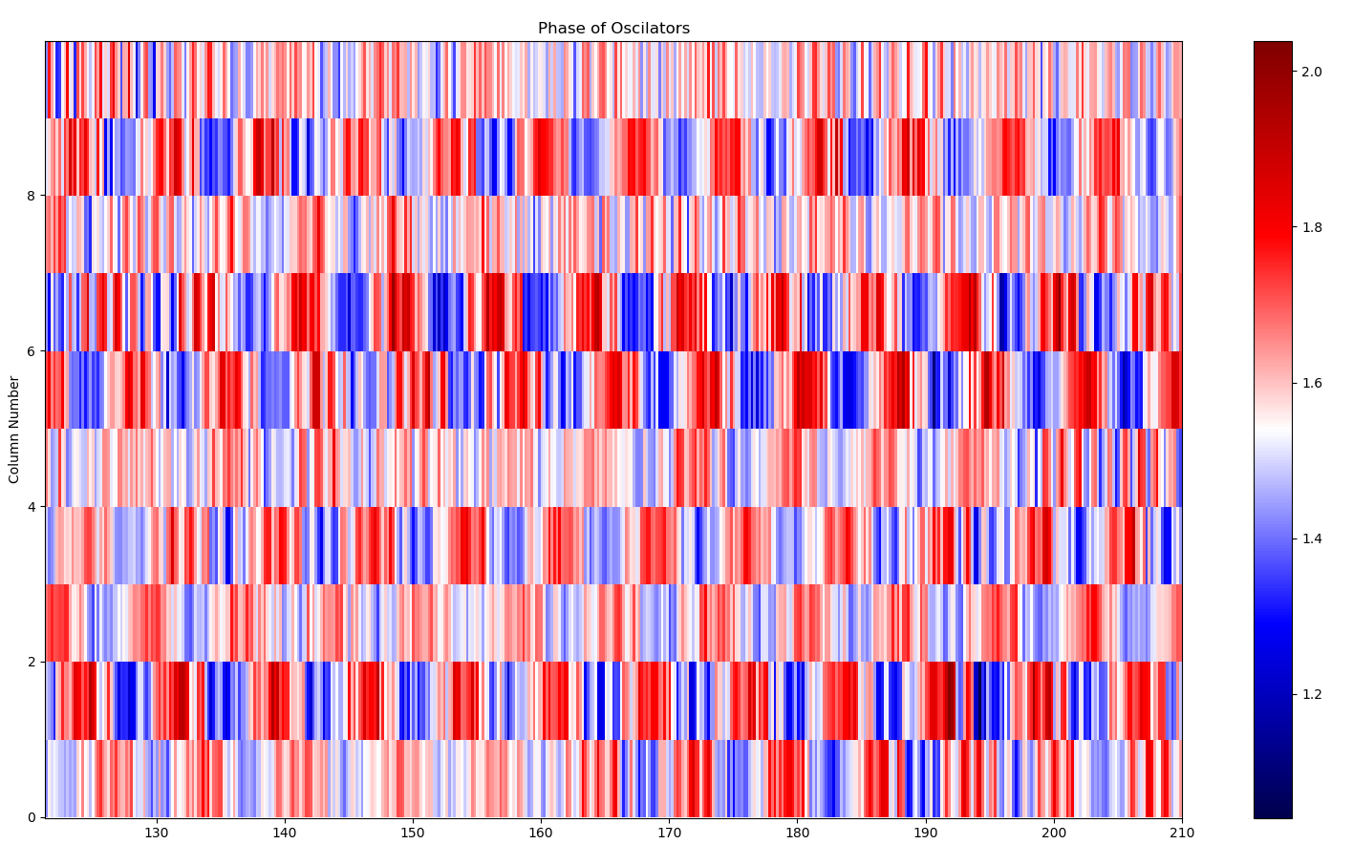
Kimogram
Parameters
asb = 1 kBT
ass = 0.04 kBT
γ = 0.005

Slide 24
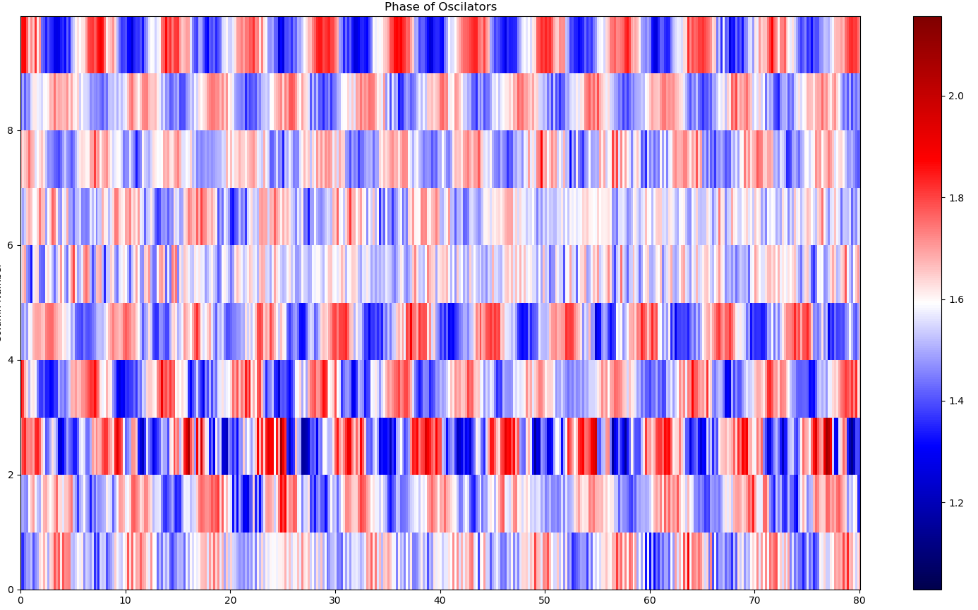
Kimogram
Parameters
asb = 1 kBT
ass = 0.04 kBT
γ = 0.005

Slide 25
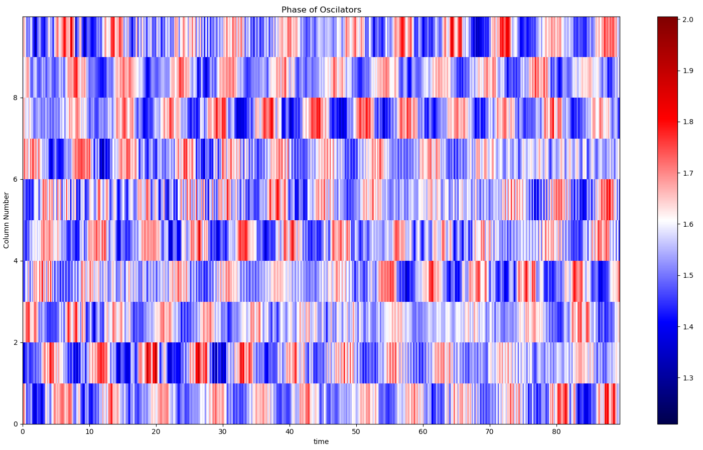
Kimogram 2D Model
Parameters
Asb = 1.3 kBT
ass = 0.4 kBT
γ = 0.01

