Slide 1

4th Workshop on Advanced Techniques
for Scientific Programming and Management of Open source Software Packages
7 – 18 March 2016, Miramare, Trieste, Italy
The Genetic Bike
Supervising: David Grellscheid (UK)
Group 3
Kevin Speyer (Argentina)
Firouzian Amir Hossein (Iran)
Faraji Nafchi Somayeh (Iran)
Tatiana Russkova (Russia)

Slide 2
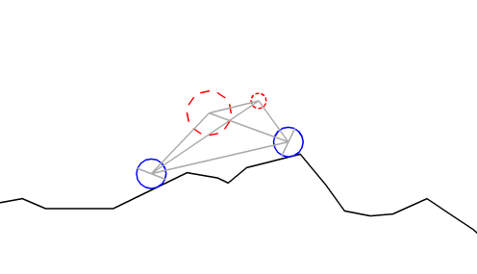
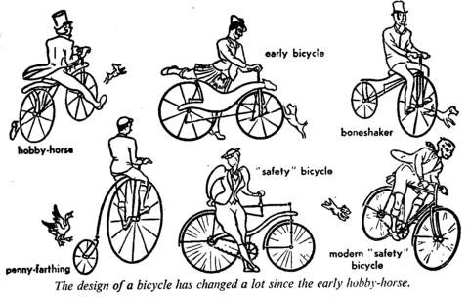
Objective
Create a simulation in Python to evolve an optimal bicycle frame

Slide 3
Main sub-tasks
1. Generation of initial bike's population
2. Physical model of simple bike and ground
3. Implementation of genetic algorithm
4. Visualization of simulation
5. Managing the development tasks

Slide 4
Program design
Bike & Ground:
generation
Bike: generation
Physics:
- Forces
- Ground Int.
Genetic algorithm
- Motion Equation
Scoring
Crossover
Visualization

Slide 5
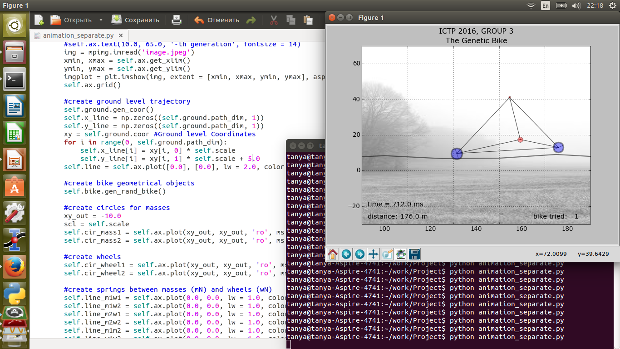
Visualization
- class Render(object): draw bike motion, frame by frame
- Matplotlib plotting library was used

Slide 6
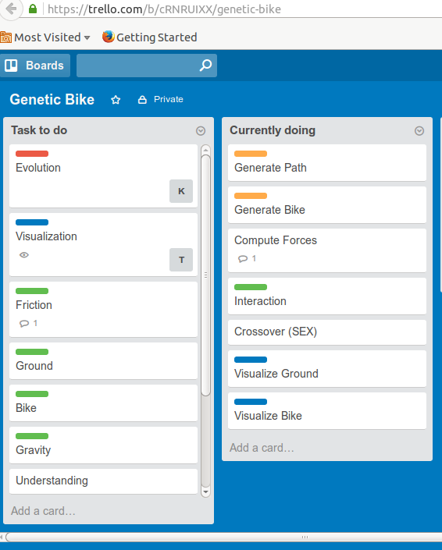
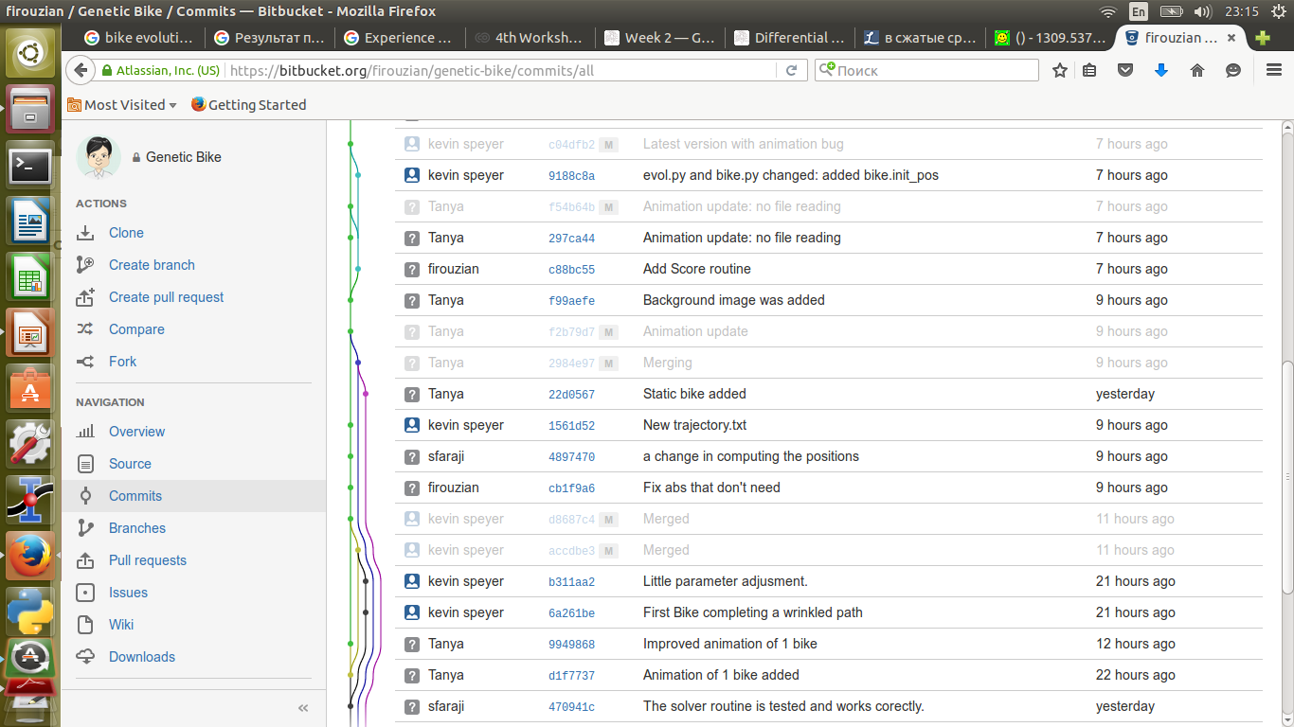
Tools to share information
Trello board
Bitbacket & Mercurial

Slide 7
Problems
- Communication
- Communication
- Communication
- Bottle Neck
- No module testing before commiting

Slide 8
Conclusions
1. Excellent project to learn:
- modern software development tools
- management tools
- documentation software
2. Divide tasks in independent modules is a good option
3. Teamwork:
“The whole may be less than the sum of its parts.”
4. Having project manager

Slide 9

Thank you!

