Slide 1


Face Recognition using PCA
Kevin Valenzuela

Slide 2
How is PCA used in Face Recognition
PCA is a statistical approach used for reducing the number of variables in face recognition. In PCA, every image in the training set is represented as a linear combination of weighted eigenvectors called eigenfaces. These eigenvectors are obtained from covariance matrix of a training image set.
ijarcet.org/wp-content/uploads/IJARCET-VOL-1-ISSUE-9-135-139.pdf

Slide 3
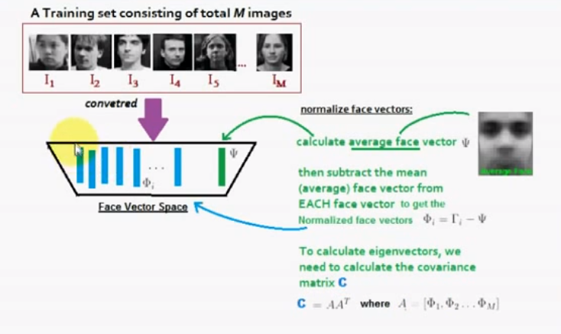

Slide 4


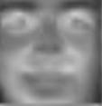




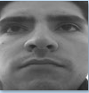

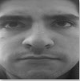


Eigenfaces

Slide 5
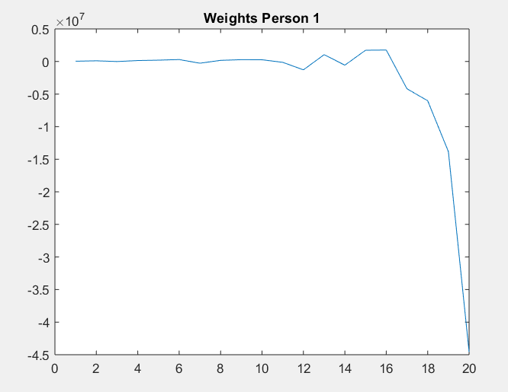
Weights for first person (Me)

Slide 6
Curve of the CMC
Still broken

Slide 7
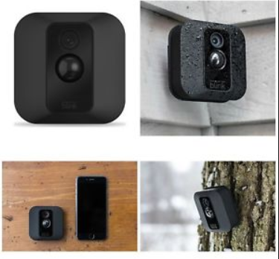
Security Camera Face Detection
Security cameras that only activate when a face is recognized
Only people and maybe larger animals will activate recording
Small animals like birds, squirrels, chipmunks will not trigger cameras
Neither will leaves, branches, debree

Slide 8
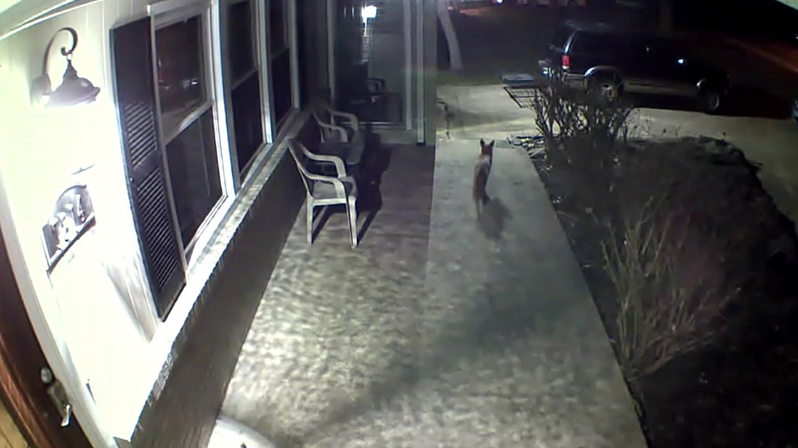
Example of object not recorded

Slide 9
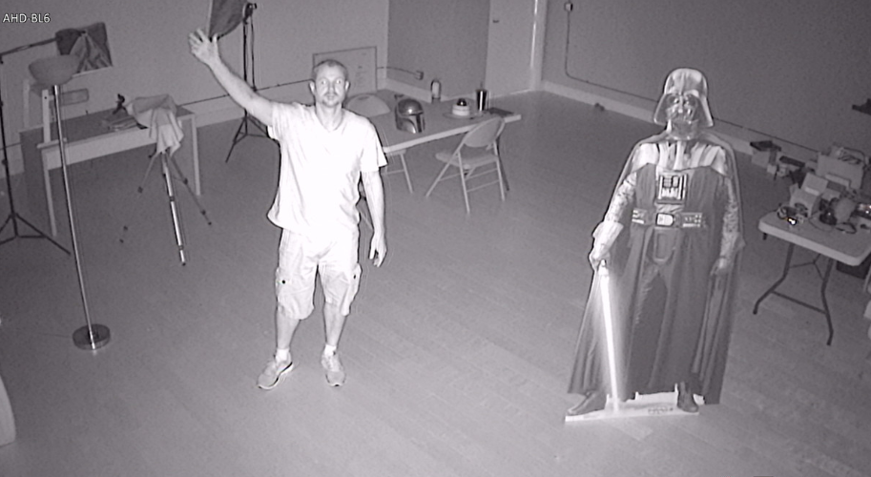
Example of recording turned ON by face detection

Slide 10
Advantages
Less footage to review
Memory space is allocated properly
No false negatives

Slide 11
