Slide 1
Biometrics security system
Feng Jiang

Slide 2
System diagram
Matching report
Face recognition
Iris recognition
Weighted matching
Input>>
Matching threshold
Iris weight
Face weight

Slide 3
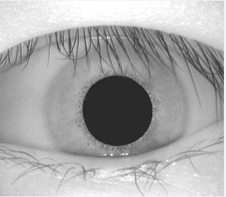
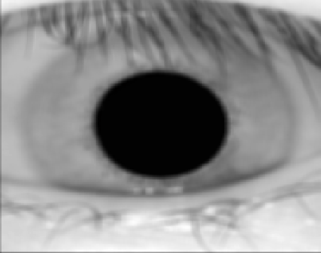
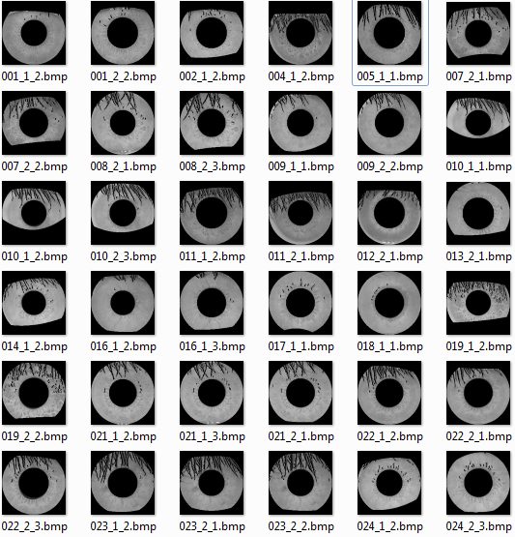

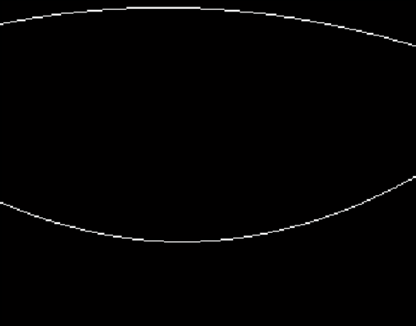
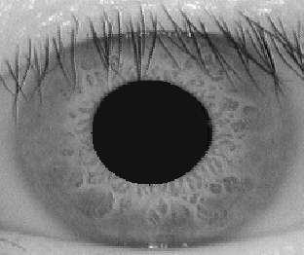

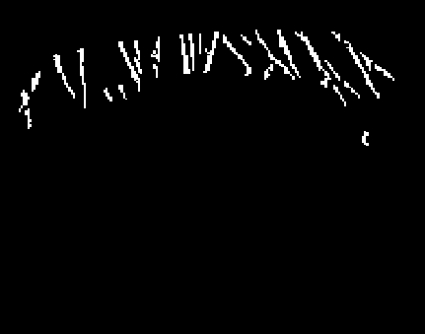
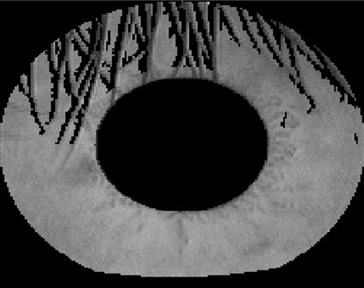
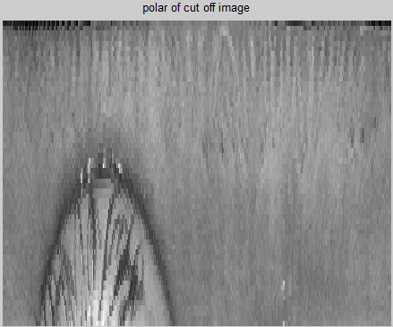
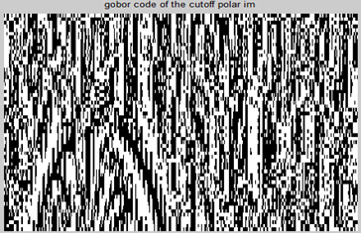
Iris recognition
Segmentation
Mask generation
Feature extraction
Matching

Slide 4
Iris recognition accuracy
1, Most FRR lower than 0.2
2, Most FAR lower than 0.05
Very secure system !
Threshold | 0.4
FRR | 20%
FAR | 5%

Slide 5
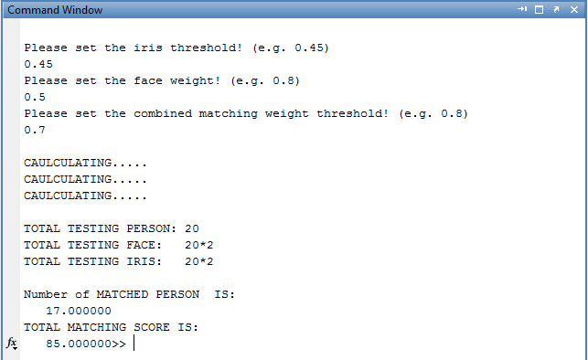
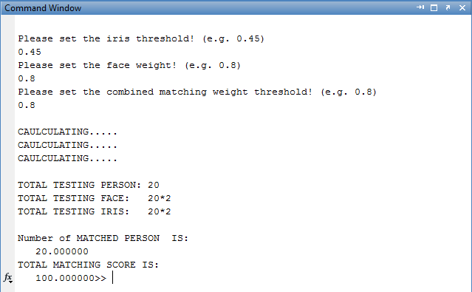
System recognition accuracy
2+2 faces * 20 persons (97.5% rank one matching)
2+2 irises * 20 persons (Th=0.45 85% matched)
Face weight is 0.8 and iris weight is 0.2
100% matched

Slide 6
Biometrics secure system
Features:
Adaptive
Secure
Easy and fast
Applications:
Bank entrance
Home entrance
Lab/working place entrance

