Slide 1
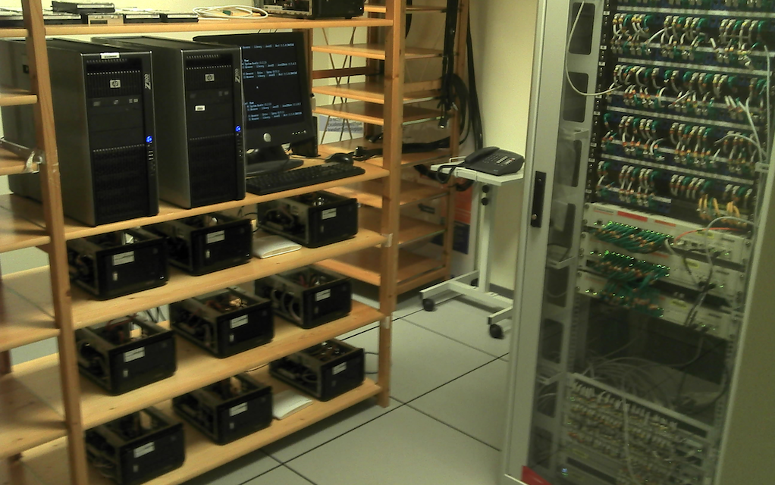
Kevoree Kloud
M@R driven IaaS

Slide 2
Kevoree overview
Model@Runtime platform for distributed dynamic adaptive system
Motivating questions : Benefits of Model@Runtime for:
  dynamic reconfiguration challenges ?
  dynamic distribution (topology) challenges ?
  heterogeneity of computational nodes challenges

Slide 3
Kevoree overview
Models@Runtime
  Shared model representation for distributed nodes
  Offline & online operation, compute@Model level, apply @Runtime
Component-based
  Actor semantics on each ports to closely separate component behavior
  Communication semantics between component in channel
Continuous Design, type definition continuous definition
  Hot (re-)deploy & provisioning
Heterogeneity management with NodeType
  Java Node, Dalvik Node, Arduino Node, Cloud Node (Jails/*BSD, JCloud, mini-cloud, EC2)
Main concepts : Component, Port, Channel, Node, Group, ...

Slide 4
How to manage Cloud with our model@runtime techniques ?
SaaS
  The software (components and channels)
  Already manage with component-based models
PaaS/IaaS
  A set of nodes
Difference between IaaS and PaaS
  The node types
PaaS node types: Manage the adaptation of SaaS
  hosting the set of adaptation primitives
  Each node define some specific properties about virtualization needs
  architecture (x86_64, x86),RAM, CPU frequency, …
IaaS node types: Manage the virtualization layer and its adaptation
  Each node is able to host some PaaS nodes

Slide 5
How to manage Cloud with our model@runtime techniques ?
Available implementations for IaaS node types:
  MiniCloud : Allow to instanciate new node on separate JVM
  Jailsd : Use BSD jails to isolate nodes
    Filesystem, RAM and network isolation
    Only kernel is shared
  AmazonEC2
  VirtualBox (on going work)
  KVM (on going work)
Related work
  Delta cloud : http://deltacloud.apache.org/

