Slide 1



Principles of Sofware Development
Principles of Software Development
Grégory NAIN, gregory.nain@uni.lu
Notes:
Say Hello !

Slide 2
Principles of Sofware Development
Component-Based Software Engineering (CBSE) w. Kevoree (3h)
General concepts of CBSE
Introduction of Kevoree and its Features
Models@Runtime w. Kevoree (~2h)
Introduction to Models@Runtime
Practice on Kevoree
Project (~7h)
Using CBSE & Models@Runtime
Notes:
Say Hello !

Slide 3

Part 0:
Software Components
Principles and concepts
Notes:
Dyanmic adaptibe system

Slide 4

Software components
Why should I use components ?
  Reuse
  Abstraction
  Separation of concerns

Slide 5
Software components
What is a component ?
A Software Component
  Independent & Self-Contained piece of Software
  Conforms to a Component Model
  Can be composed without modifications
  Deployment unit
  Functional unit
  Provides / Requires Services (defined by a set of methods)
  Living element (has a life cycle)

Slide 6

Software components
What is a component made of ?
Name
CompA
CompB
Connect
Parameters
-textColor:String
-visibleLines:int
Services Required
Services Provided

Slide 7
Software components
What is a component model ?
A Component Model defines
  How components must described
  How components can be composed
  How components can interact

Slide 8
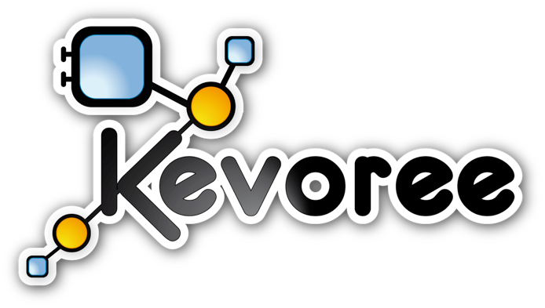


Java Environment for development of
{Dynamic, Embedded, Distributed}
Component-Based Systems
Notes:
Say Hello !

Slide 9
Part 1:
Kevoree World
From design to runtime
Notes:
Dyanmic adaptibe system

Slide 10
Kevoree Component Model
Expressive component model for M@R
Notes:
Dyanmic adaptibe system

Slide 11
Kevoree Model Elements
The hierachy
Component
Ports
  Input / Message
  Input / Service
  Output / Message
  Output / Service
Node
Group
Channel
Channel
Node
Component
Group
Node
Node
Node

Slide 12
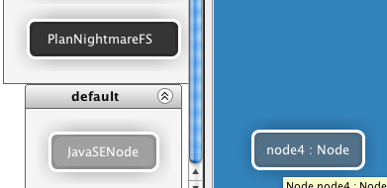
Kevoree features
NodeType & Node
NodeType encapsulate model deployment mechanism
NodeType used to declare deploy target
  JavaSENode
  Java Android
  Arduino
  [...]

Slide 13
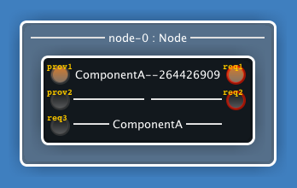
Kevoree features
Component Type
Type defines
  Name
  Library (logical)
  Required and Provided Ports
  Parameters

Slide 14

Kevoree features
Component close isolation
Component : Closed entity, part of a system, has responsibility
Close isolation = CA cannot directly call any method of CB
Components can depend on thirdparty libraries
Ports are the borders of components
Communications are supported by Channels (C1)
thirdparty_A
CA
C1
depends
CB
thirdparty_B

Slide 15
Kevoree features
Port Type
MessagePortType
  Input / Output
  Asynchronous InOnly/OutOnly
  Event driven
ServicePortType
  Provided / Required
  Synchronous InOut MEP
  RMI-like

Slide 16

Kevoree features
Channel Type
Extract communication semantics from component
Explicit complex distribution scenario
Model communication semantics
NodeA
NodeA
VS
ChannelA
ChannelB
AbstractBus
NodeB
NodeC
NodeB
NodeC

Slide 17
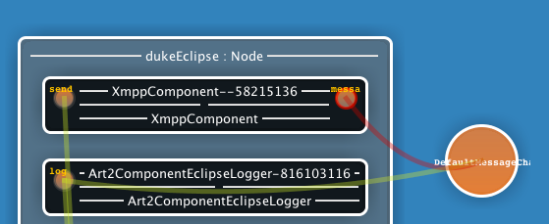
Kevoree features
ChannelType
ChannelType defines
  Lower and Upper bindings bounds
  Lower and Upper distribution bounds
Can support
  Messages only
  Services only
  Both
Implement the distribution/call mechanism
Can implement complex behavior
  Priority, parallel, sequence, first answer, collection, etc.

Slide 18
Kevoree features
Channel Instance
Channel Instance : deployed by fragments
One fragment on each node using channel, FIFO semantics
ChannelFragment communicates with
    Local bound ports
ChannelFragment is not allowed to communicate with remote port
B
B
A

Slide 19
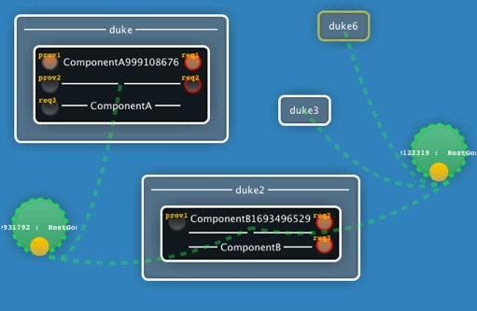
Kevoree features
GroupType & Group
Group instances ensure model consistency for related nodes, at runtime
Group are splitted in distributed fragments
GroupType <=> synchronization algorithm
Main algorithms
  Gossip (propagation)
      Best effort
  Paxos (consensus)
      Hard synchronization

Slide 20
Kevoree Overview
Expressive component model for M@R
Notes:
Dyanmic adaptibe system

Slide 21
Kevoree World
Overview
Development
Component
Runtime
Deployment
Assembly

Slide 22
Kevoree World
Overview
Development
Runtime
Deployment
Assembly
Modeling
Framework
Annotation API
Compilation Plugin
Definition of component’s contracts
Extracts the component model @ compile time
Code generator from ECore Models

Slide 23
Kevoree World
Overview
Development
Runtime
Deployment
Assembly
Kevoree Editor
Edition of assembly/application model

Slide 24
Kevoree World
Overview
Development
Runtime
Deployment
Assembly
Java SE Runtime
JavaScript Runtime
C++ Runtime
Allow live reconfiguration / adaptations
Run Kevoree in any JavaScript container (NodeJS, WebBrowser)
Native C++ Implementation for best performances
Android APK Runtime
(Deprecated)
Arduino µRuntime
(Deprecated)

Slide 25
Kevoree tools
Runtime, Editor & Model@Runtime
Notes:
Dyanmic adaptibe system

Slide 26
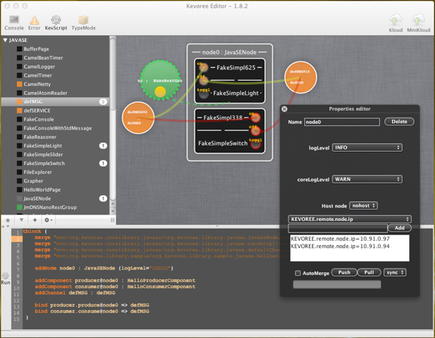
Kevoree tools
Model Editor
Synch. Group
Node Instance
Component Instance
Component Libraries
Channel
Instance
Number of instances
Node properties
KevScript Console

Slide 27
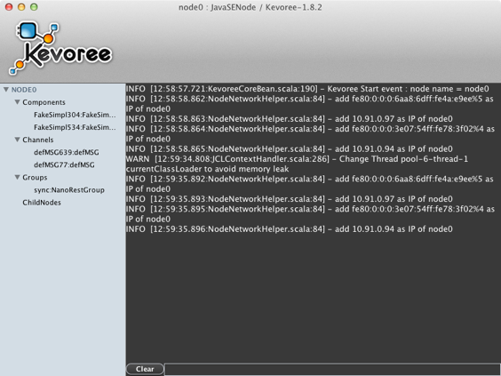
Kevoree tools
JavaSe Runtime
Running elements
System log
Command prompt

Slide 28
Kevoree tools
Model@Runtime
Abstract model of the running system
New Model
Model Edition
Adaptation of the runtime
Push
Kevoree Editor
Java SE Runtime
Pull

Slide 29
Let Try : Practice A !

Slide 30
Part 2:
Develop with Kevoree
From Source Code to Deployment

Slide 31
Kevoree Framework
Java Annotation API

Slide 32
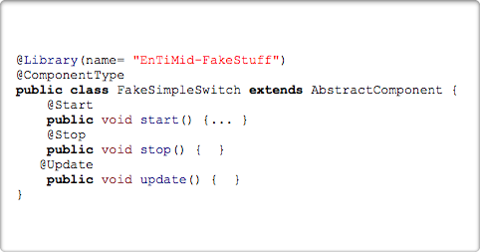
Kevoree Framework
Java Annotation API : Type definition commons
Plain Old Java Class approach ...
Declare Type contract as header of Java Class
  @ComponentType
  @ComponentFragment
  @ChannelType, [...]
Declare lifecycle method on simple void method
  @Start
  @Stop
  @Update (dictionary update)
@Library to group Type definition

Slide 33

Kevoree Framework
Java Annotation API : ComponentType
ComponentType == Java Class
@ComponentType or @ComponentFragment
@RequiredPort & @ProvidedPort to declare component type contract
Go beyond Java limitation
  Expose in one class many port with the same Java interface
  Expose one class on multiple port
  Port Mapping & Multi mapping
@Requires({
@RequiredPort(name = "on", type=PortType.MESSAGE),
@RequiredPort(name = "onoff", type=PortType.SERVICE,
    className=OnOffService.class, optional=true)
})
@Provides({
  @ProvidedPort(name = "log", type=PortType.MESSAGE)
})
@ComponentType
public class FakeSimpleSwitch extends AbstractComponent {
@Port(name="on")
public void portOnUpdate() {... }
  @Ports({
    @Port(name="on"),
    @Port(name="onoff", method="on"),
  })
  public void lightOn() {
    getPortByName("log", MessagePort.class)
    .process("log log");
  }
}

Slide 34
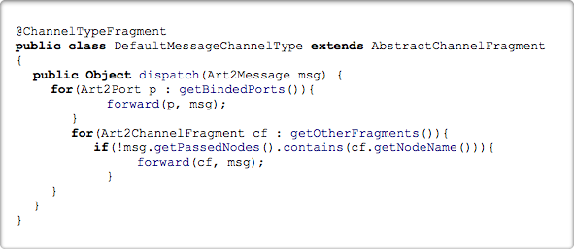
Kevoree Framework
Java Annotation API : ChannelType
@ChannelTypeFragment
Input binding use dispatch method
forward primitive to forward message
    local binding
    other fragment
Sample : Distributed Topic
B
B
A

Slide 35
Kevoree Framework
Compilation Chain

Slide 36




Kevoree tool chain
General Overview
sources
Component
create
binaries
library
Developer
assemble
provision
deploy

Slide 37
Kevoree tool chain
Maven - Software Life Cycle Management
  Project Object Model (POM)
      Describes the project, its dependencies and actions to be realized
  Goals and Phases
      clean, compile, test, install, deploy
  Artifacts and Plugins
      Stored in repositories
      <groupId>/<artifactId>/<version>

Slide 38
Kevoree tool chain
Maven - Software Life Cycle Managment
Project Object Model (POM)
  Specifies the dependencies
  Plugins to run
  Sub-Modules
  Repositories where to find dependencies and plugins

Slide 39
<project>
<modelVersion>4.0.0</modelVersion>
<groupId>lu.snt.iot.serval.rn12</groupId>
<artifactId>lu.snt.iot.serval.rn12.root</artifactId>
<version>1.0.0-SNAPSHOT</version>
<packaging>pom</packaging>
<name>Serval::ResearchersNights::ROOT</name>
<dependencies>
<dependency>
<groupId>org.kevoree.tools</groupId>
<artifactId>org.kevoree.tools.javase.framework</artifactId>
<version>${kevoree.version}</version>
</dependency>
<dependency>
<groupId>org.kevoree.tools</groupId>
<artifactId>org.kevoree.tools.annotation.api</artifactId>
<version>${kevoree.version}</version>
</dependency>
</dependencies>
<modules>
<module>../lu.snt.iot.serval.rn12.ecl</module>
<module>../lu.snt.iot.serval.rn12.bodySensors</module>
[....]
<module>../lu.snt.iot.serval.rn12.karotz</module>
</modules>
<build>
<plugins>
<plugin>
<groupId>org.kevoree.tools</groupId>
<artifactId>org.kevoree.tools.annotation.mavenplugin</artifactId>
<version>${kevoree.version}</version>
<extensions>true</extensions>
<configuration>
<nodeTypeNames>JavaSENode</nodeTypeNames>
</configuration>
<executions>
<execution>
<goals>
<goal>generate</goal>
<goal>compile</goal>
</goals>
</execution>
</executions>
</plugin>
<!-- Felix BnD plugin : allow Bundle packaging : generate OSGi JAR -->
<plugin>
<groupId>org.apache.felix</groupId>
<artifactId>maven-bundle-plugin</artifactId>
<version>2.3.5</version>
<extensions>true</extensions>
</plugin>
<!-- Java compiler plugin -->
<plugin>
<groupId>org.apache.maven.plugins</groupId>
<artifactId>maven-compiler-plugin</artifactId>
<version>2.3.2</version>
<configuration>
<source>1.6</source>
<target>1.6</target>
<encoding>${project.build.sourceEncoding}</encoding>
</configuration>
</plugin>
</plugins>
</build>
<repositories>
<repository>
<id>kevoree-release</id>
<url>http://maven.kevoree.org/release</url>
</repository>
<repository>
<id>kevoree-snapshots</id>
<url>http://maven.kevoree.org/snapshots</url>
</repository>
</repositories>
<pluginRepositories>
<pluginRepository>
<id>plugin.kevoree-github</id>
<url>http://maven.kevoree.org/release</url>
</pluginRepository>
<pluginRepository>
<id>plugin.kevoree-snapshots</id>
<url>http://maven.kevoree.org/snapshots</url>
</pluginRepository>
</pluginRepositories>
</project>

Slide 40

Kevoree tool chain
Maven - Software Life Cycle Managment
@Requires({
@RequiredPort(name = "on", type=PortType.MESSAGE),
@RequiredPort(name = "onoff", type=PortType.SERVICE,
    className=OnOffService.class, optional=true)
})
@Provides({
  @ProvidedPort(name = "log", type=PortType.MESSAGE)
})
@ComponentType
public class FakeSimpleSwitch extends AbstractComponent {
@Port(name="on")
public void portOnUpdate() {... }
  @Ports({
    @Port(name="on"),
    @Port(name="onoff", method="on"),
  })
  public void lightOn() {
    getPortByName("log", MessagePort.class)
    .process("log log");
  }
}
mvn compile
Bytecode
mvn test
56
12
mvn install
Local Repository
mvn deploy

Slide 41

Kevoree Framework
Continous Design
Produces New Binaries
Compilation Plugin
Update
Model Edition
Push
Kevoree Editor
Java SE Runtime

Slide 42
Kevoree Framework
KevScript

Slide 43
Kevoree Framework
KevScript
Scripting language to manipulate models
  addComponent <component Name>@<node name> : <component type>
  removeComponent <component Name>@<node name>
  addChannel <channel name> : <channel type>
  bind <component name>.<port name>@<node name> => <channel name>
Generate the script & execute

Slide 44
Let Try : Practice B !

Slide 45
Part 3:
Advanced Kevoree
Model@Runtime, Runtime Adaptation

Slide 46
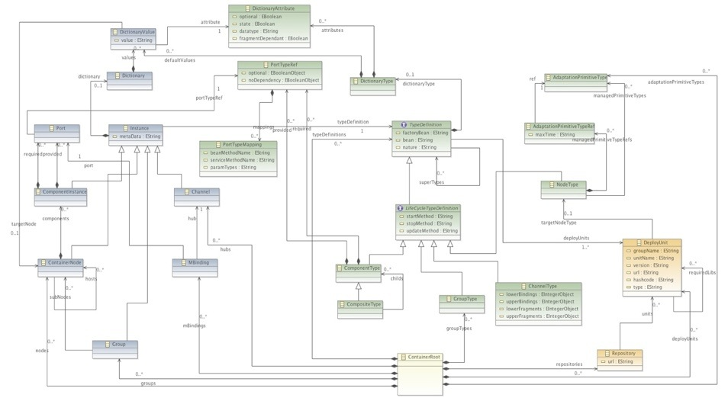
Kevoree Advanced
Kevoree Modeling Framework (KMF)
Meta-Model
Object Model
Kevoree Modeling Framework (KMF)
Loader
Serializer
Cloner

Slide 47
Kevoree Advanced
Model@Runtime
cmp:KevComp
Abstract model of the running system
cmp:KevComp
cmp:KevComp
cmp:KevComp
cmp:KevComp
Synch
Java SE Runtime

Slide 48
Kevoree Advanced
Model@Runtime : Reading the model
int instancesNumber = localModel.getComponentInstanceForJ().size();
for(
ComponentInstance inst :
localModel.getComponentInstanceForJ()) {
System.out.println(
inst.getName()
+ «:»
+ inst.getType.getName);
}
Clone
getModelService().getLastModel()
Synch
Java SE Runtime

Slide 49
Kevoree Advanced
Model@Runtime : Adapting the system (Hard Way)
val newcomponent = KevoreeFactory.eINSTANCE.createComponentInstance
newcomponent.setTypeDefinition(typeDef)
newcomponent.setName(addCompo.cid.componentInstanceName)
for (ref <- componentDefinition.getProvided) {
val port: Port = KevoreeFactory.eINSTANCE.createPort
newcomponent.addProvided(port)
port.setPortTypeRef(ref)
}
for (ref <- componentDefinition.getRequired) {
val port: Port = KevoreeFactory.eINSTANCE.createPort
newcomponent.addRequired(port)
port.setPortTypeRef(ref)
}
Clone
Clone
getModelService()
.updateModel(newModel)
getModelService().getLastModel()
Synch
Java SE Runtime

Slide 50
Kevoree Advanced
Model@Runtime : Adapting the system (Easy Way)
Create a KevScript :
Create a KevScript :
addComponent FakeConso613@node0 : FakeConsole {}
Ask the KevScriptEngine of the platform to execute the script, on the current model
kevScriptEngine
.append(myScript)
val newcomponent = KevoreeFactory.eINSTANCE.createComponentInstance
newcomponent.setTypeDefinition(typeDef)
newcomponent.setName(addCompo.cid.componentInstanceName)
for (ref <- componentDefinition.getProvided) {
val port: Port = KevoreeFactory.eINSTANCE.createPort
newcomponent.addProvided(port)
port.setPortTypeRef(ref)
}
for (ref <- componentDefinition.getRequired) {
val port: Port = KevoreeFactory.eINSTANCE.createPort
newcomponent.addRequired(port)
port.setPortTypeRef(ref)
}
getKevScriptEngineFactory()
.createKevScriptEngine()
kevScriptEngine
.interpretDeploy()
Synch
Java SE Runtime

Slide 51
Let Try : Practice C !

