Slide 1

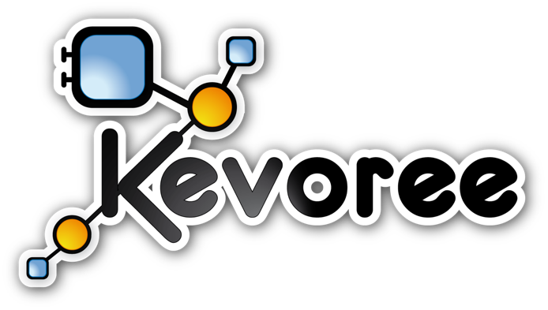





Java Environment for development of
{Dynamic, Embedded, Distributed}
Component-Based Systems
Triskell Team
Notes:
Say Hello !

Slide 2
Kevoree World
Introduction_x0001_
- Distributed Adaptive heterogeneous system
VM Dalvik,Sun,Arduino
- Internet of Things
- Smart Bulding, Quadcopters,...

Slide 3

Kevoree World
Overview
Development
Component
Runtime
Deployment
Assembly (Editor)

Slide 4
Kevoree World
Overview
Development
Runtime
Deployment
Assembly
Modeling
Framework
Annotation API
Compilation Plugin
Definition of component’s contracts
Extracts the component model @ compile time
Code generator from ECore Models

Slide 5
Kevoree World
Overview
Development
Runtime
Deployment
Assembly
Kevoree Editor
Edition of assembly/application model

Slide 6
Kevoree World
Overview
Development
Runtime
Deployment
Assembly
Java SE Runtime
Android APK Runtime
Arduino µRuntime
Allow live reconfiguration / adaptations
Android APK to run component based applications
Firmware generation facility for Arduino boards

Slide 7
Kevoree World
Demo
_x0001__x0001_
{
addRepo "http://maven.kevoree.org/release"
addRepo "http://repo.maven.apache.org/maven2"
addRepo "http://maven.kevoree.org/archiva/repository/snapshots/"
addRepo "http://repo.typesafe.com/typesafe/releases/"
addRepo "http://maven.kevoree.org/snapshots"
addRepo "http://maven.kevoree.org/archiva/repository/release/"
merge 'mvn:org.kevoree.corelibrary.javase/org.kevoree.library.javase.javaseNode/{kevoree.version}'
merge 'mvn:org.kevoree.corelibrary.javase/org.kevoree.library.javase.fakeDomo/{kevoree.version}'
merge 'mvn:org.kevoree.corelibrary.javase/org.kevoree.library.javase.nanohttp/{kevoree.version}'
merge 'mvn:org.kevoree.corelibrary.javase/org.kevoree.library.javase.nioChannels/{kevoree.version}'
merge 'mvn:org.kevoree.corelibrary.javase/org.kevoree.library.javase.nanohttpAutoDiscovery/{kevoree.version}'
merge 'mvn:org.kevoree.corelibrary.javase/org.kevoree.library.javase.webserver.api/{kevoree.version}'
merge 'mvn:org.kevoree.corelibrary.javase/org.kevoree.library.javase.swingUI/{kevoree.version}'
merge 'mvn:org.kevoree.corelibrary.javase/org.kevoree.library.javase.defaultChannels/{kevoree.version}'
merge 'mvn:org.kevoree.corelibrary.javase/org.kevoree.library.javase.jexxus/{kevoree.version}'
merge 'mvn:org.kevoree.corelibrary.javase/org.kevoree.library.javase.camel.atom/{kevoree.version}'
merge 'mvn:org.kevoree.corelibrary.javase/org.kevoree.library.javase.webserver.tjws/{kevoree.version}'
merge 'mvn:org.kevoree.corelibrary.javase/org.kevoree.library.javase.basicGossiper/{kevoree.version}'
addNode node0:JavaSENode
updateDictionary node0{logLevel="INFO",coreLogLevel="WARN"}
{
addComponent KTinyWebS413@node0 : KTinyWebServer {}
addComponent HelloWorl585@node0 : HelloWorldPage {}
addChannel defMSG162 : defMSG {}
addChannel defMSG277 : defMSG {}
bind HelloWorl585.request@node0 => defMSG277
bind KTinyWebS413.handler@node0 => defMSG277
bind HelloWorl585.content@node0 => defMSG162
bind KTinyWebS413.response@node0 => defMSG162
updateDictionary defMSG162
updateDictionary defMSG277
updateDictionary KTinyWebS413@node0
updateDictionary HelloWorl585@node0
}
addGroup sync:BasicGroup
addToGroup sync node0
updateDictionary sync{port="8000",ssl="false",ip="0.0.0.0"}@node0
}

Slide 8
Kevoree features
Expressive component model for M@R
Notes:
Dyanmic adaptibe system

Slide 9

Kevoree Model Elements
The hierachy
Component
Ports
Input / Message
Input / Service
Output / Message
Output / Service
Node
Group
Channel
Channel
Node
Component
Group
Node
Node
Node

Slide 10
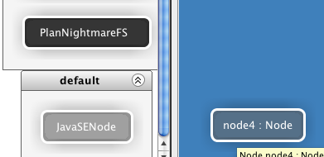
Kevoree features
NodeType & Node
NodeType encapsulate model deployment mechanism
NodeType used to declare deploy target
  JavaSENode
  Java Android
  Arduino
  [...]

Slide 11
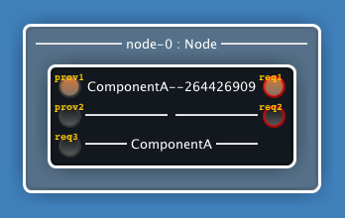
Kevoree features
Component Type
Type defines
  Name
  Library (logical)
  Required and Provided Ports
  Parameters

Slide 12

Kevoree features
Component close isolation
Component : Closed entity, part of a system, has responsibility
Close isolation = CA cannot directly call any method of CB
Components can depend on thirdparty libraries
Ports are the borders of components
Communications are supported by Channels (C1)
thirdparty_A
CA
C1
depends
CB
thirdparty_B

Slide 13
Kevoree features
Port Type
MessagePortType
  Input / Output
  Asynchronous InOnly/OutOnly
  Event driven
ServicePortType
  Provided / Required
  Synchronous InOut

Slide 14

Kevoree features
Channel Type
Extract communication semantics from component
Explicit complex distribution scenario
Model communication semantics
NodeA
NodeA
VS
ChannelA
ChannelB
AbstractBus
NodeB
NodeC
NodeB
NodeC

Slide 15
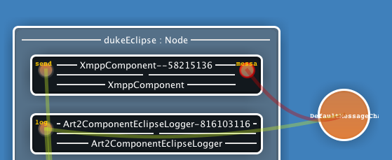
Kevoree features
ChannelType
Can support
  Messages only
  Services only
Implement the distribution/call mechanism
Can implement complex behavior
  Priority, parallel, sequence, first answer, collection, etc.

Slide 16
Kevoree features
Channel Instance
Channel Instance : deployed by fragments
One fragment on each node using channel, FIFO semantics
ChannelFragment communicates with
    Local bound ports
ChannelFragment is not allowed to communicate with remote port
B
B
A

Slide 17
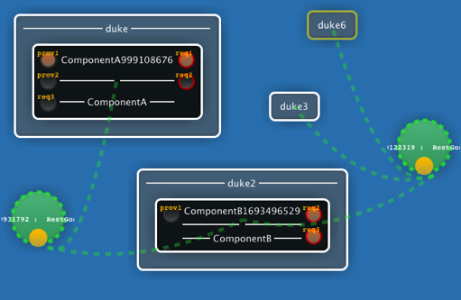
Kevoree features
GroupType & Group
Group instances ensure model consistency for related nodes, at runtime
Group are splitted in distributed fragments
GroupType <=> synchronization algorithm
Main algorithms
  Gossip (propagation)
      Best effort
  Paxos (consensus)
      Hard synchronization

Slide 18
Kevoree tools
Runtime, Editor & Model@Runtime
Notes:
Dyanmic adaptibe system

Slide 19
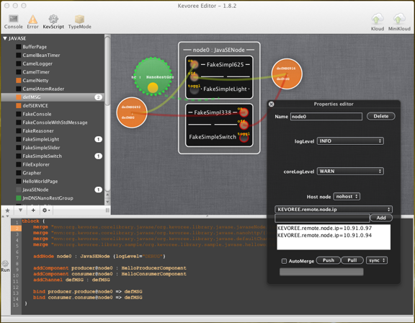
Kevoree tools
ADL Editor
Synch. Group
Node Instance
Component Instance
Component Libraries
Channel
Instance
Number of instances
Node properties
KevScript Console

Slide 20
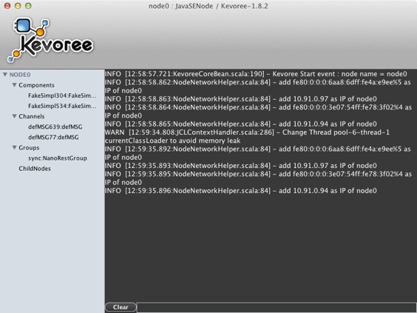
Kevoree tools
JavaSe Runtime
Running elements
System log
Command prompt

Slide 21
Kevoree tools
Model@Runtime
Abstract model of the running system
New Model
Model Edition
Adaptation of the runtime
Push
Kevoree Editor
Java SE Runtime
Pull

Slide 22
Kevoree setup
- Apache Maven 3.0.4
- Java 1.6
- Intelij IDEA

Slide 23
Let's Try : Practice A !
Chat:-)

Slide 24
Part 2:
Develop with Kevoree
From Source Code to Deployment

Slide 25
Kevoree Framework
Java Annotation API

Slide 26
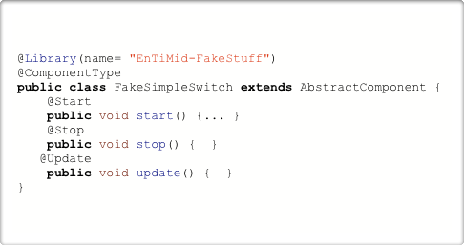

Kevoree Framework
Java Annotation API : Type definition commons
Plain Old Java Class approach ...
Declare Type contract as header of Java Class
@ComponentType
@ComponentFragment
@ChannelType, [...]
Declare lifecycle method on simple void method
@Start
@Stop
@Update (dictionary update)
@Library to group Type definition

Slide 27

Kevoree Framework
Java Annotation API : ComponentType
ComponentType == Java Class
@ComponentType or @ComponentFragment
@RequiredPort & @ProvidedPort to declare component type contract
Go beyond Java limitation
Expose in one class many port with the same Java interface
Expose one class on multiple port
Port Mapping & Multi mapping
@Requires({
@RequiredPort(name = "on", type=PortType.MESSAGE),
@RequiredPort(name = "onoff", type=PortType.SERVICE,
  className=OnOffService.class, optional=true)
})
@Provides({
@ProvidedPort(name = "log", type=PortType.MESSAGE)
})
@ComponentType
public class FakeSimpleSwitch extends AbstractComponent {
@Port(name="on")
public void portOnUpdate() {... }
@Ports({
  @Port(name="on"),
  @Port(name="onoff", method="on"),
})
public void lightOn() {
  getPortByName("log", MessagePort.class)
  .process("log log");
}
}

Slide 28
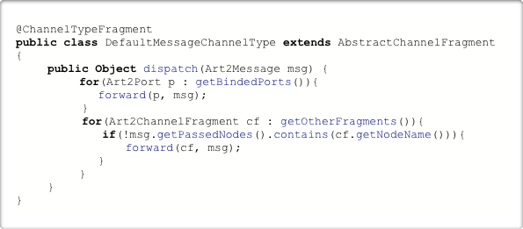
Kevoree Framework
Java Annotation API : ChannelType
@ChannelTypeFragment
Input binding use dispatch method
forward primitive to forward message
  local binding
  other fragment
Sample : Distributed Topic
B
B
A

Slide 29
Kevoree Framework
Compilation Chain

Slide 30




Kevoree tool chain
General Overview
sources
Component
create
binaries
library
Developer
assemble
provision
deploy

Slide 31

Kevoree tool chain
Maven - Software Life Cycle Managment
Kevoree tool chain
Maven - Software Life Cycle Managment
@Requires({
@RequiredPort(name = "on", type=PortType.MESSAGE),
@RequiredPort(name = "onoff", type=PortType.SERVICE,
  className=OnOffService.class, optional=true)
})
@Provides({
@ProvidedPort(name = "log", type=PortType.MESSAGE)
})
@ComponentType
public class FakeSimpleSwitch extends AbstractComponent {
@Port(name="on")
public void portOnUpdate() {... }
@Ports({
  @Port(name="on"),
  @Port(name="onoff", method="on"),
})
public void lightOn() {
  getPortByName("log", MessagePort.class)
  .process("log log");
}
}
mvn compile
Bytecode
mvn test
56
12
mvn install
Local Repository
mvn deploy

Slide 32

Kevoree Framework
Continous Design
Produces New Binaries
Compilation Plugin
Update
Model Edition
Push
Kevoree Editor
Java SE Runtime

Slide 33
Kevoree Framework
KevScript

Slide 34
Kevoree Framework
KevScript
Scripting language to manipulate models
addComponent <component Name>@<node name> : <component type>
removeComponent <component Name>@<node name>
addChannel <channel name> : <channel type>
bind <component name>.<port name>@<node name> => <channel name>
Generate the script & execute
Documentation :
https://github.com/dukeboard/kevoree/wiki/Getting-Started-KevScript

Slide 35
Let's Try : Practice B !
Producer & consumer

Slide 36
Part 3:
Advanced Kevoree
Model@Runtime, Runtime Adaptation

Slide 37
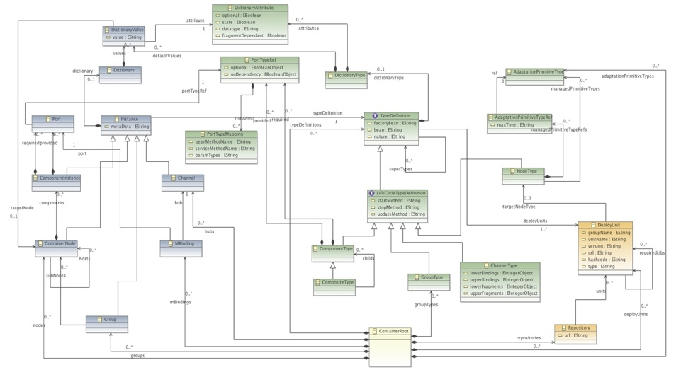
Kevoree Advanced
Kevoree Modeling Framework (KMF)
Meta-Model
Object Model
Kevoree Modeling Framework (KMF)
Loader
Serializer
Cloner

Slide 38
Kevoree Advanced
Model@Runtime
cmp:KevComp
Abstract model of the running system
cmp:KevComp
cmp:KevComp
cmp:KevComp
cmp:KevComp
Synch
Java SE Runtime

Slide 39
Kevoree Advanced
Model@Runtime : Reading the model
int instancesNumber = localModel.getComponentInstanceForJ().size();
for(ComponentInstance inst :
localModel.getComponentInstanceForJ()) {
System.out.println(
inst.getName()
+ «:»
+ inst.getType.getName);
}
Clone
getModelService().getLastModel()
Synch
Java SE Runtime

Slide 40
Kevoree Advanced
Model@Runtime : Adapting the system (Hard Way)
val newcomponent = KevoreeFactory.eINSTANCE.createComponentInstancenewcomponent.setTypeDefinition(typeDef)
newcomponent.setName(addCompo.cid.componentInstanceName)
for (ref <- componentDefinition.getProvided)
{
val port: Port = KevoreeFactory.eINSTANCE.createPort
newcomponent.addProvided(port)
port.setPortTypeRef(ref)
}
for (ref <-componentDefinition.getRequired)
{
val port: Port = KevoreeFactory.eINSTANCE.createPort
newcomponent.addRequired(port)
port.setPortTypeRef(ref)
}
Clone
Clone
getModelService()
.updateModel(newModel)
getModelService().getLastModel()
Synch
Java SE Runtime

Slide 41
Kevoree Advanced
Model@Runtime : Adapting the system (Easy Way)
Create a KevScript :
Create a KevScript :
addComponent FakeConso613@node0 : FakeConsole {}
Ask the KevScriptEngine of the platform to execute the script, on the current model
kevScriptEngine
.append(myScript)
val newcomponent = KevoreeFactory.eINSTANCE.createComponentInstancenewcomponent.setTypeDefinition(typeDef)
newcomponent.setName(addCompo.cid.componentInstanceName)
for (ref <- componentDefinition.getProvided) { val port: Port = KevoreeFactory.eINSTANCE.createPort newcomponent.addProvided(port) port.setPortTypeRef(ref)}for (ref <- componentDefinition.getRequired) { val port: Port = KevoreeFactory.eINSTANCE.createPort newcomponent.addRequired(port) port.setPortTypeRef(ref)}
getKevScriptEngineFactory()
.createKevScriptEngine()
kevScriptEngine
.interpretDeploy()
Synch
Java SE Runtime

Slide 42
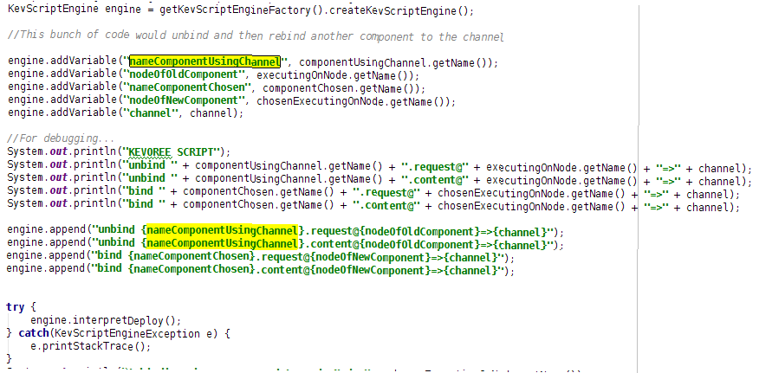
Kevoree Framework
KevScript
Example

Slide 43
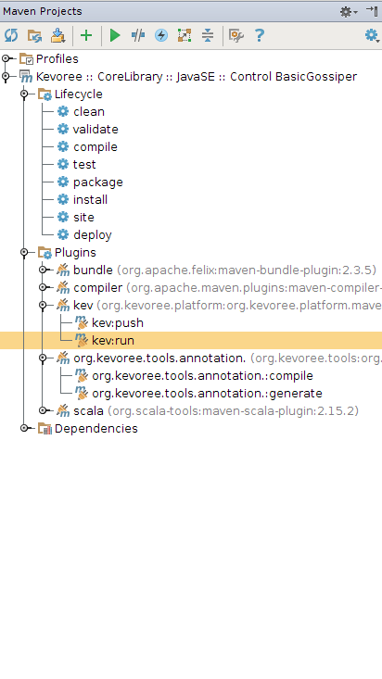
Kevoree Advanced
Model@Runtime : KevRunner
Create a KevScript :
Create a KevScript /src/main/kevs/main.kevs
{
addRepo "http://maven.kevoree.org/release"
addRepo "http://repo.maven.apache.org/maven2"
addRepo "http://maven.kevoree.org/archiva/repository/snapshots/"
addRepo "http://maven.kevoree.org/snapshots"
merge 'mvn:org.kevoree.corelibrary.javase/org.kevoree.library.javase.nanohttp/{kevoree.version}'
merge 'mvn:org.kevoree.corelibrary.javase/org.kevoree.library.javase.basicGossiper/{kevoree.version}'
merge 'mvn:org.kevoree.corelibrary.javase/org.kevoree.library.javase.javaseNode/{kevoree.version}'
merge 'mvn:org.kevoree.corelibrary.javase/org.kevoree.library.javase.jexxus/{kevoree.version}'
merge 'mvn:org.kevoree.corelibrary.javase/org.kevoree.library.javase.nanohttpAutoDiscovery/{kevoree.version}'
merge 'mvn:org.kevoree.corelibrary.javase/org.kevoree.library.javase.controlbasicGossiper/{kevoree.version}'
addNode node0:JavaSENode
updateDictionary node0{logLevel="INFO",coreLogLevel="WARN"}
addToGroup controlgroup node0
updateDictionary controlgroup{port="8002",ip="0.0.0.0"}@node0
}
Add the Maven Runner plugin
<!-- kevS -->
<plugin>
<groupId>org.kevoree.platform</groupId>
<artifactId>org.kevoree.platform.mavenrunner</artifactId>
<version>${kevoree.version}</version>
<configuration>
<targetNode>node0</targetNode>
<viaGroup>sync</viaGroup>
</configuration>
</plugin>

Slide 44
Let's Try : Practice C !

Slide 45
Kevoree Framework
Android Dalvik

Slide 46
Kevoree Android
Model@Runtime : Dalvik
Do not forget to set your sdk in the settings.xml
<profiles>
<profile>
<id>default-profile</id>
<properties>
<android.home>/opt/adt-bundle-linux-x86/sdk</android.home>
<android.platform>8</android.platform>
</properties>
</profile>
</profiles>

Slide 47
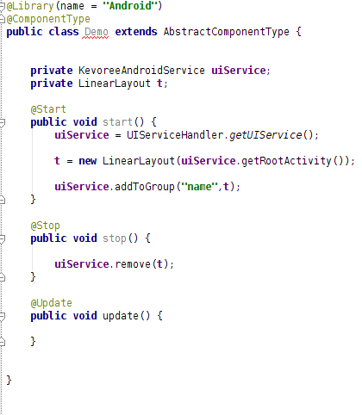
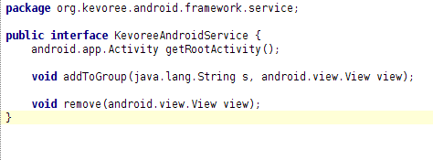
Kevoree Android
Model@Runtime : Dalvik
The Context

Slide 48
Let's Try : Practice D !

Slide 49
Some components
-JtouchDB
-Lightcouch

