Slide 1

An Instructor’s Outline of
Designing the User Interface
4th Edition
Ch8: Command Languages
by Ben Shneiderman & Catherine Plaisant
Slides developed by Roger J. Chapman

Slide 2

The Basic Goals of Command/Programming Language Design
Precision
Compactness
Ease in writing and reading
Speed in learning
Simplicity to reduce errors
Ease of retention over time

Slide 3
Command-Organization Strategies
There are several ways to design command languages
Simple command set
Command plus arguments
Command plus arguments and options
Heirarchical command structure
Simple command set
  Each command is chosen to carry out a single task. The number of commands match the number of tasks.
  Commands have no arguments
  For small number of tasks, this can produce a system easy to learn and use.
  E.g. the vi editor of Unix (Figure 8.2).

Slide 4
Command plus arguments/options
Command plus arguments
Follow each command by one or more arguments that indicate objects to be manipulated, e.g.
  COPY FILEA, FILEB
  DELETE FILEA
  PRINT FILEA, FILEB, FILEC
Keyword labels for arguments are helpful for some users, e.g. COPY FROM=FILEA TO=FILEB.
Commands may also have options to indicate special cases, e.g. to produce 3 copies of FILEA on the printer in the headquarters building:
  PRINT/3,HQ FILEA
  lpr myfile –n -r
  PRINT FILEA -3, HQ
Error rates and the need for extensive training increase with the number of possible options.

Slide 5
The Benefits of Structure
Human learning, problem solving, and memory are greatly facilitated by meaningful structure.
Beneficial for
  task concepts
  computer concepts
  syntactic details of command languages
Consistent Argument Ordering makes commands easier to learn and remember (note message id position)
Inconsistent order of arguments Consistent order of arguments
SEARCH file no, message id SEARCH message id, file no
TRIM message id, segment size TRIM message id, segment size
REPLACE message id, code no REPLACE message id, code no
INVERT group size, message id INVERT message id, group size

Slide 6
Hierarchical command structure
  The full set of commands is organized into a table or tree structure
  5 commands x 3objects x 4destinations = 60 tasks
  Only 5 command names and 1 rule of formation
  An excellent, modern way to design a command language
Action | Object | Destination
CREATE | File | File
DISPLAY | Process | Local printer
REMOVE | Directory | Screen
COPY |  | Remote printer
MOVE

Slide 7
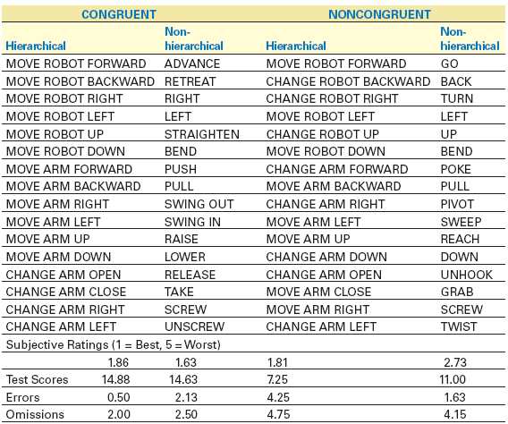
Hierarchical Structure and Congruence
Sources of structure that have proved advantageous include:
Positional consistency
Grammatical consistency
Congruent pairing
Hierarchical form

Slide 8
Functionality to Support
User’s Tasks (cont.)
Designers should
determine functionality of the system by studying users' task domain
create a list of task actions and objects
abstract this list into a set of interface actions and objects
represent low-level interface syntax
create a table of user communities and tasks, with expected use frequency
determine hierarchy of importance of user communities (i.e. prime users)
evaluate destructive actions (e.g. deleting objects) to ensure reversibility
identify error conditions and prepare error messages
allow shortcuts for expert users, such as macros and customizing system parameters

Slide 9
Six Potential
Abbreviation Strategies
There is often a lack of consistency or obvious strategy for construction of command abbreviations.
Six Strategies:
Simple truncation: The first, second, third, etc. letters of each command.
Vowel drop with simple truncation: Eliminate vowels and use some of what remains.
First and last letter: Since the first and last letters are highly visible, use them.
First letter of each word in a phrase: Use with a hierarchical design plan.
Standard abbreviations from other contexts: Use familiar abbreviations.
Phonics: Focus attention on the sound.

