Slide 1
CS 160: Lecture 11
Professor John Canny
Fall 2004

Slide 2

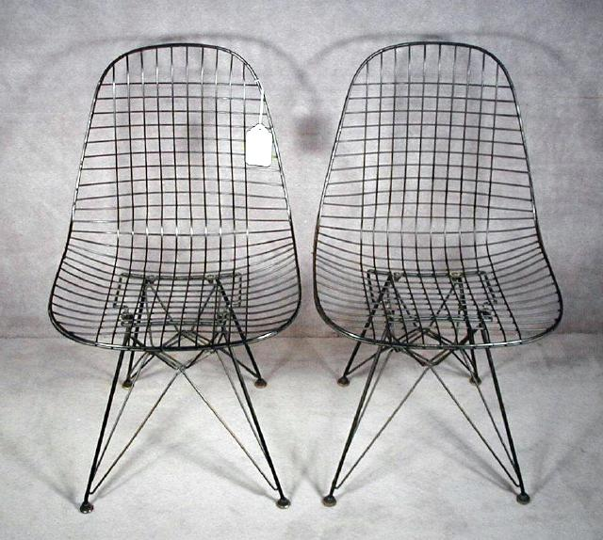
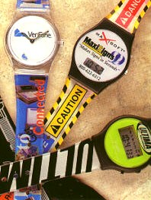
Design is…
About function:
  Good designs support user tasks
About form:
  Good designs should be a pleasure to use

Slide 3


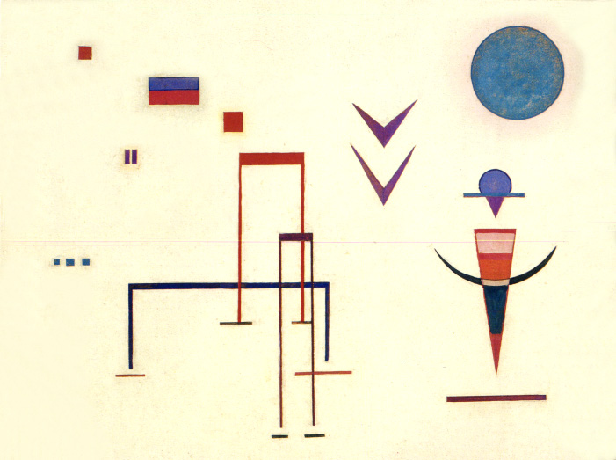
Bauhaus
Principles that shaped modern design:
  Economy of form (limited shape vocabulary)
Notes:
Constructivism had the goals of formalizing the design process, and bringing a process into design. The two guiding principles were (I) technology - using machines and their function to guide design and (ii) using human behavior and rhythms (especially the designers) as a clue to understanding what is pleasurable about an aesthetic experience. It also rejected traditional forms in favor of socially-relevant ones.

Slide 4
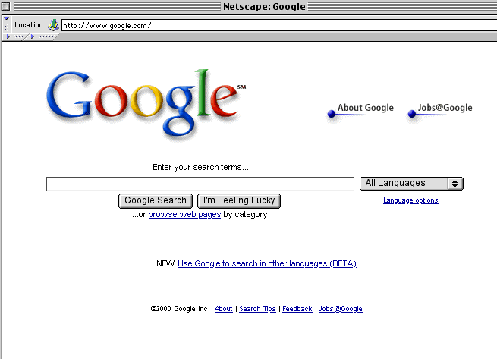
Simplicity

Slide 5
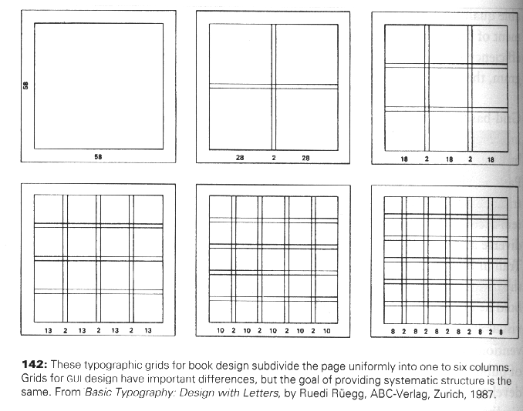
Grid-based Design

Slide 6
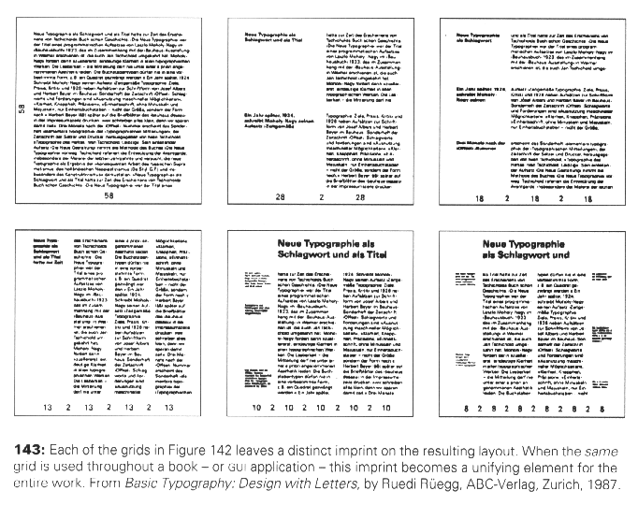
Grid-based Design

Slide 7
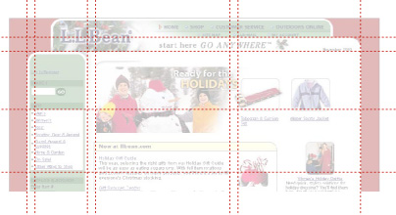
Grid-based Design
Notes:
Grids can shape layout without over constraining it. This grid is not obvious from the page layout but causes repetition of size and shape among distant elements.

Slide 8
Common mistakes
Arbitrary component positions
Arbitrary component dimensions
Random window sizes and layouts
Unrelated icon sizes and imagery
Inconsistent control presentations
Inconsistent visual language

Slide 9
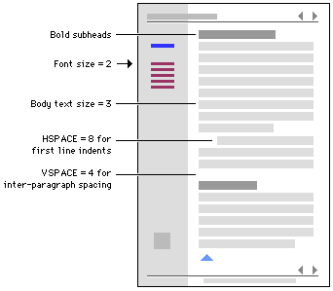
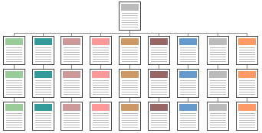
Techniques
Reinforcing structure through repetition: Repeat design elements across the program
Stylesheets can help

Slide 10
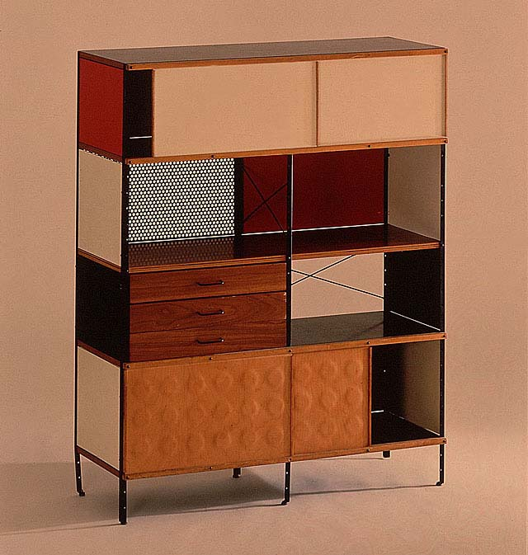
Techniques
Establish modular units

Slide 11
Techniques - Canonical grid*
The canonical grid
  A six-column basic grid with column separators and label templates
  Can be implemented with HTML tables
One does not have to follow the grids exactly
  E.g. accommodate large buttons or labels
  However, try to have at least approximate alignment, e.g. see print dialog box
Grid based design uses Gestalt principles
  Similarity
  Proximity
  Closure, etc

Slide 12
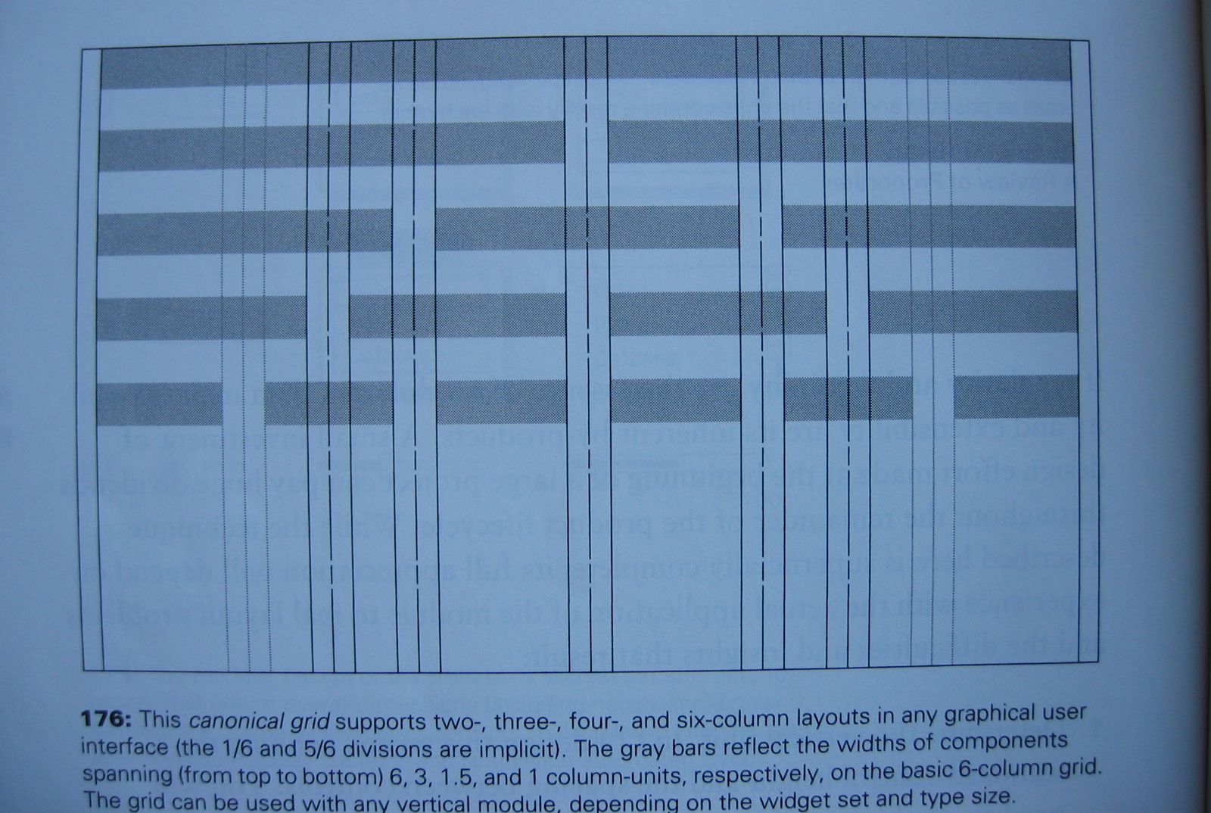
The canonical grid

Slide 13
Canonical Grid
Determine any size restrictions
Define horizontal and vertical modules
Develop a rough sketch of sizes, positions, orientations
Use the canonical grid to adjust sizes and positions of control elements
For dynamic layouts, figure out the minimum workable size.
Can also work out alignment within groups of controls (e.g. see three horizontal groups on next two slides)

Slide 14
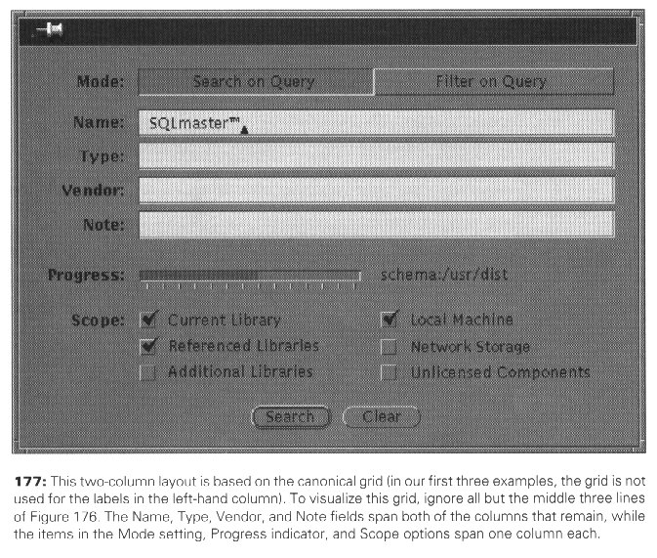
Canonical Grid

Slide 15
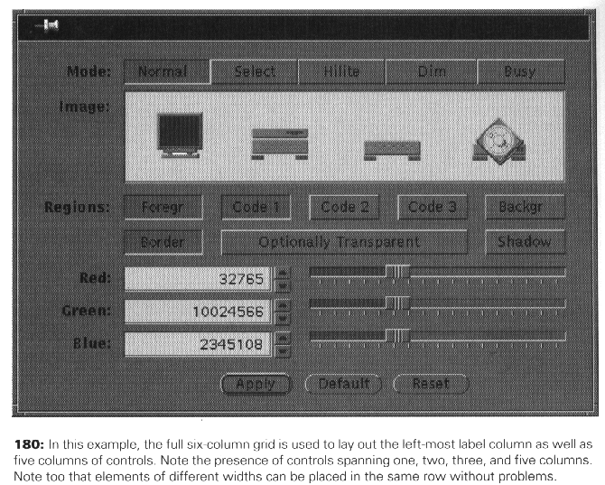
Canonical Grid

Slide 16
Places to go
See Apple Layout Guidelines in
  Apple Human Interface Guidelines:
  http://developer.apple.com/referencelibrary/API_Fundamentals/UserExperience-fund-date.html
MetaDesign: www.metadesign.com
IDEO: www.ideo.com
Frog Design: www.frogdesign.com
Swim studio www.swimstudio.com
Cooper Interaction Design www.cooper.com
Aaron Marcus and Associates www.amanda.com
Icarian www.icarian.com

