Slide 1
Introduction to Reinforcement Learning
From Tabular Q-Learning to Deep RL
Sutton & Barto · Trial and Error · Q-Learning · DQN

Slide 2
Today's Roadmap
01
02
03
04
How organisms learn
The RL Problem
Tabular Q-Learning
Notebook Demo
Biological & psychological roots of learning
Agent · Environment · State · Action · Reward
Update rule, Q-table walk-through
Tabular → Discretized → Linear FA → DQN → CNN-DQN

Slide 3
SECTION 01
How Organisms Learn

Slide 4
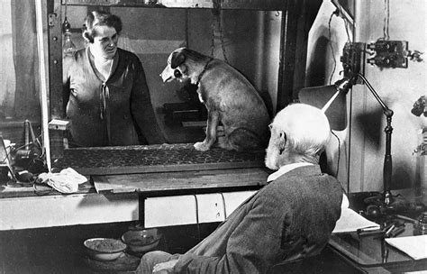
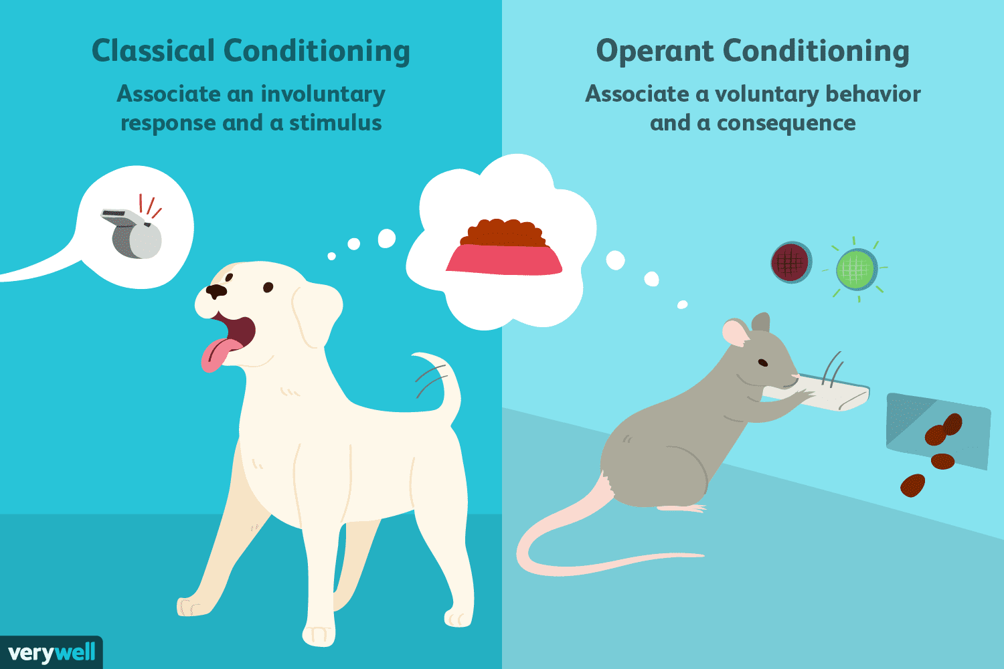
Psychology of Learning
Classical Conditioning (Pavlov)
Neutral stimuli paired with rewards become predictive cues — the bell triggers salivation because it reliably signals food to come.
Operant Conditioning (Skinner)
Behaviors are strengthened by reinforcement and weakened by punishment; frequency of action is shaped by its consequences.
Rescorla–Wagner Model
Learning occurs only when outcomes are surprising; the size of the prediction error determines how much the association is updated.
Extinction & Spontaneous Recovery
Learned associations weaken without reinforcement and can reappear spontaneously —experience shapes behavior dynamically

Slide 5
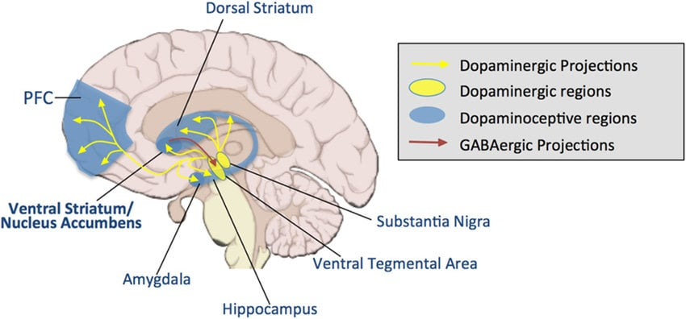
Neuroscience of Reward
Schultz et al. (1997) — The Pivotal Experiment
Monkey neurons showed activity that shifted from reward delivery to the predictive cue over trials — demonstrating that the brain learns to anticipate, not just react.
Basal Ganglia & Action Selection
The striatum tracks how rewarding actions have been; dopamine signals strengthen or weaken synaptic connections, gradually shaping which behaviours the animal repeats.
Prefrontal Cortex & Goal-Directed Behaviour
The prefrontal cortex integrates past reward experience with forward-looking planning, allowing animals to pursue goals flexibly rather than rely on fixed stimulus-response habits.
Dopamine & the Reward Circuit
Dopaminergic neurons in the VTA fire not to reward itself, but to reward prediction errors — a spike when reward exceeds expectation.
Notes:
Striatum learns value predictions (via dopamine-modulated synaptic plasticity)
Striatal GABAergic projections suppress VTA activity proportional to expected reward
VTA dopamine output encodes the surprise — the TD error
That error signal modulates synaptic strength in the striatum, updating the prediction

Slide 6
Learning by Trial and Error
KEY FOUNDATIONS
Thorndike's Law of Effect
From Brain to Algorithm
Behaviors followed by satisfying consequences become more likely to be repeated
Psychology → RL
Rescorla-Wagner prediction error = TD error
Law of Effect = reward-maximising policy
Neuroscience → RL
Dopamine PE signal = TD(0) update (Schultz 1997)
Striatum / basal ganglia = value function V(s)
PFC model-based control = planning / lookahead
Sutton & Barto
"Reinforcement learning, more than any other form of machine learning, is directly inspired by how the nervous system works"
The Formal RL Framework
Agent, environment, state, action, reward
Maximise cumulative discounted reward
No teacher — only experience and feedback
Sutton & Barto, Ch. 1 — "The idea that we learn by interacting with our environment..."

Slide 7
SECTION 02
The Reinforcement Learning Problem

Slide 8
The Agent–Environment Interface
AGENT
Action aₜ
ENVIRONMENT
▶
◀
State sₜ₊₁ + Reward rₜ₊₁
State s
Action a
Reward r
A description of the environment the agent can observe
A choice the agent makes at each timestep
A scalar signal: how good was that action?
Policy π
The agent's strategy:
s → a

Slide 9
The Markov Decision Process (MDP)
State
sₜ
Action
aₜ
Transition
P(s'|s,a)
Reward
R(s,a,s')
▶
▶
▶
Markov Property: P(sₜ₊₁ | sₜ, aₜ, sₜ₋₁, ...) = P(sₜ₊₁ | sₜ, aₜ) — the future depends only on the present, not the past.
Sparse Reward
Dense / Shaped Reward
+1 when goal reached, 0 otherwise
Simple to define, hard to learn from — agent rarely gets a signal
Common in games (e.g., win/lose at end of episode)
Penalize distance to goal, penalize holes, reward water conservation
Faster learning — more frequent feedback
Risk: agent exploits the shaping and ignores the true goal

Slide 10
SECTION 03
Tabular Q-Learning

Slide 11
What Is a Q-Value?
Q(s, a) = Expected cumulative discounted reward starting from state s, taking action a, then following policy π
Q-Table (states × actions)
State | Up | Down | Left | Right
(0,0) | 0.0 | 0.12 | 0.0 | 0.45
(0,1) | 0.33 | 0.0 | 0.07 | 0.61
(1,0) | 0.0 | 0.55 | 0.0 | 0.22
… | … | … | … | …
← Greedy action: highest Q-value
ε-Greedy Exploration
With probability ε:
→ Explore: pick a random action
With probability 1-ε:
→ Exploit: pick argmax Q(s, a)
Back to biology: Q(s, a) formalises what the striatum computes implicitly: a running estimate of how valuable a given action is from a given state, built up through experience — exactly Skinner’s operant logic, made numerical.
Notes:
The striatum is a key brain structure that predicts reward and updates reward prediction.

Slide 12
The Q-Learning Update Rule
Q(s, a) ← Q(s, a) + α [ r + γ · max Q(s', a') − Q(s, a) ]
α — Learning Rate
r — Immediate Reward
γ — Discount Factor
How much we update on each step.
Small α → slow but stable.
Large α → fast but noisy.
The reward signal received after taking action a in state s.
How much we value future rewards.
γ=0 → myopic; γ≈1 → far-sighted.
max Q(s',a') — Best Future Q
TD Error — Target − Current
Bootstrapped estimate of the value of the next state (the 'target').
r + γ max Q(s’,a’) − Q(s,a) — the correction signal; drive this to zero
Neuroscience: dopamine neurons in the VTA fire proportionally to this error — a burst when reward exceeds expectation, a dip when it falls short (Schultz et al., 1997)
Psychology: the same logic as Rescorla–Wagner — associations only update when an outcome is surprising
Notes:
The VTA is the dopamine production hub of the brain.

Slide 13
Worked Example: One Q-Table Update
Setup: α = 0.1, γ = 0.9, Current state s = (2,3), Action a = Right, Q(s,a) = 0.30, Reward r = −0.01, Next state s' = (2,4), max Q(s',a') = 0.80
Step 1
Compute the TD Target
Target = r + γ · max Q(s',a') = −0.01 + 0.9 × 0.80 = 0.71
Step 2
Compute the TD Error
δ = Target − Q(s,a) = 0.71 − 0.30 = 0.41
Step 3
Apply the Update
Q(s,a) ← 0.30 + 0.1 × 0.41 = 0.341
Intuition
Why does this work?
The old estimate (0.30) was too low. We nudge it upward toward the target. Repeated across millions of steps → Q converges to Q*.

Slide 14
SECTION 04
Notebook Demo: Rosie's World

Slide 15
Demo Overview: Growing Complexity
1. Discrete Grid
2. Continuous
3. Linear FA
Environment: 10×10 grid, (x,y)
Environment: Continuous 2D + velocity
Environment: Continuous, tile coding
Method: Tabular Q-Learning
Method: State Discretization
Method: Tile Coding SARSA
State dim: 2D
State dim: 4D
State dim: 4D
4. Momentum
5. Random Holes
Environment: + Water Mass variable
Environment: + Randomized obstacles
Method: Tabular / DQN
Method: DQN (MLP)
State dim: 5D
State dim: 7D
← Increasing state-space complexity — tabular methods break down →

Slide 16
When Tabular Methods Break Down → DQN
With 7 continuous state dimensions and random holes, the Q-table would need ~10⁷+ entries. Most are never visited. The table cannot generalize.
State s (7D vector)
Policy Network Q(s,·; θ) (MLP)
Q-values for all actions
Replay Buffer + Target Network
Stable Training via SGD
→
→
→
→
Loss(θ) = 𝔼 [ ( r + γ · max Q(s', a'; θ⁻) − Q(s, a; θ) )² ] where θ⁻ = target network parameters (updated periodically)
Experience Replay
Target Network
Store transitions (s, a, r, s') in a circular buffer
Sample random mini-batches → breaks temporal correlations
Improves data efficiency and stability
Separate network θ⁻ for computing the TD target
Updated every N steps (not every gradient step)
Prevents chasing a moving target → stable training

Slide 17
Key Takeaways
RL is grounded in biology
Trial-and-error learning and dopaminergic reward signals in the brain inspired modern RL theory (Sutton & Barto).
The MDP is the foundation
State, Action, Reward, Transition — every RL problem maps onto this structure.
Q-learning is powerful but limited
Tabular Q-learning converges to Q* but can't scale to high-dimensional or continuous spaces.
Function approximation generalizes
Linear FA (tile coding) and neural networks (DQN) let us handle complex environments by generalizing across states.
Stability tricks matter
Replay buffers and target networks are what make deep RL stable enough to actually work.

