Slide 1

14th International Conference on Information Visualisation 2010
Dynamic Visualizations for Soccer Statistical Analysis
Adrian Rusu, Edward Burns, Benjamin Hample, Kevin McGarry, Robert Russell
Department of Computer Science, Rowan University, NJ, USA
Doru Stoica
Department of Physical Education, University of Craiova, Craiova, Romania
Presented by:
Benjamin Hample & Kevin McGarry
DEPARTMENT OF COMPUTER SCIENCE
SOFTWARE ENGINEERING, GRAPHICS, AND VISUALIZATION RESEARCH GROUP

Slide 2
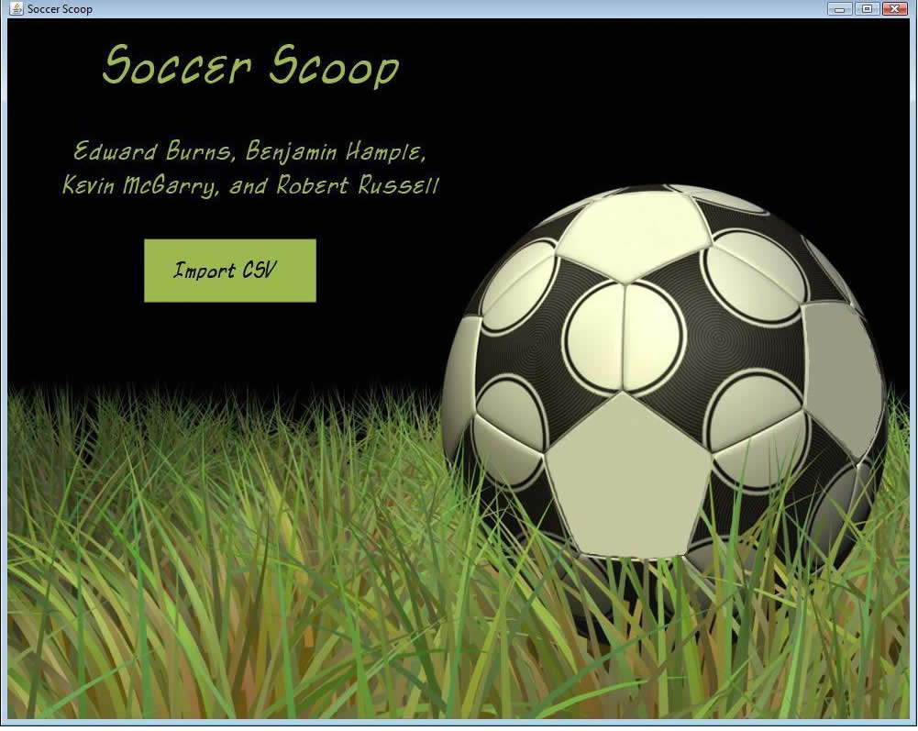
Soccer Scoop
Dynamic soccer statistic visualization application
Accepts CSV data input
Provides at a glance view of large sets of data
Visualization techniques include
  Glyphs
  Modified star plots
  Details on demand
  Color
  Gestalt Principles
DEPARTMENT OF COMPUTER SCIENCE
SOFTWARE ENGINEERING, GRAPHICS, AND VISUALIZATION RESEARCH GROUP

Slide 3
Purpose
Soccer statistic analysis at a glance
Graphical representation of large data sets to aid soccer coaches
  Player positioning
  Drill development
DEPARTMENT OF COMPUTER SCIENCE
SOFTWARE ENGINEERING, GRAPHICS, AND VISUALIZATION RESEARCH GROUP

Slide 4
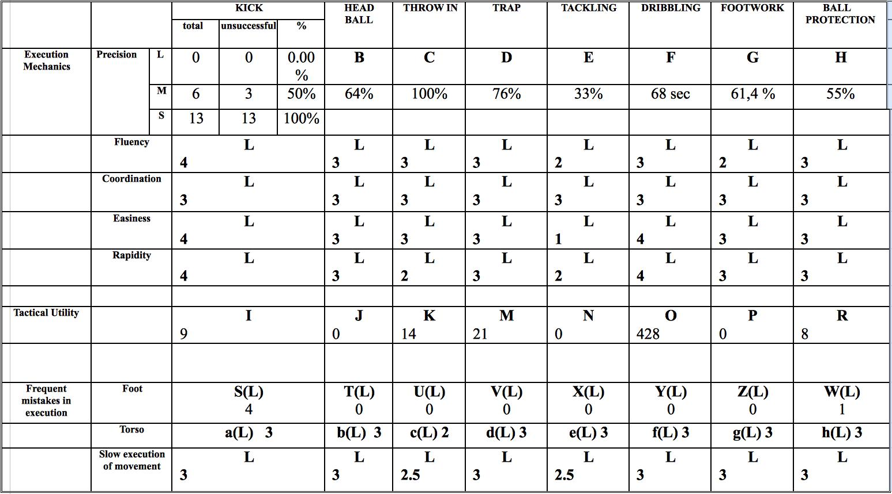
Soccer player statistics matrix
DEPARTMENT OF COMPUTER SCIENCE
SOFTWARE ENGINEERING, GRAPHICS, AND VISUALIZATION RESEARCH GROUP

Slide 5
Dataset
Three main categories
  Execution mechanics
  Tactical utility
  Frequency of mistakes in execution
Attributes per category
  Precision
  Fluency
  Coordination
  Easiness
  Rapidity
  Tactical Utility
  Mistakes
    Foot
    Torso
  Slow execution of movement
DEPARTMENT OF COMPUTER SCIENCE
SOFTWARE ENGINEERING, GRAPHICS, AND VISUALIZATION RESEARCH GROUP

Slide 6
Metaphorical Visualization
Soccer field metaphor
Unique field objects
  Goal
  Center field marker
  Ball
DEPARTMENT OF COMPUTER SCIENCE
SOFTWARE ENGINEERING, GRAPHICS, AND VISUALIZATION RESEARCH GROUP

Slide 7
Color
Color | Likert | Percentage
 | Very Good | 75 – 100 %
 | Good | 50 – 75 %
 | Satisfactory | 25 – 50 %
 | Poor | 0 – 25 %
DEPARTMENT OF COMPUTER SCIENCE
SOFTWARE ENGINEERING, GRAPHICS, AND VISUALIZATION RESEARCH GROUP

Slide 8
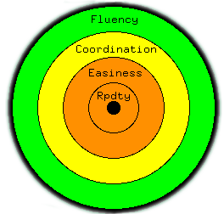
Modified Star Plot
Attributes
  Fluency
  Coordination
  Easiness
  Rapidity
Color coded based on Likert Scale
DEPARTMENT OF COMPUTER SCIENCE
SOFTWARE ENGINEERING, GRAPHICS, AND VISUALIZATION RESEARCH GROUP

Slide 9
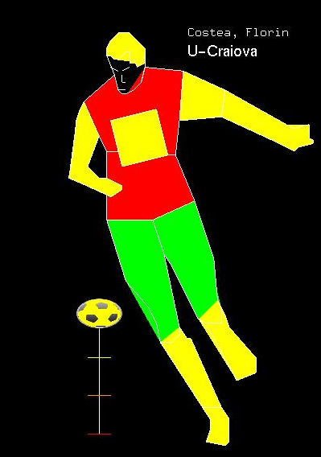

Glyphs
DEPARTMENT OF COMPUTER SCIENCE
SOFTWARE ENGINEERING, GRAPHICS, AND VISUALIZATION RESEARCH GROUP

Slide 10
Details on demand
Only relevant data presented
Unnecessary information is hidden
Intuitive navigation provides dynamic interaction with data
DEPARTMENT OF COMPUTER SCIENCE
SOFTWARE ENGINEERING, GRAPHICS, AND VISUALIZATION RESEARCH GROUP

Slide 11
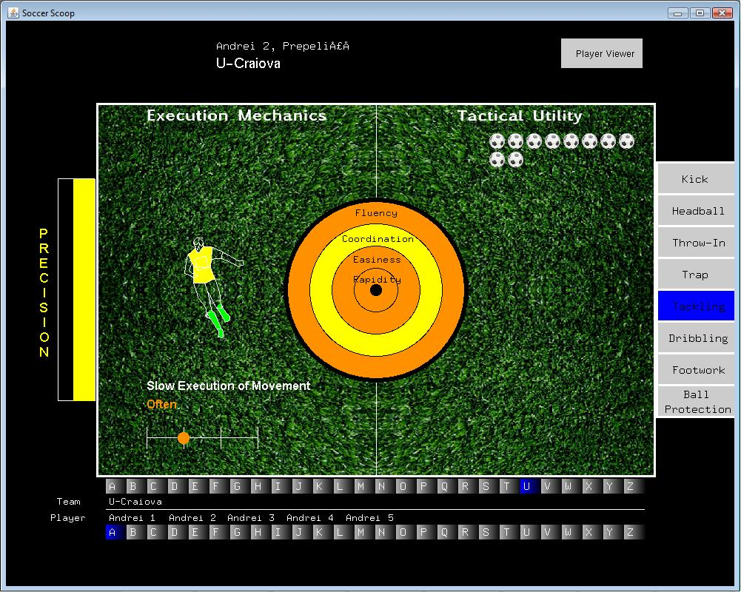
Field Viewer
Single player analysis
Attributes depicted per category
  Precision
  Fluency
  Coordination
  Easiness
  Rapidity
  Tactical Utility
  Mistakes
    Foot
    Torso
  Slow execution of movement
DEPARTMENT OF COMPUTER SCIENCE
SOFTWARE ENGINEERING, GRAPHICS, AND VISUALIZATION RESEARCH GROUP

Slide 12
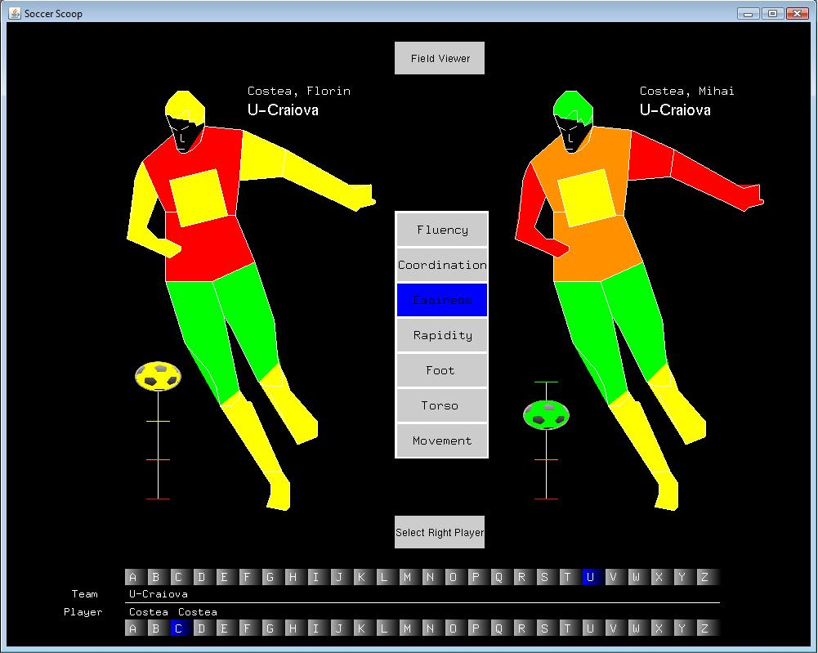
Player Viewer
Side by side comparison
Anatomical depiction of abilities per category
  Fluency
  Coordination
  Rapidity
  Mistakes
    Foot
    Torso
  Slow execution in movement
DEPARTMENT OF COMPUTER SCIENCE
SOFTWARE ENGINEERING, GRAPHICS, AND VISUALIZATION RESEARCH GROUP

Slide 13
Conclusion
Player and Field Viewer Visualizations
  Single Player Analysis
  Multi Player Comparisons (Side by Side)_x0013_
    Distinct Characteristics
    Specific player skills highlighted_x0013_
Real World Applications
  Multi-Sport focus
Future Enhancements
DEPARTMENT OF COMPUTER SCIENCE
SOFTWARE ENGINEERING, GRAPHICS, AND VISUALIZATION RESEARCH GROUP

Slide 14
QUESTIONS
Contact and Research Information
Dr. Adrian Rusu: rusu@rowan.edu
http://elvis.rowan.edu/~rusu
Benjamin Hample: mcgarr92@students.rowan.edu
Kevin McGarry: hample04@students.rowan.edu
Thank you!
DEPARTMENT OF COMPUTER SCIENCE
SOFTWARE ENGINEERING, GRAPHICS, AND VISUALIZATION RESEARCH GROUP

