Slide 1

Module 1: IT Governance Frameworks

Slide 2





About me
Senior Lecturer, Applied Ethics & Cybersecurity, School of ICT

Slide 3

Course notes
Course notes contained in a single (large) PDF
Endeavour to read the weekly topic before the lecture
Course notes are the basis of the lectures and of the workshop tasks each week.
Download from course website

Slide 4

Assessment schedule
Do the weekly Workshop exercise (500 words using the workshop template provided on the course website.
Assignment 1A due no later Friday midnight Week 6
Assignment 1B due no later Friday midnight Week 11
A 3,000 to 3,500-word industry report, due Friday of Week 8. It explores a topic in cyber security governance that interests you and which you may like to be involved with later. Assignment helps clarify career focus.
Weekly self-review quizzes

Slide 5
Weekly tasks
Participate in workshop exercises and discussions in Weeks 1-10.
You receive a maximum of 5 marks per weekly task; 50 marks in total (10 w’shops)
Each weekly workshop gives instructions for that week’s task.
Write up each week’s task (500 word) in the template document provided, adding to it each week
Submit the first five weeks in Week 6 (First Checkpoint), then weeks 6-10 in week 11 (Second Checkpoint). Use the same document throughout.

Slide 6
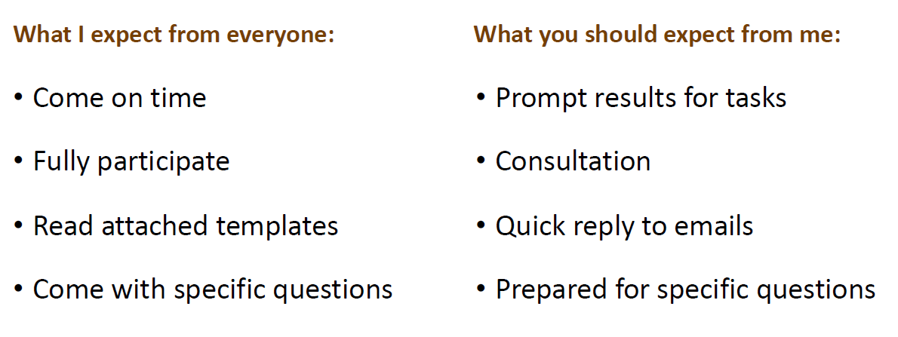
expectations

Slide 7
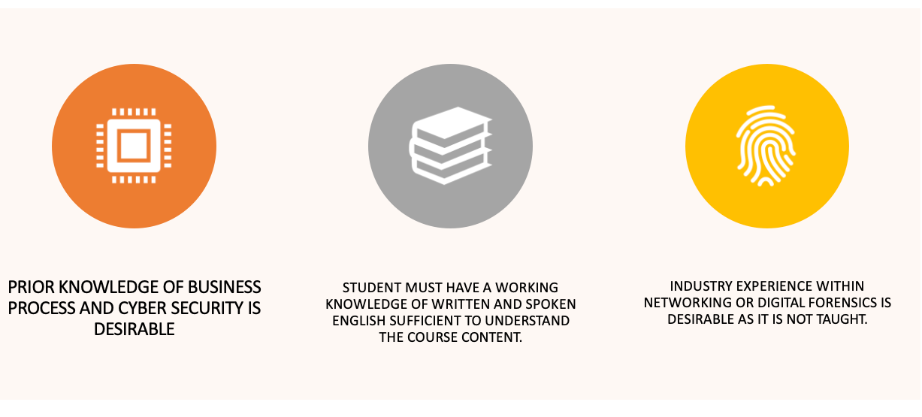
Assumed background

Slide 8
Overview
IT governance frameworks are the rules and guidelines that help organizations manage their IT resources and processes effectively
IT compliance and regulatory standards are the requirements that organizations must follow to meet the expectations of external stakeholders, such as customers, auditors, or government agencies
Data retention and deletion are the policies and practices that determine how long and where organizations store their data, and when and how they dispose of it

Slide 9
1.1. IT Governance Frameworks
COBIT. This is a comprehensive framework that covers 37 IT processes, each with detailed objectives, practices, inputs, outputs, activities, and metrics
AS8015
ISO/IEC
ITIL. This is a widely adopted framework that focuses on the delivery and management of quality IT services that meet the needs and expectations of customers and stakeholders

Slide 10
COBIT Orchestrating Control & Assurance
COBIT is a comprehensive framework for the governance and management of enterprise information and technology
COBIT consists of seven enablers: principles, policies and frameworks; processes; organizational structures; culture, ethics and behaviour; information; services, infrastructure and applications; and people, skills and competencies
COBIT also provides a common language and terminology for I&T governance that can be understood by all stakeholders, including business executives, IT managers, auditors and regulators

Slide 11
MEA01: Managed Performance and Conformance Monitoring
This process collects, validates, and evaluates enterprise and alignment goals and metrics, monitors that processes and practices are performing against agreed performance and conformance goals and metrics, provides systematic and timely reporting, and provides transparency of performance and conformance and drives achievement of goals

Slide 12
MEA02: Managed System of Internal Control
This process continuously monitors and evaluates the control environment, including self-assessments and self-awareness, enables management to identify control deficiencies and inefficiencies and to initiate improvement actions, plans, organizes and maintains standards for internal control assessment and process control effectiveness, obtains transparency for key stakeholders on the adequacy of the system of internal controls

Slide 13
MEA03: Managed Compliance with External Requirements
This process evaluates that I&T processes and I&T-supported business processes are compliant with laws, regulations and contractual requirements, obtains assurance that the requirements have been identified and complied with; integrates IT compliance with overall enterprise compliance, ensures that the enterprise is compliant with all applicable external requirements

Slide 14
MEA04: Managed Assurance
This process plans, scopes and executes assurance initiatives to comply with internal requirements, laws, regulations and strategic objectives, enables management to deliver adequate and sustainable assurance in the enterprise by performing independent assurance reviews and activities, enables the organization to design and develop efficient and effective assurance initiatives

Slide 15
ITIL Elevating Service Management
Improve customer satisfaction by delivering reliable and high-quality IT services
Enhance IT services delivered using best practice procedures
Reduce costs and risks by optimizing the use of resources and avoiding service disruptions
Increase agility and innovation by enabling faster and more effective changes to IT services
Support digital transformation by integrating ITSM with other frameworks such as DevOps, Agile and SRE

Slide 16
ITIL Elevating Service Management
Assess the current state of your ITSM practices and identify gaps and areas for improvement
Define a vision and strategy for your ITSM that aligns with your organizational goals and customer value propositions
Implement the ITIL Service Value System that consists of five components: guiding principles, governance, service value chain, practices, and continual improvement
Use the SVS to plan, engage, design, transition, obtain/build, deliver/support and improve your IT services
Apply the seven guiding principles of ITIL to guide your decisions and actions: focus on value, start where you are, progress iteratively with feedback, collaborate and promote visibility, think and work holistically, keep it simple and practical, optimize and automate

Slide 17
ITIL Elevating Service Management
Establish a Service Management Office that provides a central point for consistency and governance in organizational best practice
Monitor and measure your service performance using relevant metrics and indicators
Report and communicate your service achievements and challenges to your customers and stakeholders
Review and evaluate your service outcomes and feedback using various methods such as surveys, audits, reviews, benchmarks etc
Identify and prioritize improvement initiatives using techniques such as SWOT analysis, gap analysis, root cause analysis etc
Implement improvement actions using methods such as PDCA cycle , CSI approach etc

Slide 18
ISO/IEC 38500 The Governing Standard
Strategy
Performance
Conformance
Governing Body
Evaluation
Direction
Monitoring

Slide 19
ISO/IEC 38500 The Governing Standard
Improving the alignment of IT with the organizational strategy
Enhancing the delivery of value from IT investments
Reducing risks related to IT projects and operations
Increasing transparency and accountability for IT decisions and outcomes
Fostering a culture of trust and collaboration among IT stakeholders
Supporting continuous improvement and innovation in IT

Slide 20
Unifying Business & Technology
Ensure business value is generated by information and technology
Oversee the performance of IT managers
Assess risks associated with the IT department and mitigate them as needed

Slide 21
Unifying Business & Technology
COBIT. This is a comprehensive framework that covers 37 IT processes, with each process having a set of objectives, inputs, outputs, activities, roles, and responsibilities
AS8015
ISO/IEC

Slide 22
Unifying Business & Technology
Define the scope and objectives of IT governance
Establish the roles and responsibilities of IT governance stakeholders
Identify the key IT processes and activities that need to be governed
Define the policies, procedures, guidelines, and standards that govern IT
Establish the mechanisms and tools for monitoring, reporting, and evaluating IT performance and compliance
Implement continuous improvement initiatives to enhance IT value and maturity

Slide 23
Guidelines for Decision-Making
What is IT governance and why is it important?
What are the key principles of IT governance?
What are the common IT governance frameworks and how do they support decision-making?
How to define the roles and responsibilities of decision-makers in IT governance?
How to ensure transparency, accountability, and compliance in IT governance decisions?

Slide 24
Guidelines for Decision-Making
Achieve its strategic goals and objectives by aligning IT with the business needs and expectations
Optimize the value of IT by delivering benefits to the organization and its stakeholders
Manage the risks associated with IT by identifying, assessing, and mitigating them
Enhance the performance of IT by improving the quality, efficiency, and effectiveness of IT services
Foster a culture of continuous improvement by learning from feedback and best practices

Slide 25
Guidelines for Decision-Making
Documenting and communicating the IT governance framework, including the principles, rules, processes, roles, responsibilities and authorities that guide decision-making
Establishing and maintaining a repository of IT governance decisions, including the rationale, criteria, evidence, alternatives and impacts of each decision
Implementing and monitoring a set of KPIs and metrics that measure the performance and outcomes of IT governance decisions
Conducting regular audits and reviews of IT governance decisions to verify their validity, effectiveness and efficiency
Reporting and disclosing IT governance decisions to relevant stakeholders, such as senior management, board of directors, regulators, customers and suppliers

Slide 26
Guidelines for Decision-Making
Establishing and enforcing a mechanism for escalating, resolving and learning from issues, disputes and complaints related to IT governance decisions

Slide 27
Risk Management & Mitigation
Protect their assets, data, reputation, and stakeholders from harm or loss
Ensure the continuity and availability of their IT services and operations
Achieve their strategic objectives and deliver value to their customers
Comply with legal, regulatory, contractual, and ethical obligations
Enhance their decision-making and innovation capabilities
Reduce costs and optimize resources

Slide 28
Risk Management & Mitigation
Establish a risk management framework that defines the scope, objectives, roles, responsibilities, policies, procedures, tools, and metrics for managing and mitigating risks
Conduct a risk assessment that identifies and prioritizes the sources and impacts of risks for each IT system and process
Develop a risk treatment plan that specifies the actions, resources, timelines, and owners for reducing or eliminating the risks or their consequences
Implement the risk treatment plan by executing the actions and allocating the resources as planned
Monitor and review the risk situation by measuring the performance, effectiveness, and efficiency of the risk treatment actions and reporting the results and progress

Slide 29
Risk Management & Mitigation
Update the risk management framework, assessment, treatment plan, and actions as needed to reflect changes in the internal or external environment or feedback from stakeholders

Slide 30

Ethical & Legal Compliance
It helps to build trust and reputation among stakeholders, which can enhance customer loyalty, employee engagement, partner collaboration and social responsibility
It helps to avoid or minimise legal liabilities, fines, sanctions or lawsuits that can result from violating laws, regulations or standards that apply to the organisation's IT activities
It helps to prevent or mitigate ethical issues or dilemmas that can arise from the use or misuse of IT, such as privacy breaches, data misuse, cyberattacks, bias or discrimination
It helps to foster a culture of ethics and integrity in the organisation, which can encourage innovation, creativity and excellence in IT

Slide 31

Ethical & Legal Compliance
Identify and understand the legal, regulatory and ethical requirements that apply to the organisation's IT activities
Assess and document the current state of compliance in the organisation's IT governance framework
Develop and implement a plan to improve compliance in the organisation's IT governance framework
Review and update the compliance plan regularly

Slide 32
1.2. IT Compliance & Regulatory Standards
Today's business environment is becoming more complex, and organizations must negotiate the web of regulations and standards
IT compliance and regulatory standards ensure that organizations adhere to a set of guidelines, laws, and best practices
Organizations must define and implement policies that not only facilitate compliance but also engender ethical conduct, responsible innovation, and safeguards against risks

Slide 33
The Regulatory Framework
The regulatory framework for IT and cybersecurity compliance and regulatory standards is the set of laws, rules, guidelines and best practices that govern how businesses use, store, process and transmit information technology
The framework varies depending on the type and nature of the data involved, such as personal data, health data, financial data or government data
The framework also depends on the geographic location of the business and its customers, as different regions and countries have different regulations

Slide 34
IT and Cybersecurity compliance standards include
GDPR: The General Data Protection Regulation is a set of IT regulations that the European Union enforces
The data subject has given consent to the processing of his or her personal data
Contractual obligations with a data subject have been fulfilled
The data subject has complied with a data controller's legal obligations
The vital interests of a data subject are protected
The processing is done in the public interest or official authority
The processing is done in the legitimate interests of a data controller unless precedence is taken by the interests of the data subject
Anti-Money Laundering & Know Your Customer

Slide 35
IT and Cybersecurity compliance standards include
PCI DSS: The Payment Card Industry Data Security Standard governs the security of financial card data, such as credit card or debit card information
HIPAA: The Health Insurance Portability and Accountability Act is an IT compliance standard for the health care industry
NIST SP 800-171: The National Institute of Standards and Technology Special Publication 800-171 is a set of IT security requirements for businesses that work with federal or state agencies
Identify the IT compliance standards that apply to your business
Assess your current level of compliance
Implement security measures to meet the compliance requirements
Monitor and maintain your compliance status

Slide 36
IT Compliance Policies
They help the organization meet its legal and contractual obligations, such as the Sarbanes-Oxley Act for financial reporting, the Gramm-Leach-Bliley Act for financial data protection, or the Payment Card Industry Data Security Standard for credit card transactions
They enhance the organization's reputation and trustworthiness among its customers, partners, and regulators, by demonstrating its commitment to data security and privacy
They reduce the likelihood and impact of cyberattacks, data breaches, and other incidents that could compromise the organization's data and systems, by implementing preventive and corrective measures

Slide 37
IT Compliance Policies
Identify the applicable laws, regulations, and standards that affect its IT activities, such as SOX, GLBA, PCI DSS, HIPAA, GDPR, ISO 27001, NIST 800-53, etc
Assess the current state of its IT compliance posture, by conducting audits, gap analyses, risk assessments, and maturity assessments
Define the desired state of its IT compliance posture, by setting goals, objectives, and metrics for each compliance area
Develop the IT compliance policies that outline the roles, responsibilities, procedures, controls, and tools for achieving compliance in each area

Slide 38
IT Compliance Policies
Implement the IT compliance policies across the organization, by communicating them to all stakeholders, providing training and awareness programs, enforcing them through monitoring and reporting mechanisms, and reviewing them periodically for improvement

Slide 39
Risk Management & Mitigation
The General Data Protection Regulation , which is a European Union law that protects the privacy and rights of individuals in relation to their personal data
The Payment Card Industry Data Security Standard , which is a set of security requirements for organizations that process, store, or transmit credit card information
The ISO/IEC 27000 series, which is a family of international standards for information security management systems
Establishing a governance framework for IT compliance and regulatory standards
Conducting a risk assessment for IT compliance and regulatory standards
Implementing risk treatment strategies for IT compliance and regulatory standards

Slide 40
Risk Management & Mitigation
Implementing technical safeguards such as encryption, firewalls, antivirus software, or backup systems to protect information and technology from unauthorized access or damage
Implementing administrative safeguards such as training, awareness, policies, procedures, or audits to ensure that staff follow the rules and requirements for information and technology
Implementing legal safeguards such as contracts, agreements, or insurance to transfer or share the responsibility or liability for information and technology with other parties
Monitoring and reviewing the effectiveness of risk management activities for IT compliance and regulatory standards

Slide 41
Ethical Considerations in Emerging Technologies
Emerging technologies such as artificial intelligence, cloud computing, big data, and cybersecurity have enormous potential to transform various domains of human activity

Slide 42
Ethical Dilemmas and Principles in Data Retention and Deletion
How long should data be retained?
How should data be deleted?
Who should decide on data retention and deletion?
What are the trade-offs between data retention and deletion?
Respect for human dignity
Fairness and justice
Beneficence and non-maleficence
Autonomy and consent
Transparency and accountability

Slide 43
Case Study: Suspicious behaviour linked to large-scale identity fraud operation
The report described over-the-counter transactions in which two people were involved – the account owner and the main suspect
The suspect was not connected to the account but controlled the transactions and would not allow the account owner to speak
AUSTRAC information allowed authorities to link the suspect in this matter with the movement of funds to Jordan, the United Arab Emirates and Peru

Slide 44
Thank You
See you next week!
d.tuffley@griffith.edu.au

