Slide 1


Module 7: Legal Governance, Cyber Forensics, Cyber Intelligence

Slide 2

7.1 Agencies that Investigate Cyber Crime
Attorney-General’s Department : formulates Commonwealth criminal law policy for parliament to enact
Australian Criminal Intelligence Commission : Australia’s national criminal intelligence agency provides independent advice to government on current and developing risks of organised crime
Australian Federal Police : Enforcement of federal criminal law and the proactive protection of Australia’s interests from crime at home and overseas
Australian Transaction Reports and Analysis Centre is the Australian government’s financial intelligence agency that monitors financial transactions to detect money laundering, organised crime, tax evasion, welfare fraud and terrorism

Slide 3
7.1 Agencies that Investigate Cyber Crime
Commonwealth Director of Public Prosecutions : Works with AFP and ACIC to prosecute offenders
State and Territory law and justice agencies: Concerned with criminal law policy at the state and Territory level
State and Territory police: Enforcement of State and Territory law
CERT Australia: The initial point of contact for cyber security incidents occurring in or impacting on Australian networks
Australian Communications and Media Authority : Notifies Internet Service Providers of transient threats such as malware identified among their customers
Australian Competition and Consumer Commission : Disrupts scams and prosecutes under the Competition and Consumer Act

Slide 4
7.1 Agencies that Investigate Cyber Crime
Australian Security Intelligence Organisation : Concerned with cyber activity for the purpose of espionage, sabotage, terrorism or other forms of politically motivated violence
Australia New Zealand Policing Advisory Agency : A trans-Tasman advisory and coordinating body that provides policy advice on cross-jurisdictional issues
CrimTrac: A national database aimed at disseminating timely advice to state and federal agencies and stakeholders
Department of Broadband, Communications and the Digital Economy : Responsible for the provision of internet services to government, industry and the community
Department of Defence’s Cyber Security Operations Centre : Concerned with identifying sophisticated cyber threats against Australia

Slide 5
7.1 Agencies that Investigate Cyber Crime
Department of Foreign Affairs and Trade : Protects Australia’s interests by combating cybercrime internationally
Department of the Prime Minister and Cabinet : Central coordinator of cyber policy

Slide 6

7.2 Cyber Forensics
Cyber forensics is an extensive discipline in its own right -- a fit topic for a course all its own
This section gives an overview of the discipline, highlighting methods and important considerations
While it will not make the average cyber-security professional a forensics expert, it will nonetheless acquaint them with the principles, and equip them to communicate with forensics consultants in a meaningful way

Slide 7

Legal Issues
While a data breach cause might be determined through the application of forensic techniques, certain legal issues might complicate matters
For example, the ‘Trojan Defence’ which allows an apparent perpetrator to argue that it was not they, but a piece of malicious computer code, or Trojan, that performed the actions unbeknown to them
A competent forensic investigator could anticipate this defence and obtain evidence to dismiss the argument

Slide 8

Scene of the Crime
Hacking of commercially sensitive material
Intellectual Property theft
Fraud
Forgery
Bankruptcy
Improper or illegal system use in the work place
Regulatory compliance

Slide 9
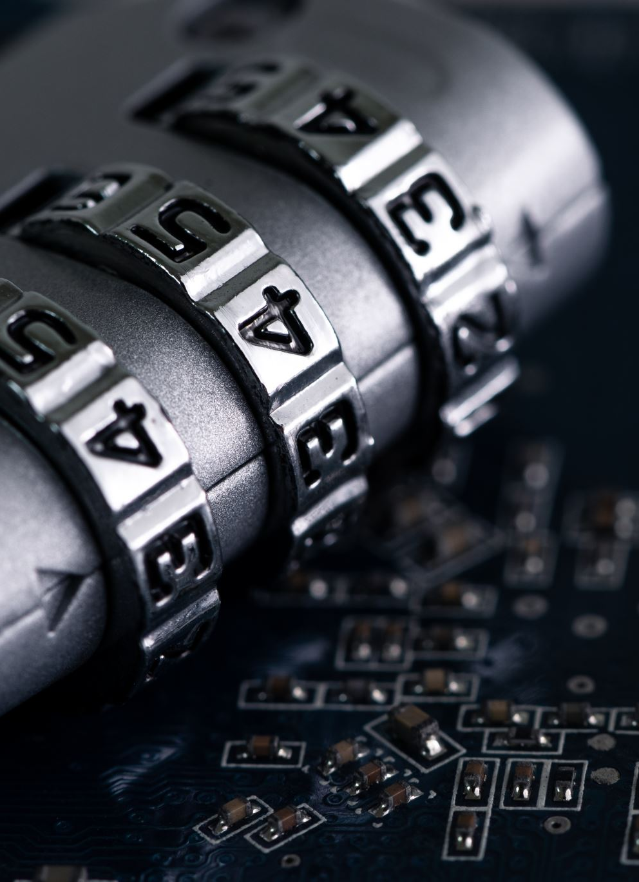
Evidence must be admissible in court
Data that may be subsequently relied upon in court must not have been changed during collection
Persons with access to said data must be competent and have a legitimate reason for access
Access logs are kept providing an audit trail of access, complete with details of who, what, where when and how access occurred, and any actions performed
The chief investigator has oversight and is responsible for ensuring the law is always respected

Slide 10

Investigatory Stages
Readiness – a proactive stance that ensures a system is in a state of functional readiness for forensic investigation
Evaluation – in the event of an incident, it must be clear to all concerned what their role is and what the impact of the incident is likely to be
Collection – the process of collecting evidence in a way that ensures admissibility in a court of law
Analysis -- must be accurate, thorough, impartial, recorded, repeatable and completed within the time-scales available and resources allocated
Presentation – preparation of a report on findings written in plain language that non-forensic experts would understand

Slide 11

Investigatory Stages
Review – performed afterwards as a kind of lessons learned, process improvement exercise that identifies how the process might be done more efficiently in the future

Slide 12
Countermeasures
Criminals engage in an on-going game of cat and mouse in which they constant seek loop-holes in existing defences to exploit
Encryption is one such way; to prevent forensic analysis data may be over-written to render it unrecoverable
A files metadata can be changed, or the file subjected to “obfuscation” to disguise it

Slide 13
7.3 Data Breach Intelligence
Data breach intelligence forms a subset of a larger threat intelligence landscape
There are categories of threat intelligence that agencies of all kinds use to gather information that might be useful in proactively managing threat
If you are a commercial organisation, or government department not directly concerned with legally sanctioned intelligence gathering, some of these methods will not be legally available

Slide 14
Intelligence Sources
Cyber intelligence is the collective name for data derived from a variety of intelligence-collection disciplines, as discussed below
Signals intelligence derived from having listened into or intercepted the signals of persons of interest
Tech intelligence relates to information on the hardware and software capabilities of adversaries, allowing proper countermeasures
AlienVault Open Threat Exchange
ACSC Annual Cyber Threat Report
CrowdStrike Global Threat Report
Threat Intelligence Communities
Endpoint Devices
Network Traffic
Threat Intelligence Platforms

Slide 15
Intelligence Sources
Cyber intelligence is the collective name for data derived from a variety of intelligence-collection disciplines, as discussed below
Threat Intelligence Providers
Market intelligence helps in understanding the commercial environment of an adversary
Human intelligence through direct or indirect contact with people likely to have useful information
Geospatial intelligence derived from sources such as GPS data and maps
Financial intelligence is information relating to the finances, or financial capabilities of adversaries

Slide 16
Create a Cyberthreat Intelligence Program
Identify from where you will be getting your data – this is a pre-requisite of properly defining the threat landscape
Concentrate your efforts on your specific business or sector because collecting intelligence that is not relevant will deplete your resources and divert attention
Create your table of priorities early and be disciplined in giving proper focus to the higher priorities, not allowing peripheral matters to deflect your efforts into less productive areas
Think of your CIP as a work-in-progress and deliberately build in the kind process improvement feedback loops that will allow the plan to evolve strategically over time

Slide 17
Create a Cyberthreat Intelligence Program
As far as possible automate the processing and dissemination of intelligence, as relying on manual processing is time consuming and limited in capability

Slide 18
7.4 Legal Aspects of Cyber Risk: State, National & International
Criminal Activity
Applicable Laws
Specific Sectors
Corporate Governance
Litigation
Insurance
Employees
Investigatory & Police Powers

Slide 19
7.5 Case Studies
Case Study 1: X, the sales manager of Company A gives 4 weeks’ notice
Case Study 2: Computer Forensics - Cyber CrimeIt was noticed by her manager that C’s work output had been dropping over the previous 3 weeks, which coincided with the provision of broadband Internet to her department

