Slide 1
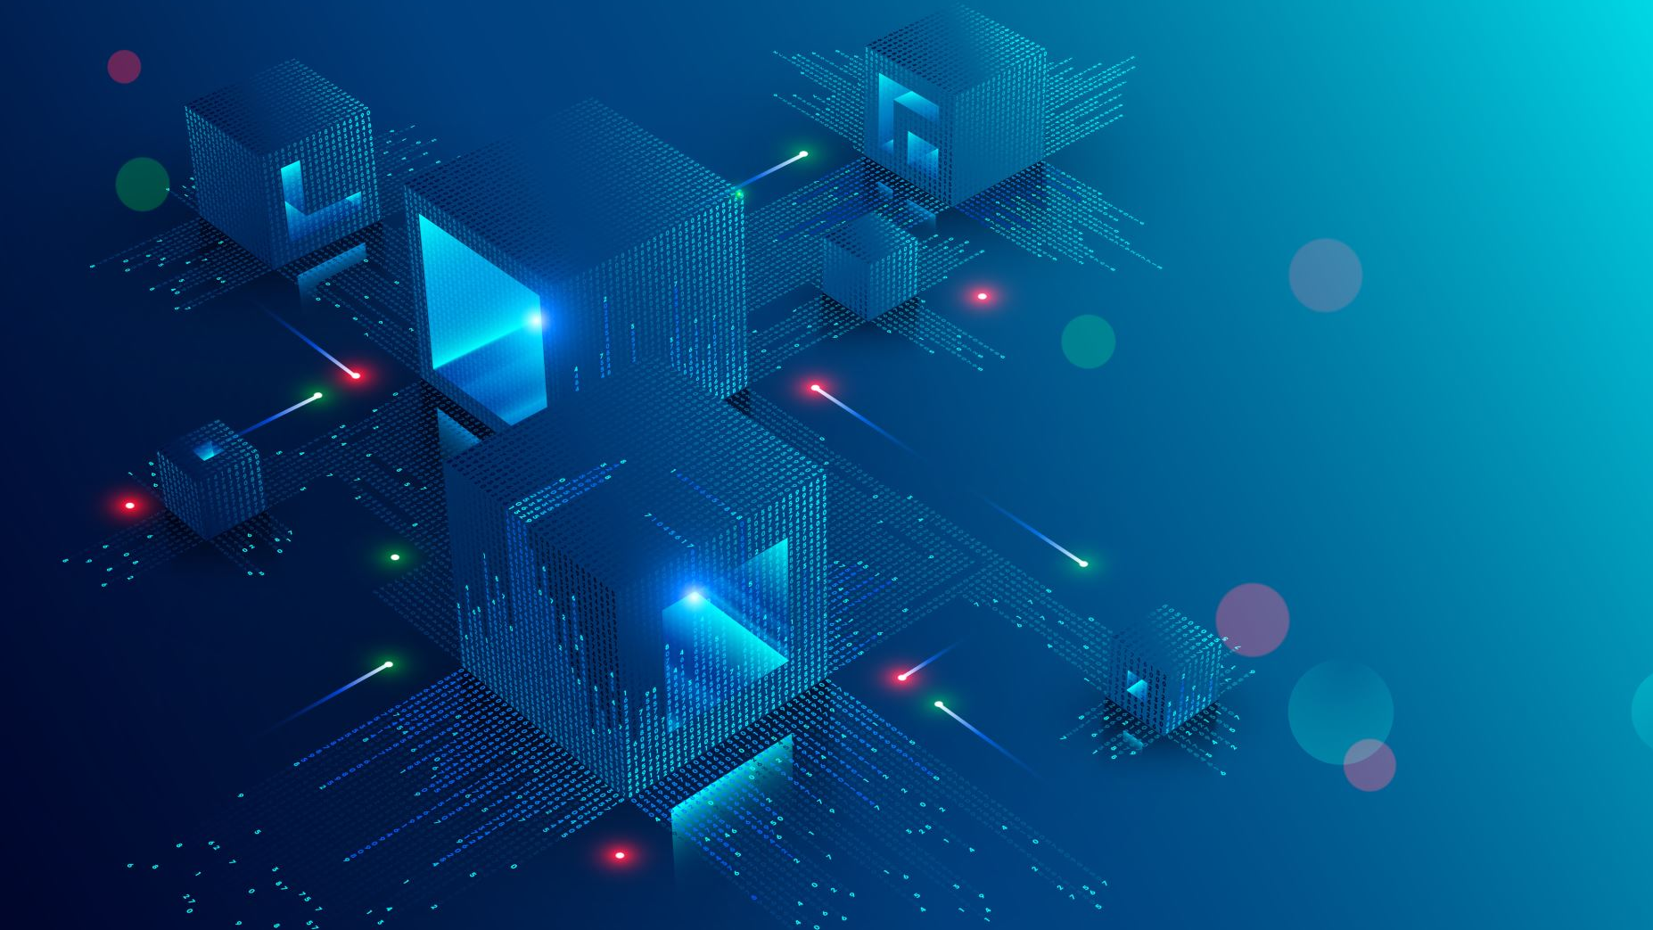
Module 9: Cyber Loss Process & Cyber Insurance

Slide 2

Incident Response Automation - organizations are adopting automation tools and technologies to improve their incident response capabilities
Threat Intelligence Sharing - collaboration and sharing of threat intelligence between organizations, industries, and even across national borders has become crucial
Cyber Insurance - demand for cyber insurance has been on the rise as organizations recognize the financial risks associated with cyber incidents
Focus on Cyber Resilience - rather than solely relying on prevention measures, organizations are shifting their focus towards building cyber resilience

Slide 3
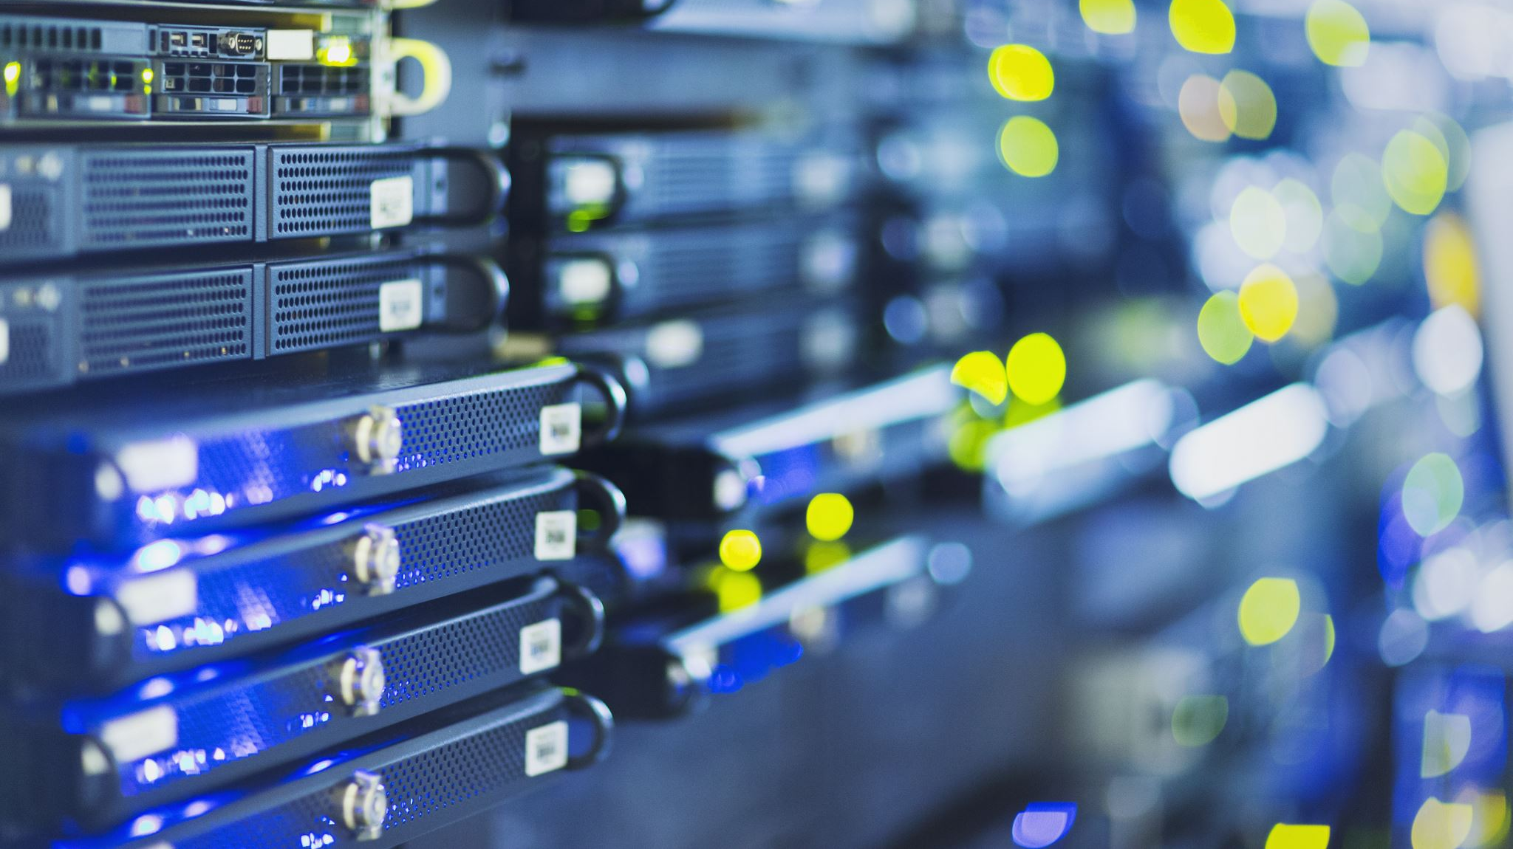
Regulatory Compliance and Data Privacy - with the increasing number of data protection regulations worldwide , organizations are prioritizing compliance efforts
Cloud Security and Third-Party Risk Management - as organizations embrace cloud computing and rely on third-party vendors for various services, managing cloud security risks and assessing third-party cyber risk have become critical
Cybersecurity Training and Awareness - recognizing that human error is a significant factor in cyber incidents, organizations are investing in cybersecurity training and awareness programs for their employees

Slide 4
Cyber Exercise and Simulation - organizations are conducting regular cyber exercises and simulations to test their incident response plans and identify potential gaps

Slide 5
Data Exfiltration
Data exfiltration is the unauthorized extraction or theft of data from a computer network, system, or device
It involves the unauthorized transfer of sensitive, confidential, or valuable data from an organization's internal network to an external location or unauthorized recipient
Data exfiltration can occur through various methods, such as exploiting vulnerabilities in the network, using malware or malicious software, leveraging social engineering techniques, or unauthorized physical access to devices
The stolen data can include intellectual property, financial information, personally identifiable information , trade secrets, or any other valuable data assets

Slide 6
Data Exfiltration
Data exfiltration is a significant risk to organizations, including financial loss, reputational damage, regulatory compliance issues, and potential legal repercussions
Data exfiltration continues to be the predominant cause of insured losses, with individual companies suffering significant data breaches
Data exfiltration events in U.S. increased rapidly during the period 2009 to

Slide 7
Selected Recent Large Data Breaches
“Data is the new gold”: Companies are harvesting data from their customers and mining it for insights in ever increasing volumes
The total amount of business data being stored is estimated to be doubling every 12 to 18 months
This means that the potential for data exfiltration of sensitive information is increasing rapidly
The magnitude of data exfiltration losses can be expected to increase in the future
Certain types of data are worth more than others and personal health records and personal identifiable information are worth more on the black market, relative to credit cards and other personal finance records

Slide 8
Selected Recent Large Data Breaches
An emerging recent target for data breaches has been offshore legal firms in tax havens, with a string of incidences of whistle-blower tax filings, including another exfiltration, following on from the Panama Papers in 2016, of the so- called ‘Paradise Papers’ where 1.4TB of sensitive financial and legal information about clients of offshore legal firm Appelby was leaked to the public
Costs of data exfiltration attacks vary significantly between countries and increases in countries with lower compensation costs have resulted in average costs worldwide apparently decreasing, but costs are generally increasing over time in many countries, as regulations tighten

Slide 9

Contagious Malware
Malware that can replicate and spread through networks of communication has been one of the longest-standing cyber threats
Recent events have shown that malware remains a potent trigger for loss, even in companies with high standards of security
WannaCry and NotPetya demonstrated the disruptive capabilities of viruses, worms, and trojan horses to spread through populations of organizations, see case studies
WannaCry affected over 300,000 machines, many critical to national infrastructure such as power stations and transportation hubs, localized and international banking systems, global manufacturing networks and logistics and delivery centres

Slide 10
Contagious Malware
The use of ransomware, where malware is infiltrated into the networks of a company and disables servers or locks up data until a ransom is paid, has become one of the most pressing concerns for cyber security specialists
Ransomware has historically afflicted personal computers and small and medium sized enterprises, but recent developments have seen large multinational corporations affected, with security companies seeing some 42 percent of all ransomware infections in the first half of 2017 targeting organizations in an interconnected and networked environment

Slide 11
Financial Theft
Financial theft has continued to be a major source of cyber-attacks and cyber-enabled fraud
Compromising networks of trust to misappropriate financial transfers remains a significant threat, despite major efforts to improve security
Cyber-attacks on customer systems continue to be a major cause of loss
Cyber attacks on the customer side of financial institutions continue to dominate, with online fraud plaguing the e-commerce, airline and retail industries
Cyber-attacks for financial theft and fraud are still a more significant element of cyber loss than ransomware, with 2.5 times the annual detection of cyber-attacks involving financial malware

Slide 12

Financial Theft
The U.S. remains a key location for credit card fraud, accounting for 24 percent of total credit card use, but 47 percent of global credit card fraud
U.S. continues to see many types of card-present and point-of-sale fraud, including cashing counterfeit EU payment cards
Cyber-attacks have increased against third-party cryptocurrency wallets to steal digital currency, exploiting weaknesses in factor security verification in wallets

Slide 13
Cloud Outage
The failure of a cloud service provider, while very unlikely, represents a potential cyber insurance systemic exposure as many cyber policies include coverage for outages
Cloud computing has successfully inundated the global markets, creating a utility-like service for over 90% of companies.103
Large numbers of companies depend on the cloud, particularly in the ecommerce sector which accounts of 8.9% of total sales in the U.S
The global market of CSPs continues to be dominated by Amazon Web Services at 47%, followed by Microsoft Azure at 10%, Google Cloud Platform with 4%, & IBM Softlayer with 3%
To be competitive in the public CSP market, providers need to minimize downtime and deliver on promised reliability ratings

Slide 14
Cloud Outage
To maintain such high levels of reliability, the architecture of CSPs focuses on strategic isolation to protect the spread of malicious software and geographic redundancies for datacentres to reduce downtime

Slide 15

Denial of Service Attacks
Distributed Denial of Service attacks continue to be a major component in the cyber risk landscape
A third of all organizations reportedly experience DDoS attacks, twice as many as a year ago
This trend of growing likelihood of attack is likely to continue across sectors, geographies, and activity areas, as the firepower capacity of attackers increases, and they seek out new targets
A Distributed Denial of Service attack uses internet traffic to overwhelm servers forcing a shut-down of the system or a slowing of services
Not only is the number of DDoS attacks increasing, but so too is the complexity

Slide 16
Denial of Service Attacks
Instead of tactics focused on single aspect of a company’s infrastructure, DDoS attacks are taking a more diversified approach, alternating targets within a single attack including web application servers, firewalls, and other infrastructure components
The typical attack pattern of DDoS attacks has also grown in complexity
Pulse DDoS attacks can extend for days at a time and thus pose a significant risk to the accessibility of a company’s network

Slide 17
Denial of Service Attacks
The significance of complex successive attacks is that large commercial servers designed to deal with high traffic volumes are resilient against attacks of low intensity, but very-high intensity attacks with frequently changing targets within a network’s infrastructure can bring down even the strongest websites

Slide 18
Case Study: The Return of Lazarus: More SWIFT Financial Thefts in 2017
Sophisticated cyber-attacks continued to enable financial thefts from the SWIFT inter-banking financial transaction system, following on from the major attacks in
The gang used a vulnerability in the bank’s security, which allowed the group to secretly implant their malicious malware onto the bank’s computers and servers.97
This group is a sophisticated advanced persistent threat group which has been associated with many high-profile financial thefts including Bangladeshi SWIFT attack in 2016 and the 2017 attack on Polish banks

Slide 19
9.2 Cyber Insurance
The growing cyber insurance market is continuing to be profitable but has had some near misses that could have substantially impacted the industry loss ratio
Growth is coming from new sectors and markets
Implementing growth and loss control strategies is a major priority

Slide 20
Rapid Growth
The cyber insurance market continues to demonstrate consistent growth at around 30% year on year
It is also relatively small in comparison with the overall corporate cyber risk management spend, with Gartner reporting worldwide cybersecurity spending at over $75.4 billion
A review of many cyber insurance policies seen by RMS suggests the growth in the U.S. has been driven by increased take up from non-traditional purchases of cyber insurance , as well as additional premiums generated from the availability of larger limits
International growth has also played a key part, with several markets demonstrating strong growth including Australia, Japan, and the United Kingdom

Slide 21
Rapid Growth
Corporate risk managers need to develop comprehensive digital risk management strategies that involve a range of mitigations with risk transfer solutions through insurance being critical

Slide 22
Profitability of Cyber Lines
RMS estimates the industry loss ratio for 2016 at 54.6%
RMS analysis shows that breach of privacy events continues to contribute the largest financial impact to losses
An analysis of the WannaCry incident carried out by RMS calculated that with just a few small variations in the way it played out, insured losses for the industry would have exceeded $3 billion

Slide 23
Cyber Reinsurance
The cyber reinsurance market has continued to develop over the last 12 months
Insurers are now more aware of the potential for systemic incidents to trigger substantial losses and are looking to the reinsurance market to transfer some of this risk off their balance sheets
The majority of reinsurance contracts remain as per risk quota share with some aggregate stop loss terms adding additional protection for the reinsurer

Slide 24
Managing Cyber Exposure
Driven by increased regulatory pressures and improved awareness at the board level, insurers have looked to implement practices to manage cyber risk
Implementing a consistent approach to managing risk across these diverse classes of business is a challenge for many insurers
The clear need for visibility into cyber risk has led insurers to tackle these challenges head on

Slide 25
Pricing Cyber Risk
Approaches to pricing cyber risk have yet to come to a consensus across the industry
A review of the rate fillings provided to insurance commissioners in the U.S. highlight the challenges of pricing cyber risk given the limited historical data and the relatively dynamic peril
These challenges highlight the need for improved data and risk models to support the industry’s growth in a resilient manner

Slide 26


9.3 Case Study: WannaCry Malware Attack
WannaCryptor ransomware spread via file-sharing network protocols on computers using outdated Windows XP and v8 OS
It resulted in 300,000 infections of computers across 150 countries
WannaCry used a NSA exploit codenamed EternalBlue
It mainly affected personal users, public sector organizations, and SME-sized companies, affecting unpatched boxes and equipment on dedicated older operating systems
The great majority of the Windows computers running version 8 or earlier were protected by a Microsoft patch MS17-010 issued two months earlier, in March

