Slide 1
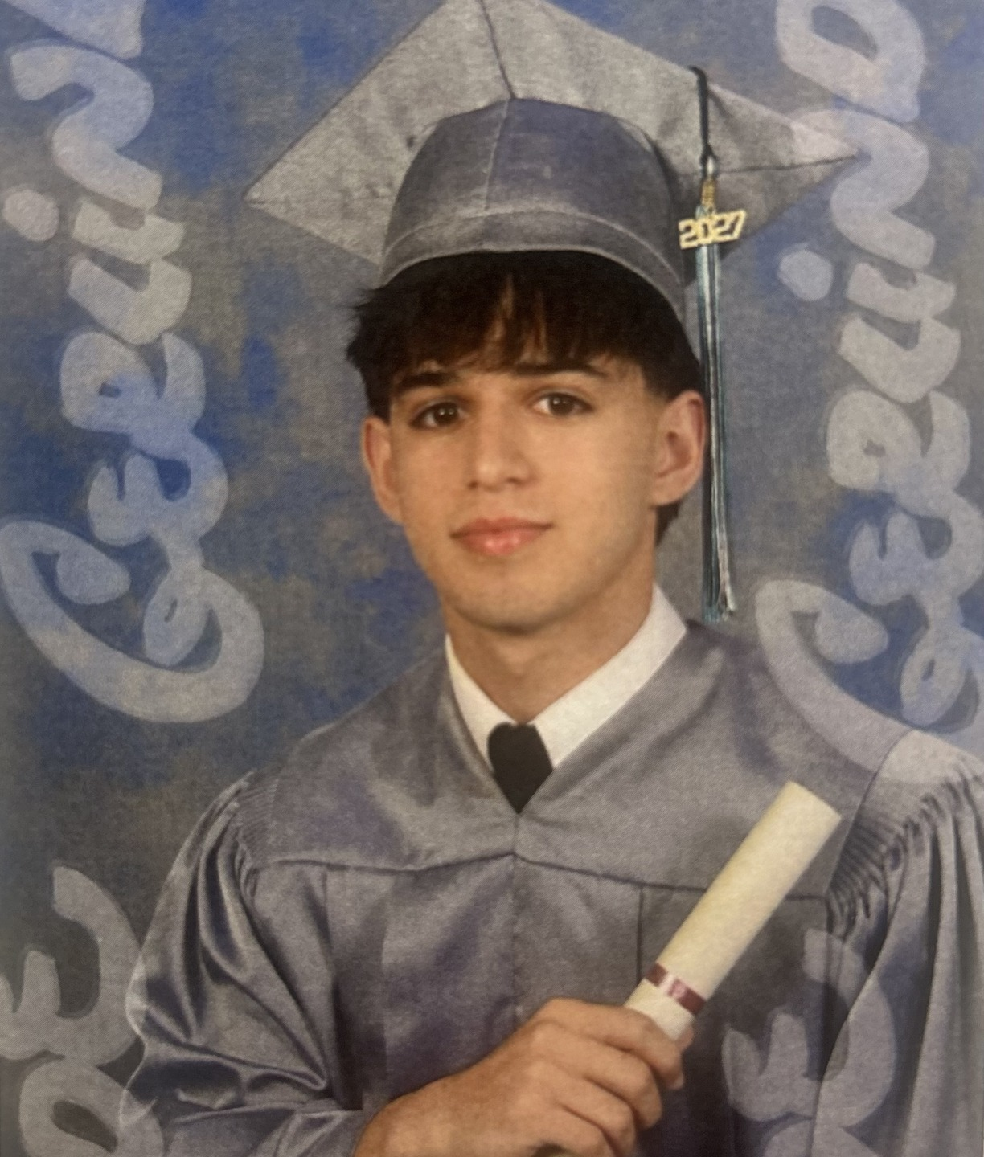
ARCHBISHOP MCCARTHY HIGH SCHOOL · 10 YEAR DREAM KEYNOTE
Kevin
Hernandez
Build a life that feels like mine.
In 10 years I hope to be back in Miami, running my own business, with a family and a life I’m proud of.
01 / 05

Slide 2
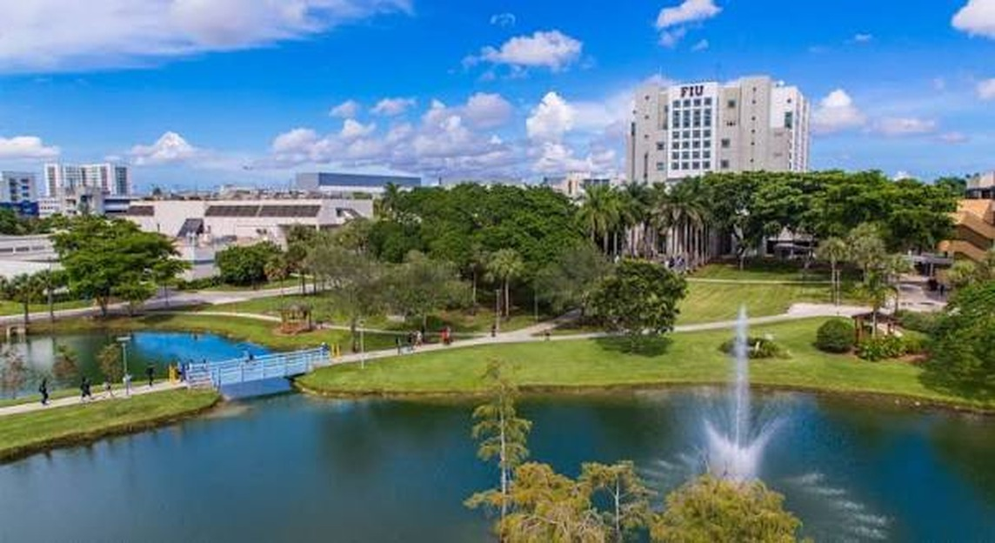
EDUCATION
The Next Step
After McCarthy I want to go to college and study business. I’m most interested in the entrepreneurship side of it — finance, marketing, and how a company actually runs day to day.
I also want to use college to meet people and get real experience, not just sit in class. An internship, a job, whatever I can get. And if I come up with an idea I believe in, I’d like to try starting something small while I’m still in school.
02 / 05

Slide 3

CAREER · MIAMI, FLORIDA
Building My Own Thing
Ten years out, I picture myself in Miami running my own business. I don’t know exactly what it will be yet — that’s the honest answer. I just know I want it to be mine.
I’m fine with working a lot, especially early on. What I really want is control over my own time, enough money that I’m not worried about money, and something I built that I’d put my name on.
03 / 05

Slide 4
FAMILY
LIFE OUTSIDE OF WORK
The Life I Want
Outside of work I keep picturing something pretty normal, honestly. A wife, two kids, a dog, and a house with enough room for people to come over. Sundays with family. The same friends I have now, still around.
I want to stay in the gym, get to the beach when I can, keep up with my teams, and probably spend too much on a car at some point.
04 / 05

Slide 5
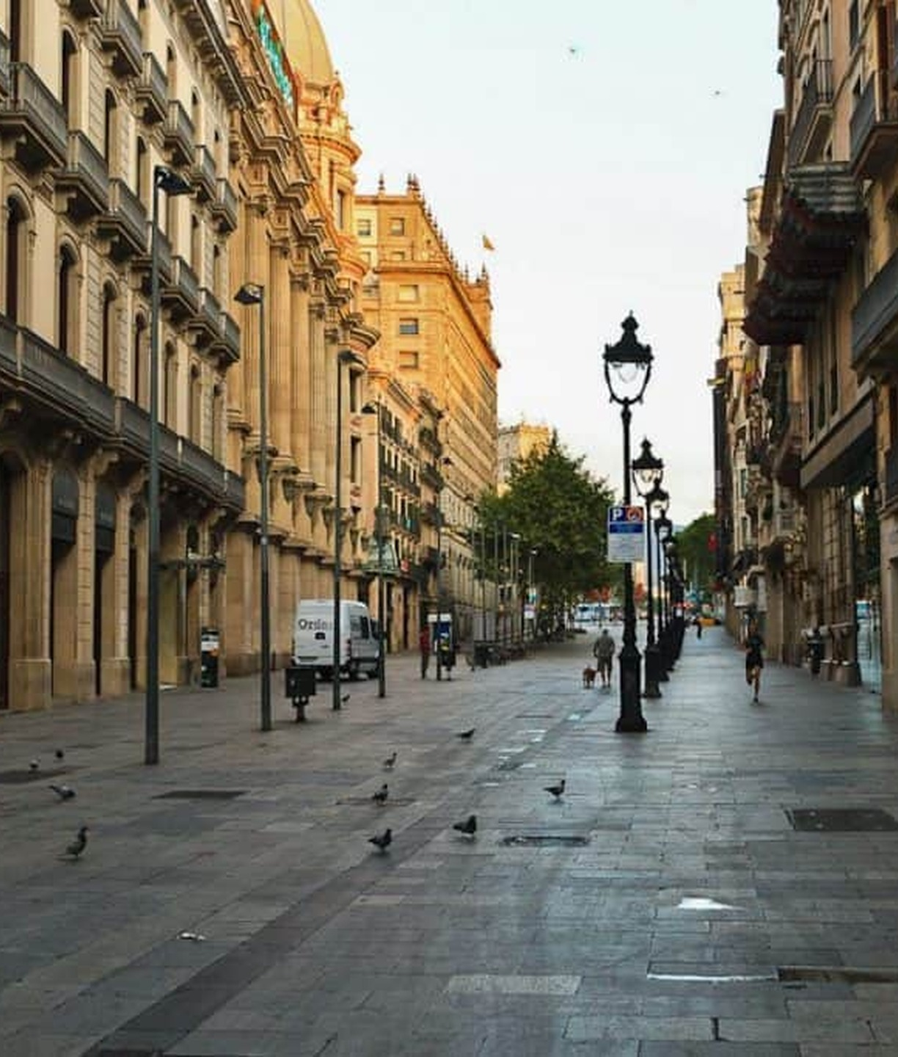
THE REUNION
See You in 10
If it goes the way I hope: I’m living in Miami, running my own business, and I pull up with my wife, our two kids, and probably the dog too.
By then I want to have made it to Barcelona — Spain is the one trip I really want to take. Comfortable, not rich. Proud of what I built, and still close with the same people I care about now.
I know it won’t go exactly like this. I just want to look back and know it was all mine.
05 / 05

