Slide 2
Methodology
Baseline
5 Models
Logistic Regression
Gradient Boost
XG Boost
Random Forest
Extra Trees
Optimised for ROC-AUC
Gathered other metrics as well
Model
(Base Features)
Feature Expansion
SMOTE
Model Evaluation
Model Selection

Slide 3
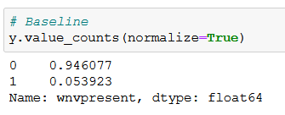
Baseline
Baseline
Imbalanced data
ROC-AUC: 0.500
Model
(Base Features)
Feature Expansion
SMOTE
Model Evaluation
Model Selection

Slide 4
Model with Base Features
Baseline
49 features
GridSearchCV for each model
Top performing model: XGBoost
Validation ROC-AUC – 0.87
Recall – 0.051
All models had poor Recall & F1 Score
Model
(Base Features)
Feature Expansion
SMOTE
Model Evaluation
Model Selection

Slide 5
Feature Expansion
Baseline
Try and improve metrics
PolynomialFeatures
Degree = 2
1274 features
Might have too many noisy features
Reduce dimensionality/complexity
PCA
Filtering
Model
(Base Features)
Feature Expansion
SMOTE
Model Evaluation
Model Selection

Slide 6
Principal Component Analysis (PCA)
Baseline
To reduce dimensionality
GridSearchCV + Pipeline
Each model
30/40/50 Principal Components
Top performing model: RandomForest
Validation ROC-AUC – 0.846
Recall – 0.014599
Not much difference from basic model
Model
(Base Features)
Feature Expansion
SMOTE
Model Evaluation
Model Selection

Slide 7
Filtering
Baseline
By Pearson’s Correlation with target
GridSearchCV + Pipeline
Each model
Different correlation cutoff points
Top performing model: XGBoost
Validation ROC-AUC – 0.857
Recall – 0.014599
Not much difference from basic model
Model
(Base Features)
Feature Expansion
SMOTE
Model Evaluation
Model Selection

Slide 8
SMOTE
Baseline
To address class imbalance
Improve recall
GridSearchCV for each model
Top performing model: XGBoost
Validation ROC-AUC – 0.847
Recall – 0.54
Slightly lower ROC-AUC, much better recall!
Model
(Base Features)
Feature Expansion
SMOTE
Model Evaluation
Model Selection

Slide 9
Model Evaluation & Selection
Baseline
Compared top 2 models from each method
Important metrics:
ROC-AUC
Recall
Best model: GradientBoost with SMOTE
max_depth = 3, learning_rate = 0.15
Validation ROC-AUC – 0.842
Recall – 0.657
Kaggle submission score: 0.727
Model
(Base Features)
Feature Expansion
SMOTE
Model Evaluation
Model Selection

Slide 10
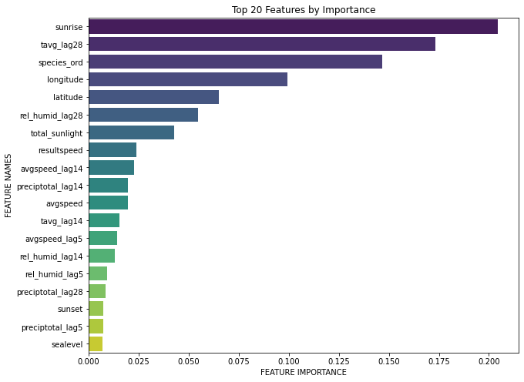
Feature Importance
Many temporal features
Features related to season
Location also important

Slide 11
Model Conclusions?

