Slide 1
Industrial automation

Slide 2
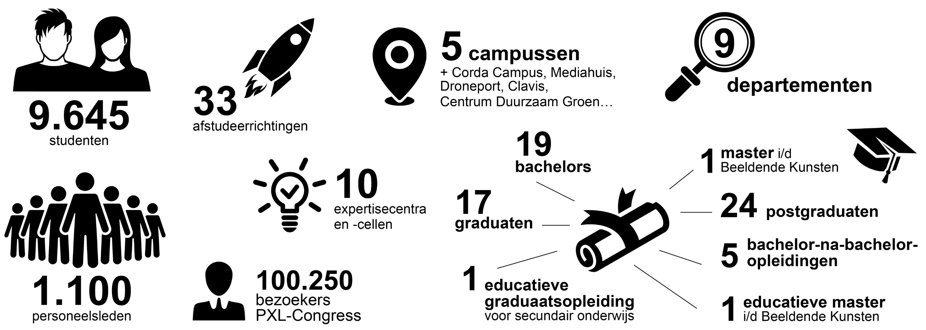
Facts and figures

