Slide 1
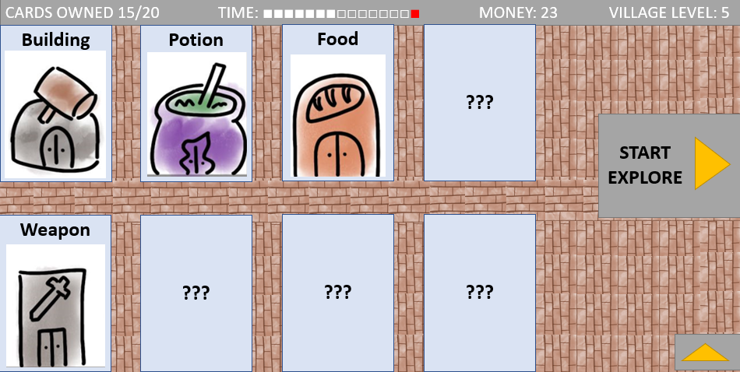
主界面最终效果

Slide 2
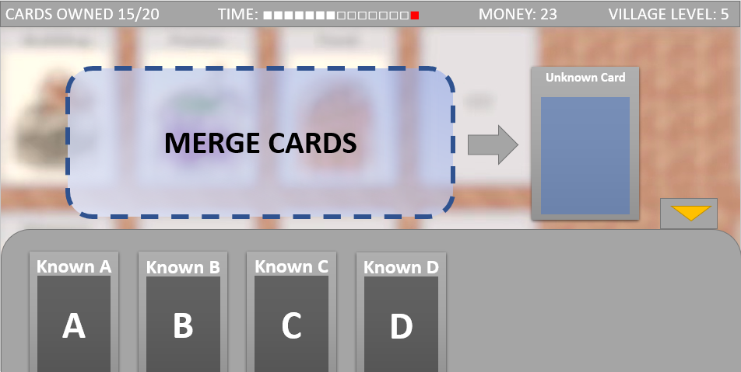
合成界面最终效果

Slide 3
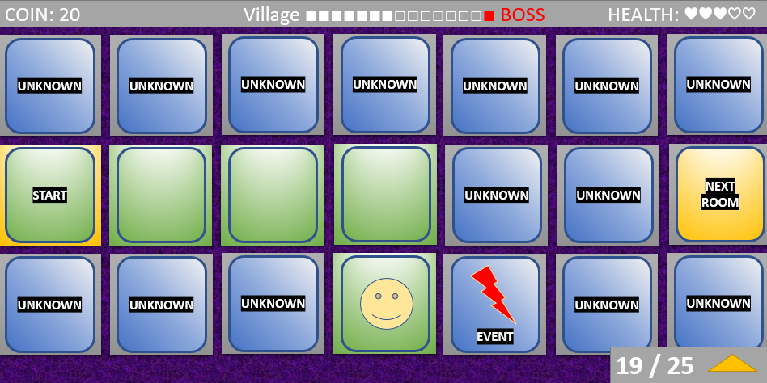
地牢界面最终效果

Slide 4
参考宽度 18
Building
CARDS OWNED 15/20 TIME: ■■■■■■■□□□□□□□■ MONEY: 23 VILLAGE LEVEL: 5
Village Map
参考高度 9
Animal
Building
Resource
Resource
Resource
Building
Animal
Villagers
Animal
Resource
Animal
Resource
START
EXPLORE
Weapon
Villagers
Resource

Slide 5
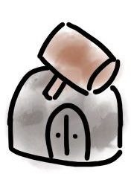


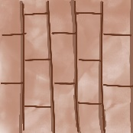

参考宽度
Building
CARDS OWNED 15/20 TIME: ■■■■■■■□□□□□□□■ MONEY: 23 VILLAGE LEVEL: 5
参考高度
Animal
Building
Potion
Food
???
Weapon
START
EXPLORE
Weapon
???
???
???
Villagers
Resource

Slide 6
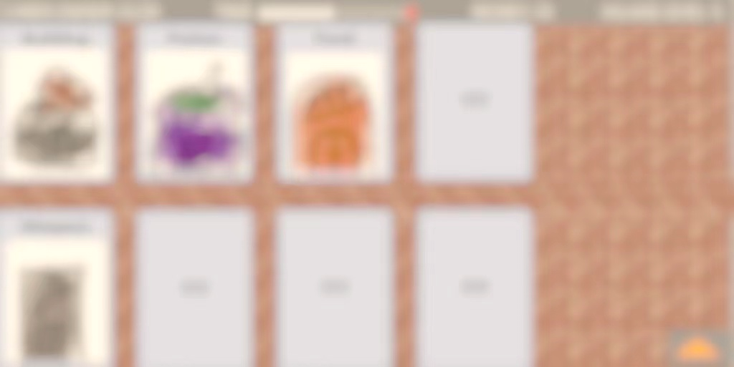
参考宽度
Building
CARDS OWNED 15/20 TIME: ■■■■■■■□□□□□□□■ MONEY: 23 VILLAGE LEVEL: 5
参考高度
Animal
MERGE CARDS
Unknown Card
Weapon
Known A
Known B
Known C
Known D
Villagers
A
B
C
D
Resource

Slide 7
参考宽度
COIN: 20 Village ■■■■■■■□□□□□□□■ BOSS HEALTH: ♥♥♥♡♡
参考高度
19 / 25

Slide 8
参考宽度
COIN: 20 Village ■■■■■■■□□□□□□□■ BOSS HEALTH: ♥♥♥♡♡
参考高度
UNKNOWN
UNKNOWN
UNKNOWN
UNKNOWN
UNKNOWN
UNKNOWN
UNKNOWN
START
UNKNOWN
UNKNOWN
NEXT
ROOM
UNKNOWN
UNKNOWN
UNKNOWN
UNKNOWN
UNKNOWN
UNKNOWN
19 / 25

Slide 9

参考宽度
COIN: 20 Village ■■■■■■■□□□□□□□■ BOSS HEALTH: ♥♥♥♡♡
参考高度
UNKNOWN
UNKNOWN
UNKNOWN
UNKNOWN
UNKNOWN
UNKNOWN
UNKNOWN
START
UNKNOWN
UNKNOWN
NEXT
ROOM
UNKNOWN
UNKNOWN
UNKNOWN
EVENT
UNKNOWN
UNKNOWN
19 / 25

