Slide 1
CAR BLACK BOX
Author : Kewal Ukunde

Slide 2
INTRODUCTION
The purpose of car black box project is to reflect the car system on PIC microcontroller board.
The user have controls on board like gear change, speed and current time.
If any error occur in system it will store error logs in EEPROM.
Giving facility to analyses logs generated in system.

Slide 3
BOARD ARCHITECTURE
Key 1 : Increment
Key 2 : decrement
Key 3 : select
Key 5 : gear up
Key 6 : gear down
Key 7 : back
Key 8: collegian
LCD SCREEN
1
2
3
5
6
7
SPEED CONTROL
8
MATRIX KEYPAD

Slide 4
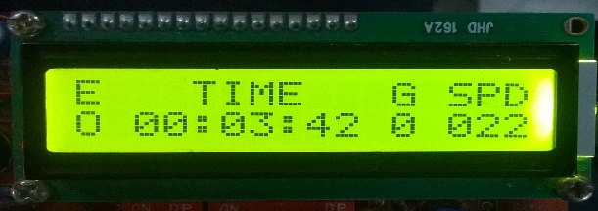
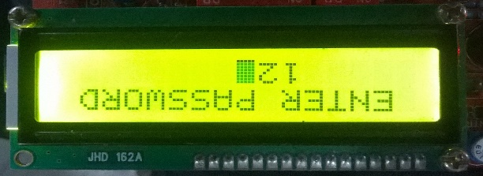
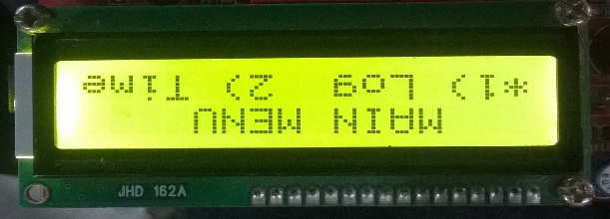
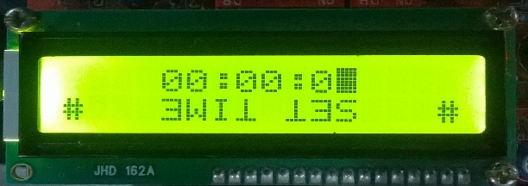
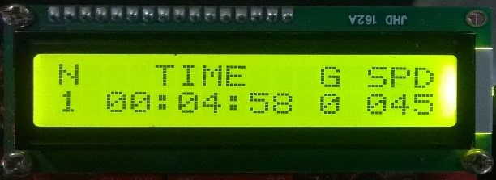
FLOW CHART
Start
true
Key =8
Key = 7
Scan Key
Save log in EEPROM
Speed limits
true
Key = 7
Scan Key
No
Pass verified
yes
S = 2
true
Key = 7
Scan Key
select =
1 / 2
S = 1

Slide 5
Key challenges & Learnings
State-event cycle operation.
Manage key bouncing effect.
LCD data display and maintain cursor.
Storage of error logs in EEPROM.

Slide 6
THANK you

