Slide 1
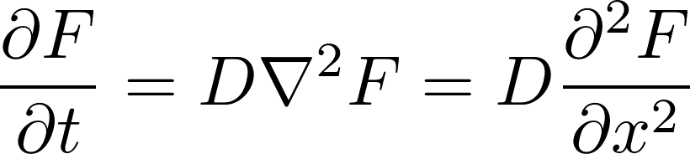

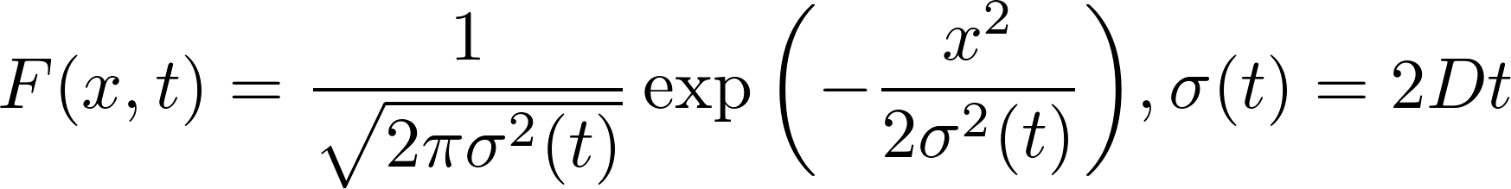
2. 1D Diffusion Equation
The 1D diffusion Equation is
D is the diffusion constant. For a delta function like initial condition, the solution of the diffusion profile is a gaussian function with a time dependence width .
is also the standard deviation of this solution.

Slide 2
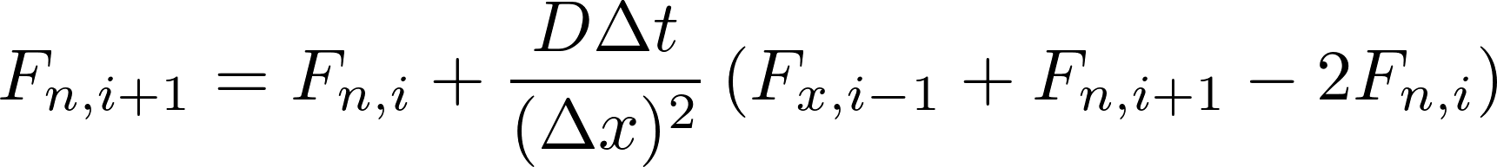
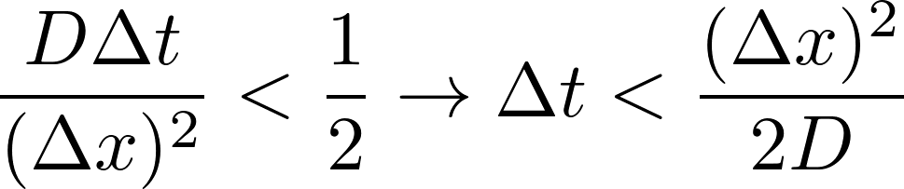
2. 1D Diffusion Equation
Finite difference approach and stability criterion
Time evolution from the initial condition:
Periodic boundary condition:
Stability criterion:

Slide 3
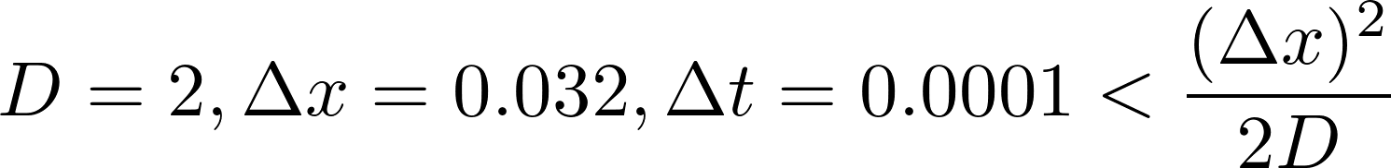
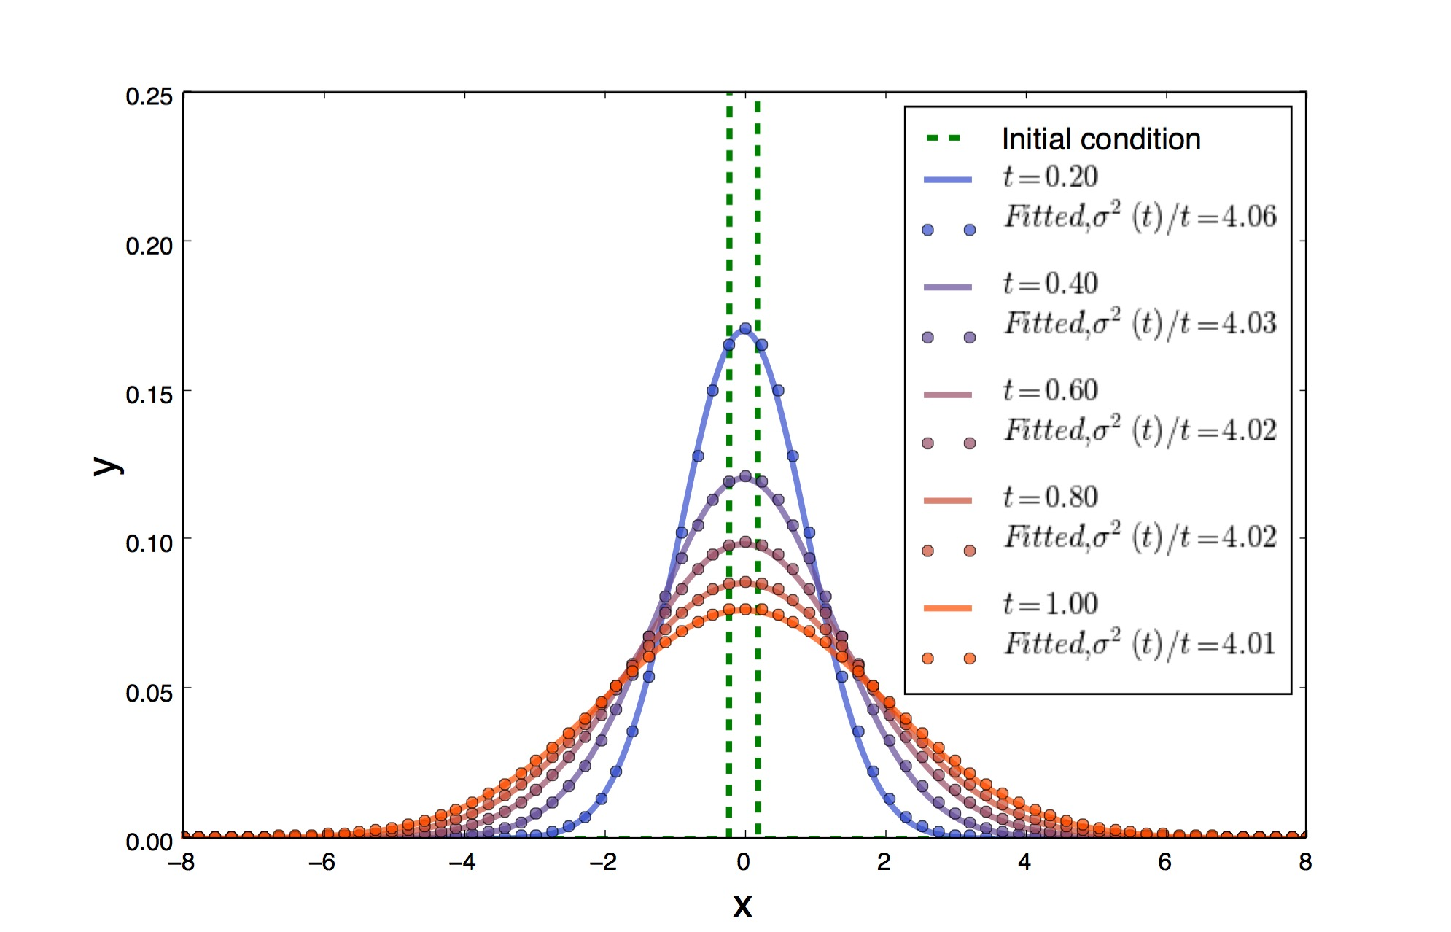
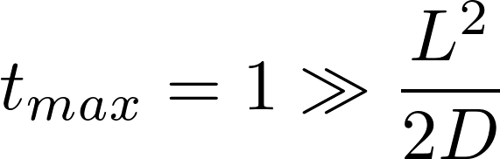
2. 1D Diffusion Equation
Initial length scale L
L << maximum x range
Gaussian fit

