Slide 1
Group Assignment 1A:
Random Walk, Diffusion, and Cluster Growth
David Hicks, Weiyao Ke,
Shagun Maheshwari, and Fan Zhang

Slide 2
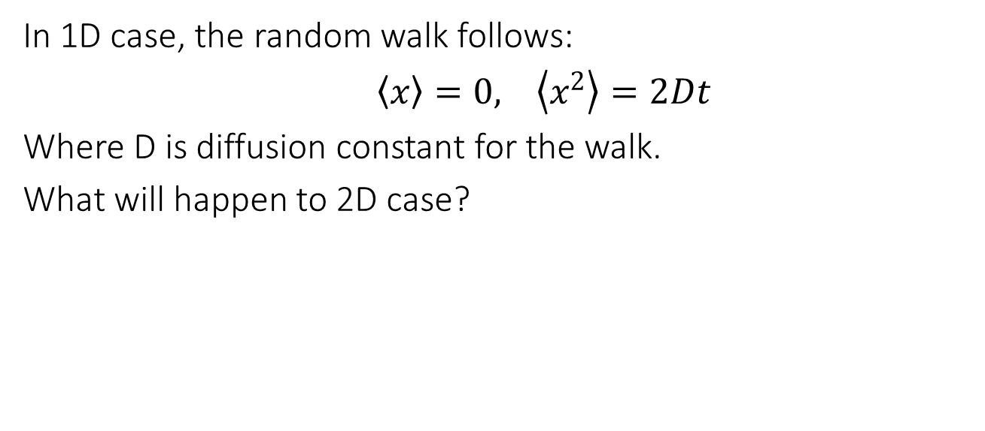
Q1: 2D Random Walk

Slide 3
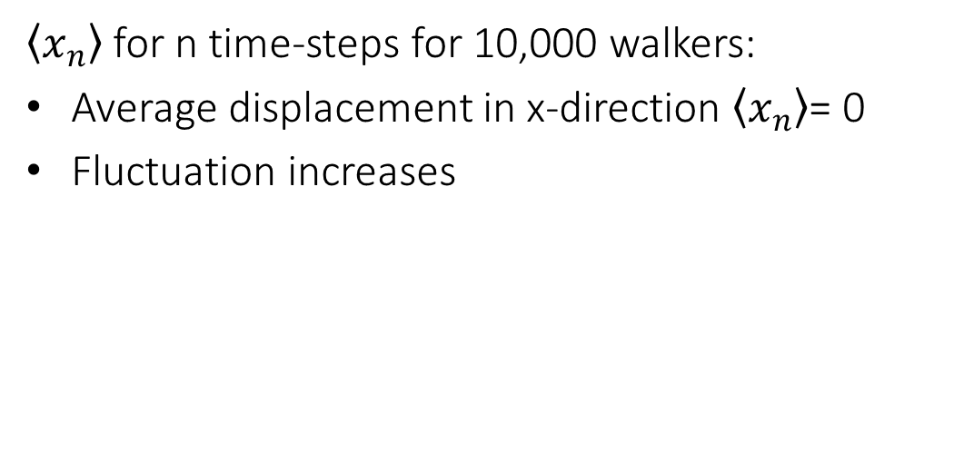
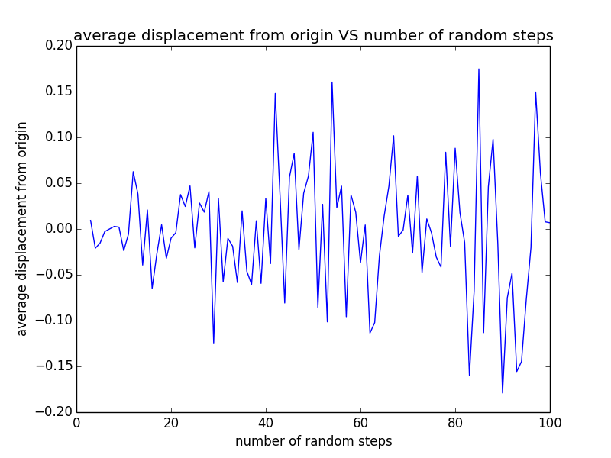
2D Random Walk

Slide 4
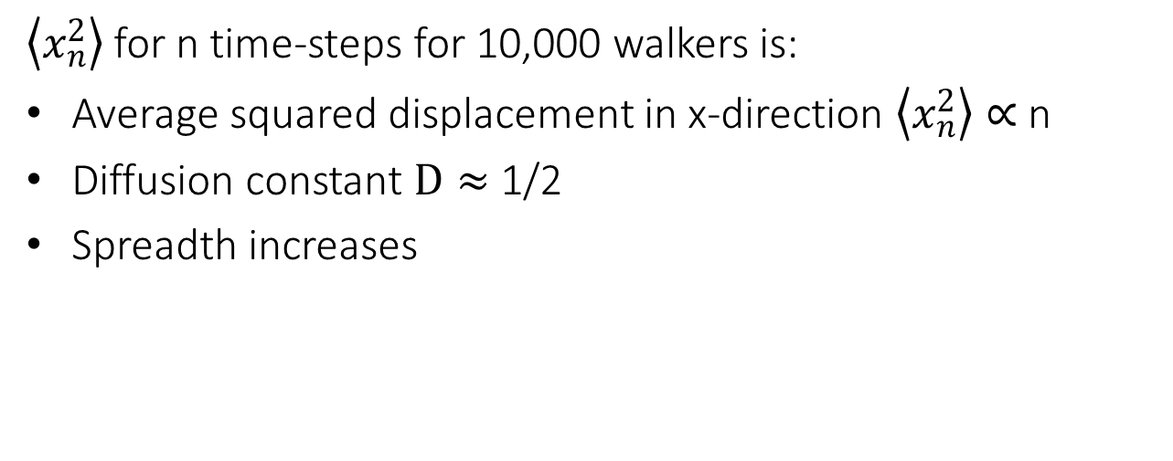
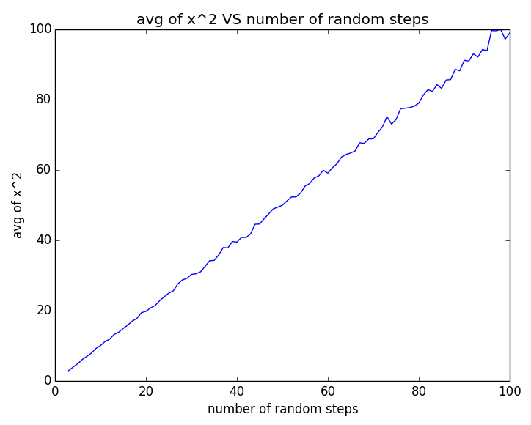
2D Random Walk

Slide 5
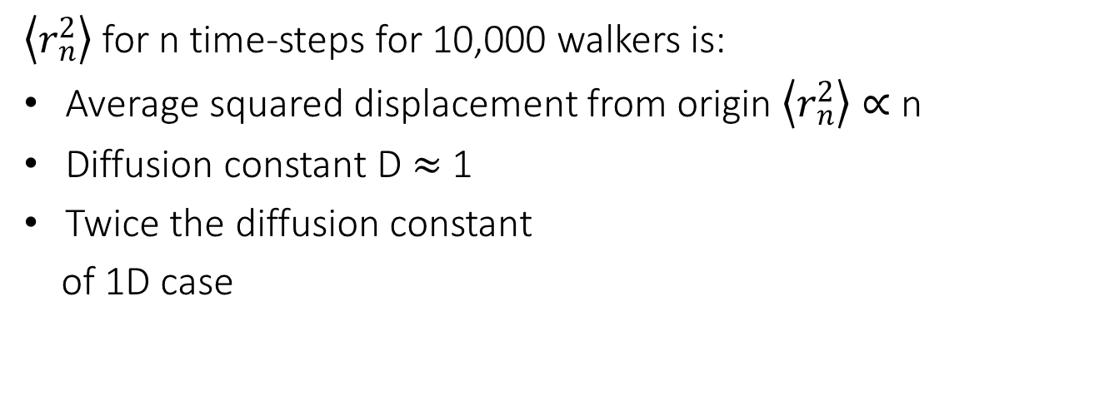
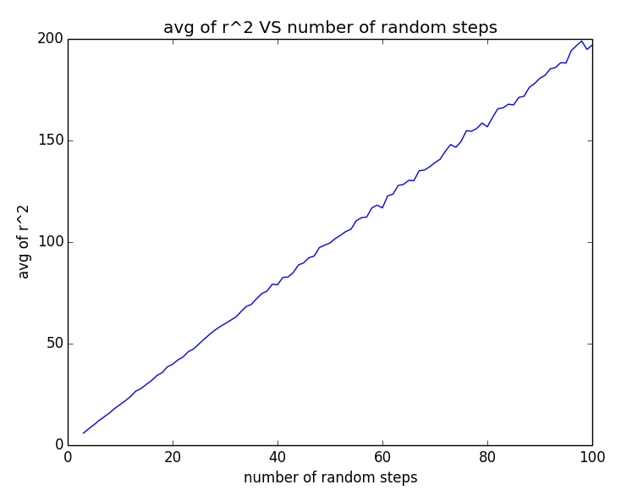
2D Random Walk

Slide 6
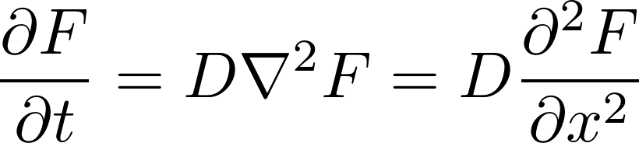

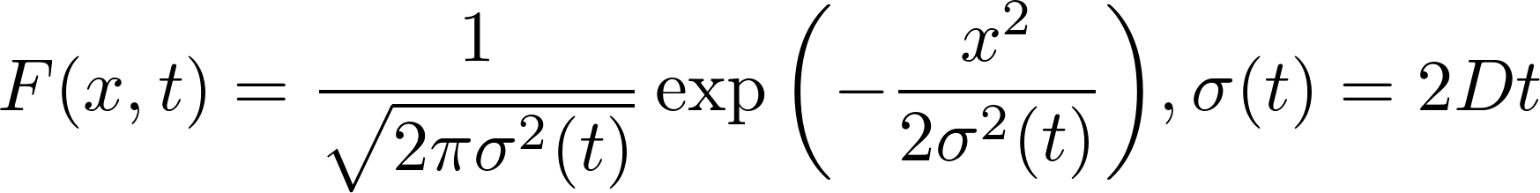
2. 1D Diffusion Equation
The 1D diffusion Equation is
D is the diffusion constant. For a delta function like initial condition, the solution of the diffusion profile is a gaussian function with a time dependence width .
is also the standard deviation of this solution.
4/2/15

Slide 7
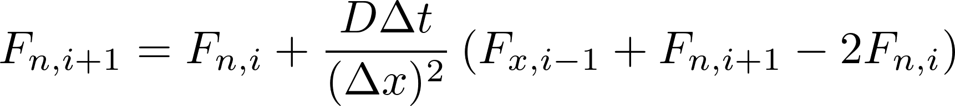
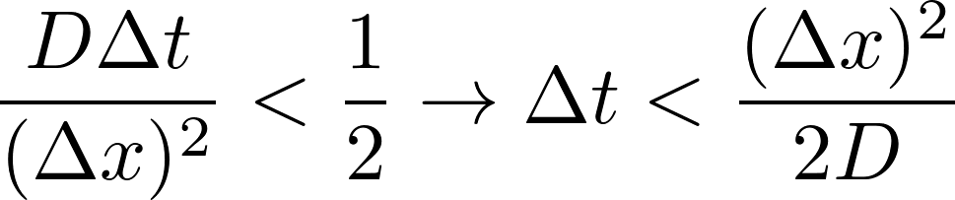
2. 1D Diffusion Equation
Finite difference approach and stability criterion
Time evolution from the initial condition:
Periodic boundary condition:
Stability criterion:
4/2/15

Slide 8
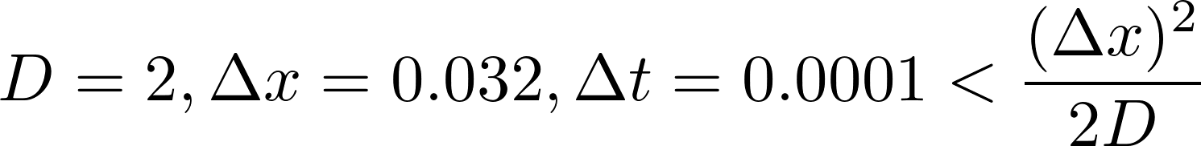
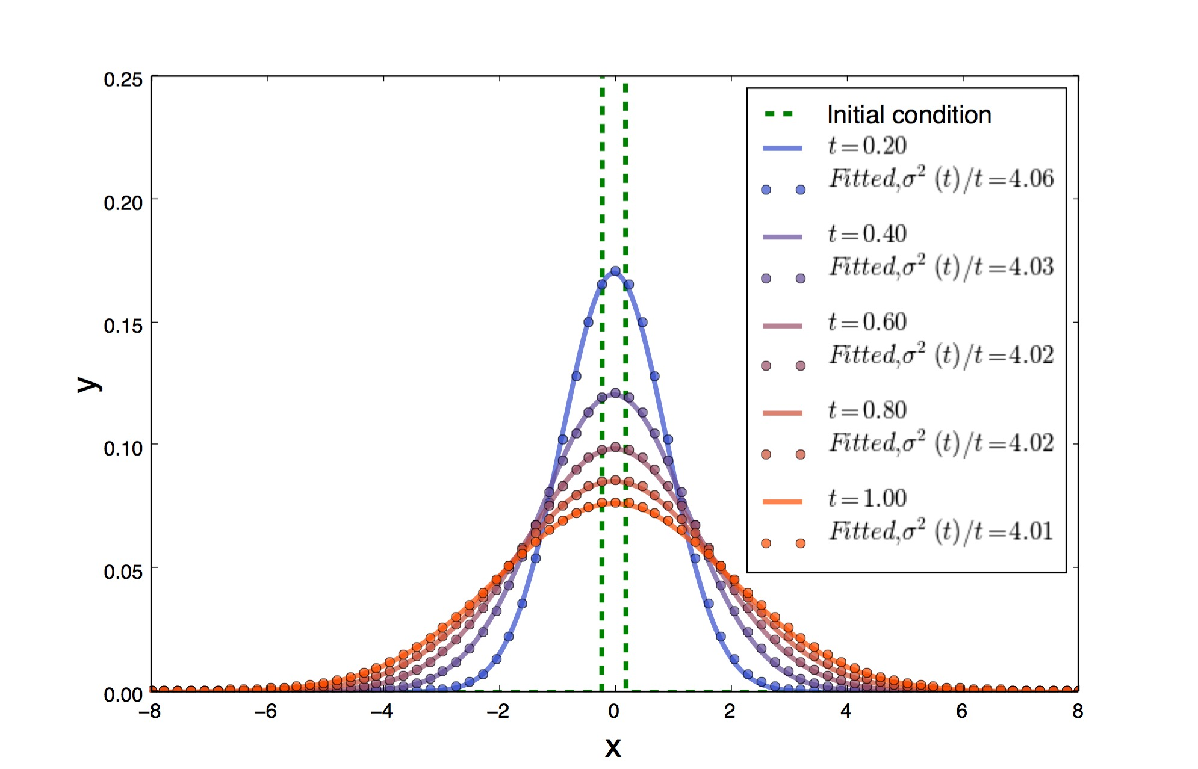
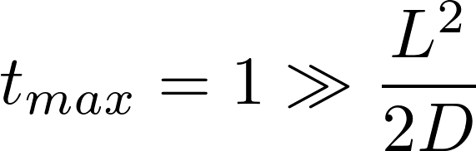
2. 1D Diffusion Equation
Initial length scale L
L << maximum x range
Gaussian fit
4/2/15

Slide 9
3. Diffusion Limited Aggregation (DLA) Method
Boundary
DLA Model (Example code)
Seed particle at origin
While radius of cluster <= 100
  Generate random walker on given radius
  Perform random walk
If out of bounds:
Throw out walker
Go to 1.
If hits perimeter:
Add walker to cluster Update perimeter
Go to 1.
Walker Release Radius

Slide 10
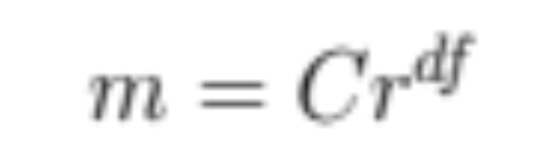
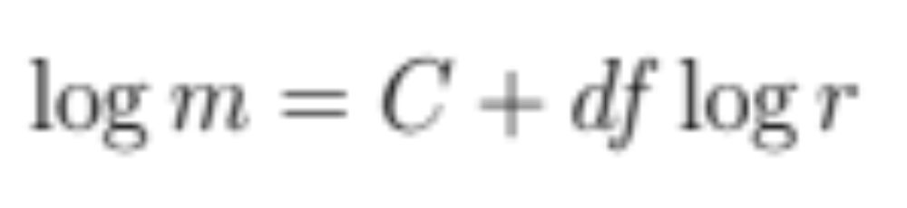
3. Fractal Dimension
m: mass C: proportionality constant r: radius df: fractal dimension

Slide 11
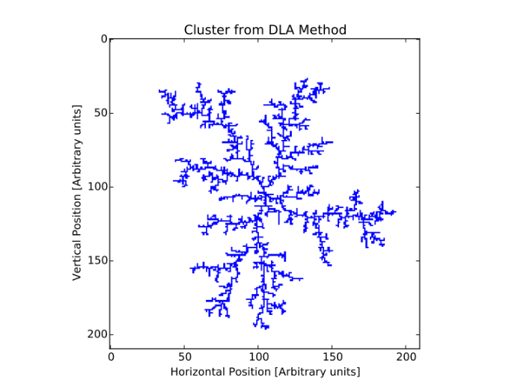
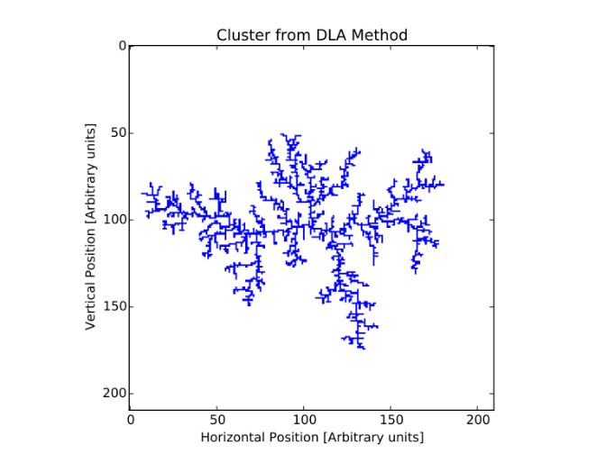
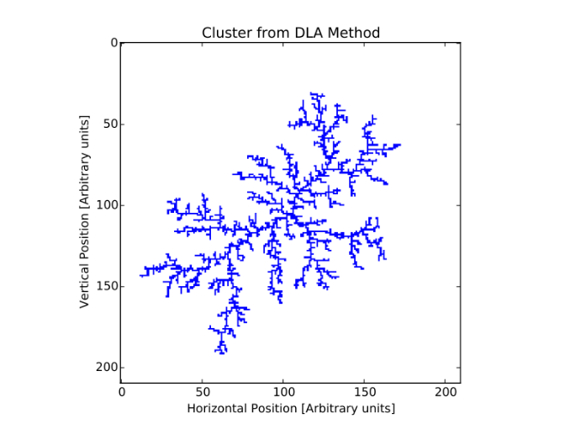
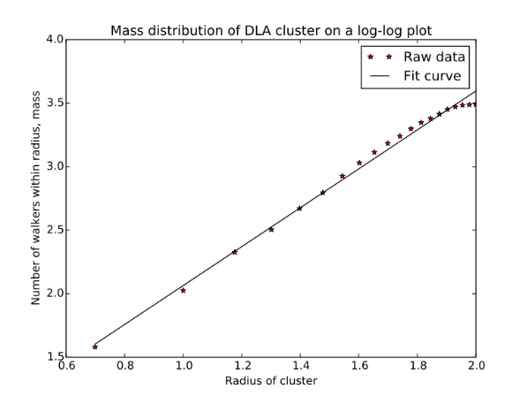
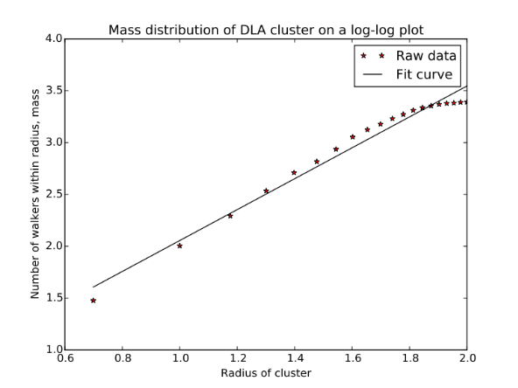
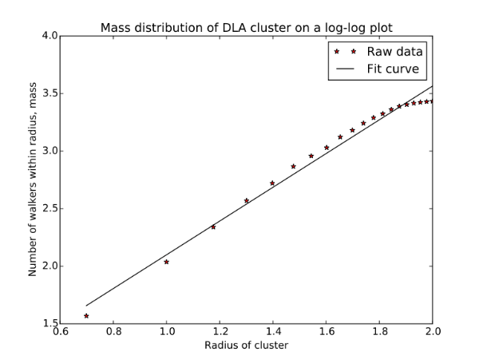
3. DLA Results
As expected: Irregular perimeter, many open spaces
Fractal Dimension=1.53
# of Walkers Used=17,349
Fractal Dimension=1.49
# of Walkers Used=15015
Fractal Dimension=1.47
# of Walkers Used=16,295

Slide 12
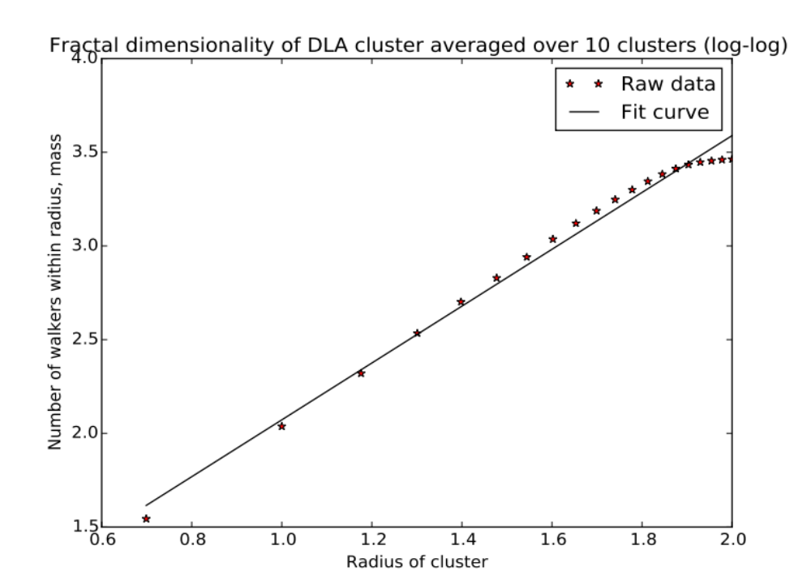
3. DLA Results – Average Over 10 trials
Average over 10 trials; fractal dimension= 1.516

