Slide 1

Simplifying your DevOps toolchain with a single platform, GitLab as an example
DevOps Meetup Zürich
16.03.22
Schlieren, Zürcherstrasse 39J, ZH

Slide 2
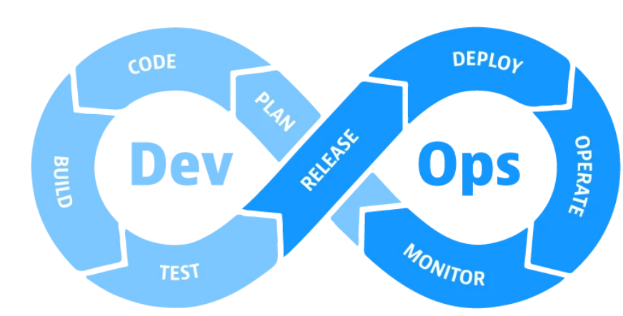
One mission: flowing

Slide 3
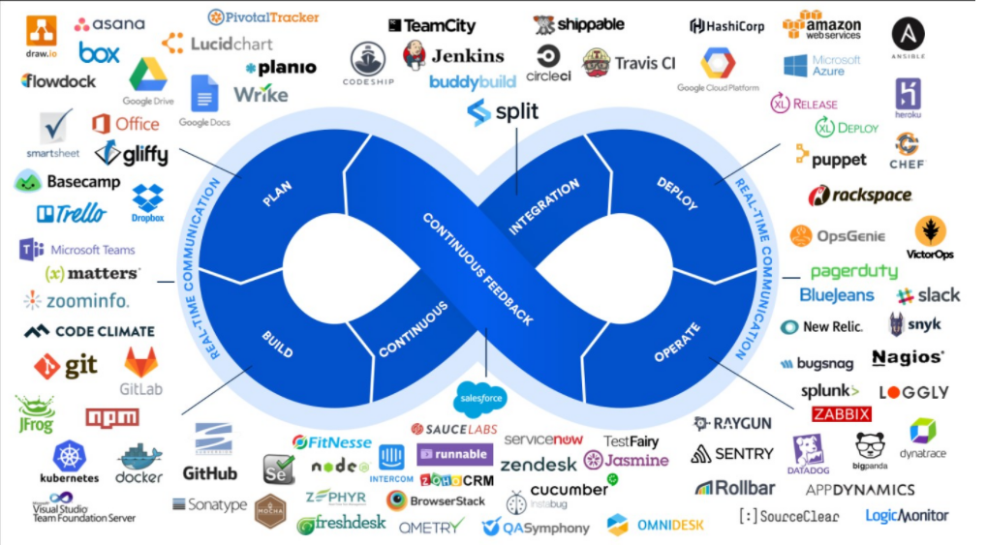
Tools for enhancing DevOps as a philosophy

Slide 4
Some downsides of this “tool atomisation”…
Starting with 5 obvious reasons…
CI/CD toolchain operators have many tools to maintain & care about
Developers must onboard to all those tools
Developers must know how to use all those tools
The integration of all the tools can be cumbersome and needs custom integration software or 3rd party solutions
Many tools = many licenses

Slide 5
What if there would be a better way ?

Slide 6



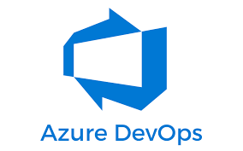

There are many “platform” options !!
Azure Devops, Github, Gitlab, Harness, JenkinsX, Cloud Bees, Circle CI, etc.

Slide 7
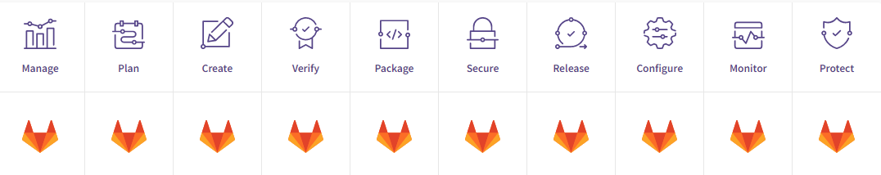
The promise made by gitlab

Slide 8
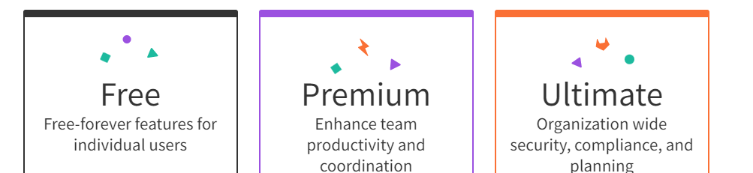
Gitlab & versions

Slide 9


Features of the free version

Slide 10
Enough talking ☺… What does a deployment look like with GitLab ?

Slide 11
2 DevOps paradigms:
CI/CD pushed base
vs
GitOps

Slide 12



Components & reversed architecture
Gitlab Runner
Gitlab Agent
Gitlab Main
(Self-hosted or SaaS)

Slide 13


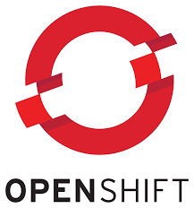

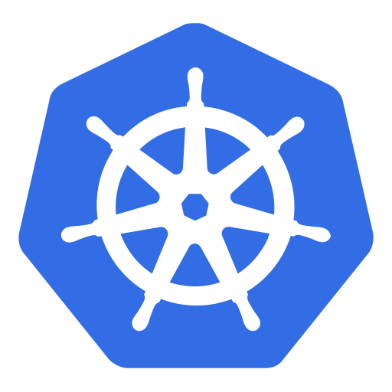
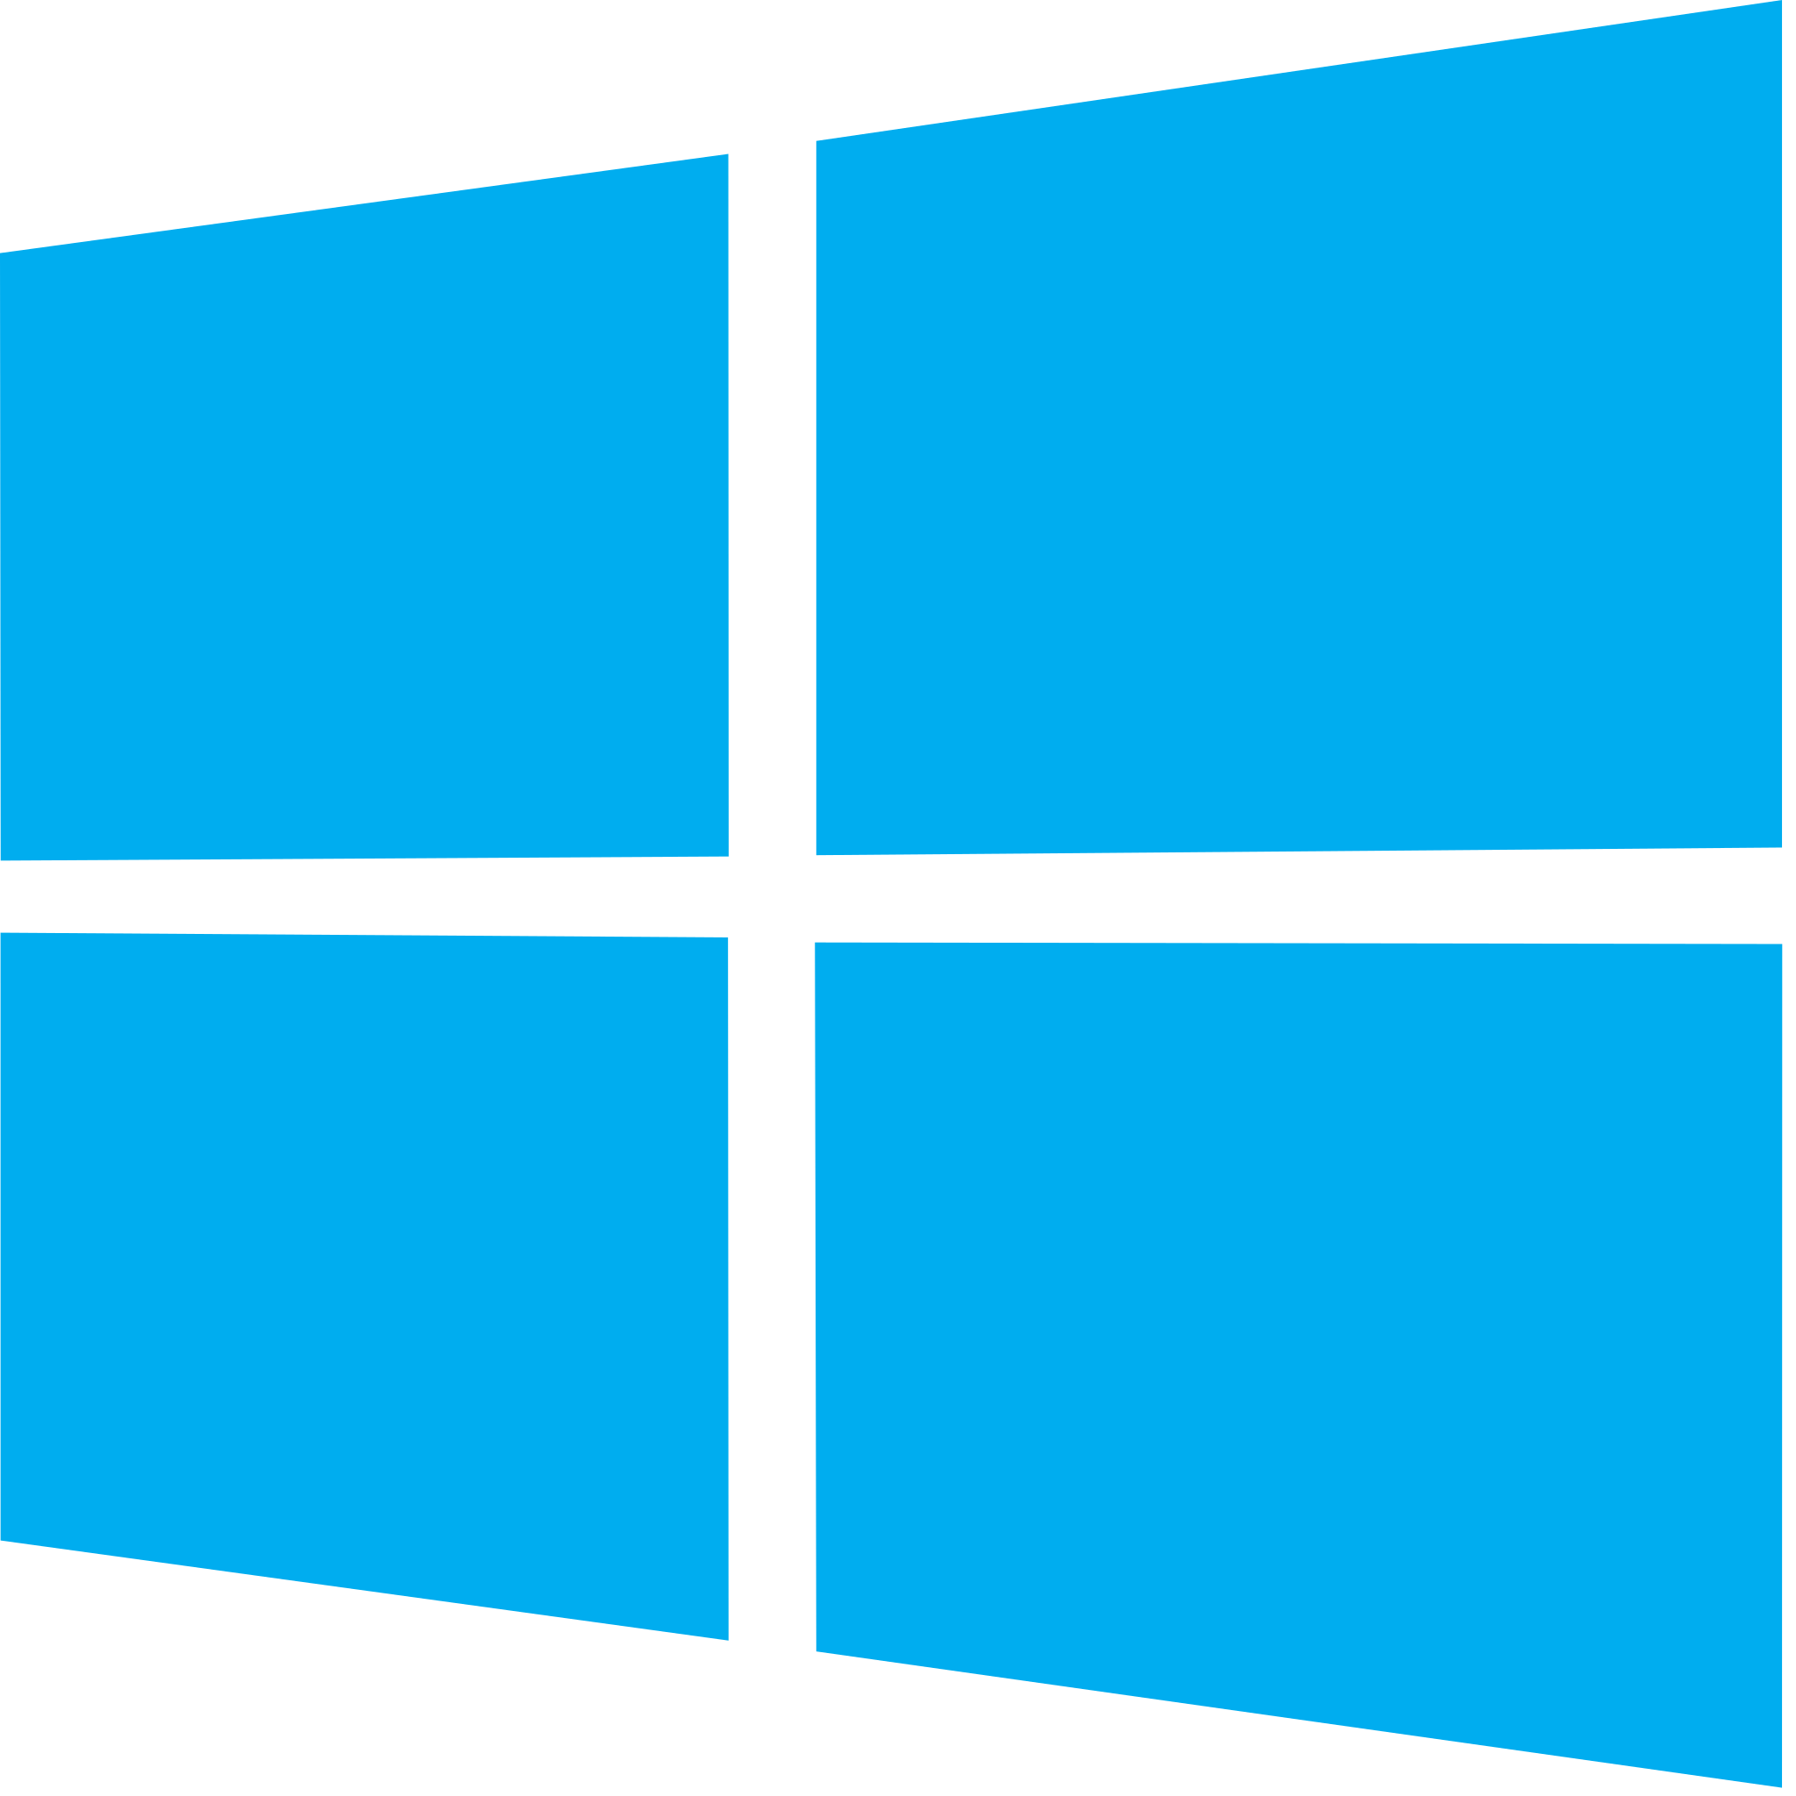
Platforms supported for installing those gitlab runners & agents
Linux
Docker
Kubernetes
OpenShift
Windows
Mac

Slide 14

Let see how this works and deploy an application to a Kubernetes cluster … ☺

Slide 15


DEMO
gitlab runner
gitlab.com

Slide 16




What I wished I would have covered
Stream Value Analysis
Features
Compliance
Features
Migration
strategies
Deployment in highly
regulated environments

Slide 17
Want to access to the material or any question?
https://github.com/kewinremy/
kewinremy@protonmail.com
linkedin.com/in/kewinremy
https://kewinremy.net/

Slide 18

Any questions ?

Slide 19
Thanks for your attention and …

