Slide 1





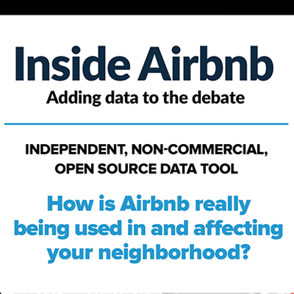

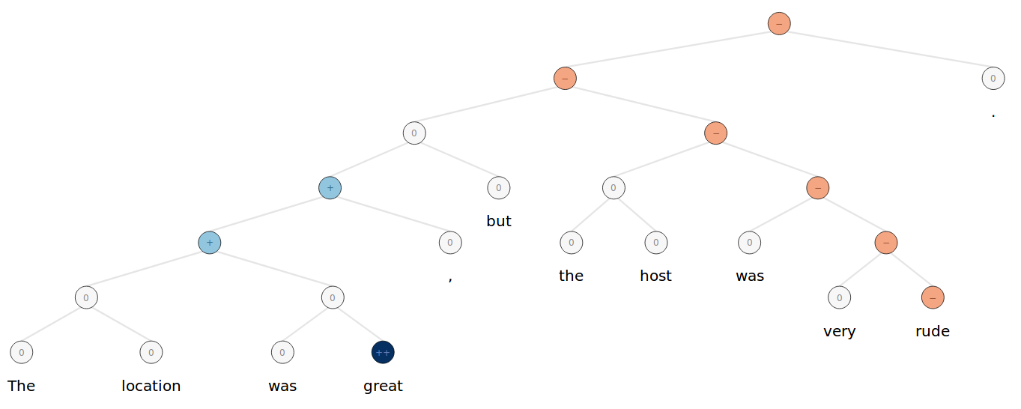
vs
Suprabhat Gurrala, Marc Marone, Aniruddha Nadkarni, Farhan Tejani, and Kexin Zhang
CX 4242, Georgia Institute of Technology
Motivation
Data Gathering
What options do short-term stay customers have?
The sharing economy has taken over a number of consumer industries, providing customers with many alternatives to traditional housing or transportation, with Airbnb being a major player in the space.
Airbnb
Pricing Over Time
Hotels
Airbnb pricing data was gathered by scraping using Selenium, a web scraping tool for Python
Amadeus, a travel technology company, provided us with the pricing data over time for the traditional hotels.
How do these options compare?
Options like Airbnb provide a wide variety of choices for consumers, but these also vary dramatically in the amenities provided and level of comfort, often unbeknownst to the customer. Hotels have a far more rigid pricing model, but the level of care is easily anticipated.
We used Inside Airbnb, a data collection platform that gathered the listing reviews from Airbnb itself and compiled them into a dataset.
Reviews
The Amadeus API provided a number of reviews for hotels, and that data was augmented by scraping reviews from TripAdvisor
The Inside Airbnb dataset also included columns for Location, in the form of Latitude and Longitude coordinates.
Location
We utilized the OpenStreetMap API to convert the hotel addresses to Latitude and Longitude coordinates.
Is there a clear winner?
We have conducted analyses on Airbnb and Hotel options in New York City. By identifying similar bookings across the two platforms, we determine which option provides the best return on investment for consumers.
Amenities for Airbnbs include kitchens, television, air conditioning, and others, and were included in the Inside Airbnb dataset.
Amenities
The hotel amenities data was provided by Amadeus and by TripAdvisor, and included data such as gyms, refrigerators, kid-friendliness, and others.
Approaches and Experiments
Results
Cluster Analysis
Directed Review Sentiment
Unified Search
Attempted to cluster by:
Latitude/longitude grid:
The hotel locations were too sparse to make comparisons.
Voronoi – Nearest subway:
Some cells were too large and regions with many hotels were broken up into too many small cells
Voronoi – K Means Centroid:
Clustered only hotel locations only with k=130 and then assigned each Airbnb listing to a centroid if they were within 1km. 36% of Airbnb listings were disregarded for being too far away from a center.
Our main visualization shows pricing data, but we also want to analyze subjective features
Reviews are good, but don’t have a standard format and are often only a single rating
Our method allows us to obtain sentiment scores towards specific aspects of a listing:
Location
Hospitality
Room Quality
Use the Stanford CoreNLP Library to obtain “sentiment trees”
Break the trees into subtrees (phrases)
Classify each subtree to determine the aspect
We can handle a single sentence with multiple sentiments towards multiple aspects!
Used ElasticSearch as a database and search backend.
Converted search string to a latitude/longitude pair using OpenStreetMap API.
Fed this pair into an ElasticSearch location query which returns a unified list of nearest Airbnb and hotels.

