Slide 1
June 21th, 2025
MLArchSys @Tokyo, Japan
SafeKV: Safe KV-Cache Sharing in LLM Serving
Kexin Chu, Zixu Shen, Dawei Xiang, Wei Zhang
School of Computing, University of Connecticut, CT, USA
Email: kexin.chu@uconn.edu
Notes:
Hello everyone, my name is Kexin Chu from University of Connneticut, today I'll present our work on SafeKV, a system designed to address privacy risks associated with Key-Value cache sharing in Large Language Model (LLM) inference.

Slide 2
Outline
Background
Motivation & Challenges
Our Approach
Preliminary Results
Conclusion & Future work
Notes:
Our presentation is structured as follows:
First, we introduce the Background and motivation behind our work.
Next, we highlight key Challenges.
We'll discuss our proposed approach (SafeKV), showing preliminary results.
Finally, we summarize and outline future research directions.

Slide 3
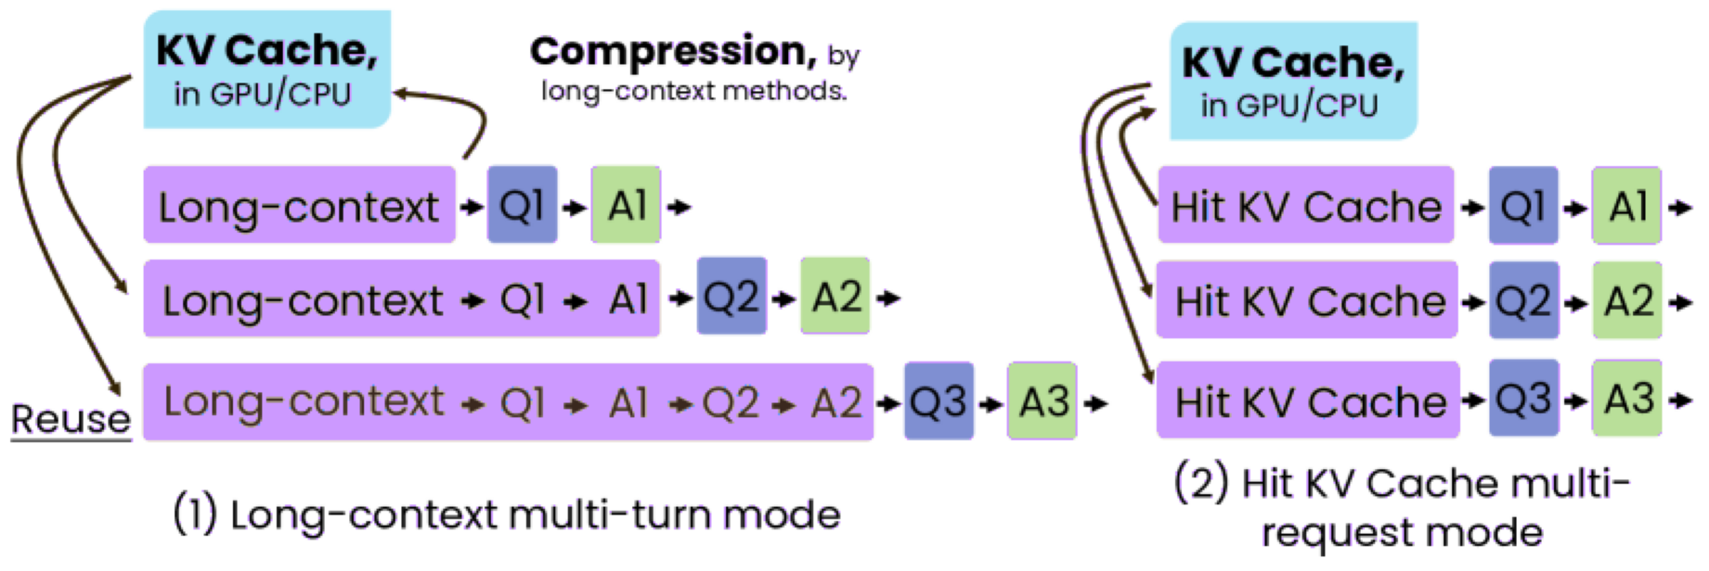
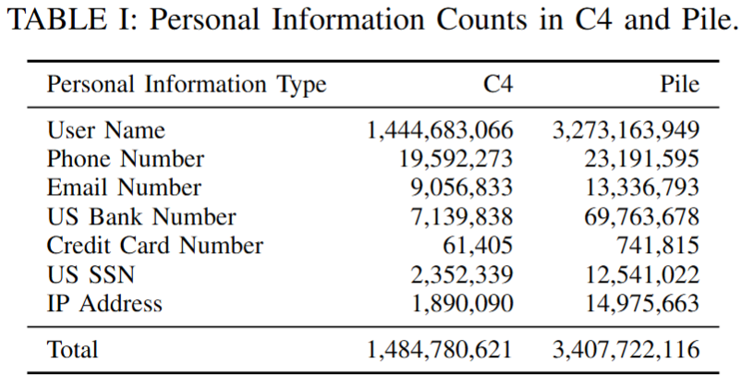
Background
KV-Cache sharing in LLM inference Improves performance sifnificantly
Mooncake^{[1]} improves the throughput by 5.25X
Sglang^{[2]} reduces latency by up to 3.7x and improves throughput by up to 6.4X.
KV Cache sharing increases the risk of privacy leakage: (Attackers can use Timing Side-Channel Attacks to obtain user’s personal information.)
[1]: Ruoyu Qin, .et.al. (2024). Mooncake: A KVCache-centric Disaggregated Architecture for LLM Serving.
[2]: Lianmin Zheng, et.al. (2024). SGLang: Efficienr Execution of Structured Language Model Programs.
Notes:
Large Language Models (LLMs) have significantly benefited from KV cache sharing, which dramatically improves performance，As shown in the figure, with KV cache sharing, there is no need to re-comppute the prefix prompts. And there are several works gains a significant benefits from KV Cache resue. For example:
Mooncake improved throughput by over 5 times.
SGLang reduced latency by 3.7 times and increased throughput by 6.4 times.
However, KV-cache sharing, despite its benefits, raises substantial privacy risks. Specifically, attackers can leverage timing side-channel attacks to extract sensitive user information. This table shows the personal information in datasets C4 and Pile. we can not ignore this type of risks.

Slide 4
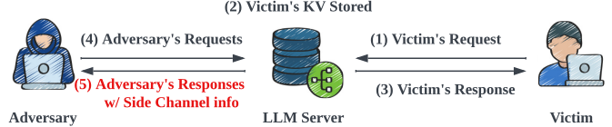
Background
Timing Side Channel Attacks
Exploits observable timing differences to infer private data.
Occurs in shared KV-cache environments of LLMs:
Attacker issues carefully crafted prompts and measures inference latency(mainly TTFT).
Low latency (cache hit) indicates the prefix was previously accessed (by victim).
High latency (cache miss) indicates no prior cache entry.
Step-by-Step Example:
Attacker probes with a potential prefix.
Measures time-to-first-token (TTFT).
Detects if victim has previously cached the same prefix.
Iteratively reconstructs sensitive information.
Black Box Attack
Notes:
Let’s briefly discuss how timing side-channel attacks function in shared KV-cache systems:
Attackers exploit differences in inference latency, mainly measuring the time-to-first-token (TTFT).
A low latency indicates a cache hit, revealing that the prefix token was previously provided by a victim.
A high latency signals a cache miss, meaning no victim provide this information.
In practice, attackers:
Probe the system using crafted prefixes. Then they measure the response latency.
If got an low TTFT, the attacker knows that they obtains an valid personal information from victims; and they continue to predict following tokens,
Gradually they can reconstruct sensitive information.
Notably, these attacks only require black-box access, making them particularly dangerous.

Slide 5
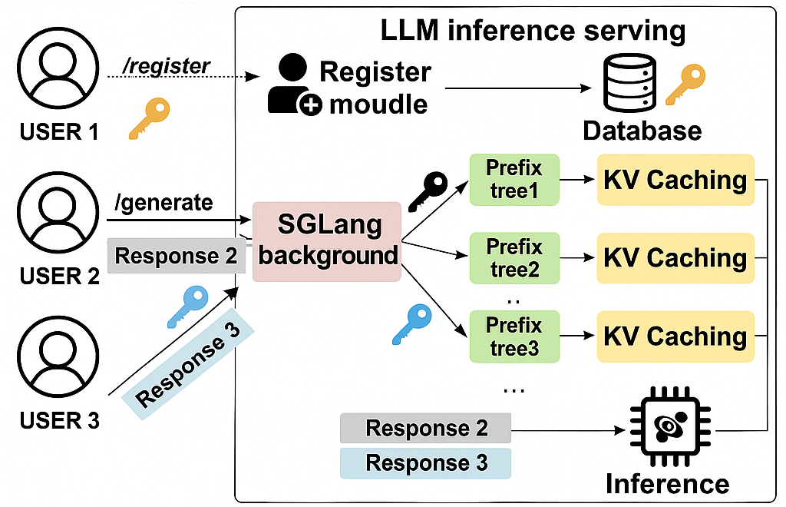
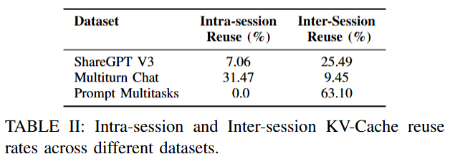
Background
Existing Work:
Pang^{[1]} use Cache Partitioning to Mitigate Timing Side-Channel Attacks;
In different scenarios, this partitioning solution will cause performance loss
[1]: Zixuan Pang, .et.al. (2024). Cache Partitioning for Mitigating Timing Side-Channel Attacks in LLM Serving Systems.
Notes:
Existing solutions primarily rely on cache partitioning to mitigate timing side-channel attacks, as explored by Pang, as show in the figure, each user has their own prefix tree, there is no reuse across users, so it can protect privacy information. However, this approach introduces considerable performance penalties because it isolates cache entries, thus sacrificing efficiency and limiting cache reuse significantly. For example. in prompt multitasks scenarios, there are mainly cross user KV-Cache Sharing requirement. if use seperated KV-Cache management, we will lose the improvement.

Slide 6
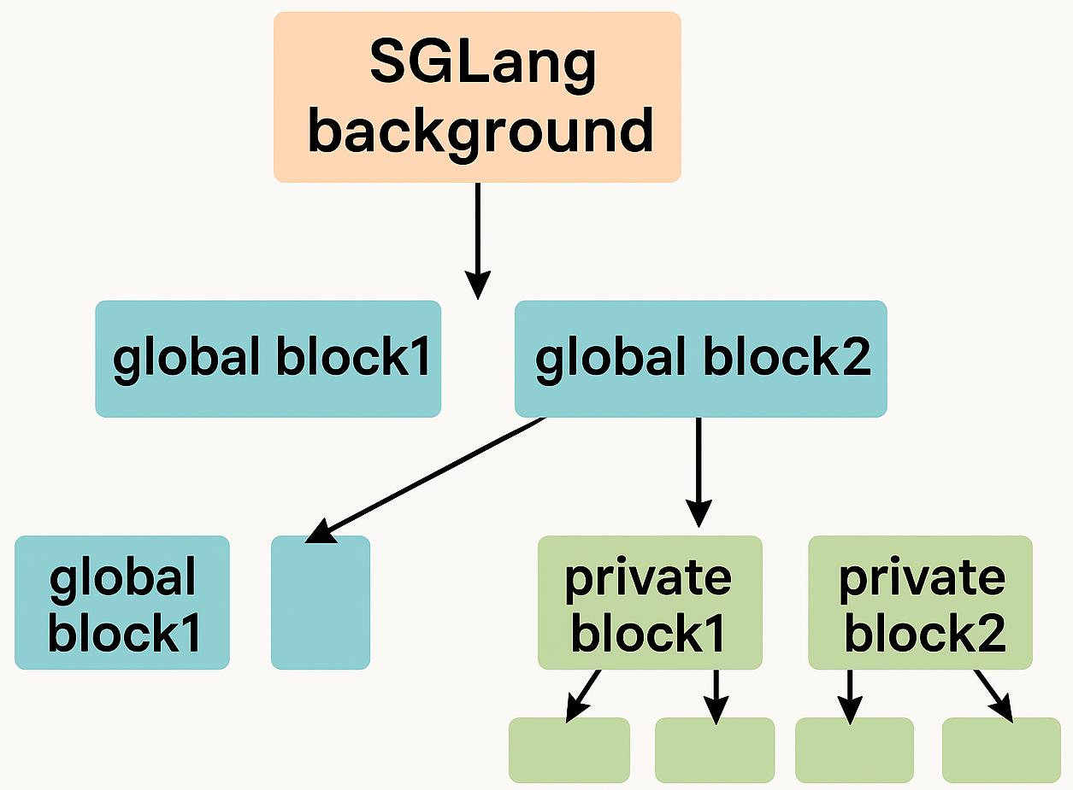
Motivation & Challenges
Motivation:
Achieve balance between performance and privacy
Only isolate KV-Cache blocks containing private data
Challenges:
Privacy Detection: Real-time identification of sensitive entries.
Cache Lifecycle Management: Efficient isolation without compromising reuse.
Cache Lookup Optimization: Maintaining low latency in cache lookups.
False Detection Mitigation: Handling misclassifications securely and effectively.
Notes:
To address these limitations, our motivation is clear: Balance performance with privacy protection by isolating only sensitive KV-cache entries. As shown in the picture, only some nodes with privacy informations is structured as privacy and isolated without reuse.
However, this goal introduces several technical challenges:
Privacy Detection: We need real-time methods to accurately distinguish sensitive parts from non-sensitive data.
Cache Lifecycle Management: Efficiently isolating private cache entries without sacrificing global reuse efficiency.
Cache Lookup Optimization: Maintaining low latency during lookups across multiple cache types.
False Detection Mitigation: Effectively managing scenarios where privacy detection might incorrectly classify data.

Slide 7
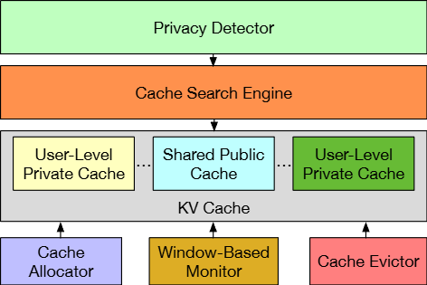
Our Approach
Overview:
Privacy Detector (ChunkGuard): Classifies sensitive content at chunk-level.
Cache Search Engine: Supports efficient batch lookups.
KV-Cache Management: Unified management of global sharing public KV-Cache and User-level private Cache.
Cache Allocator: Adaptive provisioning of private/shared caches.
Cache Evictor: Clean up expired/attacked KV Cache blocks based on privacy-aware policies
Windows-Based Monitor:Anomaly-aware protection against timing attacks by monitoring KV Cache block reuse frequency.
Notes:
In response, we introduce SafeKV, a privacy-aware selective KV-cache sharing architecture. The main components include:
ChunkGuard: Real-time detection of sensitive content at the chunk level.
Cache Search Engine: Efficiently handles batch processing of KV-cache lookups.
KV-Cache Management: Unified management of both shared public caches and isolated private caches. it contains two main parts:
first, Adaptive Cache Allocator: Dynamically provisions memory resources between private and public caches based on real-time demands.
then, Privacy-aware Evictor: Cleans up potentially compromised or expired cache entries using privacy-aware policies.
Finally, is the Windows-Based Monitor: Actively monitors for anomalies indicative of timing side-channel attacks.

Slide 8
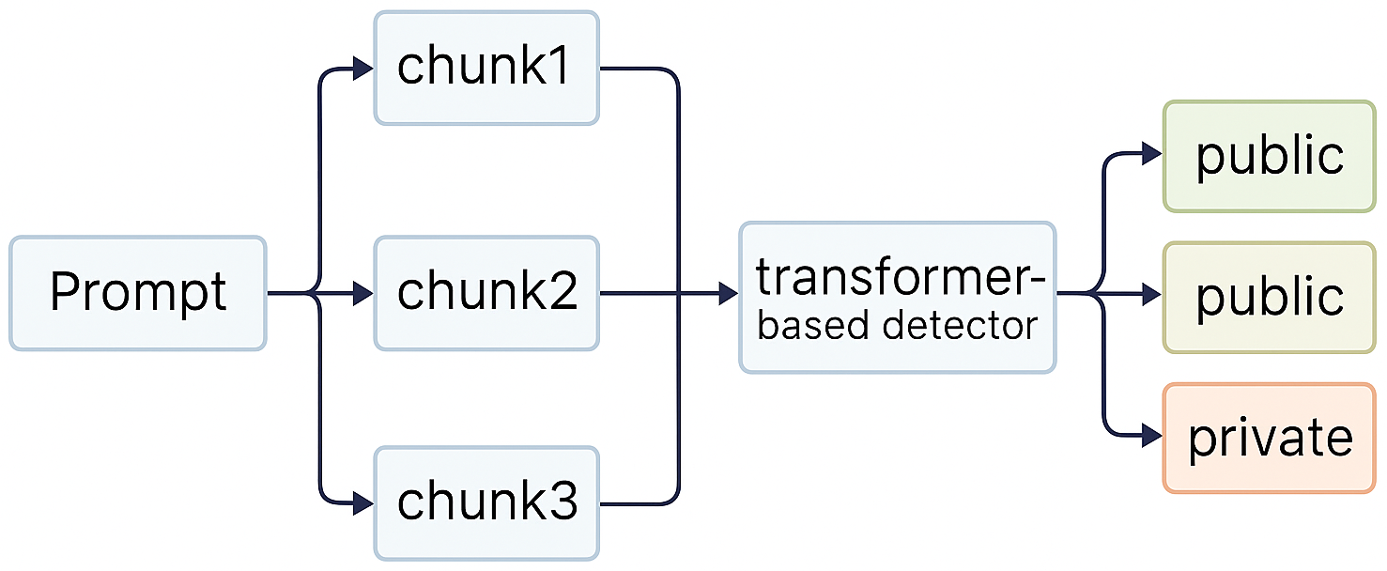
Our Approach
ChunkGuard – Privacy Detection:
Segment prompts into fixed-size chunks.
Lightweight transformer-based model classifies chunk’s privacy.
Routes sensitive data to private caches, safe data to shared cache.
Cache Search Engine:
Based on fix-size blocks, split prompts, batch requests the KV-Cache reuse tree.
Adaptive Cache Management:
Allocator dynamically adjusts cache memory based on real-time privacy demands.
Privacy-Aware Evict Policy: Allocate memory space to private and public KV cache respectively & Use LRU Policy
Windows-based Monitoring:
Notes:
Let's delve deeper into key innovations:
ChunkGuard: It segments prompts into fixed-size chunks, classifying their privacy status using a lightweight transformer-based model. This enables routing sensitive chunks into isolated caches, while safely sharing non-sensitive data.
Cache Search Engine: Uses a fixed-size block-based approach, efficiently batching requests for cache lookups, significantly accelerating the reuse detection process.
Then is the Adaptive Cache Management:
The Cache Allocator adjusts cache allocations in real-time, adapting to privacy-sensitive workloads.
The Privacy-Aware Eviction Policy leverages an LRU strategy with privacy considerations, actively maintaining privacy integrity.
Finally, the Windows-Based Monitoring: Continuously monitors cache block usage frequency to identify and mitigate anomalies indicative of potential privacy breaches.

Slide 9
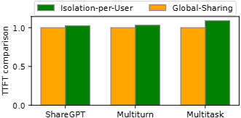
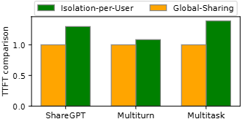
Preliminary Results
Env:
sglang 0.4.6
NVIDIA A6000 x 2
Preliminary Results:
Compared Isolation vs. Global-Sharing using LLaMA-2 (13B, 70B).
Isolation significantly degrades performance, especially for larger models(8%~38.9%).
(a) Llama2-13B
(a) Llama2-70B
Notes:
We implemented a preliminary version of SafeKV using SGLang v0.4.6 on two NVIDIA A6000 GPUs, and tested on LLaMA-2 (13B and 70B):
Our evaluations compared isolated KV caches per user against global sharing.
Results confirmed that full isolation significantly degrades performance, especially with larger models—introducing overheads ranging from 8% to 38.9%.
These findings clearly demonstrate the necessity of our selective sharing approach.

Slide 10
Conclusion & Future work
Our Selective KV-Cache sharing architecture(SafeKV) balances performance and security; and enables safe reuse of non-sensitive cache entries while isolating sensitive data.
Our ChunkGuard method provides real-time lightweight privacy detection and improves batch searching speed.
Future Directions:
Complete SafeKV prototype implementation.
Further reduces latency and enhance robustness.
Explore broader scenarios and real-world deployments.
Notes:
In conclusion, there is a significant potential for SafeKV to addresses the critical trade-off between performance and privacy in LLM inference, especially for bigger LLM models:
It selectively isolates sensitive KV-cache data, allowing for efficient and secure global cache reuse.
Our ChunkGuard mechanism provides lightweight, real-time privacy detection, significantly enhancing overall system efficiency.
Looking forward, our future work includes:
Completing a fully functional SafeKV prototype.
Further optimizing latency and enhancing robustness against advanced attacks.
Exploring deployments in broader, more complex, real-world inference scenarios.

Slide 11
Thank You!
Notes:
Thank you very much for your attention.

