Slide 1
News Popularity Analysis and Prediction
Kexin Wang
MSDS 699 ML LAB Final Project
Notes:
Hi every one,
Thanks for sharing time on my project. My project is about news popularity analysis and prediction

Slide 2
Workflow
Introduction
.
05
Future work
01
04
Conclusion
Why work? Why not work?
Data Engineering
Features & Targets
02
03
Model
Grid search
Random search
Validation
Notes:
This presentation will cover these following part, introduction of my project, what data I used and how I used them, model selection, conclusion part and the future work

Slide 3

Introduction
Binary
classification
Notes:
In this information era, reading and sharing news have become the center of people’s entertainment lives. How to define the concept of popular? We always think about the number of shares under a news article,. In this project, we intend to find the best model and set of feature to predict the popularity of online news, using machine learning techniques
this project is a binary classification problem (popular or not ) and I mainly use weighted F1 score to evaluate the performance.
I will give more details about the evaluation metric in later slides, so I would just call it accuracy for easy understanding in the next following slides,

Slide 4

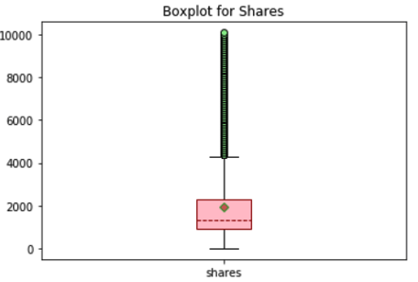
Data Engineer
Data source: UCI machine learning repository
2. Data size : 39644 rows 61 columns
3. Target variable: shares
numerical to categorical (popular or not)
Features: choose 59 features, like data_channel_is_tech, rate _negative_words
Median
1400
Notes:
Our data is from UCI machine learning repository, this comes from comes from Mashable, a well-known online news website.
the dataset contains over 39 thousands rows and 61 columns. The last column is our target variable – shares.
I use the median to transform it to 2 categories, the median of share is 1400, if it is large than 1400, label as 1. otherwise label as 0
There are totally 60 features, I used 59 of them and skip the column url, since I did't plan in include that string format feature in this project

Slide 5
Data Engineer
Column Transformer
Categorical Variable
Continuous Variable
Customized function to change dtype
SimpleImputer : constant
OneHotEncoder
StandardScaler
SimpleImputer : median
PCA
Notes:
To process these features, I mainly use COLUMN TRANSFORMER
This is the big picture of my data enginner step, I would explain 2 points I think it is most interesting
Customized function as in original dataset all data types are numerical
The second point is I perform pca on continuous set as I think there are too much features, let jump to the next slide

Slide 6
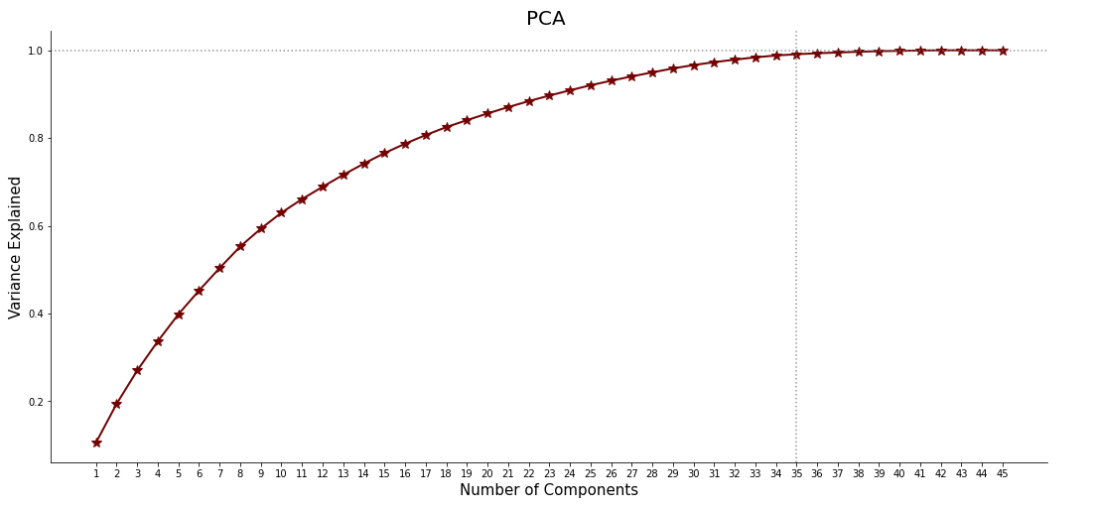
Data Engineer
RADE OFF ?
Notes:
As we all know, a full feature set may include much noise. So I would like to perform PCA on the continuous set as it contains too much features.
The right plot indicates the relationship between the number of components PCA gives, and the total variance they explained.
It is clear than when the number increase to 35, almost 100% variance can be explained so I set n_components as 35.

Slide 7
Model Selection - Grid Search
Use 2/3 of the training data
65.09%
64.64%
64.51%
64.42%
63.28%
Random
Forest
ExtraTree
Classifier
Linear
Support
Vector
Machine
Logistic
Regression
Light
Gradient
Boosting
Machine
max_features : sqrt
min_sample_split : 2
n_estimators : 200
Notes:
The next part is how I do model selection.
For grid search, I use 2/3 of original training data and totally use 5 models
Which are logistic regression, linear SVC, random forest , extra tree classifier and one boosting model : light gradient boosting machine
Then I use the left 1/3 to test, random forest perform the best.
So I would like to explain why I would like to split the data, since I would do randomized search on overall training data in later step,
so for this grid search, my goal is to have a general ideal about each model performance to do further parameter search

Slide 8
Model Selection - RandomizedSearchCV
Randomforest
ExtraTree
Logistic Regression
Linear SVC
LGBM Boosting
n_iter = 15
cv = 5
Notes:
The next step is randomized search CV, as what we learnt from the class,
First I create a dummy estimator and then put the model and relevant hyperparameters into this randomized search with cross validation
The setting of randomized search cv is listed here as well.

Slide 9
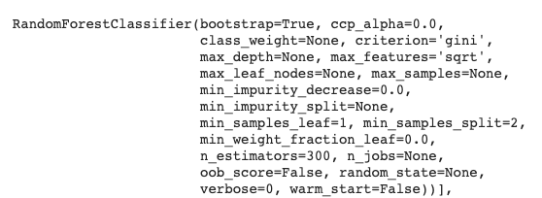
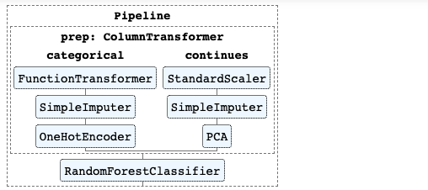
Final Model
Train : 65.23% Test : 64.69%
Notes:
From the randomized search cv results, the best model is still random forest with the following hyperparameters. which means there is no overfitting on our model. Also, although the number is not as high as 99%, I still think the performance is good.
What’s more, I have read some paper which do research with this dataset, similar topic,
The highest accuracy is not higher than 70% , so I believe this performance can be considered good work.

Slide 10
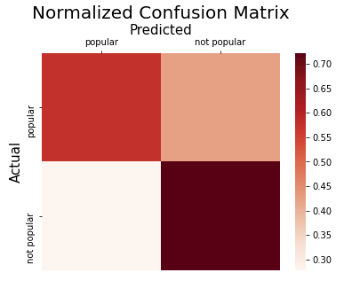
Model Validation
Normalized Confusion Matrix
Cross Validation : F1 weighted score
Notes:
How I evaluate the model performance?
The first metric I used is normalized confusion matrix, the y-axis is the actual label (popular or not), the x-axis is the predicted label.
I would skip too detailed information but just let u know what a good model will looks like. So if the model is good enough, we want the corner of upper left and lower right be darker and the left 2 corner can be as light as possible.
From our confusion matrix, the upper left and lower right is obviously darker, which means the model performed well.
The second metric is weighted f1 score based on cross validation, u can consider f1 weighted score as the summary of the upper left and lower right. Beside, cross validation can give us a more robust result.

Slide 11
Conclusion
Why random forest perform the best?
Business impact
Limitation
Notes:
Then another question come, why random forest would give the best performance,
Compared with Logistic, Linear SVC, LGBMClassifier, Random Forest use the ensemble method which composed of multiple trees and use majority vote to make final decision. The magic of improved performance is often the reduction in the variance of predicted errors made by its contributing models.
Compared with ExtraTreeClassifier, Random Forest use bootstrap replica but ExtraTree use the original whole data, so ExtraTree may get higher variance. Besides, Random Forest choose best split to minimize loss while ExtraTree use random value. Therefore ExtraTree add randomization.
I think this topic would bring great value to the real business, if we could accurately predict the popularity of news prior to its publication,those social media workers (authors, advertisers, etc) can make certain changes on it.
For the limitation, I think my project doesn’t cover all dimension of a news so there are still a lots of space to improve

Slide 12
Future Work
Model Space
- NN or other DL models
Feature Space
- Combination of NLP and my pipeline
Notes:
For the future work,
For model space, we can explore more like neural networks or other deep learning model
For feature space, it would be interesting if we can get the original news, really look at their content and do NLP analysis,
It would be interesting if we can combine this NLP analysis and my current pipeline

Slide 13
Thanks! kwang58@usfca.edu

