Slide 1
Organization
Ke Xu, Ph.D.

Slide 2
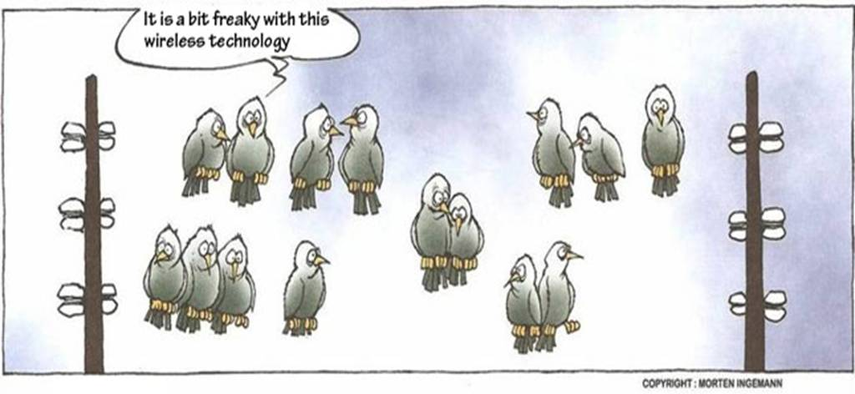
Leading Semiconductor Industry
#1
#1
#1
#4
WIRELESS
COMPANY
FABLESS
COMPANY
RFIC
COMPANY
SEMICONDUCTOR
COMPANY

Slide 3
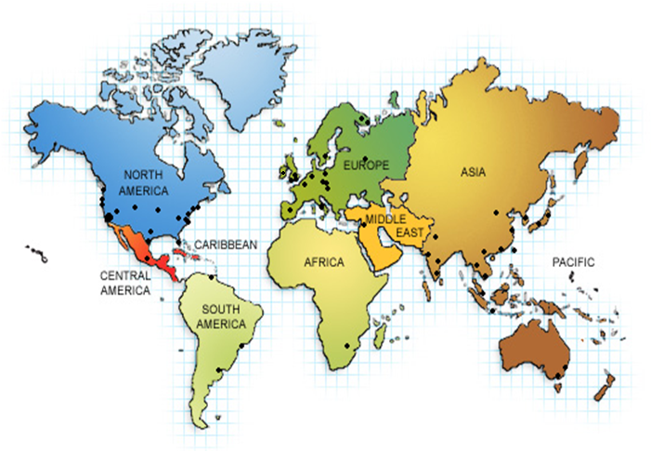
Global
30,000+ employees in 144 worldwide
office locations
Offices in:
North America
Middle East
South America
Australia
Europe
Africa
India
Asia

Slide 4
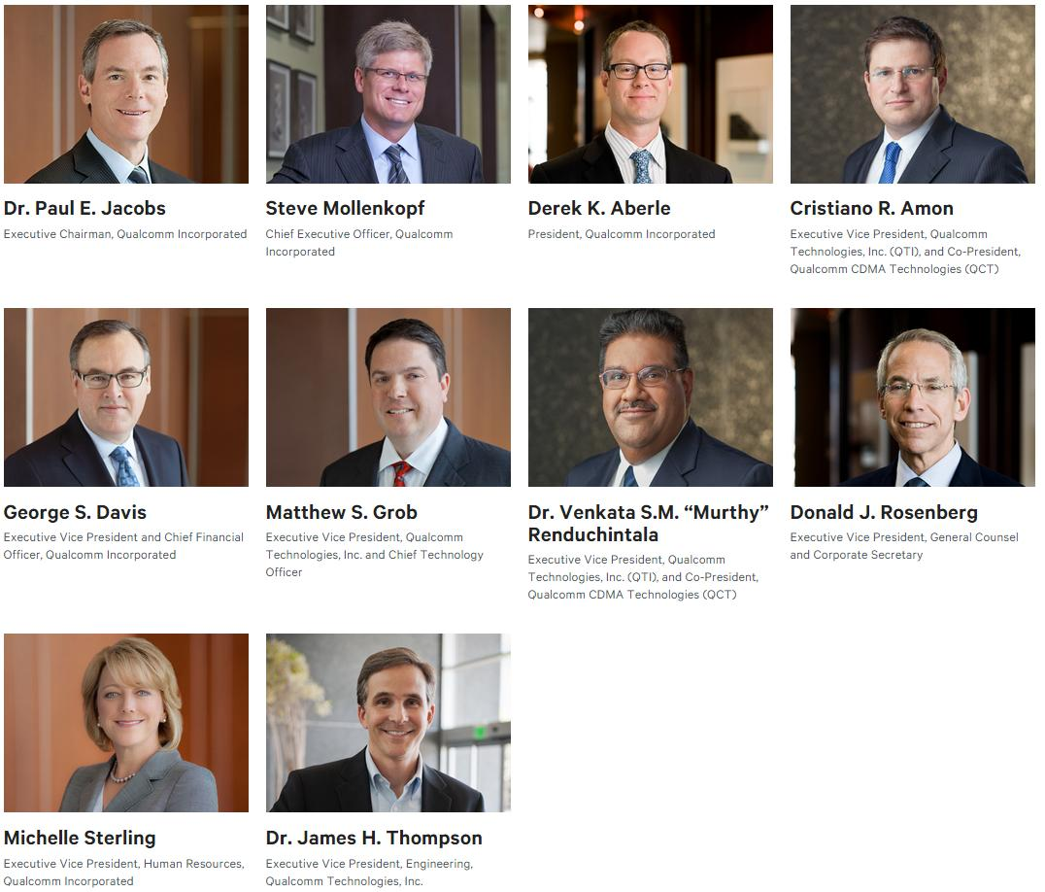
Executives
3 PhD
6 Glasses ☺

Slide 5



Engines
QTL
QCT
QWI
Technology
Licensing
Semiconductor
Business
Wireless
Internet

Slide 6
Corporate Structure
QCT
QTL
QWI
Qualcomm CDMA Technologies
Qualcomm Technology Licensing
Qualcomm Wireless and Internet
The largest provider of wireless chipset
Qualcomm Mobile Computing
Qualcomm Atheros
Qualcomm Innovation Center
Manages Qualcomm’s extensive IP
Qualcomm Internet Services
Qualcomm Government Technologies
Qualcomm Firethorn Mobile, Inc.
Qualcomm Enterprise Services
CORPORATE
ACTIVITIES
QSI
OTHER
BUSINESSES
Qualcomm Strategic Initiatives
Engineering
Qualcomm Research
Qualcomm Corp. Engineering Services
Office of the Chief Scientist
Qualcomm Ventures
Qualcomm MEMs Technologies, Inc.
Qualcomm Life, Inc.
SnapTracs, Inc.
Qualcomm Labs, Inc
Shared Services
HR QREF IT
Legal Marketing & IR Security
Finance Gov’t Affairs GBO

Slide 7




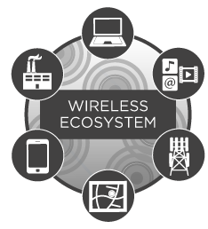

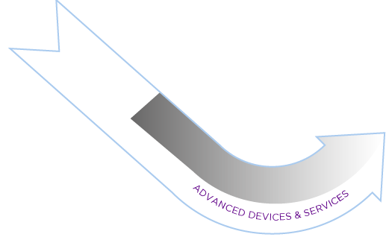
Business Model

Slide 8
All-in-One Snapdragon
Location
Multimedia
Power
Management
RF
DSP
CPU
GPU
Modem
Software/
HLOS
Memory
Connectivity

Slide 9
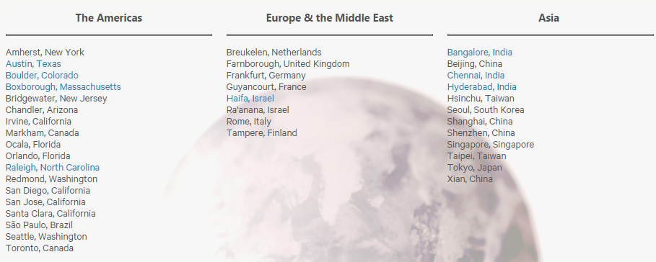
Q CDMA Technology
20, 000 employees
38 locations

Slide 10
Departments

Slide 11
Multimedia

Slide 12
Staffing - Video

Slide 13
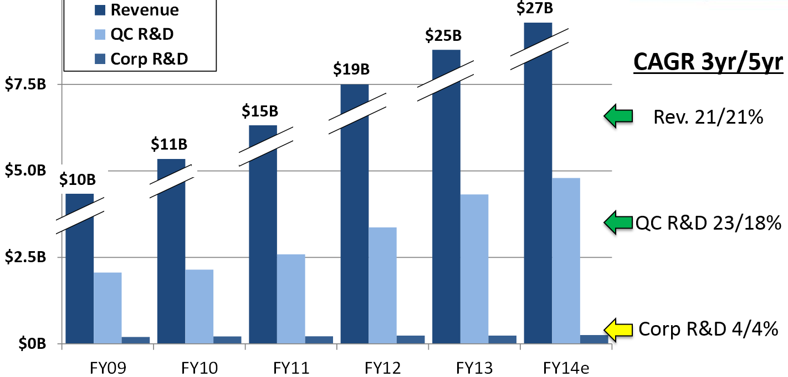
Growth Rate

Slide 14
Thank you!

