Slide 1
Mobile SoC Architecture
Simulation & Emulation
Ke Xu, Ph.D.

Slide 2
Arch
Sim
Emu

Slide 3
Philosophy
Past
Modem with
integrated multimedia
Now
Apps Processor with integrated modem
Behave and execute like a
multimedia application processor
with best in class integration

Slide 4
Goal
Structured Design Methodology
Use case → area, power & performance targets
Feedback Quick Integration
Incorporate competitive analysis findings
Outcome
Candidate architecture evaluation
Early software input & driver development
Proactive with customer for next-gen requirements
Leading-edge chips – functionality, power & performance
Commercialize new design quickly
Increased market share and customer satisfaction
Less software churn

Slide 5
Fields
Architecture spec &
documentation
Use-case development
Multimedia architecture
Architecture analysis
Use-case driven candidate arch. Design & modeling
Peripherals
Chipset architecture
Technology roadmap
Security
Modeling & simulation tools
Modeling & simulation tools
OS architecture
Resource & memory management
API definition
Device driver framework
Software subsystem partition
Domain experts
Interprocessor communication

Slide 6
Abstract View

Slide 7



CPUSS
Scorpion
Krait
Hydra
1st gen
ARMv7 architecture
32bit
65nm & 45nm technologies
2nd gen
ARMv7 architecture
32bit
28nm & 20nm technologies
3rd gen
ARMv8
AArch64 & AArch32
14nm & 10nm technologies

Slide 8
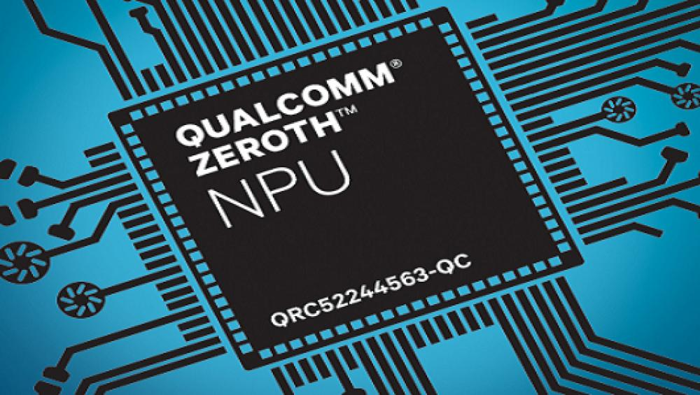

Zeroth
Smart phone that learns
Before the “cloud”
Brain inspired ML on device
Data privacy & work offline

Slide 9
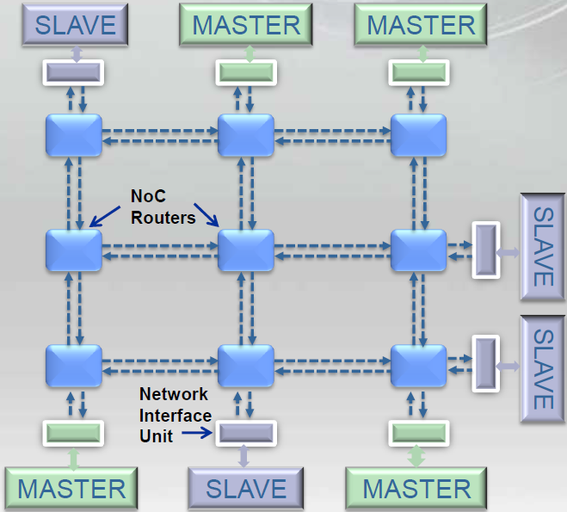
NoC – Network on Chip
On-chip bus-based scaling problem
NoC – Plug & Play
Unified streaming interface
Faster time-to-market

Slide 10
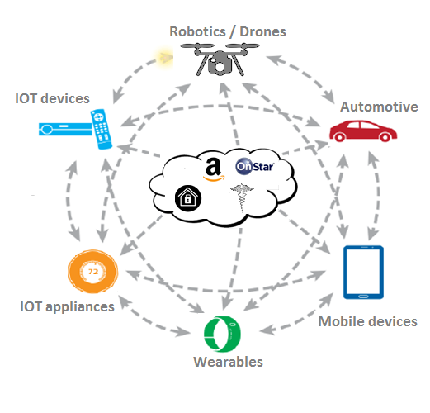
Sensor Hub
Who am I? | User Authentication
What am I doing? | Personalized Services
Where am I now / going? | Navigation
What events occurred? | Life Logging
How am I? | Health & Wellness: Heart Rate; Stress/Mood Detection; Sleep Quality; Skin Temp; Hydration
What do I need? | Environment Monitoring & Control

Slide 11
Arch
Sim
Emu

Slide 12
Product Revisions

Slide 13
Simulation
Core simulation
  Subsystem
    Block level
    Core level (end-to-end)
  Functional: RTL vs. Golden
    Text file comparison
  Coverage 100%
    High level coverage
    RTL: functional coverage, code coverage
SoC simulation
  Virtual platform

Slide 14
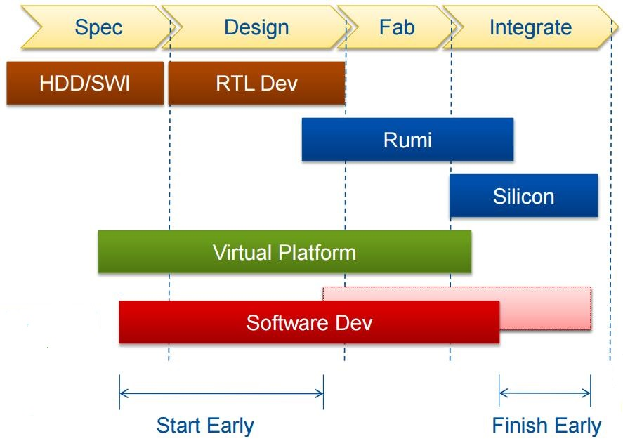
Virtual Platform

Slide 15
Virtual Platform
Language – SystemC
  Parallelism, event synchronization
High abstraction level
  Transaction Level Modeling (TLM)
Commercial tools
  Synopsys Virtio

Slide 16
Virtual Platform Benefits
Functional accurate
Complete system model
Execute unmodified code and binary compatible to silicon
Available early as pre-silicon
High visibility & good debugability
Fast simulation: 5 ~ 50 MIPS
Easy to deploy: run on a PC

Slide 17
Arch
Sim
Emu

Slide 18
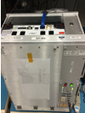
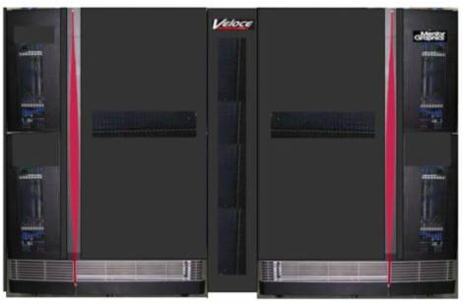
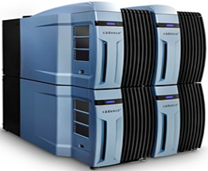
Flow
Project Setup
Q-build
VELOCE (Mentor)
2. Run
2. Run
Compilation
PALLADIUM (Cadence)
1. Build
Job
scheduler
2. Run

Slide 19
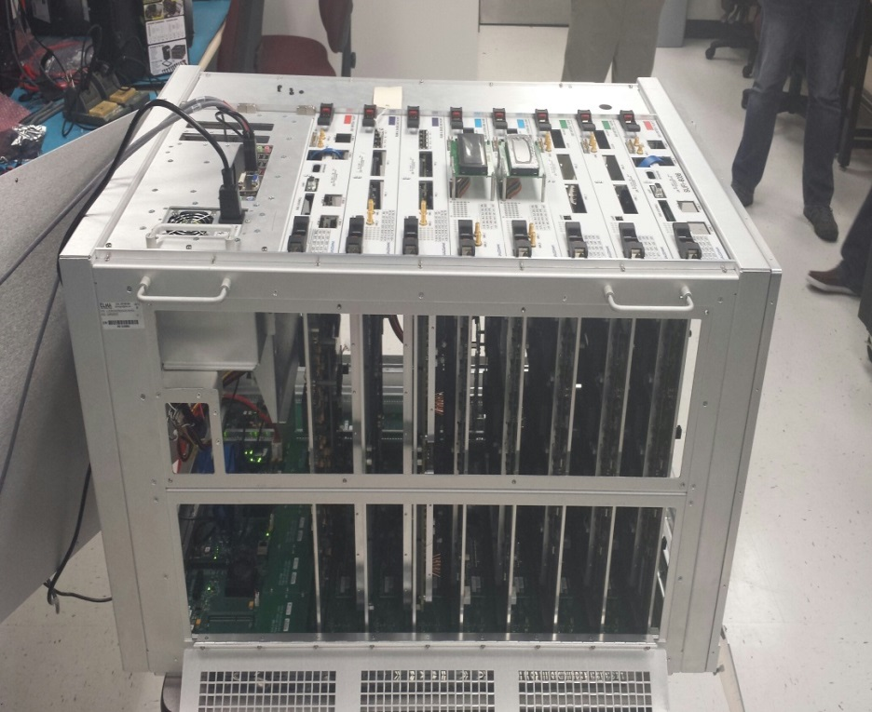
Q-build
8 slots, 138 FPGA 800M ASIC gates
Cost ~$350K per unit
Complete remote access

Slide 20

Utilization
 | Peripherals | Video | GPU | SoC
FPGA # | ~3 | ~6 | ~20 | ~60
Gate counts | ~16M | ~31M | ~90M | ~312M
Design performance: 10MHz ~ 20MHz

Slide 21
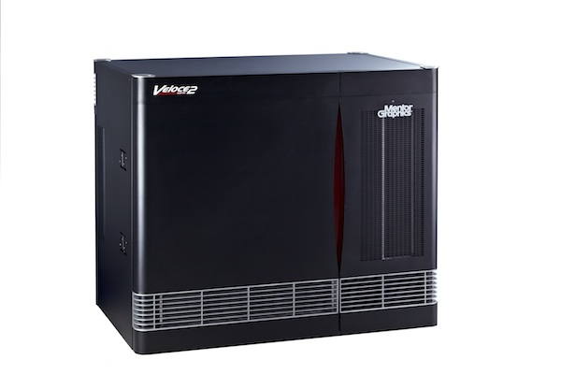
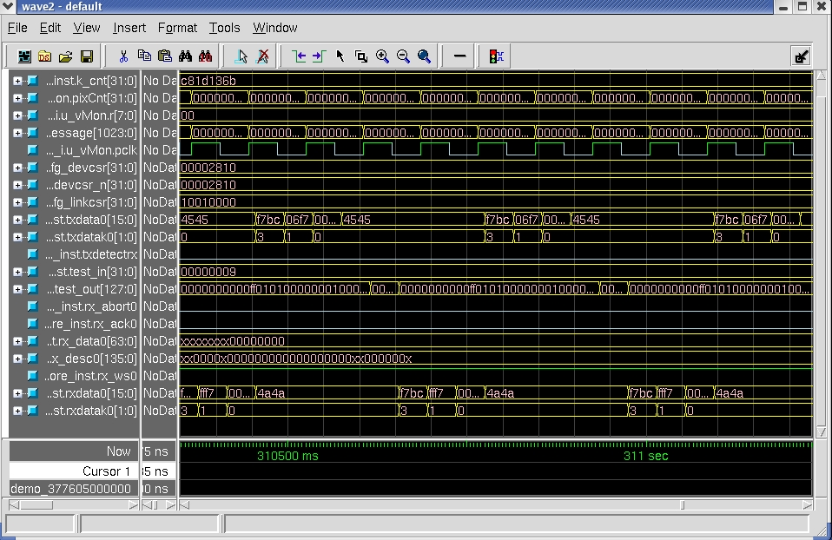
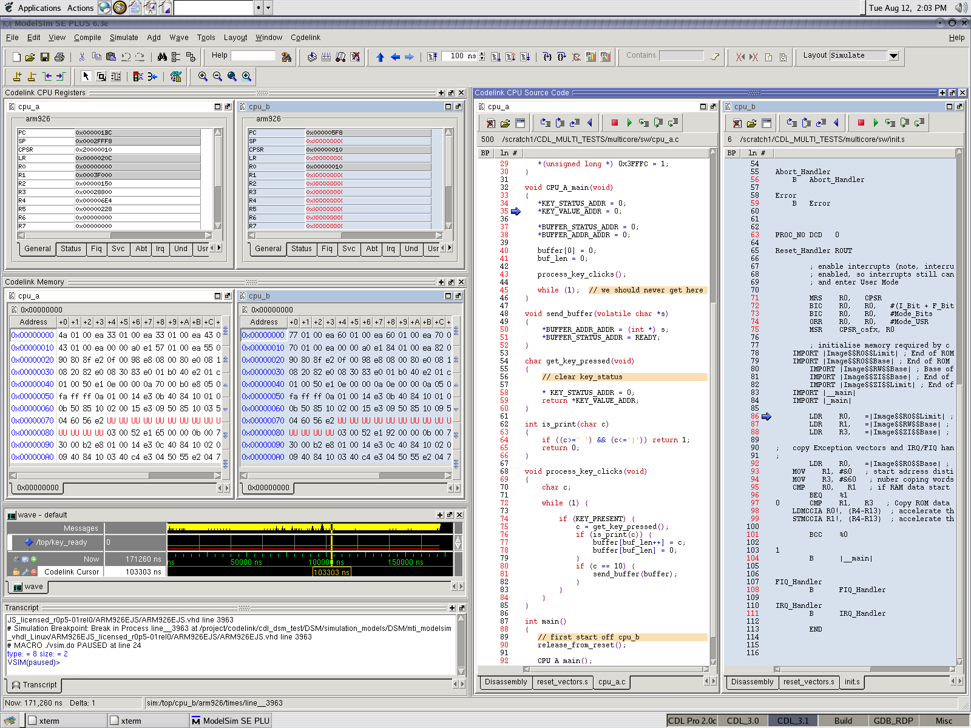
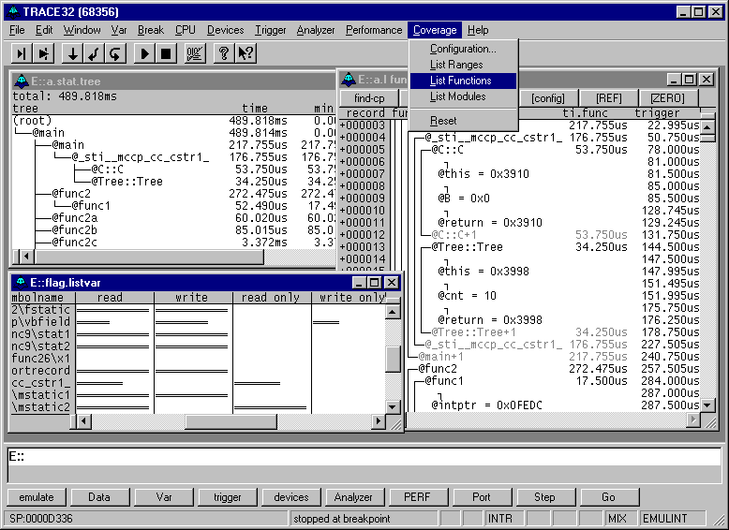

Veloce
Integrated Software
Debugger
Lauterbach,
3rd party
Waveform View
Integrated Software
Debugger
Lauterbach,
3rd party
Waveform View
Codelink replay database

Slide 22
Co-emulation

Slide 23

Thank you!

