Slide 1
Mobile Video System
Ke Xu, Ph.D.

Slide 2
1
2
3
4
5
Overview
Architecture
Decoder
Encoder
MISC

Slide 3
A Competitive Solution
Fundamentals
Opportunities to differentiate
Performance
Video Quality
4K 30/60/120fps
Pre & post-processing
Power
Editing & Sharing
4K thermal issues
Enabling fast editing & Sharing
Codec & Features
Streaming & Video Chat
HEVC, SHVC, VP9, 10 bit
Video communication over Modem
Die Size
Video HW for other use-cases
Lowest possible cost
Video analysis, Computer vision

Slide 4
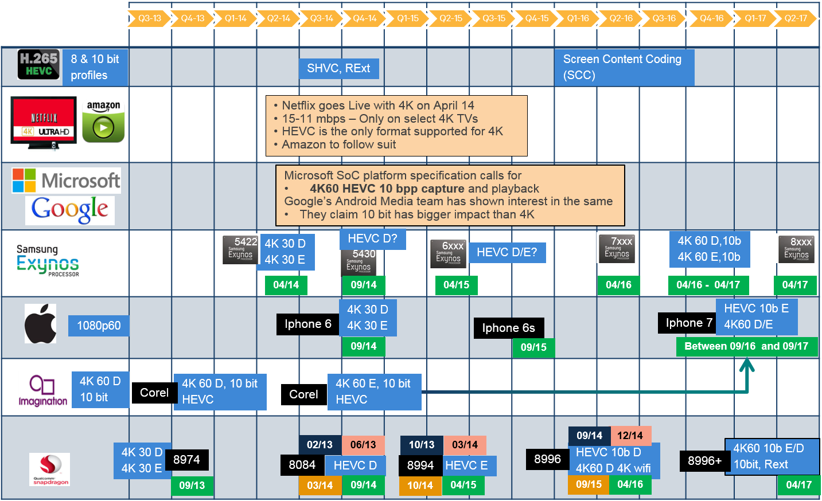
Market Trends

Slide 5
Basic Usecase
WiFi Display
Camcorder
Video Playback
Video Streaming
Video Telephony
Encoder + decoder
Miracast 2.0
4K, 10bit, 422 or 444
Encoder
1080p or UHD
Not 4K yet
Decoder
4K 60, 4K 120?
Decoder
Encoder + decoder

Slide 6
Video Codec Solution
  Hardware IP Core
  Dedicated Video IP core.
  DSP Video
  Fully or partially (hybrid) DSP accelerated based solutions.
  Software Codecs
  Optimized software solutions (licensed or developed in-house).

Slide 7
1
2
3
4
5
Overview
Architecture
Decoder
Encoder
MISC

Slide 8
System Overview
A: host and ARM communication via general registers
B: host and ARM data exchange via system memory
C: host access HW SWI registers directly (debug mode)
D: ARM controls HW via SWI (normal mode)
E: FW access data in system memory
F: HW access data in system memory

Slide 9
Software Overview
…
Windows on ARM
QNX
Windows Phone
…
Android
User space - Java
Application
User space – C++
Multimedia Framework
Video Driver
Kernel space
Firmware
Hardware

Slide 10
Firmware Tasks
HW side
  Frame level interaction between FW/HW
  Slice interaction for H264/H265
SW side
  SW queue in bitstream and YUV buffers.
  FW/HW finish encoding/decoding and return to buffers
Multiple session support
Data processing for encoder
  Frame level rate control
  Frame type decision
  Reference frame management
    Different GOP structure
    Long term reference
  Header encoding
Data processing for decoder
  Start code search
  Frame accumulation
  Frame/slice header parsing
  Reference frame management

Slide 11
Hardware Architecture

Slide 12
Architecture Options
2. High
Performance
3. Multi-core
1. Shared

Slide 13
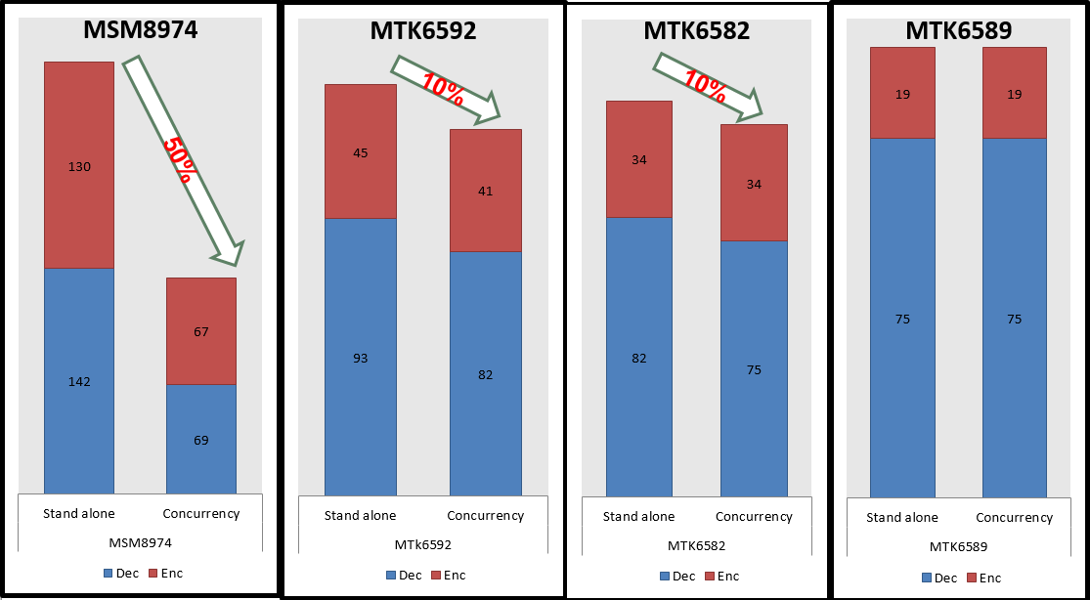
Concurrency Measurement (max frame rate)
Some MTK chipsets don’t have significant frame drop for simultaneous encode & decode

Slide 14
Engine Configuration

Slide 15
1
2
3
4
5
Overview
Architecture
Decoder
Encoder
MISC

Slide 16
Decoder Dataflow

Slide 17
Codec | Standard |  |  | Core Requirement
 | Profile | Level | Max Performance | Max. Sessions | Processing Capacity
HEVC | Main/Main Still Picture/Main10 | 5.1 | 4096x2160, 60fps, 160Mbps | 1 | Max resolution & fps: 4096x2160, 60fps Max bit-rate: 240 Mbps Main Still Picture Profile supports resolution up to 8192x4320 with TBD fps.
 |  | 4.1 | 2048x1080,60fps, 50Mbps | 4
 |  | 4.0 | 1080p, 32fps, 30Mbps | 8
 |  | 3.1 | 720p, 33.7fps, 10Mbps | 16
H264 | Baseline, Main, High, High-10, High-10 Intra | 5.1 | 4096x2304, 26.67 fps, 240Mbps | 1 | Max resolution & fps: 4096x2160, 60fps Max bit-rate: 300 Mbps
 |  | 4.2 | 2048x1080, 60fps, 50Mbps | 4
 |  | 4.1 | 1080p, 30fps, 50Mbps | 6
 |  | 4.0 | 1080p, 30fps, 20Mbps | 8
 |  | 3.1 | 720p, 30fps, 14Mbps | 16
 | High 4:2:2, High 4:2:2 Intra | N/A | 4096x2160, 45fps, 180Mbps |  | Max resolution & fps: 4096x2160, 45fps Max bit-rate: 180 Mbps
 | High 4:4:4 Predictive, High 4:4:4 Intra CAVLC 4:4:4 | 5.1 | 4096x2304, 26.67 fps, 240Mbps | 1 | Max resolution & fps: 4096x2160, 30fps Max bit-rate: 240 Mbps Note: High 4:4:4 profiles support up to 10 bits
VP9 | - | - | 4096x2160, 60fps | 1 | Max resolution & fps: 4096x2160, 60fps Max bit-rate: 320 Mbps
VP8 | - | - | 4096x2160, 60fps | 1
MPEG4 | SP | 8 | 1080p, 30fps, 20Mbps | 8 | Max resolution & fps: 1080p, 240fps Max bit-rate: 320 Mbps
 | ASP | 5 | 720x576, 30fps, 8Mbps | 16
DivX 3/4/5/6 | HD |  | 1080p, 30fps, 20Mbps | 16
 | Home Theater |  | 720p, 30fps, 20Mbps | 16
H263 | P0 | 70 | 720x576, 30fps, 16Mbps | 16
Sorenson | V0/V1 |  | 720x576, 30fps, 16Mbps | 16
MPEG2/1 | Main | High | 1080p, 30fps, 80Mbps | 4 | Max resolution & fps: 1080p, 240fps Max bit-rate: 320 Mbps
VC1 | SP | Medium | 352x288, 15fps, 384Kbps | 16 | Max resolution & fps: 1080p, 240fps Max bit-rate: 360 Mbps

Slide 18
Codec | Host | Video Controller ARM9 | Video HW
HEVC | Stream queuing Buffer management | SPS, PPS, SEI Slice header/APS Reference frame management Buffer management for 2-stage SP | Slice data Header parsing assistance
H264 | Stream queuing Buffer management | SPS, PPS, SEI Slice header Reference frame management Buffer management for 2-stage VSP | Slice data Header parsing assistance
VC-1 | Stream queuing Buffer management Metadata processing | Sequence layer Entry-point layer (AP) Metadata (SP/MP) Picture header except bit plane | Bit plane parsing Slice header Slice data
MPEG2 | Stream queuing Buffer management | Sequence and extension headers Picture/GOP, extension headers & user data | Slice header Slice data
MPEG4/ DivX4,5,6 | Stream queuing Buffer management | Visual object sequence header Visual Object header Visual Object Layer header | MB data RM/HEC
DivX3.11 H263/ Sorenson | Stream queuing Buffer management Metadata | Picture header | Picture data
VP8/9 | Stream queuing Buffer management | Frame header Probability update Buffer management for 2-stage VSP | Frame data

Slide 19
SDE Performance
Tier | Spec | Cycle count/16x16 | Upper bound Bitrate performance | Required Bin Processing Rate
HT/MT (Turbo) | 4K60@ 533Mhz | 215 | 1080p@30 8 channels 400 MBps | 1.2 Bins/cycle
HT/MT (Nominal) | 4K30@ 333Mhz | 306 | 1080p@30 4 channels 200 MBps | 0.85 Bins/cycle
ULT-H (Turbo) | 1080p90@ 326 MHz | 400 | 1080p@90 1 channel 150 Mbps | 0.6 Bins/cycle
ULT-H (Nominal) | 1080p60@ 217 MHz | 400 | 1080p@60 1 channel 100 MBps | 0.6 Bins/cycle

Slide 20
1
2
3
4
5
Overview
Architecture
Decoder
Encoder
MISC

Slide 21
Encoder Data Flow

Slide 22
Codec | Host | Video Controller ARM9 | Video HW
HEVC | Frame queuing Buffer management | Frame and slice level RC SPS and PPS packing Slice header packing Reference frame management Buffer management for 2-stage VSG | All MB encoding MB level RC Stream generation
H264 | Frame queuing Buffer management | Frame and slice level RC SPS and PPS packing Slice header packing Reference frame management Buffer management for 2-stage VSG | All MB encoding MB level RC Stream generation
MPEG4 | Frame queuing Buffer management | Frame and packet level RC Visual Object Sequence packing Visual Object header packing Visual Object Layer header packing Data partition management | All MB encoding MB level RC Stream generation
H263p0 | Frame queuing Buffer management | Frame and GOB level RC Picture header packing Plus header packing | All MB encoding MB level RC Stream generation
On2 VP8/9 | Frame queuing Buffer management | Frame level RC Frame header packing Probability update | All MB encoding MB level RC Stream generation

Slide 23
Engine Tasks (1)
Component | Task
HW SDE | Arithmetic Encoding for slice data QP prediction
HW SE | Top/Left Neighbor fetching, Scaling list/Lambda fetching, Collocated MV fetch and data store MV reconstruction/Intra mode Prediction/BS computation Residue data Inverse Scan Command preparation and dispatching for TE/PE/FE Feedback to TE on RCI Pipeline control for MEC Binstream/Bitstream packing

Slide 24
Engine Tasks (2)
Component | Task
HW MEC | Subsampled Search Engine Integer Search Engine Fractional Search Engine MVP (Merge Candidate derivation, Pruning, Skip/Direct candidate calculation) MVP (Buffer maintenance for neighboring MVs) Pack the final Modes/MVs to SE
HW TE | Forward Quant/Transform Inverse Quant/Transform Rate control Slice boundary detection Zero Block Detection Redo Intra Prediction
HW PE | Reference Pixel Fetch Spatial/Temporal Prediction Redo Intra Prediction Pixel reconstruction
HW FE | In-loop filtering SAO Algorithm + SAO Processing

Slide 25
Encoder Evolution
 | 1st Gen | 2nd Gen | 3rd Gen
Codec | H.264, MPEG4, H.263, VP8 | H.264, MPEG4, H.263, VP8, HEVC | H.264, MPEG4, H.263, VP8, HEVC, VP9
Encoding Quality | 1080p30 | 4K30 | 4K30, 4K60
Search Range | ±96 x ±48 (1ref) ±64 x ±32 (2ref) | ±160 x ±80 (1ref) ± 96 x ±48 (2ref) | ±160 x ±80 (1ref) ± 96 x ±48 (2ref)
Cost Metric | SAD, SATD | SAD, SATD, SAITD | SAD, SATD, SAITD
Block Size | 8x8 (min), 16x16 (max) | 8x4/4x8 (min), 32x32(max) | 8x4/4x8 (min), 64x64(max)
Slicing | Byte-based, MB-based | Byte-based, LCU/MB-based, accurate byte-based | Byte-based, LCU/MB-based, accurate byte-based
WFD Quality | No specific tools | Transform-skip, re-do intra | Transform-skip, re-do intra, 4:4:4

Slide 26
Rate Control

Slide 27
Background
Basics
  Changing Quantization Parameter (QP)
  Skip (not encode) some frames
Modes
  Variable Bit-Rate(VBR)
    Maintain constant quality as much as possible
    Allow bitrate to fluctuate within bounds
  Constant Bit-Rate(CBR)
    Reduce convergence time to target bit-rate as much as possible
    Maintain constant bit-rate within fixed time intervals (e.g. 1s)

Slide 28
Applications
  Video telephony
  Cisco telepresence
  ALS
  WFD
  MMS
  Aggressive VT
  eMBMS
  HTTP streaming
CBR
CBR+
VBR
VBR+
  Camcorder
  WFD
  Best quality
  Storage mode
  Post processing (editing)

Slide 29
Rate Control

Slide 30



Perceptual Quantization
Better perceptual quality at same bitrates
  Make use of Human Visual System (HVS) model
  Less sensitive to high frequency components

Slide 31
MEC

Slide 32
Motion Estimation Control

Slide 33
1
2
3
4
5
Overview
Architecture
Decoder
Encoder
MISC

Slide 34
MISC
Performance
Power
Scalability
Error Concealment
Value Added Features
Research

Slide 35
Performance

Slide 36
Performance
Static performance and BW analysis
  Linear vs. tile format
  Frame compression ON vs. OFF
  Separate vs. unified RPB/DPB
System-level static analysis
  With system architecture team
Dynamic performance and BW analysis
  Latency curves

Slide 37
Video Level Static Analysis
Video heavy use cases
  Worst case: decode 4K@60fps 10bpp + WFD 1080p@60fps 4:4:4
Source of BW variations
  Various content for decoder
  Start code search for decoder
  Reference read BW variations for encoder

Slide 38
System Level Static Analysis
4096x2160p60 4:2:0 8bpc
Compressed
Display Picture Buffer
4096x2160p60 4:2:0 8bpc
4096x2160p60 4:2:0 8bpc
Video
Decode
Buffer
MDP
Rotate
Buffer
MDP
Main Panel
Graphics Buffer
MDP
Write back
MPR @ 60FPS ARGB32
Buffer
Video
Encode
MDP
Rotate
Buffer
1080p60 4:2:0 8bpc
Compressed

Slide 39
Dynamic Latency Tolerance

Slide 40
Performance Variations

Slide 41
QoS

Slide 42
Power

Slide 43
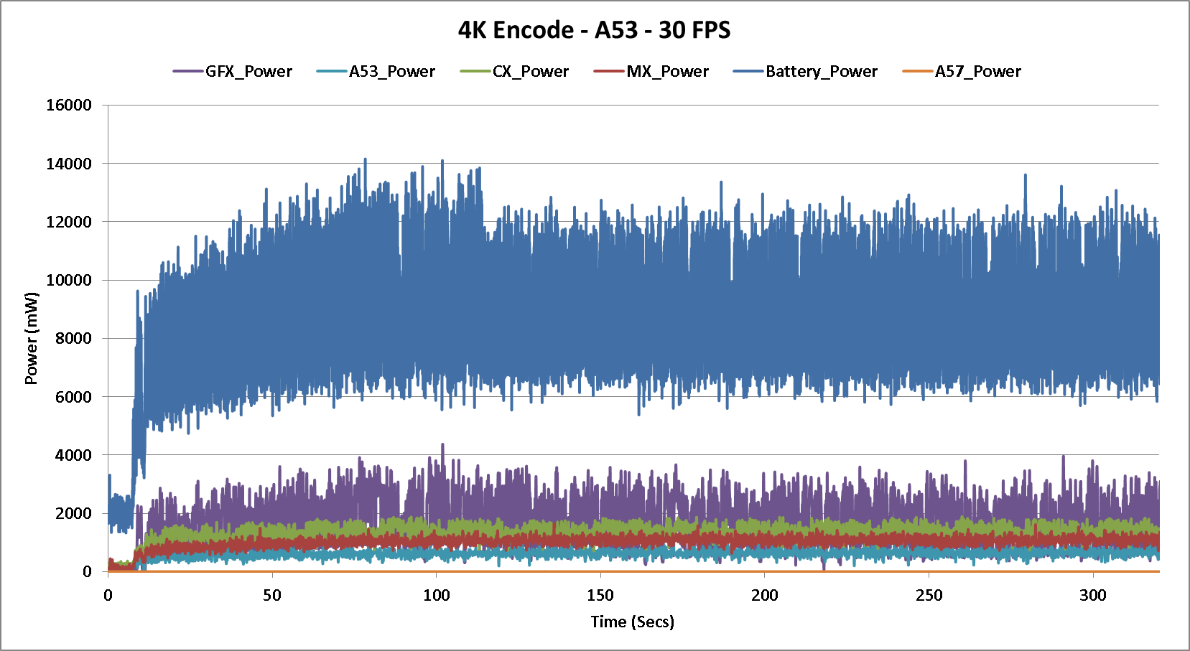
CPU Encode
  4K@30 encoding with A53 alone
  4xA53, 95%@941MHz
  Average battery power 9.3W

Slide 44
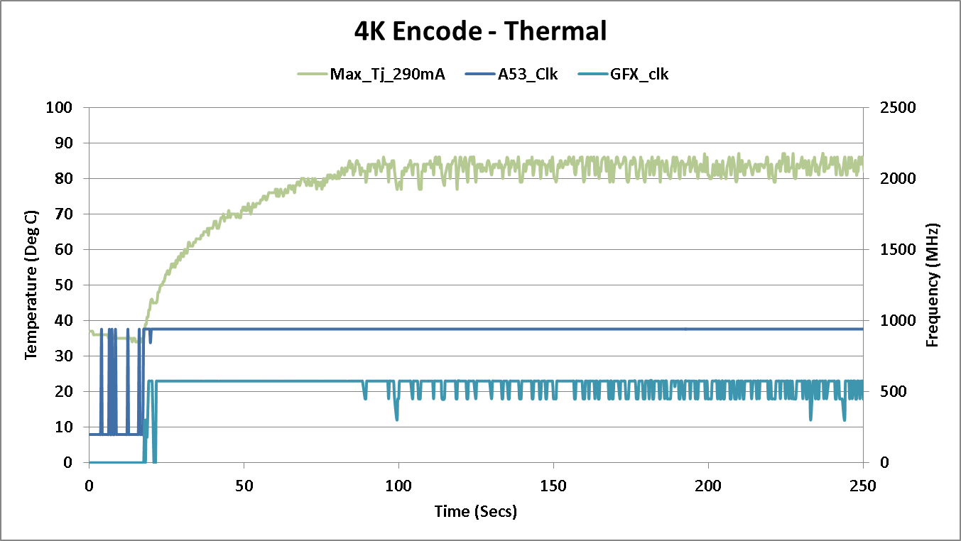
CPU Encode

Slide 45
Frame Complexity
V_{low}
V_{mid}
V_{high}
Example where per frame
complexity varies significantly

Slide 46
DCVS

Slide 47
HW Competitive Analysis
4k@30fps video playback capability
  iPhone5s does not truly support 4k30
  Exynos 5420 does not support 4K
Profile | Complexity | iPhone5s | Qualcomm
Baseline | Low | ü | ü
 | Medium | X | ü
 | High | X | ü
Main | Low/Medium/High | X | ü
High | Low/Medium/High | X | ü
Decoding
complexity

Slide 48
Power Reduction
86 mA
51mA due to design, process change
35mA due to BW compression

Slide 49
4K Downscaling
2355
Motivation: downscaler saves both BW and power
  52% reduction in bandwidth if the 4K output is (inline) downscaled to 1080p
  With this optimization, Q beats A by 51%
  Reduction in bandwidth directly contributes to an overall power saving of ~26% for the 4K decode
1700
MB/s
1124
Bandwidth saving from 4K downscaler

Slide 50
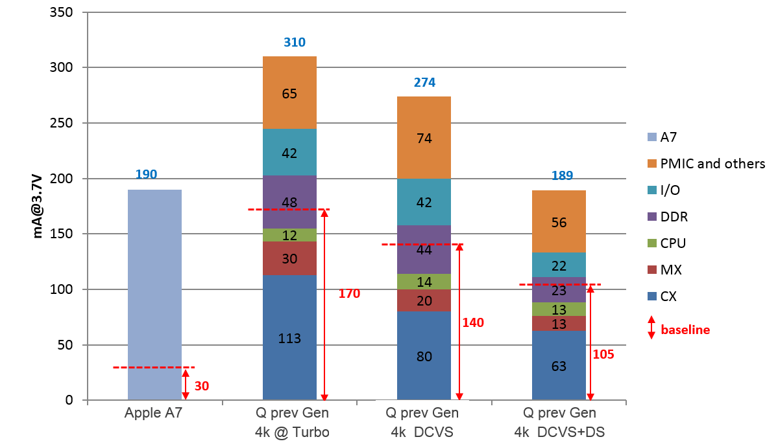
4K DCVS + Downscaling

Slide 51
Scalability

Slide 52
Scalability
Separate vs. merged encoder & decoder
  High tier: separate for performance and power collapse
  Mid/low tier: merged for area
Memory scalability
  L1, L2, L3 cache size
  On-chip memory size
Datapath scalability
  Multiple transform engine
  Pixel-level parallelism
Multi-pipe scalability
  4K 60fps and beyond
  VSP: multiple engines for consecutive slices/frames, HEVC WPP
  VPP: multiple engines for LCU rows (staggered by 2 MBs)
Bitrate scalability
  Multiple CABAC engines for bitrate > 400Mbps
Hybrid solution
  VSP in SW, VPP in HW
  MEC in HW, rest in SW, etc.

Slide 53
Error Concealment

Slide 54
Error Concealment
Error can be detected in following modules
  FW
  CCE
  SDE
  SE
Error detection in FW involves
  Range checking of SPS/PPS and slice header data
  Checking for lost NAL units
  Watch-dog timer in case of HW hangs

Slide 55
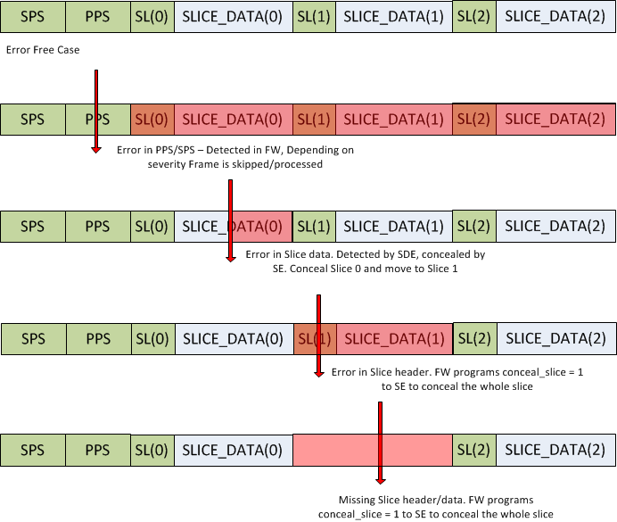
Scenarios

Slide 56
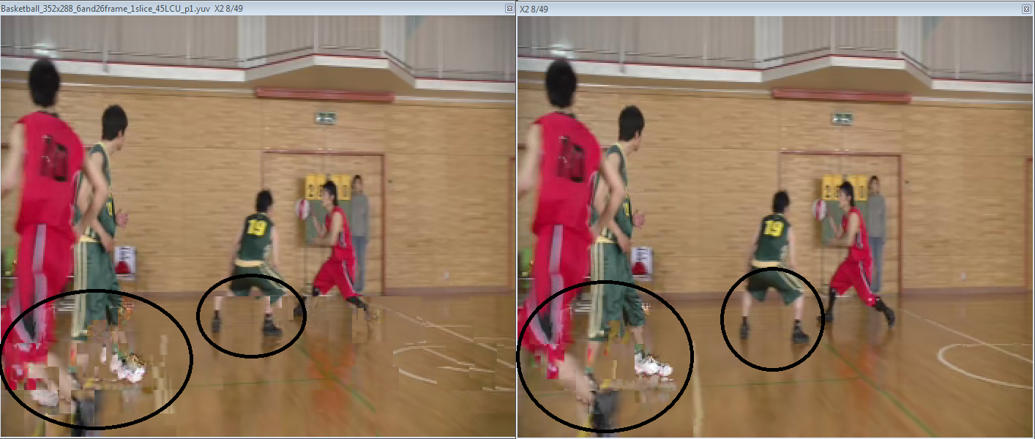
Error Concealment
Merge Mode concealment vs. Colocated concealment

Slide 57
Value Added Features

Slide 58
Value Added Features
Video stats for scene analysis
  [HW] Motion estimation, block texture, frame disparity, etc.
  [SW] Post processing
  [App] Scene change detection, object tracking, video analysis
Electronic Image Stabilization (EIS)
  Correct camera shake
  Compensate rolling shutter effect
Video over modem

Slide 59
Research

Slide 60
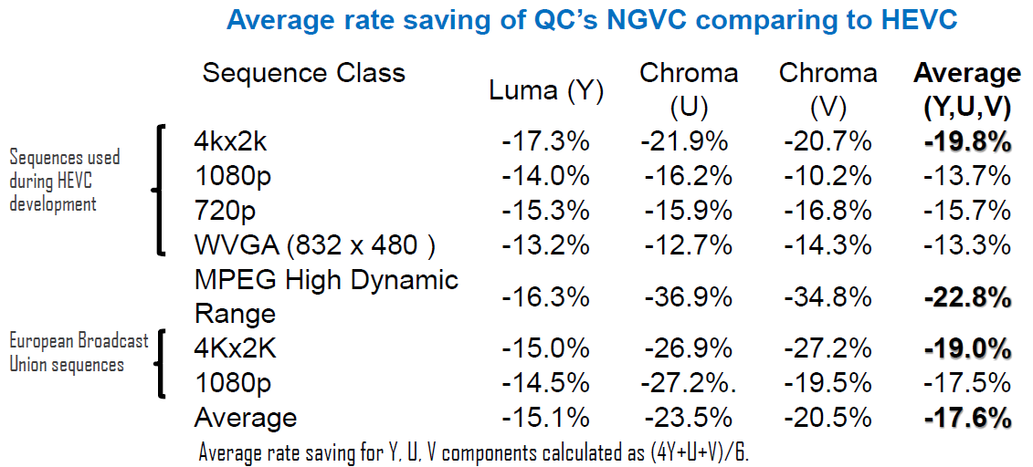
Research - H.266/NGVC

Slide 61
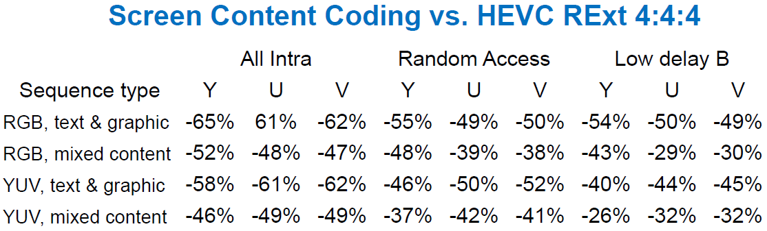
Research - Screen Content Coding
HEVC extension (started April 2014)
  Synthetic (graphics & text)
  Intra block copying, palette mode, etc.
  Average improvement ~ 50%

Slide 62
Thank you!

Slide 63
Backup slides

Slide 64
Team Organization
Video
VP
Algorithm & System Team
Director, >30
HW Team
Director, ~30
DV Team
Director, ~40
SW/FW Team
Director, ~50
Usecase analysis
Algo development
System architecture
Test vector generation
System modeling
Performance modeling
Power modeling
Microarchitecture
RTL
HW emulation
UVM framework
Functional verification
Coverage
Virtual platform
HW emulation
Software for playback, telephony, streaming, etc.
Various drivers
Usecase analysis

Slide 65
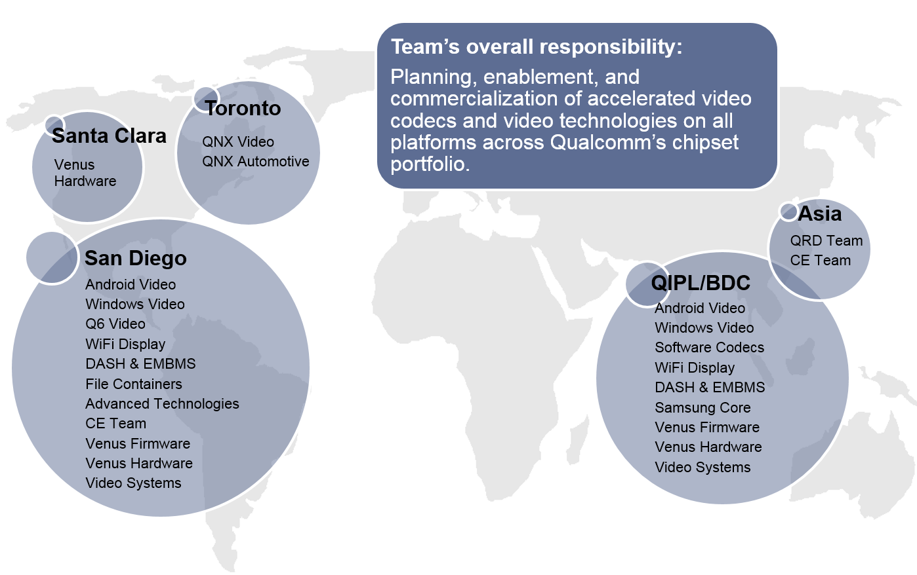

Slide 66


Playback Power Analysis
Only plays simple Baseline clips
Not a commercial 4K solution

Slide 67
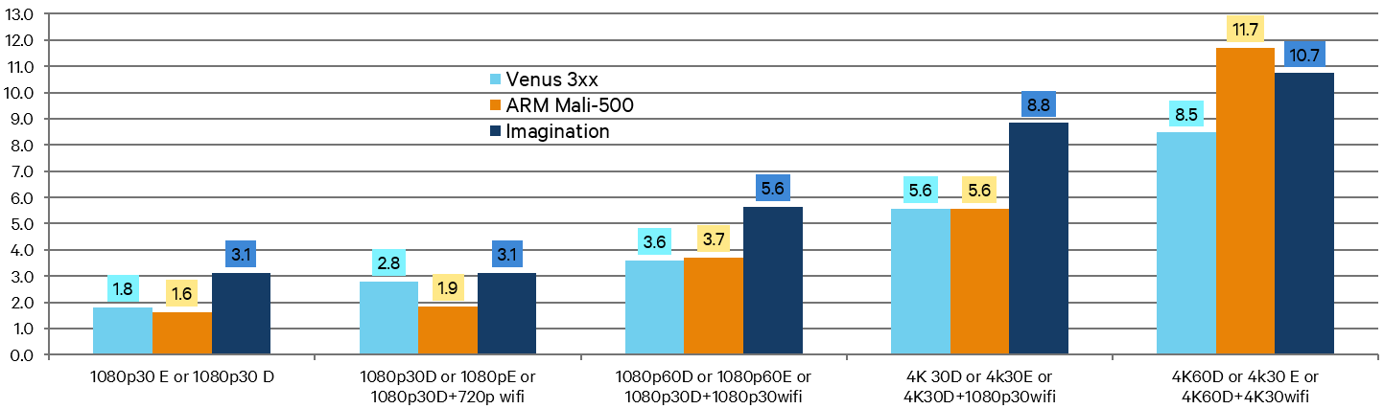
Video Die Size
Re-evaluate practical worst case
Resource sharing (SRAM size reduction)
Low tier trade area for compression efficiency/video quality
Targeting PD optimization to improve utilization

Slide 68
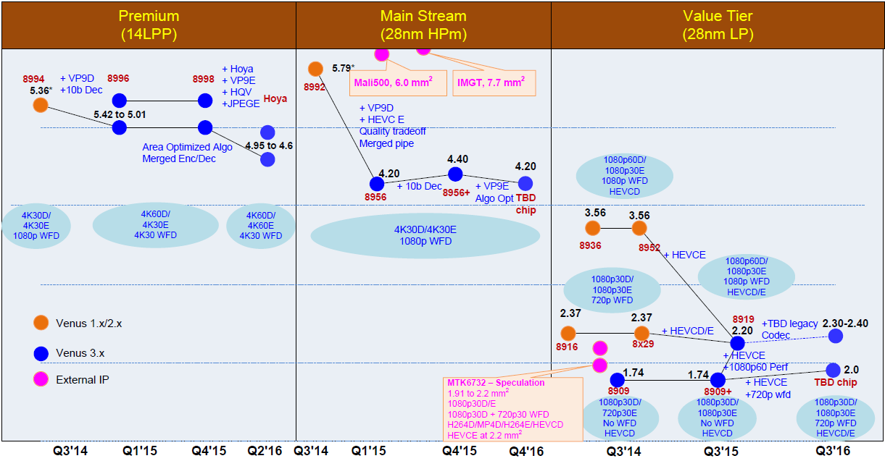
Die Size Reduction Roadmap

Slide 69
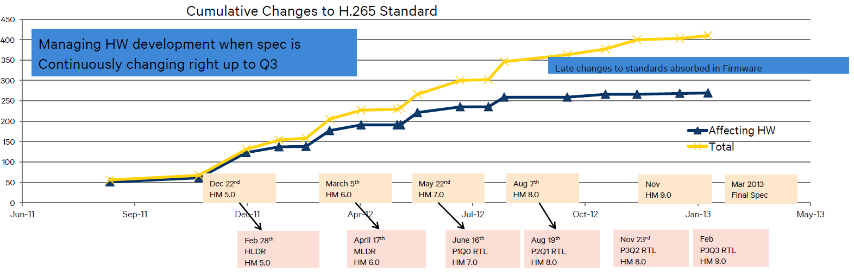
Fastest HEVC Enablement

Slide 70
My Roadmap
Step1
Video Codec
Step2
Differentiation
Step3
Computer Vision
Multi-standards
4K, 10bit
Area
Power
Performance
SW + FW + HW
Preprocessing
Postprocessing
IP/connected camera
  Video Stabilization
  120/240 fps encoding, 1/8th playback
Video surveillance
Video telephony
  Basic rate adaptation
  Dynamic FPS/resolution
  vs. Facetime/Skype
IoT/IoE
  Ultra low-cost solution
ADAS (automotive)
Augmented reality
Face detection
Face recognition
Hand gesture detection

Slide 71
My Advantage
Vision
English
Strategic planning
15 years chip design
Connections
11 years video experience
10 years oversea
Communication
Leadership
Academy + industry

