Slide 1
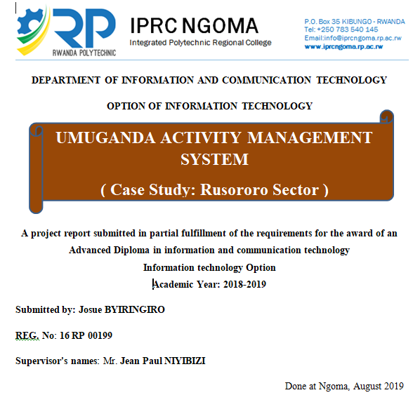

Slide 2
INTRODUCTION OF UMUGANDA ACTIVITY MANAGEMENT SYSTEM
Today, Technology changes the life and behavior of the world, now technology as part of Information Communication and Technology (I.C.T) is used by different areas like companies, public sectors and private sectors and even different states in their daily activities. Therefore many activities are managed through the internet where many manage or gain access to services without matter of everywhere there are, then the `time and cost of the services reduced and the production increase.
That is why Umuganda Activity Management System will be computerized management system for developing the current system of Rwanda Country in the report of Umuganda activity through Villages, Cells, sectors and District which will helping them to record, manage and sharing easily information related with Umuganda activity around country where the current system was done by recording all people attended the activity on papers

Slide 3
BACK GROUND OF THE STUDY
Since 1995 in Rwanda most records, management and reporting information of activities have been done manually written papers and this working condition was caused slow of development of the country due to the lack of technology in their works. Where exactly umuganda activity is still facing this issue of manually system they used a lot time to get recorded data, also they used huge amount of time in transport from one way to another for delivering report of observed data and communication were very difficult because there were no way of direct communication and communication devices to facilitate people in their daily life activities.

Slide 4
PROBLEM STATEMENT
In general the current system to make report around the Country was done manually where start from Village, Cells and Sectors up to the District through the use of written papers. Also due to the current system there is no way of sharing person’s information direct to the other Villages, Cells, Sectors and Districts when they need to know the information of a given person. Not only that they could be possible to make attendance in unfair way for a given people. Where could record that people attended the activity without coming.

Slide 5
OBJECTIVE OF THE RESEARCH
General objectives
The main objective to design this system, it will be having the ability to connect every area located in Rwanda country and this ability will establish easy way of getting all records then giving access to the areas and also sharing records across anywhere in country in a rapid and perfect way therefore will establishing officially way of costing absent people as the main goals of Umuganda Activity Management System using web monitoring platform is the main task I have to accomplish.
Specific objectives
To create database for storing all information needed by the system.
To create reporters, agents and administrator interface (forms).
To build android application to make easy attendance
To identify absent times and attended times for user.
To generate reports.
This system will generate way of making attendance across whole the country at the same time
This system will remove unfair attendance happened in current system.
This system will store information in secured way and reduce isolation of data.
Finally, the system will create other way of source of income to the country.

Slide 6
SCOPE AND LIMITATION OF THE PROJECT
The system will be used only by the reporters, agents and the sectors officers (there will be different kinds of department to check the user’s status) around the country
The system will be accessible through the platform over internet by allowed users.
The system will be developed to share records direct all over the country.
The system will help reporters to make attendance after umuganda activity.

Slide 7
CONCLUSION AND RECOMMENDATION
CONCLUSION
Base on the objectives of the study and the implementation of Umuganda Activity Management System, this system will help our country in development through in management of umuganda activity in the country in the way of using this activity to make money from those absent people. Not only that this project will also encourage people to attend this monthly activity, due to avoid themselves the punishment of charges as we have seen that absent persons will be cost and not only that also making Umuganda Activity Management System through the internet, the time and cost of service will be reduced, and also the system is more user friendly. Therefore the Development and the implementation of this system have been a great instance for me to extend my knowledge and skills in web development through the use of PHP and JAVASCRIPT programming. Once this application will be used by Rusororo sector, I hope that it will help them by resolving the problem presented by existing system and will improve quality of service. Also will encourage the others areas to starting using this platform. And finally this project has been successful achieved but it was not completed in time as I had planned, due to the lack of some resources in libraries for documentation related to my project and other were some information from interview which were difficult to get.

Slide 8
RECOMMENDATIONS
The project objectives that listed have been achieved successfully but this system needs other functionalities such as: like people could have checking their profile on themself. Also I wish that this project could use fingerprint scanner to make attendance rather than taking identification number of people on computer also i wish that the system could notify peoples the date of umuganda activity and also notify those absent ones to pay all absent like To count amount of money absent people will pay. To generate congrats message for attended users.. Also am recommending IPRC NGOMA College to support students to get resources from library and especially to redirect the students to go on fields for asking required information before starting their project and to increase the time of working on projects

Slide 9
Thank
you!!!!

