Slide 1
图覆盖
(第三部分)
陈梓楠
edisonchan@szu.edu.cn
深圳大学致腾楼618-3

Slide 2
7.3 基于源代码的图覆盖
最常用的图覆盖准则是针对源代码
图：通常是控制流程图
  节点覆盖：执行每条语句（语句覆盖）
  边覆盖：执行每条分支（分支覆盖）

Slide 3
7.3.1 控制流程图
控制流程图(CFG)：通过描述控制结构对方法的所有可能执行进行建模的图
  节点：语句或者语句序列（基本块）
  边：控制迁移
  基本块：一段最长的可以被同时执行的语句序列
从程序语句到控制流程图的转换。
Notes:
Control,flow graph

Slide 4
if语句
if (x < y)
{
y = 0;
x = x + 1;
}
else
{
x = y;
}
1
if (x < y)
{
y = 0;
x = x + 1;
}
1
x < y
x >= y
x < y
y = 0
x = x + 1
2
3
x = y
2
x >= y
y = 0
x = x + 1
4
3

Slide 5
if-return语句
if (x < y)
{
return;
}
print(x);
return;
1
x < y
x >= y
return
2
3
print(x)
return
节点2和节点3之间没有边
必须区分不同的return节点

Slide 6
while循环语句
循环需要额外增加一些哑节点(dummy node)
  这些节点不表示语句或基本块
x = 0;
while (x < y)
{
y = f(x, y);
x = x + 1;
}
return x;
x = 0
1
哑节点
2
x < y
x >= y
3
4
y = f(x, y)
x = x + 1
return x

Slide 7
for循环语句
x = 0
1
隐式地初始化循环
for (x = 0; x < y; x++)
{
y = f(x, y);
}
return x;
2
x < y
x >= y
y = f(x, y)
3
5
return x
4
x = x + 1
隐式地循环递增

Slide 8
do-while循环
x = 0;
do
{
y = f(x, y);
x = x + 1;
} while (x < y);
return y;
x = 0
1
2
y = f(x, y)
x = x + 1
x >= y
3
x < y
return y

Slide 9
break和continue语句
x = 0;
while (x < y)
{
y = f(x, y);
if (y == 0)
{
break;
} else if (y < 0)
{
y = y * 2;
continue;
}
x = x + 1;
}
return y;
x = 0
1
2
x < y
3
y = f(x, y)
x >= y
y == 0
4
5
break
y < 0
return y
8
y = y * 2
continue
7
6
x = x + 1

Slide 10
switch语句
read(c) ;
switch(c)
{
case ‘N’:
z = 25;
case ‘Y’:
x = 50;
break;
default:
x = 0;
break;
}
print(x);
1
read(c)
c == ‘N’
c == ‘Y’
default
2
3
4
x = 50
break
x = 0
break
z = 25
5
print(x)
没有break的case将跳转到下一个case

Slide 11
exception
try
{
s = br.readLine();
if (s.length() > 96)
throw new Exception
(“too long”);
if (s.length() == 0)
throw new Exception
(“too short”);
} (catch IOException e) {
e.printStackTrace();
} (catch Exception e) {
e.getMessage();
}
return s;
1
s = br.readLine()
IOException
2
e.printStackTrace()
3
s.length > 96
s.length <= 96
throw
4
5
s.length == 0
e.getMessage()
6
7
throw
s.length != 0
8
return s

Slide 12
控制流程图例子
public static void computeStats (int [ ] numbers)
{
int length = numbers.length;
double med, var, sd, mean, sum, varsum;
sum = 0;
for (int i = 0; i < length; i++)
{
sum += numbers [ i ];
}
med = numbers [ length / 2];
mean = sum / (double) length;
varsum = 0;
for (int i = 0; i < length; i++)
{
varsum = varsum + ((numbers [ i ] - mean) * (numbers [ i ] - mean));
}
var = varsum / ( length - 1.0 );
sd = Math.sqrt ( var );
System.out.println ("length: " + length);
System.out.println ("mean: " + mean);
System.out.println ("median: " + med);
System.out.println ("variance: " + var);
System.out.println ("standard deviation: " + sd);
}

Slide 13
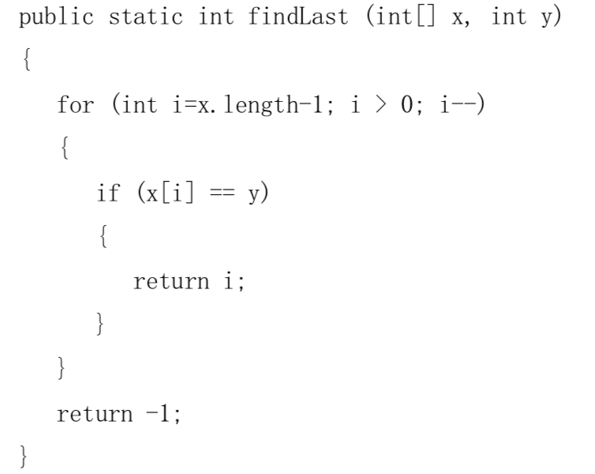
练习
给出下图的控制流程图

