Slide 1

BIG 5 STOCK TRENDS
First_Project = True
By: Keyur Patil, Sydney Robertson, Katrina Smith, Scooter Smith, James Williams
From 2009-2019

Slide 2
THE BIG 5:
OVERVIEW:
Apple (APPL)
Google (GOOGL)
Microsoft (MSFT)
Facebook (FB)
Amazon (AMZN)
Index (^IXIC)
Review NASDAQ data for the big 5 from 2009-2019
Which stock is the best to invest in:
Short term
Long term
Compare & contrast the big 5 with the Nasdaq as a whole
Notes:
Define the core message of your project

Slide 3
OUR QUESTIONS
trends over the last 10 years
Which of the big 5 was the best investment over the last 10 years?
Which of the big 5 was the worst investment over the last 10 years?
Which of the big 5 was the Most consistent over the last 10 years?
Are there yearly events that contribute to stock volatility?
Are these regularly occurring?
Are there general good times to buy and sell the big 5 throughout the calendar year?
Did the big 5 outperform or underperform the NASDAQ composite as a whole over the 10 year period?
Of all the shares bought in the big 5, who had the most shares bought over the last 10 years?
What are the closing prices for the big 5 going to be on Aug 31st 2020?
How does the prediction compare to the actual prices they were this year?
Notes:
Describe the questions you asked, and why you asked them
Describe whether you were able to answer these questions to your satisfaction, and briefly summarize your findings
Describing what kinds of data you needed to answer them, and where you found it

Slide 4
CLEANING THE DATA
Problems: •Stock data dated back to 1971 (only needed Last 10 years) •Stock data was by date (needed to aggregate and sort data) •Stock data was independent and unsorted (needed to group data and organized there within)
•Group By vs Merge
•Change of Format for Plotly
Insights: •For Loops aren’t always the best way to cycle through large amounts of data •Sometimes a simple merge by value is all you need
•Wide vs Long formatting for Plotly
Notes:
Describe the exploration and cleanup process
Discuss insights you had while exploring the data that you didn't anticipate
Discuss any problems that arose after exploring the data, and how you resolved them
Present and discuss interesting figures developed during exploration, ideally with the help of Jupyter Notebook

Slide 5
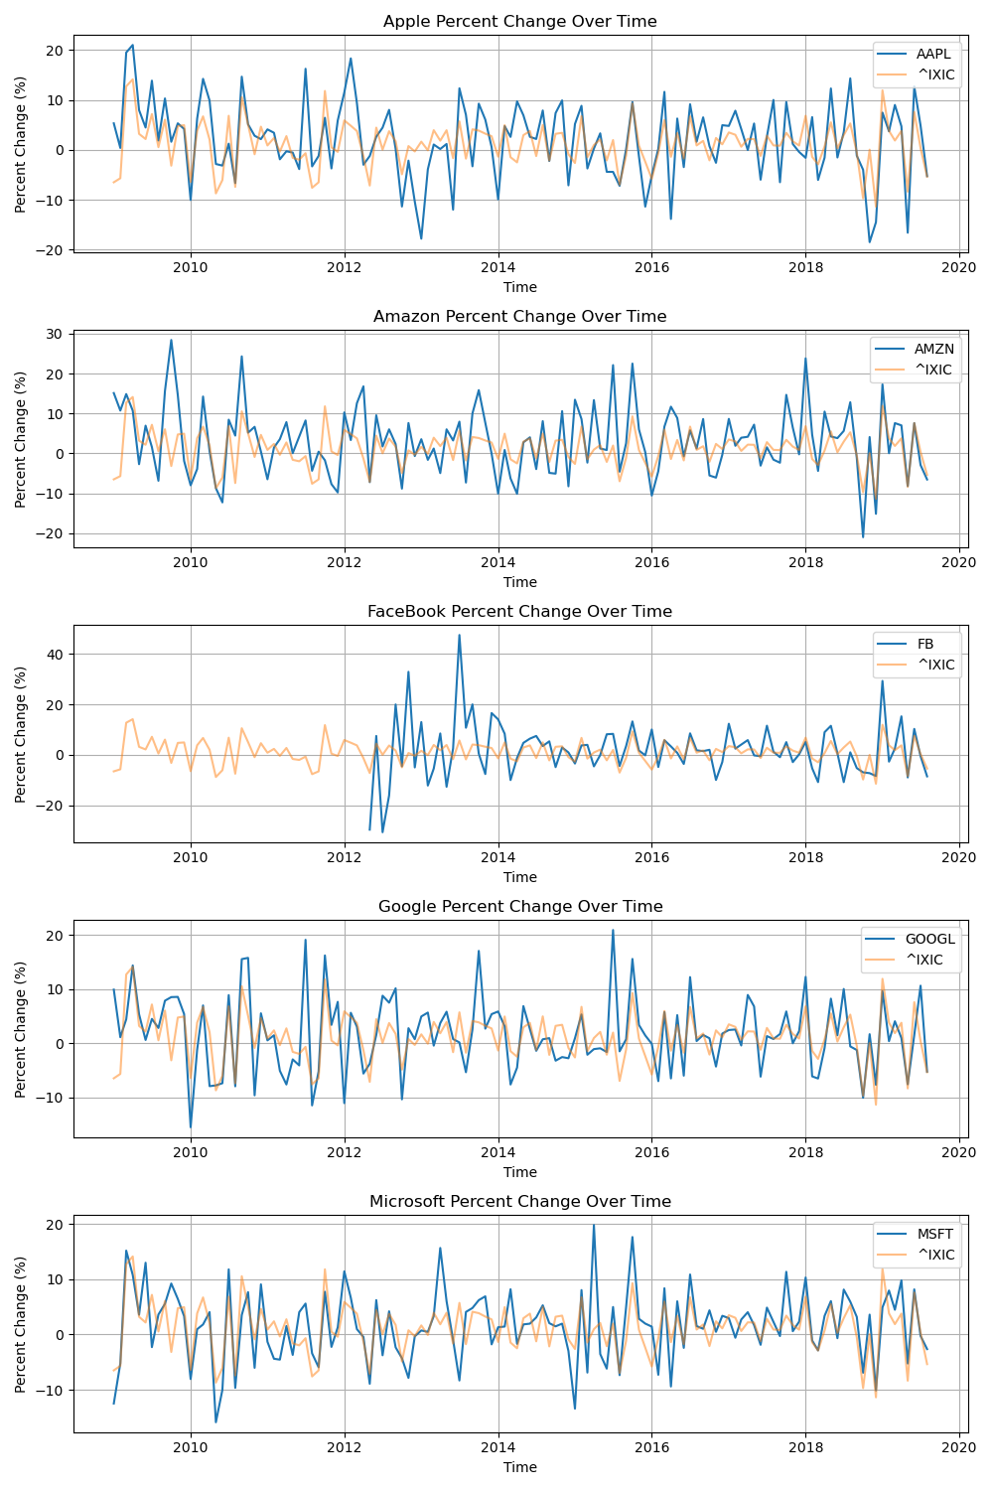
QUESTION ONE TRENDS OVER THE LAST 10 YEARS
Problems
Calculated percent change for all stocks
Had to separate the stocks into their own dataframes
Created 5 separate subplots that compares each stock to the NASDAQ index
Formatted titles and labels for each subplot
Initially tried all stocks compared on one graph together, but we were not able to get any insights visually from that setup
Our data had to be converted from long to wide for Plotly (big initial hurdle)
Insights
Ax plot (5 subplots)
Formatting
plotly

Slide 6
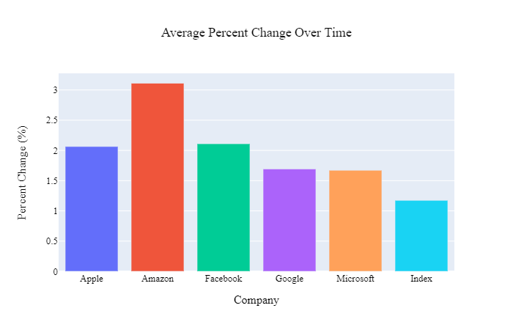
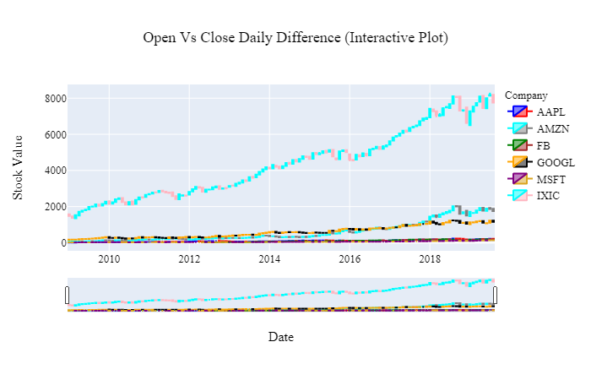
QUESTION ONE ANALYSIS
Trends over the last 10 years
Which of the big 5 was the best investment over the last 10 years?
Amazon (Very consistent upward trajectory)
Which of the big 5 was the worst investment over the last 10 years?
Microsoft (Low, albeit consistent growth)
Which of the big 5 was the Most consistent over the last 10 years?
Microsoft (despite being the lowest return, it hasn’t demonstrated the dips the other stocks have)

Slide 7
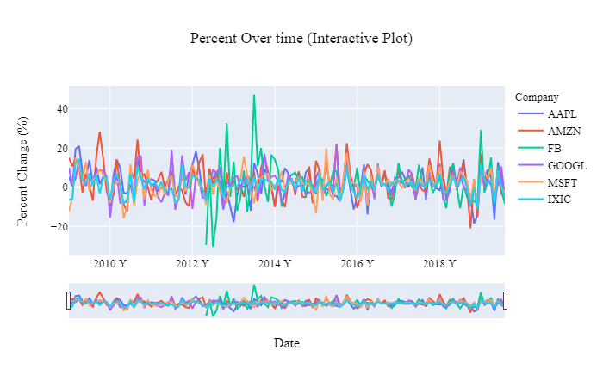
QUESTION TWO ARE THERE YEARLY EVENTS THAT
CONTRIBUTE TO STOCK VOLATILITY?
Problem:
Hypothesis assumes there are recurring factors
how do we identify the pattern that correlates to said factors?
Insights:
Assumed things like new device keynotes would cause spikes in price
found that all stocks maintained steady growth
Dips observed matched behavior of the stock market as a whole
Notes:
ANSWER BOTH Q2 AND Q3 TOGETHER
2nd question: Are there yearly events that contribute to stock volatility
3rd question: is there a predictable time to buy/ sell stocks
the notion/hypothesis → some factor/event that causes these dips/spikes
based on the pattern over time → we can look at the correlation of those changes
for Example:
microsoft launching a product, or apple showcasing a KeyNote presentation might cause a spike,
and from these dips/spikes we can develop a pattern and help us make more accurate predictions
The Line Graph shows the dips and spikes from which we can develop a our patterns
The CandleStick graph shows that the overall behavior of the Big 5 companies follows the index(NASDAQ) trend → overall trending upwards
We expected on finding outliers → but the data shows the behaviors of the big 5 matches the index
buy stocks as early as possible → trajectory is upwards

Slide 8
QUESTION THREE ARE THERE GENERAL GOOD TIMES TO BUY AND SELL THE BIG 5 THROUGHOUT THE CALENDAR YEAR?
Our hypothesis assumed that based off of recurring factors like keynotes and device releases would lead to clearly visible spikes in pricing
we found that with these 5 companies in particular, with their consistent upward growth buying early is the best time to buy as their valuations have only gone up over time

Slide 9
QUESTION FOUR DID THE BIG 5 OUTPERFORM OR
UNDERPERFORM THE NASDAQ
COMPOSITE AS A WHOLE OVER THE 10 YEAR PERIOD?
When comparing average percent change over time, each of the big 5 stocks outperformed the nasdaq over the 10 year period, with amazon coming out on top.
However, when considering the ups and downs of the market over the same period, the nasdaq and the big 5 behaved very similarly.
With a few exceptions for events like facebook’s launch which had major abrupt changes, the big 5 fluctuations mirror the market as a whole.

Slide 10
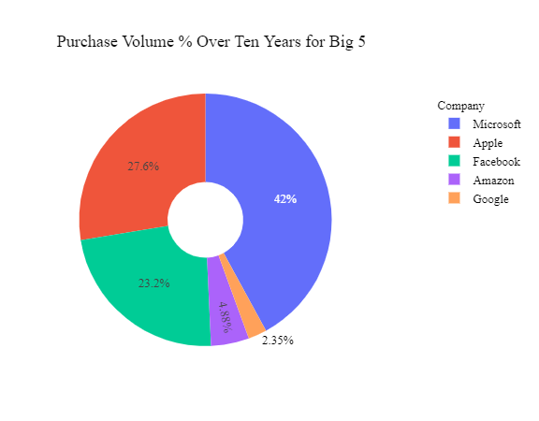
QUESTION FIVE OF ALL THE SHARES BOUGHT IN THE BIG 5, WHO HAD THE MOST SHARES
BOUGHT OVER THE LAST 10 YEARS?
Problem
we had gone through and collected open and close dates for each month, but we also needed to total the daily volume of sold stock for the brands
Insights
interestingly our ‘worst performer’ from question one is actually our most bought stock
seems microsoft’s consistent, albeit low, return is attractive to many investors likely looking for more of a sure thing than something more volatile like apple
Notes:
up to now we were focused only on the open close prices and dates, we needed to shift our focus and look at daily volume of stock sold and sum the values for each company to visualize in a pie graph

Slide 11
QUESTION SIX WHAT ARE THE CLOSING PRICES FOR THE BIG 5 GOING TO BE ON AUG 31ST 2020?
Challenges:
converting date/time formatting to run Linear Regression
Created Regression for Stocks Individually
Used regression solutions for Plotly as opposed to ones from class
Predictions:
Closing price will be higher
Actual:
Apple: $129.04
Microsoft: $ 225.53
FB : $ 293.20
Amazon: $ 3,450.96
Google: $ 1,634.18
Notes:
--Linear Regression + Scatter Plot
→ What are the closing prices for the Big 5 on August 31st 2020
-Data end Aug 2019 (Scatter Plot)
- Scatter Plot shows an upward positive trend for all of the companies. → R-sqd Values
=~ 0.7 and above → indicating a Large Positive Linear association
- Our Data ends August of 2019:
- Predictions: Closing price will be higher
- Actual:
Apple: 129.04
Microsoft: 225.53
FB : 293.20
Amazon: 3,450.96
Google: 1,634.18
→ back to Q3 → buy stocks as early as possible

Slide 12
CONCLUSIONS
implications of findings:
Great volatility in the market
all stocks show upward trajectory
time to buy?
Other Insights:
Microsoft
Facebook
Notes:
have Line Graph Open

