Slide 1
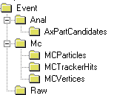
Converter
Application
Manager
Converter
Event
Selector
Transient Event Store
Converter
Data
Files
Message
Service
Event Data
Service
Persistency
Service
JobOptions
Service
Algorithm
Algorithm
Algorithm
Transient Detector
Store
Data
Files
Particle Prop.
Service
Detec. Data
Service
Persistency
Service
Other
Services
Data
Files
Transient
Histogram Store
Histogram
Service
Persistency
Service

